Slide 1




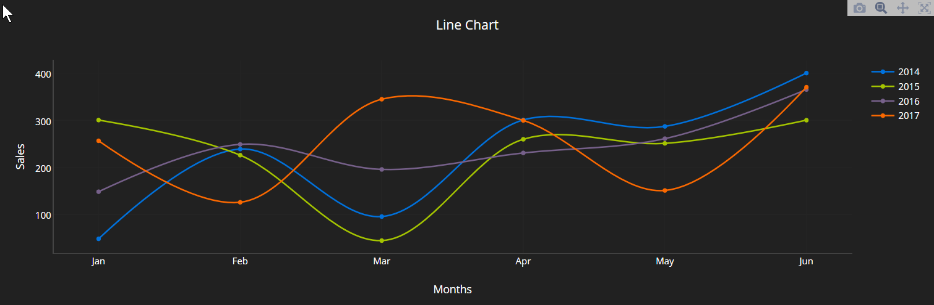
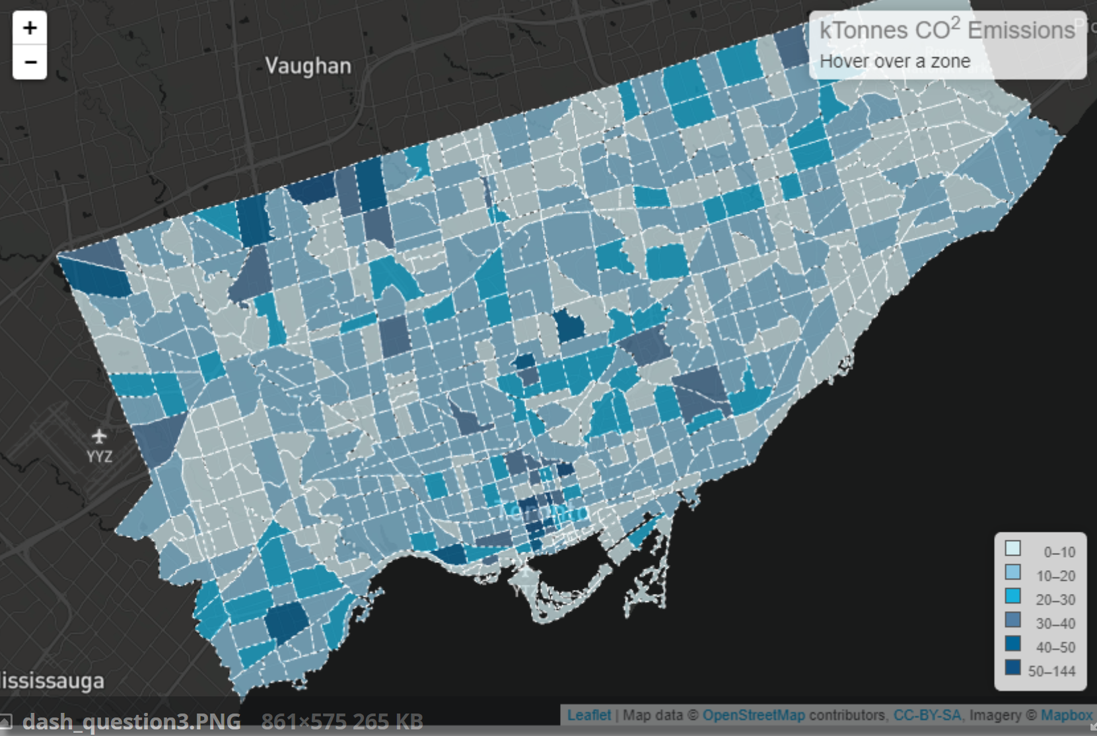
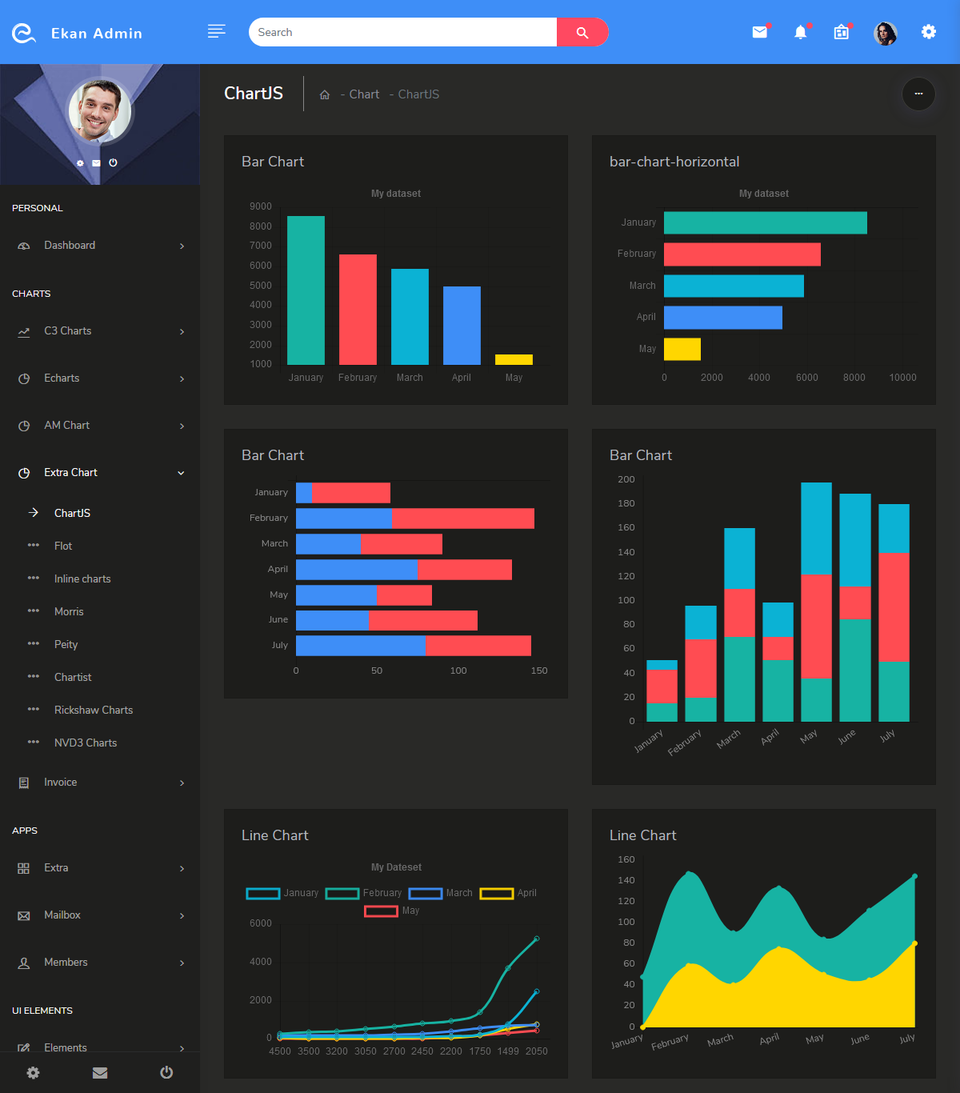

Focus Multi
Foresight
Dataset: CMIP6
Base Year: 2015
Base Scenario: Scenario 1
Underlayer: County
Parameter: Water Demands
Difference: Abs % - -
Overlayer: Basin

Slide 2

Focus Multi
Foresight
Dataset: CMIP6
Base Year: 2015
Base Scenario: Scenario 1
Underlayer: County
Parameter: -
Difference: Abs % - -
Overlayer: Basin
Water Supply
Water Demands
Landuse
Scarcity

Slide 3






Packaged Models
Software Map
Software Health
Workflows
Data Management
Visual Analytics

Slide 4
Workflows and architecture to containerize and
scale-up model configurations on HPCs, AWS ect.
Maintain map of
existing and
under-development software
Standards for the most efficient data formats and software
Curated data storage across life-cycle of single and
large-ensemble runs
Examples of model interoperability and feedbacks
Tools for
visualization and data analytics

