Slide 1
GCIMS Integration

Slide 2
Agenda
Overview of GCIMS Integration – Task 4.2
Existing efforts
Plan
Maintain Integration Map
Standardize Data I/O
Interoperability/Feedbacks
Reproducibility/Containerization
Scalability/Large Ensembles/Scenario Discovery
Accessibility/Visual Anlaytics

Slide 3
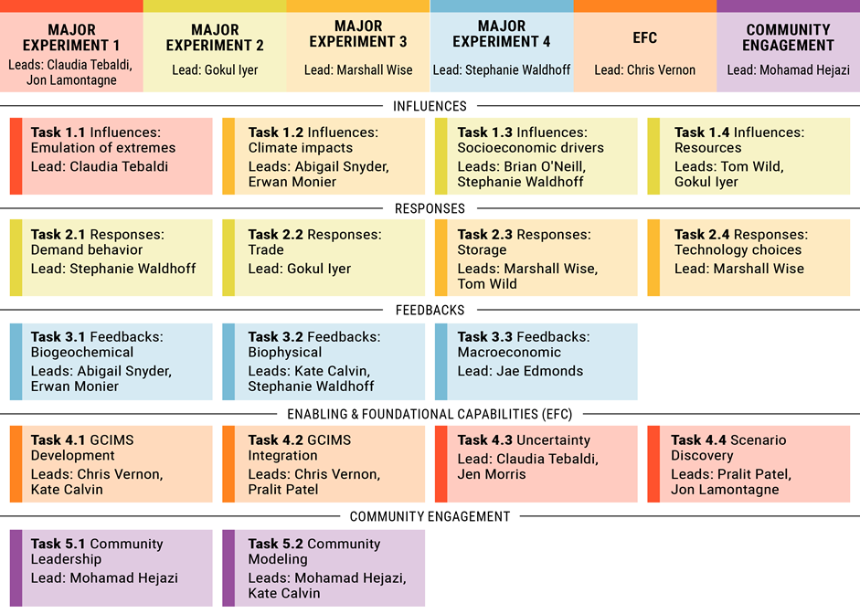
Overview of GCIMS Integration – Task 4.2

Slide 4
Overview of GCIMS Integration – Task 4.2

Slide 5
Existing
Cassandra https://github.com/JGCRI/cassandra
Cassandra is a coupling framework for scientific models that tracks model dependencies and automates the running of multiple interconnected models.
Message Passing Interface (MPI)
GCAM Fusion https://jgcri.github.io/gcam-doc/fusion.html
C++ GCAM query and feedbacks
gcamwrapper https://github.com/JGCRI/gcamwrapper
C++ and R/python source code to wrap the GCAM model such that simulations can be run interactively

Slide 6
GCIMS Integration - Plan
Maintain Integration Map
Standardize Data I/O
Interoperability/Feedbacks
Reproducibility/Containerization
Scalability/Large Ensembles/Scenario Discovery
Accessibility/Visual Anlaytics

Slide 7
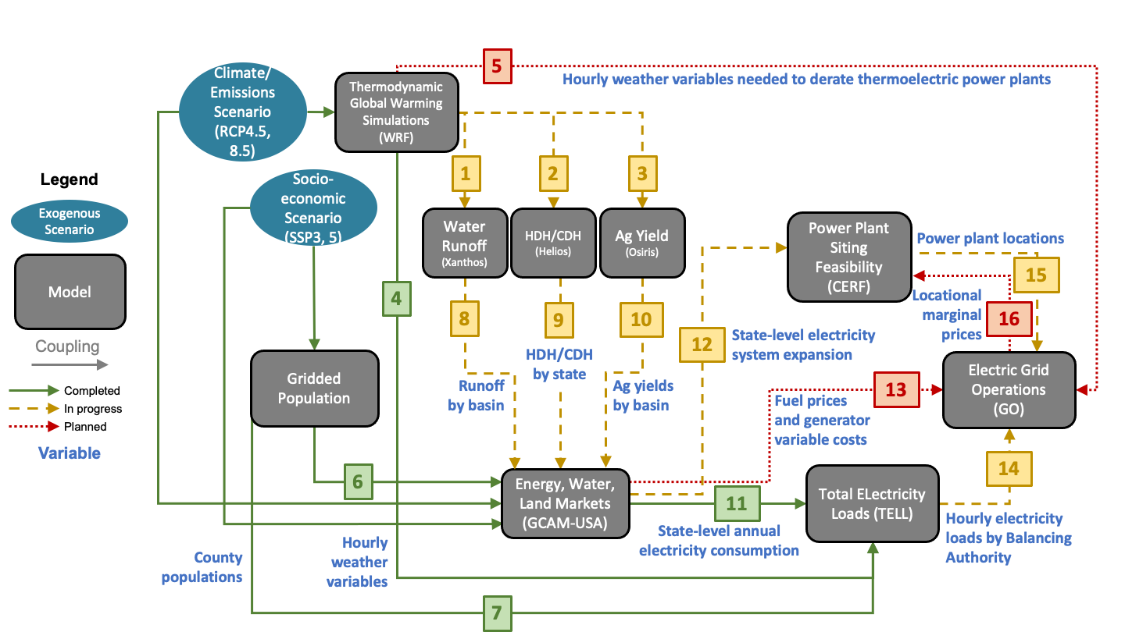
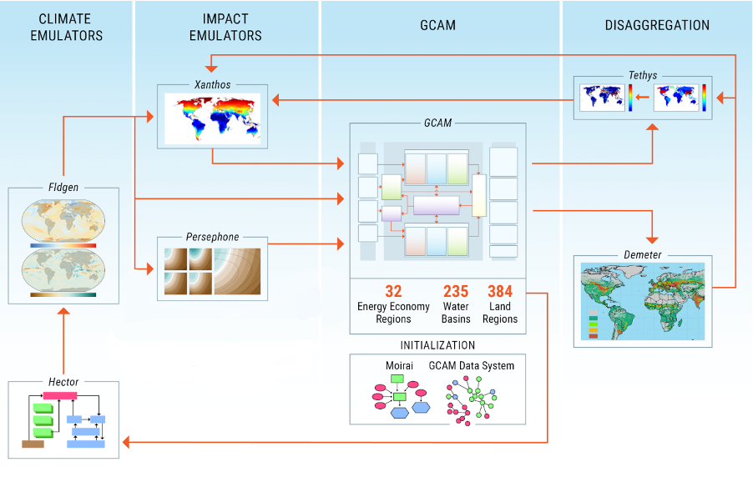
1. Maintain Integration Map
IM3 Exp B Example
https://github.com/IMMM-SFA/exp_group_b_test
GCIMS

Slide 8
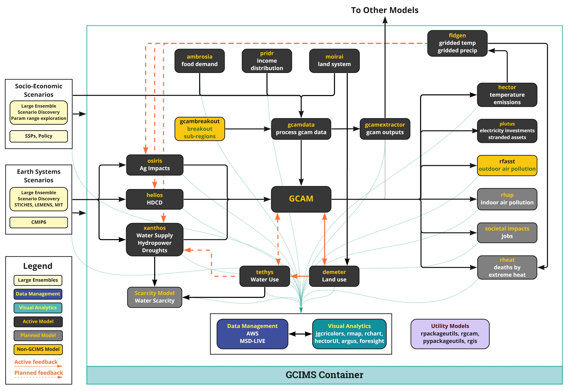
Maintain Integration Map
Standardize Data I/O
Interoperability & Feedbacks
Reproducibility & Containerization
Scalability, Large Ensembles & Scenario Discovery
Accessibility & Visual Anlaytics

Slide 9
2. Standardize Data I/O
Outputs/Inputs and data storage
Database management
Database querying/sharing
Data formats (.csv, pandas, .rds, ncdf)

Slide 10
Maintain Integration Map
Standardize Data I/O
Interoperability & Feedbacks
Reproducibility & Containerization
Scalability, Large Ensembles & Scenario Discovery
Accessibility & Visual Anlaytics

Slide 11
3. Interoperability/Feedbacks
gcamwrapper
Feedbacks at each time-step
CSDMS (Community Surface Dynamics Modeling System) and BMI (Basic Model Interface)

Slide 12
Maintain Integration Map
Standardize Data I/O
Interoperability & Feedbacks
Reproducibility & Containerization
Scalability, Large Ensembles & Scenario Discovery
Accessibility & Visual Anlaytics

Slide 13
4. Reproducibility/Containerization
It just works independent of OS/packages
Choose your own adventure - Mix and match components as needed

Slide 14
Maintain Integration Map
Standardize Data I/O
Interoperability & Feedbacks
Reproducibility & Containerization
Scalability, Large Ensembles & Scenario Discovery
Accessibility & Visual Anlaytics

Slide 15
5. Scalability/Large Ensembles/Scenario Discovery
AWS
MSD Live

Slide 16
Maintain Integration Map
Standardize Data I/O
Interoperability & Feedbacks
Reproducibility & Containerization
Scalability, Large Ensembles & Scenario Discovery
Accessibility & Visual Anlaytics

Slide 17
6. Accessibility/Visual Anlaytics
Curated scenarios
Visualization -> Visual Analytics
HectorUI, Argus, Foresight

Slide 18
Maintain Integration Map
Standardize Data I/O
Interoperability & Feedbacks
Reproducibility & Containerization
Scalability, Large Ensembles & Scenario Discovery
Accessibility & Visual Anlaytics

Slide 19




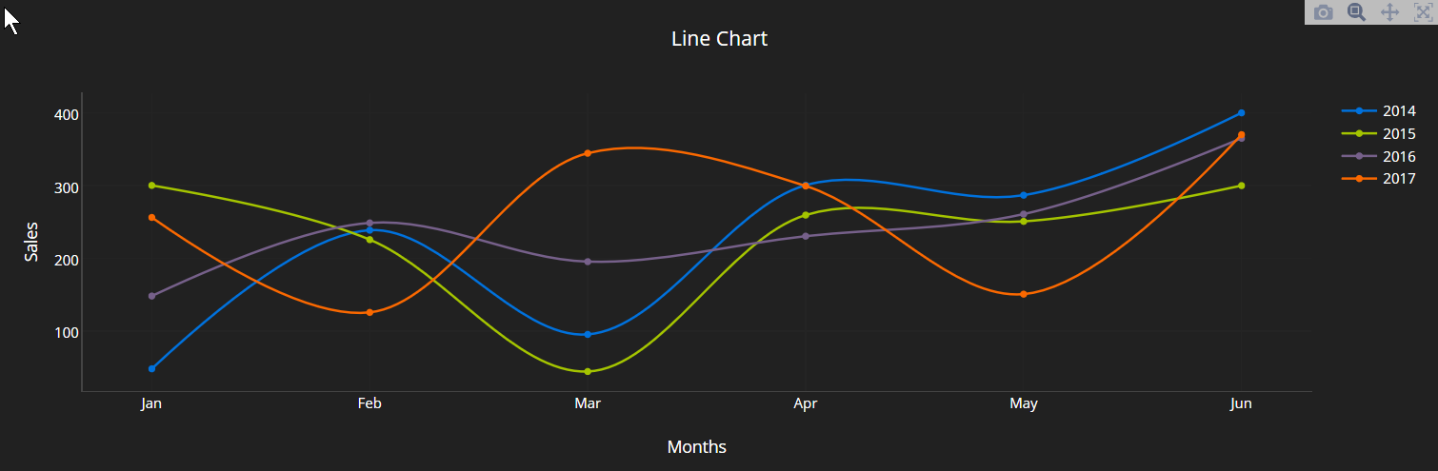
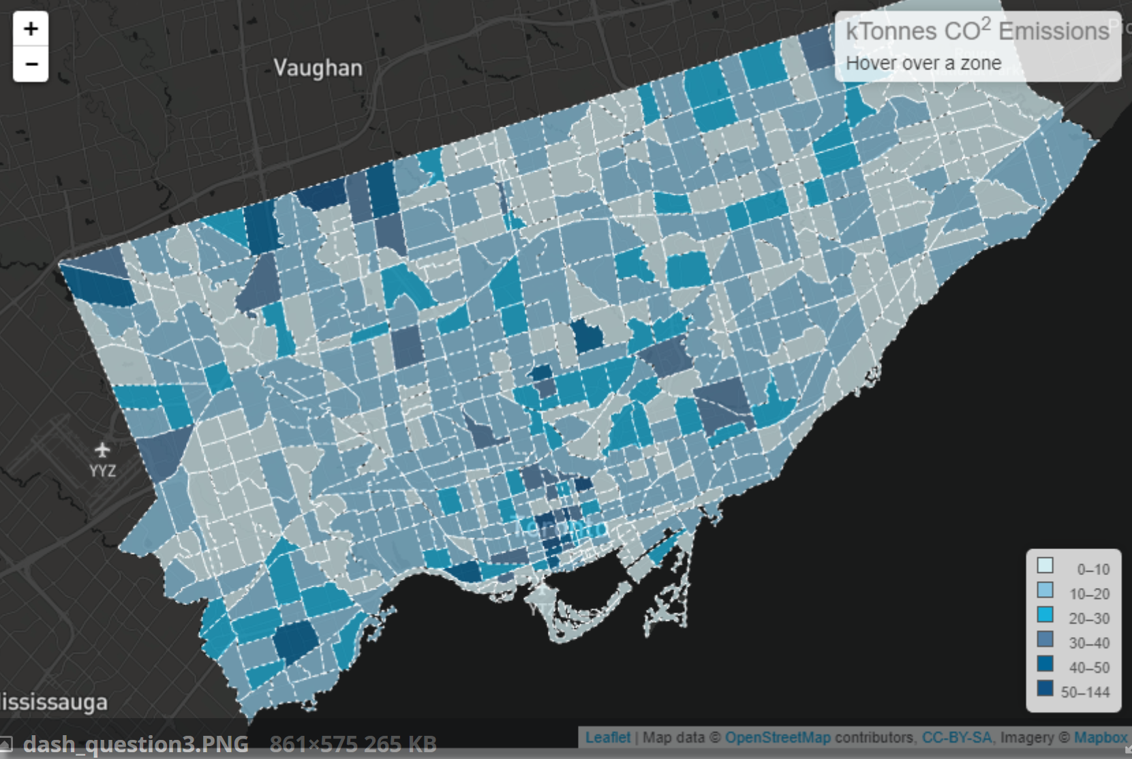
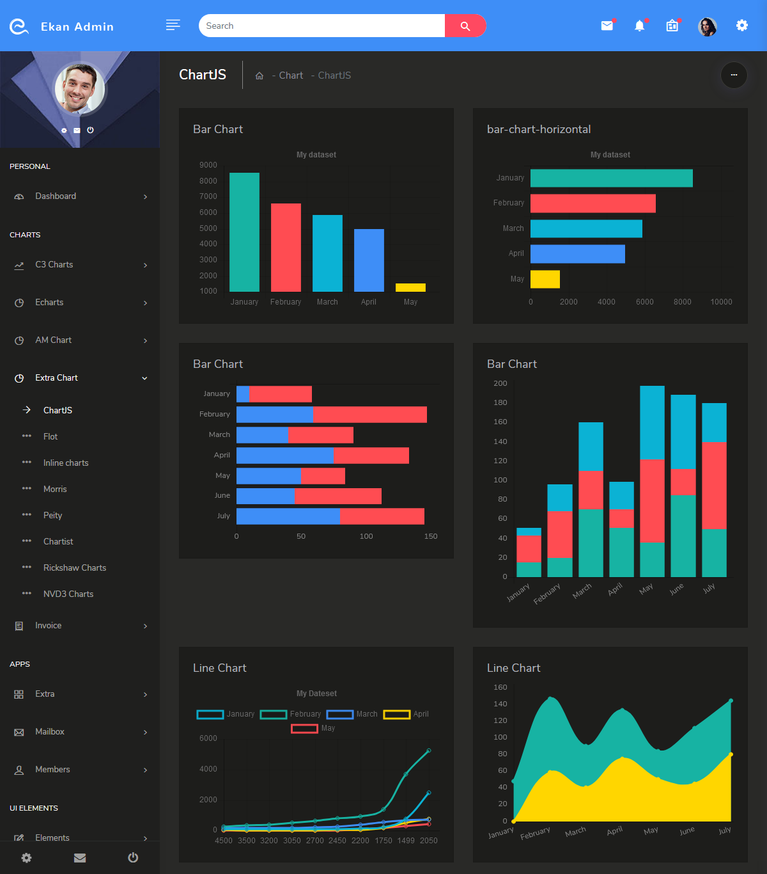

Focus Multi
Foresight
Dataset: CMIP6
Base Year: 2015
Base Scenario: Scenario 1
Underlayer: County
Parameter: Water Demands
Difference: Abs % - -
Overlayer: Basin

Slide 20

Focus Multi
Foresight
Dataset: CMIP6
Base Year: 2015
Base Scenario: Scenario 1
Underlayer: County
Parameter: -
Difference: Abs % - -
Overlayer: Basin
Water Supply
Water Demands
Landuse
Scarcity

Slide 21
Maintain Integration Map
Standardize Data I/O
Interoperability & Feedbacks
Reproducibility & Containerization
Scalability, Large Ensembles & Scenario Discovery
Accessibility & Visual Anlaytics

