Slide 1
GCIMS Integration

Slide 2
GCIMS Integration
Software Map
Standards:
Data formats, compression, decompression, querying (Isaac)
Dashboards, R shiny, Python Dash, Profiling (Tanner, Stephanie)
Workflows (Carina):
Front-end config file/GUI to call scenarios+models
Back-end to execute jobs on Deception/AWS
Feedbacks:
gcamwrapper (Ellie)
Data Management
Ec3 buckets (MSD Live) – (Isaac, Carina, Casey)
Visual Analytics
Connect to central data base (Tanner/Stephanie P)

Slide 3
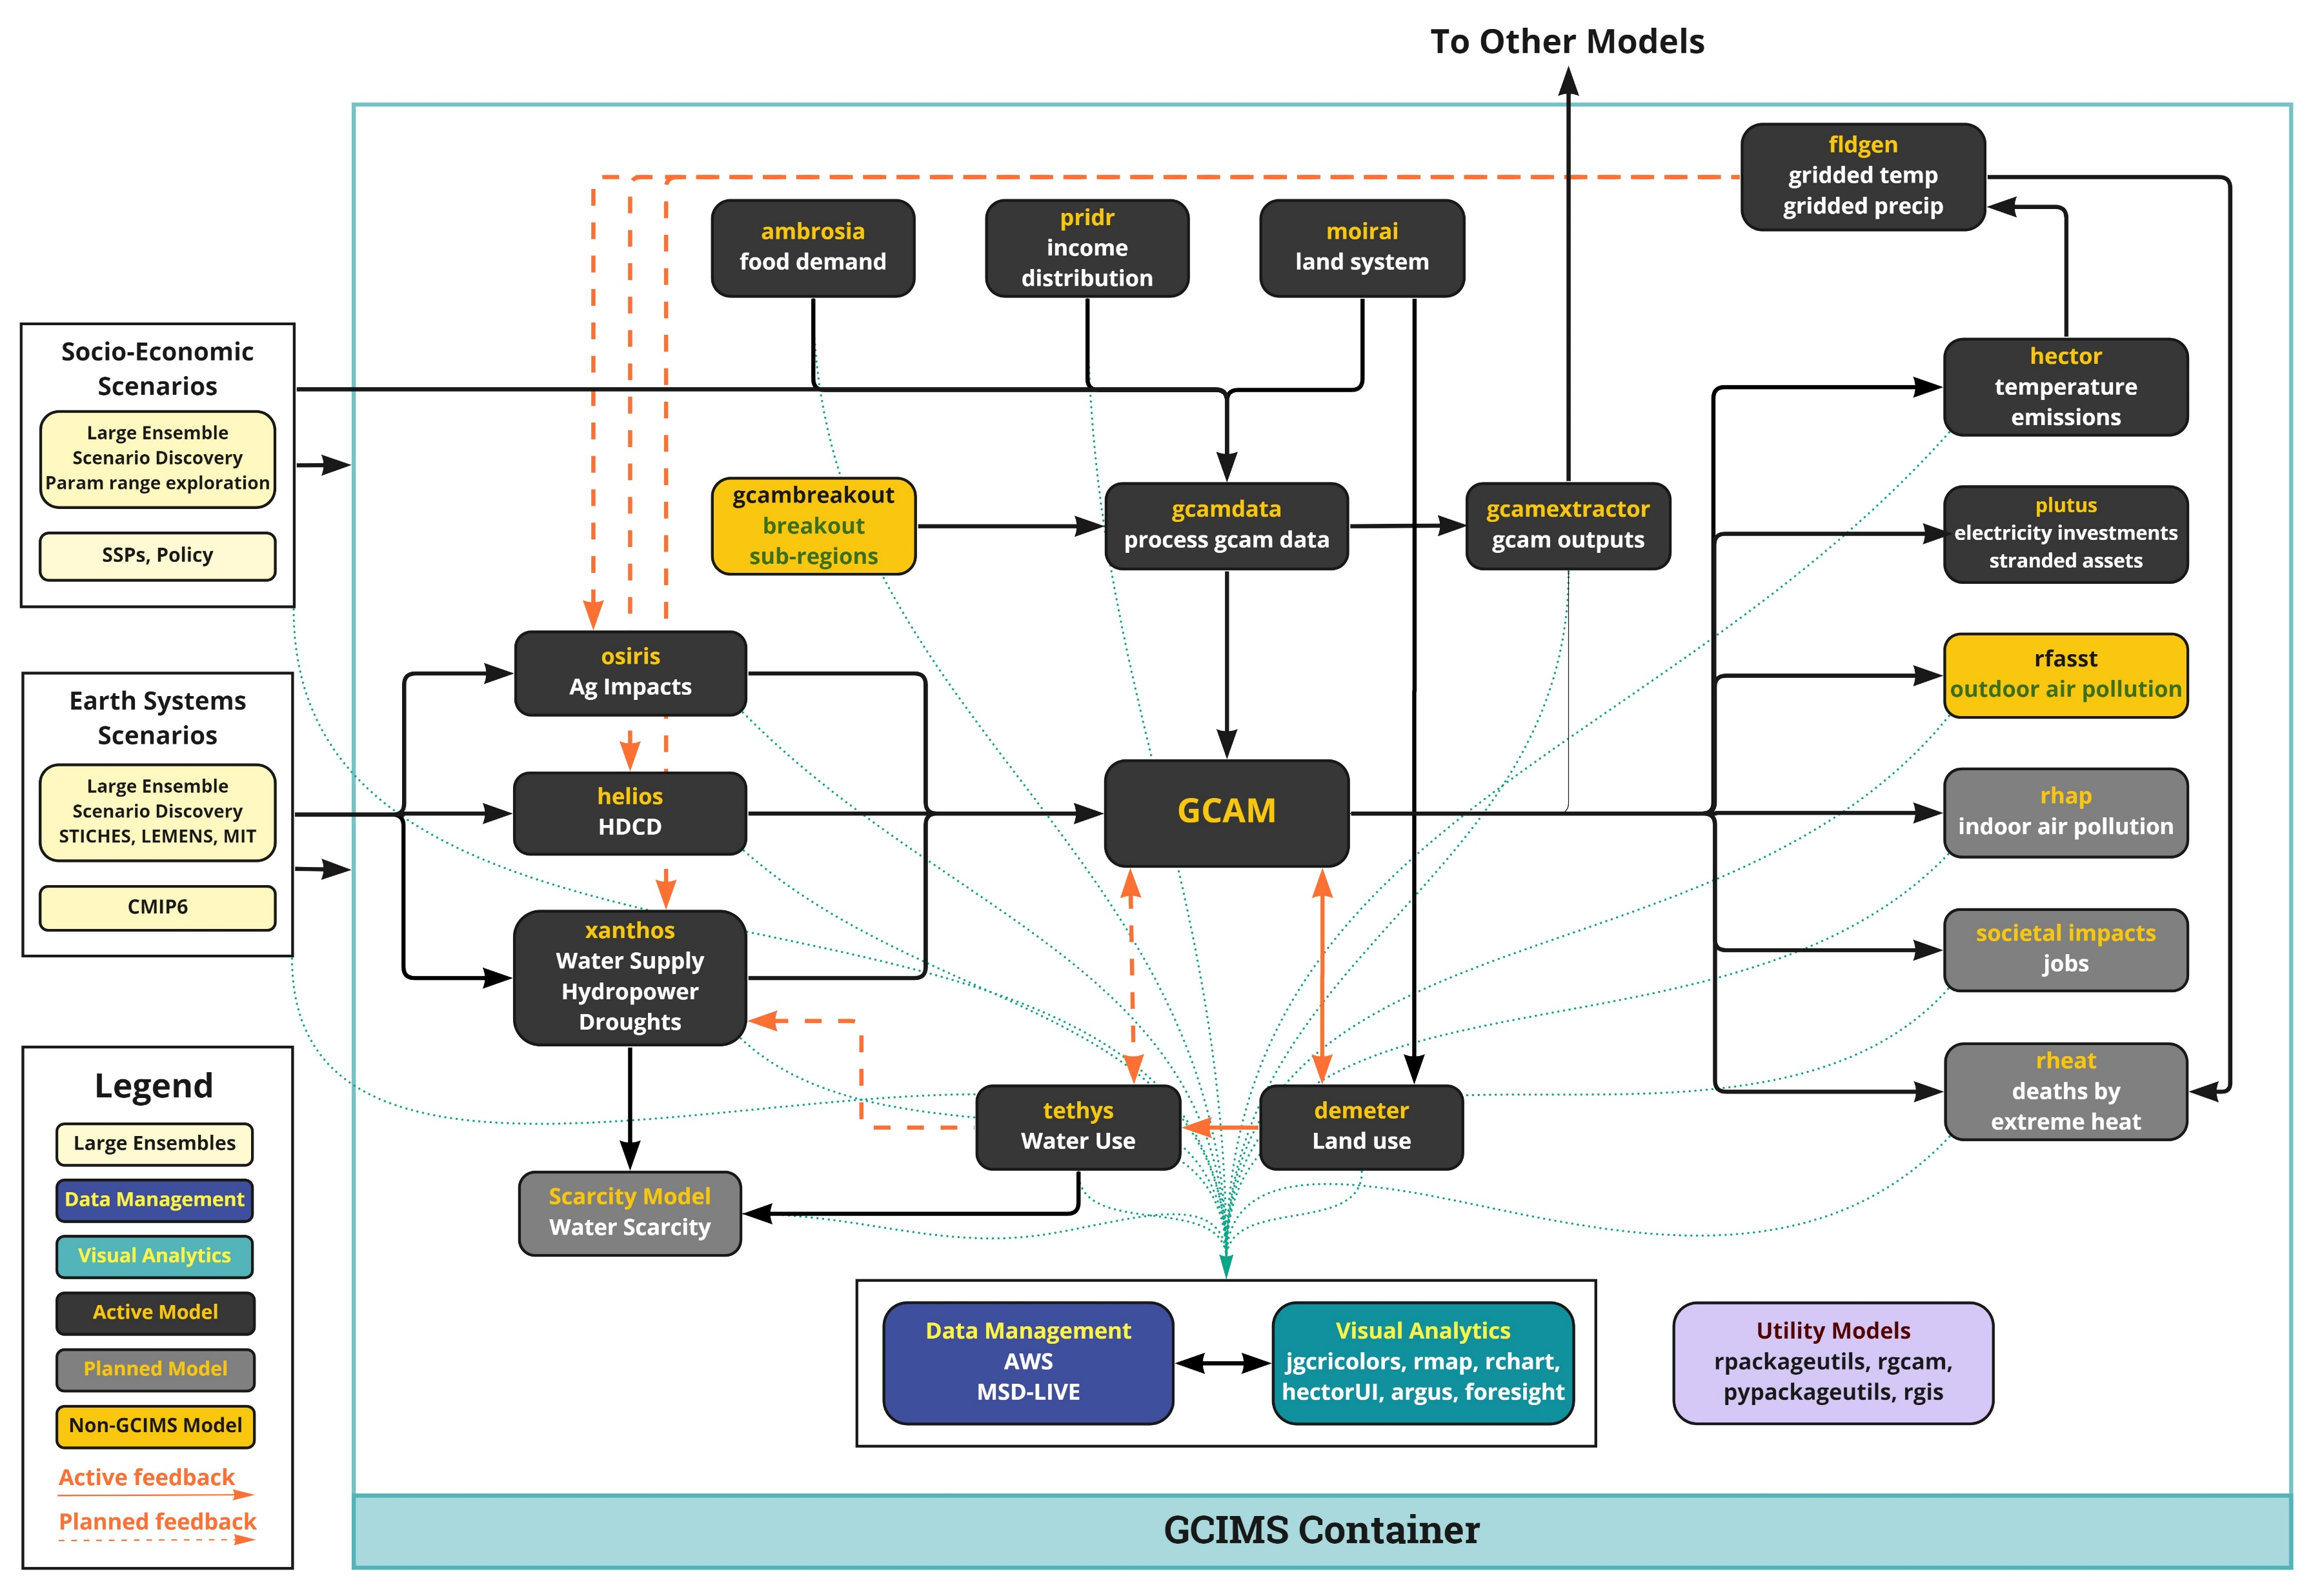
Maintain Integration Map
Standardize Data I/O
Interoperability & Feedbacks
Reproducibility & Containerization
Scalability, Large Ensembles & Scenario Discovery
Accessibility & Visual Anlaytics

