Slide 1
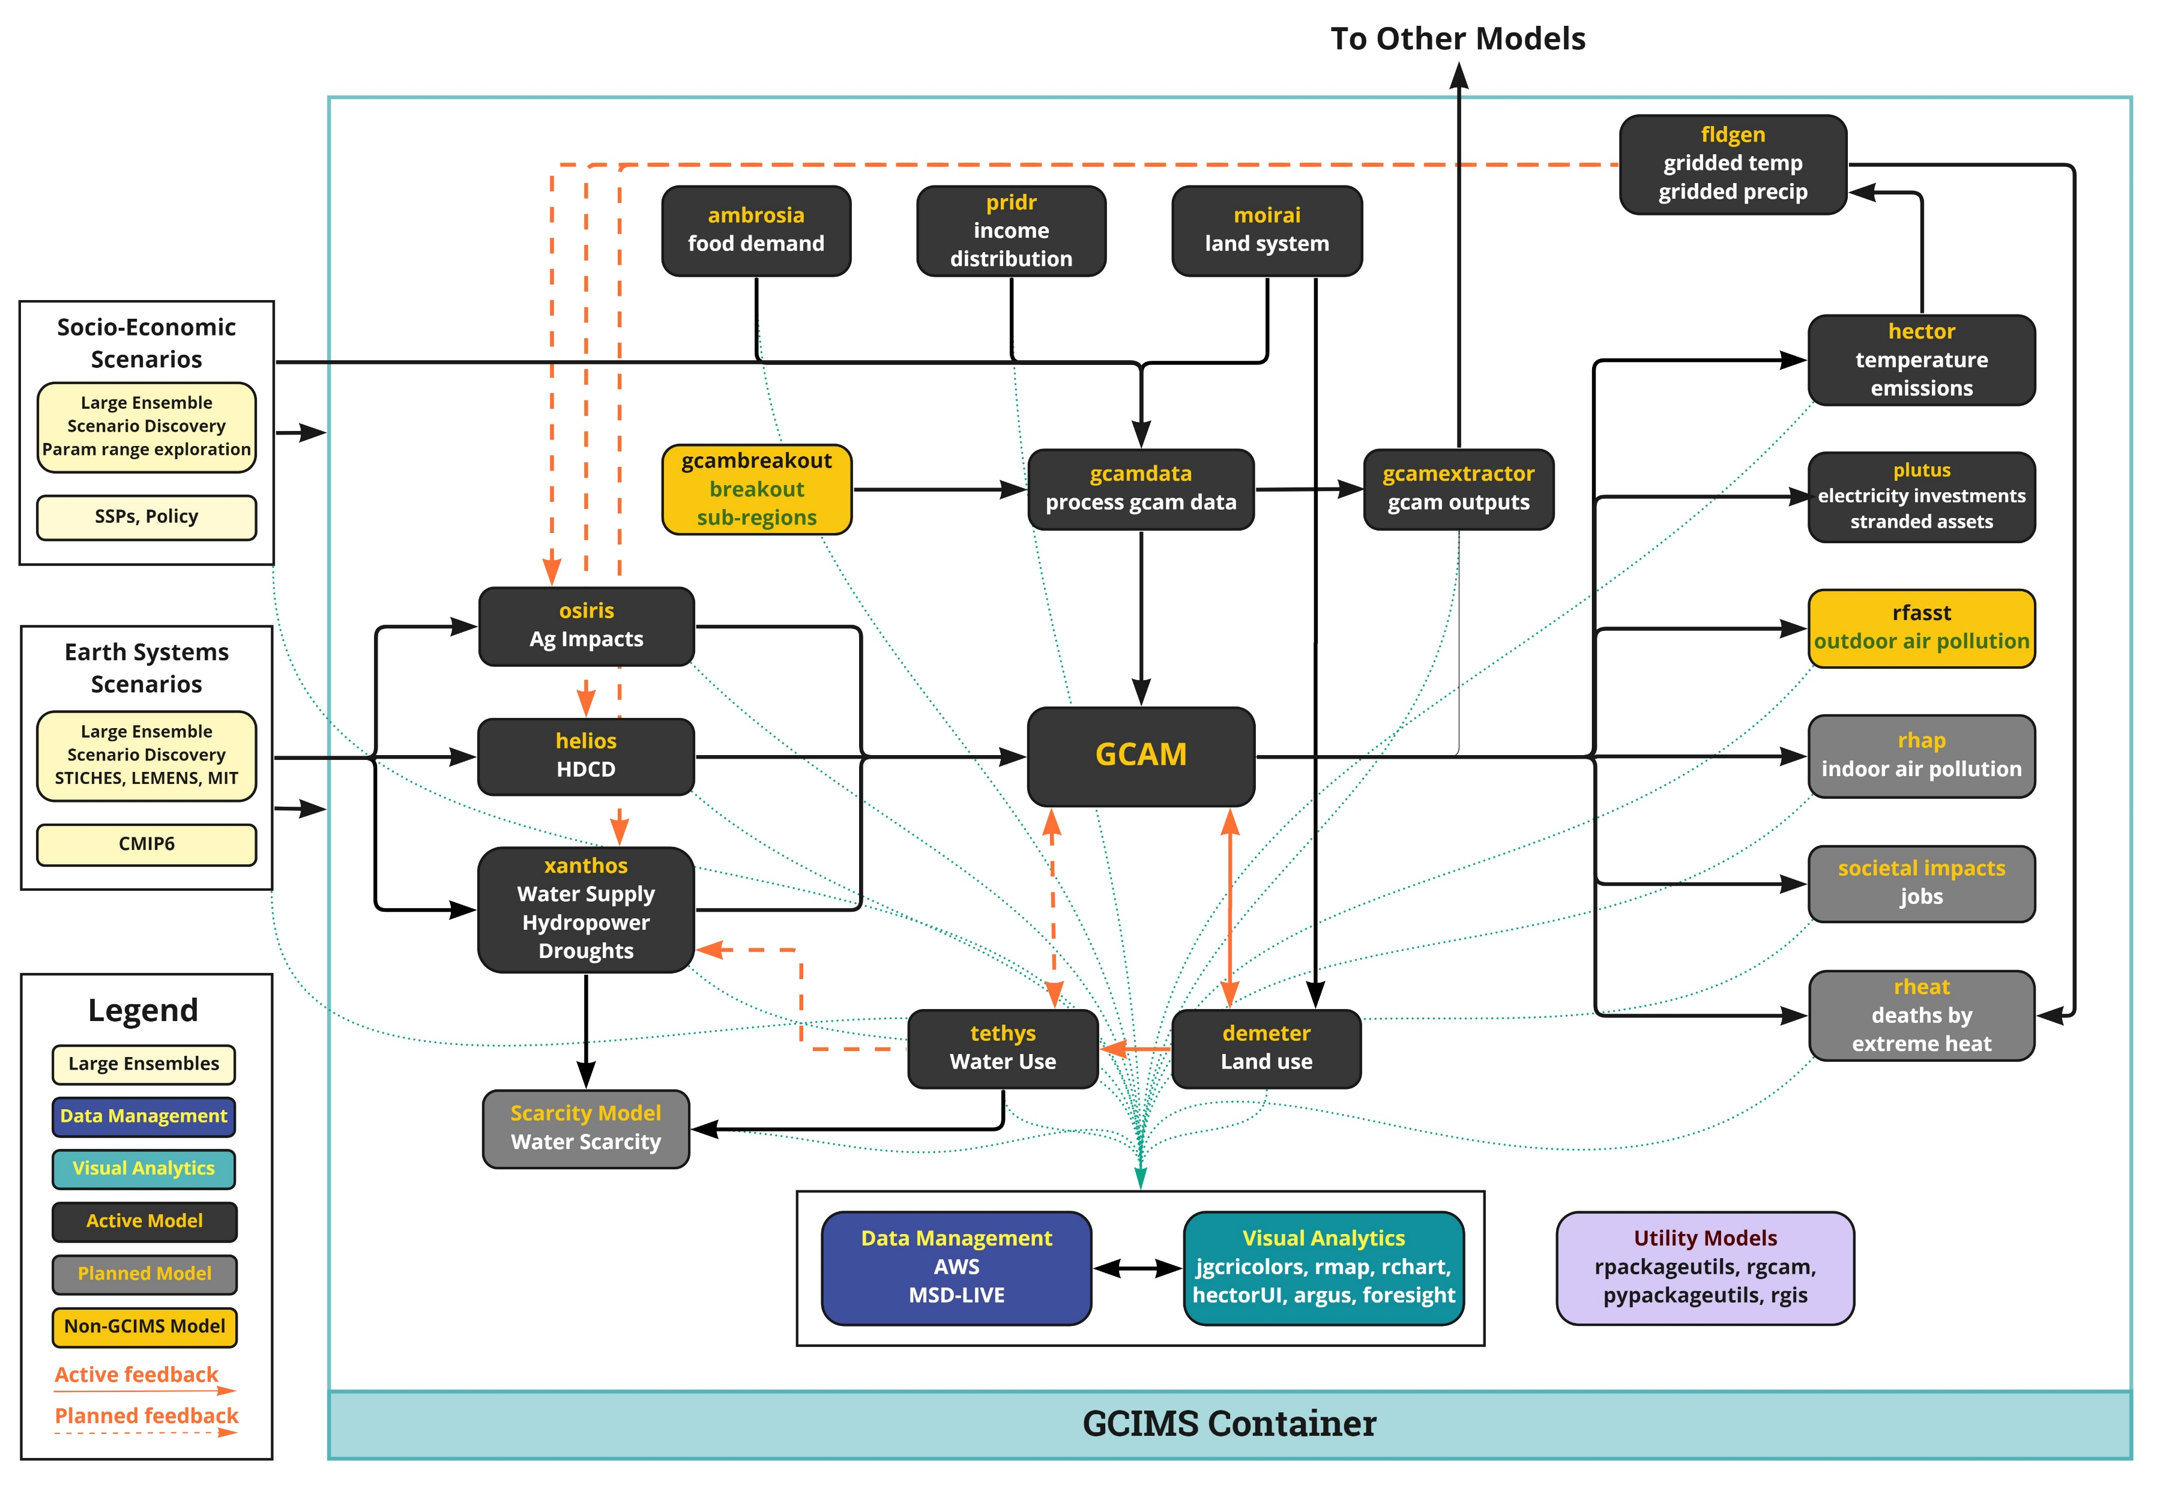
STITCHES
New realizations of existing CMIP6 scenarios
Gridded data for new scenarios from Hector
Entire time series for feed-forward models OR integration in feedback loops for specific time windows.
Emulates the ESM’s internal variability -> have to manage number of realizations
Papers: esd, joss
ETH workshop, stitches in r, shiny
IAMC and archive
STITCHES
Monthly/daily
Gridded T
Gridded P
Gridded other vars
Osiris
Ag impacts data processing
CMIP6 ESMs raw gridded data, ISIMIP data, Hector GSATs
Bias Correction?
STITCHES

Slide 2
STITCHES
New realizations of existing CMIP6 scenarios
Gridded data for new scenarios from Hector
Entire time series for feed-forward models OR integration in feedback loops for specific time windows.
Emulates the ESM’s internal variability -> have to manage number of realizations
PEEPS
Just the mean spatial field of an ESM (interpretable and only one realization if that’s enough for experiment)
Monthly T, P for downscaling Hector results
Very very fast
STITCHES/PEEPS
Monthly/daily (st only)
Gridded T
Gridded P
Gridded other vars (st only)
Osiris
Ag impacts data processing
CMIP6 ESMs raw gridded data, ISIMIP data, Hector GSATs
Bias Correction?
STITCHES

