Slide 1
GCIMS Integration

Slide 2
Agenda
GCIMS Integration – Task 4.2 in official proposal
Motivation
Roadmap

Slide 3
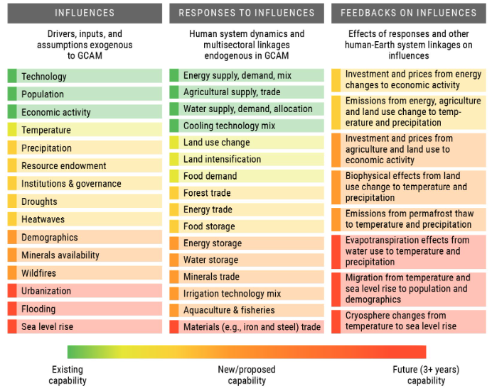
Eecutive Summary from GCIMS Proposal
Science Question 1: How will compounding human and environmental influences affect the coevolution of energy, water, land, climate, and socio-economic systems, and what individual and combination of influences lead to compounding effects within the U.S. and globally?
Science Question 2: How will regional teleconnections via resource supply networks and trade create, amplify, or attenuate the responses associated with different influences in the U.S. and other parts of the world, and how will varying assumptions about the ease or difficulty of trade alter these teleconnections?
Science Question 3: How will human responses to short-term influences through investments in long-lived capacity and in storage technologies in the energy, water, and land systems affect the long-term dynamics of these systems, and how will these investments affect the ability to respond to future influences in the U.S. and globally?
Science Question 4: How could the response of the human–Earth system to influences create feedbacks that are currently not captured in integrated modeling frameworks, and which feedbacks
Figure B.1. Typology of influences, responses, and feedbacks in the GCIMS SFA
https://gcims.atlassian.net/wiki/spaces/HOME/pages/190513175/Official+copy+of+the+proposal+FY21-23

Slide 4
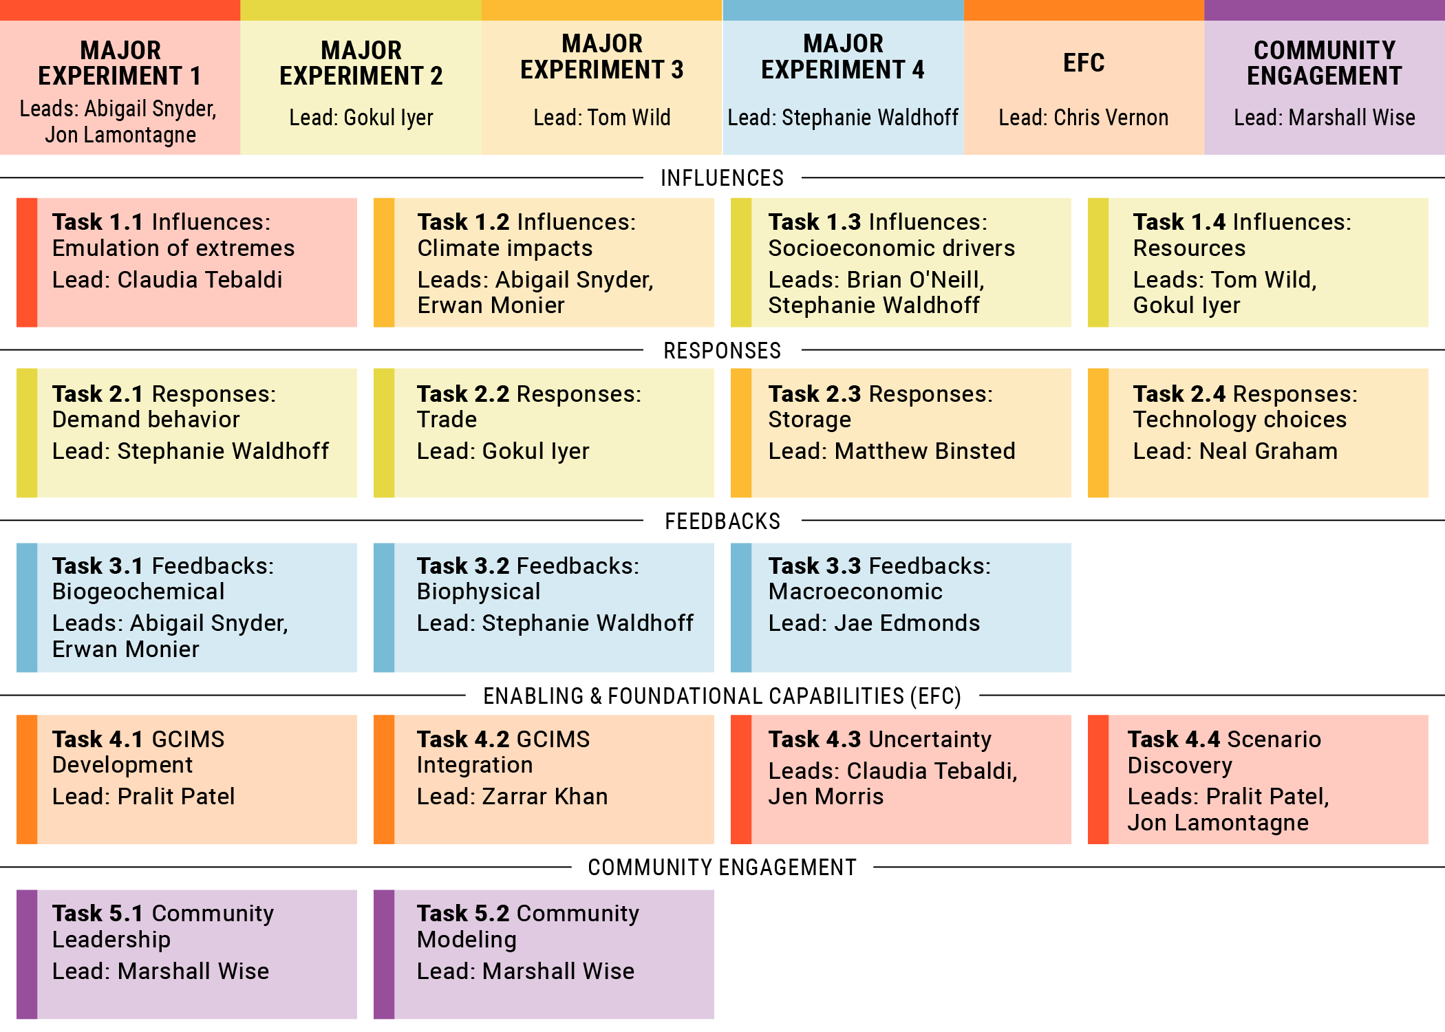
Overview of GCIMS Integration – Task 4.2
https://gcims.atlassian.net/wiki/spaces/HOME/pages/190447644/Project+Structure

Slide 5
Task 4.2 Description in Proposal
The experiments proposed in this SFA require linking influences, responses, and feedbacks. In GCIMS, the representation of these processes occurs in different models. For example, Hector and fldgen model climate-related influences, while Persephone and Xanthos calculate the effect of changes in climate on land productivity and water availability, respectively. GCAM models the responses to influences. Representing environmental feedbacks can require spatial disaggregation of outputs from GCAM via Tethys (water) and Demeter (land) and/or links back to Hector. In the previous phase of the SFA, we developed a tool, Cassandra, to facilitate linking between GCIMS components. However, this tool has only been successfully tested using our climate emulators in combination with Xanthos.
To facilitate the coupling required in the experiments described above, we need two separate but related efforts.
First, Cassandra will need to be extended to facilitate a variety of coupling options, including time step by time step transfer of data from multiple modeling components. We will implement each model and tool within Cassandra and ensure compatibility with Cassandra’s requirements as described in Task 4.1. We will establish a standard testing process for all required Cassandra couplings.
Second, GCAM will need to be updated to facilitate coupling with other GCIMS components. Most of the models in GCIMS were developed in high-level languages such as R or Python. However, GCAM is written in C++. We will use frameworks, including `Rcpp` and `Boost.python`, to make the C++ code available directly from R and Python, respectively. In addition, we will provide an API for the other GCIMS components to update GCAM parameters or retrieve results throughout the model simulation period. In the previous phase of the SFA, we developed a generic API called GCAM-Fusion. Given GCAM’s object-oriented, hierarchical, and dynamically configured design, GCAM-Fusion is implemented as a query-based system. Thus, for users to update “power plant costs” or retrieve “land allocation,” for example, they must know how to develop the specific query to access that information. This requiresusers to know where that data exists in GCAM, and as GCAM is further developed those queries may change. We will fill out a library of common queries that users can readily pick from and which we willmaintain over time. As a result of this task, GCAM will be accessible from R and Python to couple to other models or for interactive use, and users will have a readily available set of predefined queries to get data in and out of GCAM. (GCAM-wrapper)
https://gcims.atlassian.net/wiki/spaces/HOME/pages/190513175/Official+copy+of+the+proposal+FY21-23

Slide 6
Motivation
Selective Interoperability: Coordinate efforts to push our models into selective interoperability (not an über model, but more of a choose your own adventure) on demand for research needs
gcamwrapper: This would start by getting gcamwrapper production ready as it will be the hub
Expand component library: Expand the current component library to be more granular (this transitions our workflows into reusable, bite sized pieces that can be shared and that robust test suites can be built for centrally) – Actively find and avoid Redundancy!
Fluid multi-model integration: Highly coordinated, highly automated, high communication, integration across the board for all of our modeling components (hector, xanthos, demeter, etc.)
Redeployable/Scalable Space: Moving our integration into redeployable and scalable space (Isaac's containerization work will come in good here) so we can push our experiments to cloud compute platforms if need be
Education/Useability/Transparency: Empower people to use our tools and extract insights that matter
Pilot-tests/Indicators: Working with other experiments to identify key metrics and indicators that are meaningful and get buy-in using small pilot projects to demonstrate capabilities
Audience: Client (DOE) Science Objectives + beyond: public? students? policy makers? Multi-lateral banks? NGOs?

Slide 7
GCIMS Integration - Plan
Software Map (What is there to link?)
Standards (Optimize efficient storage and I/O, pypackageutils, rpackageutils)
Workflows (Container Orchestrations/Robustness/Scalable)
Feedbacks (rename to avoid confusion with experiments) (gcamwrapper, gcimswrapper)
Data Management (Central, traceable, provenance):
QC/QA’d data integrated with CI
Visual Anlaytics (Share, track, diagnose):
Indicators? Impacts metrics? (coming from experiment leads)
Science communication:
Models (Tethys/Xanthos):
Software paper per version
Data paper
Vis Apps/Dashboards? – Social media, lectures, conferences (Track use SEO etc.)

