Slide 1
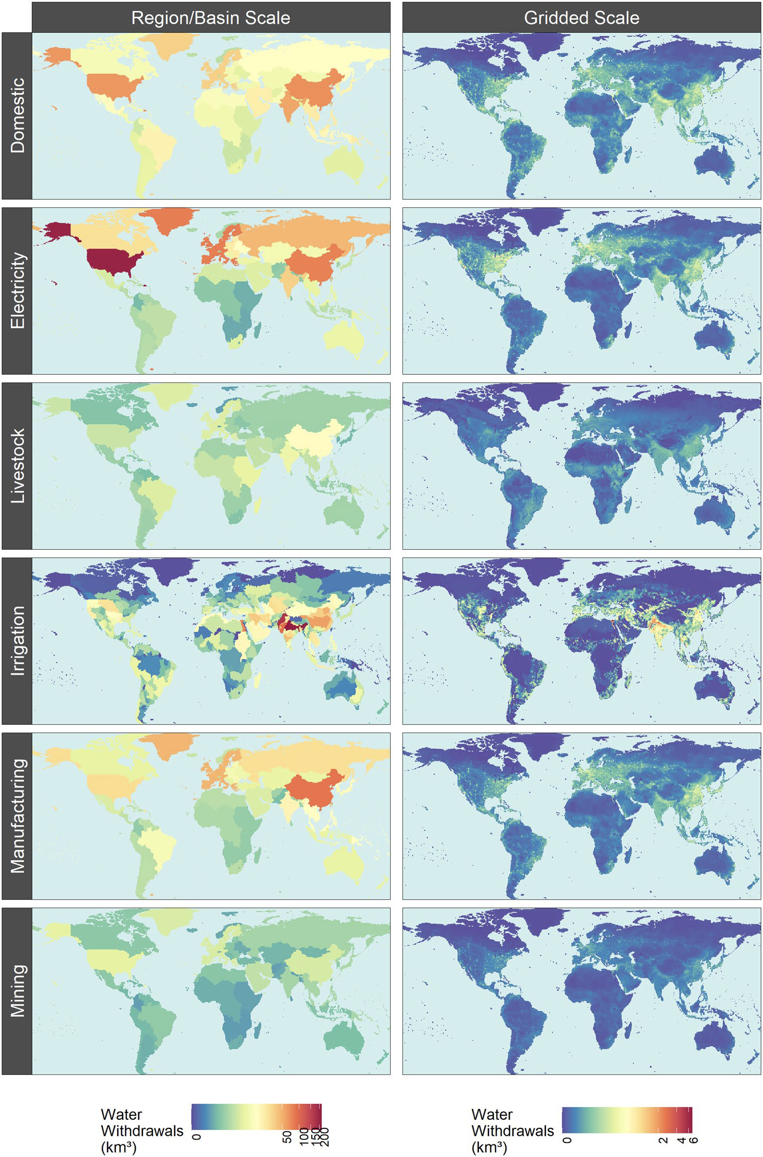
Navigating the Future of Global Water Use: A High-Resolution Analysis
Objective
Generates a global gridded monthly sectoral water withdrawal and consumption dataset for 2010-2100 across 75 scenarios, harmonized with Shared Socioeconomic Pathways and Representative Concentration Pathways, to support studies evaluating the implications of human and earth system change on future global and regional water dynamics.
Approach
Couple the Global Change Analysis Model (GCAM) with a land use spatial downscaling model (Demeter), a global hydrologic framework (Xanthos), and a water withdrawal downscaling model (Tethys) to generate a global gridded monthly sectoral water withdrawal and consumption dataset.
Utilize 75 scenarios harmonized with Shared Socioeconomic Pathways (SSPs) and Representative Concentration Pathways (RCPs) to capture a range of futures reflecting diverse global change across human and Earth systems.
Impact
The study generates a novel global gridded monthly sectoral water withdrawal and consumption dataset at 0.5° resolution for 2010–2100, covering 75 diverse scenarios to support long-term planning and sustainable development.
The dataset quantifies demand-side pressures on scarce water resources globally under various future scenarios, highlighting that future water scarcity is primarily driven by human water demands rather than climate impacts on water availability.
The research provides a transparent and open-source dataset with a fine spatio-temporal scale, capturing key drivers of future water scarcity and offering a more detailed understanding of irrigation water use by crop types.
This figure displays the spatial downscaling of 2010 water withdrawals by sector from GCAM regions and basins to 0.5° × 0.5° grid cells. This helps in understanding future water usage and scarcity at a finer spatio-temporal scale across diverse socio-economic and climate scenarios.
Khan, Z., I. Thompson, C.R. Vernon, N.T. Graham, T.B. Wild, and M. Chen. 2023. “Global monthly sectoral water use for 2010–2100 at 0.5° resolution across alternative futures.” Sci. Data., 10(201. DOI: 10.1038/s41597-023-02086-2

