Slide 1
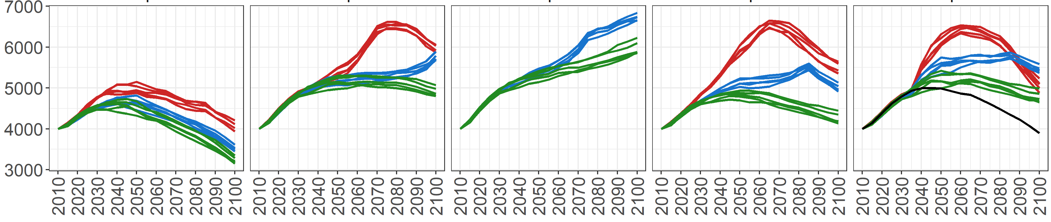
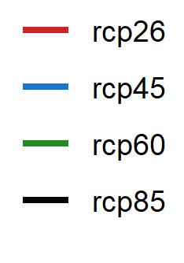
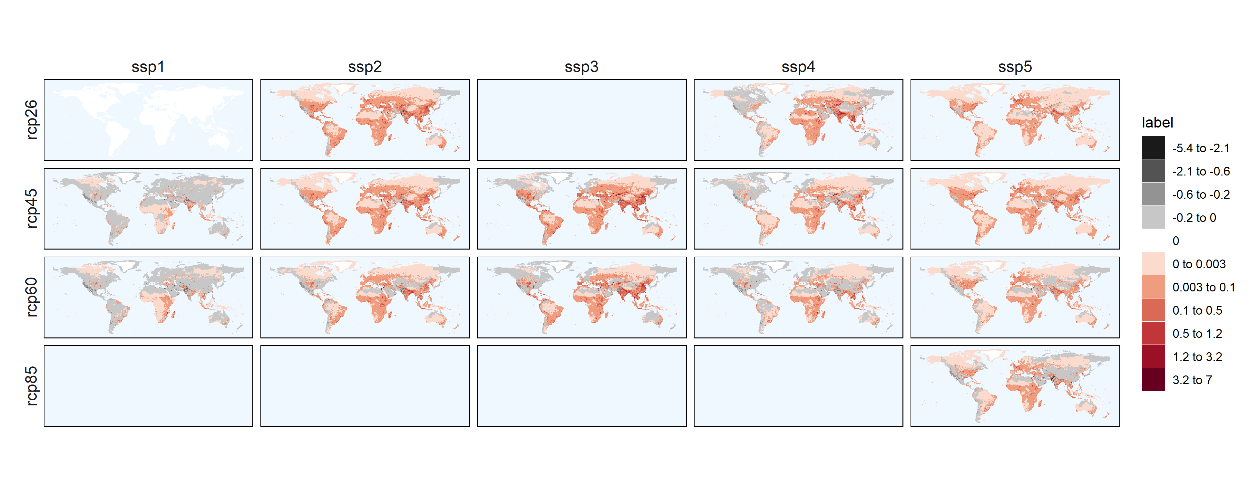
Global gridded water withdrawal dataset to 2100 at 0.5° across SSP/RCPs
Water Withdrawals (km³)
SSP1 SSP2 SSP3 SSP4 SSP5
Difference in Water Withdrawals (km³) from SSP 1 - RCP 2.6 in 2100
SSP1 SSP2 SSP3 SSP4 SSP5
RCP 2.6
RCP 4.5
RCP 6.0
RCP 8.5
* Note RCPs represent multiple GCMs. Mean value of GCM’s used in map

Slide 2
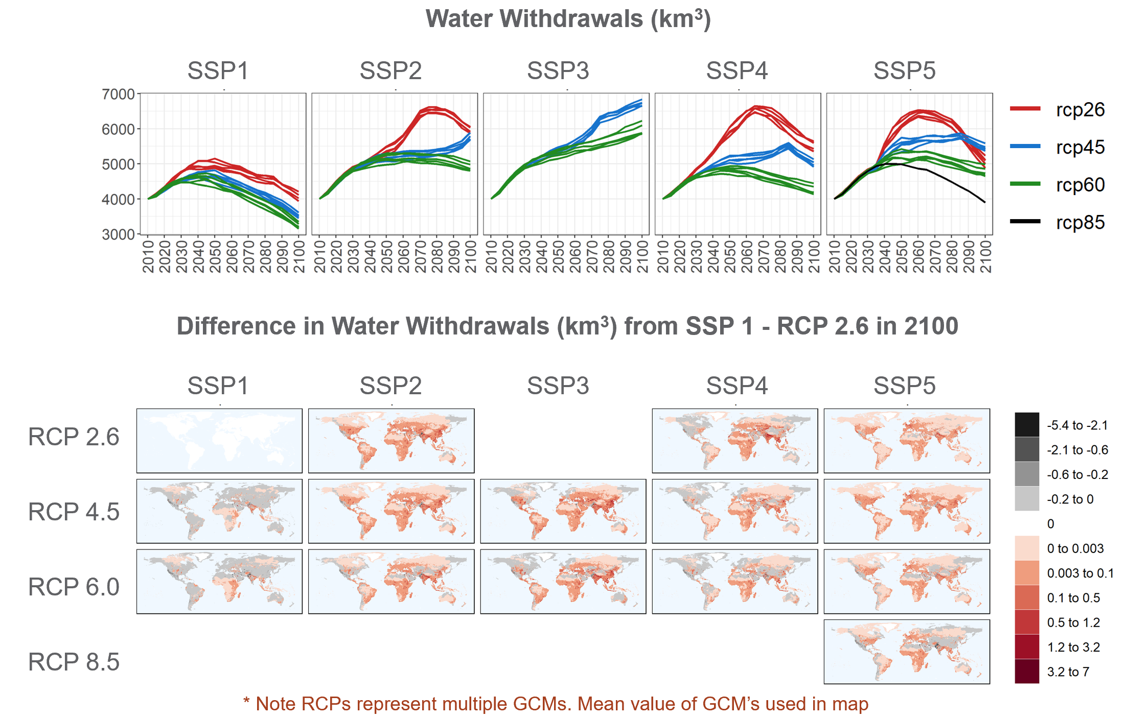
Global gridded water withdrawal dataset to 2100 at 0.5° across SSP/RCPs
METHODS
PRELIMINARY RESULTS
Model: Tethys
Dataset features:
Spatial Resolution: 0.5 degree
Temporal Resolution: Monthly
Scope: Global
Sectors: Domestic, Electricity, Agriculture, Industry, Primary, Livestock
Harmonized Data Inputs from:
GCAM
Demeter
Xanthos
https://github.com/JGCRI/tethys
https://github.com/JGCRI/gcam-core
https://github.com/JGCRI/demeter
https://github.com/JGCRI/xanthos
Khan, Z., Graham, N., Vernon, C., Wild, T., Chen, M., and Calvin, K.: A global gridded monthly water withdrawal dataset for multiple sectors from 2015 to 2100 at 0.5° resolution under a range of socioeconomic and climate scenarios, EGU General Assembly 2021, online, 19–30 Apr 2021, EGU21-903, https://doi.org/10.5194/egusphere-egu21-903 , 2021

