Slide 1
Figures for SRN documentation

Slide 2
SRN
Modules
Key Functions
Descriptions
Read GCAM data
Create tables for selected parameters
Create templates for stakeholder local data
GCAM
srn.readgcam.R
srn.chartsProcess.R
srn.chart.R
Create charts for each region, scenario
Create diff-plots to compare scenarios
Create combined plots to compare regions
Charting
srn.mapsProcess.R
srn.map.R
Aggregate gridded data to given boundary shapefile
Create diff maps to compare scenarios
Create combined maps to compare regions
Mapping
Future developments
Create links between different sectors
Harmonize links across sectors, regions and periods
Nexus Links
Future developments
Given changes in one sector, sub-region, period
Forecast changes in other sectors, regions and periods.
Forecasting

Slide 3
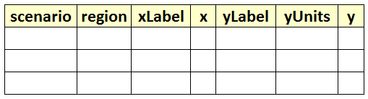
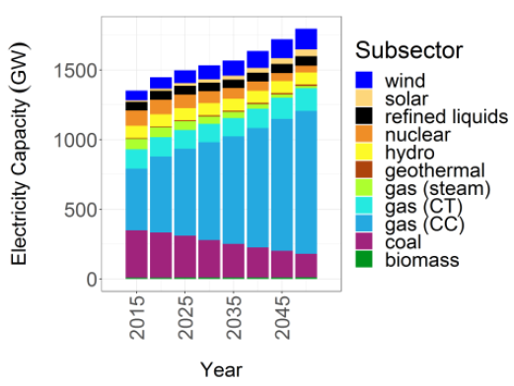
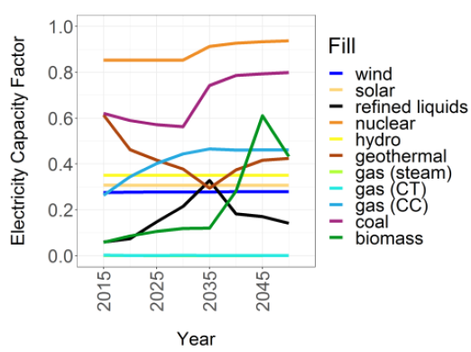
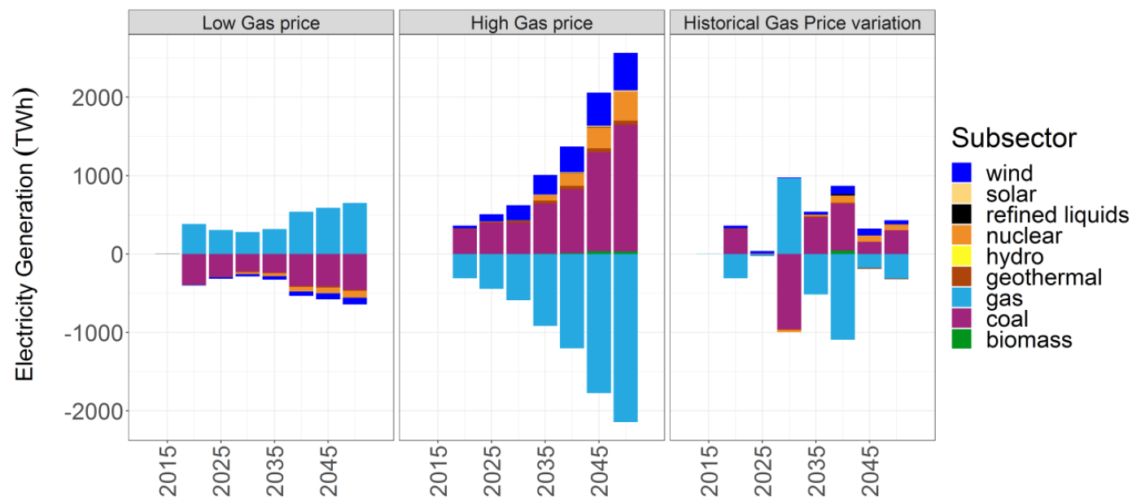
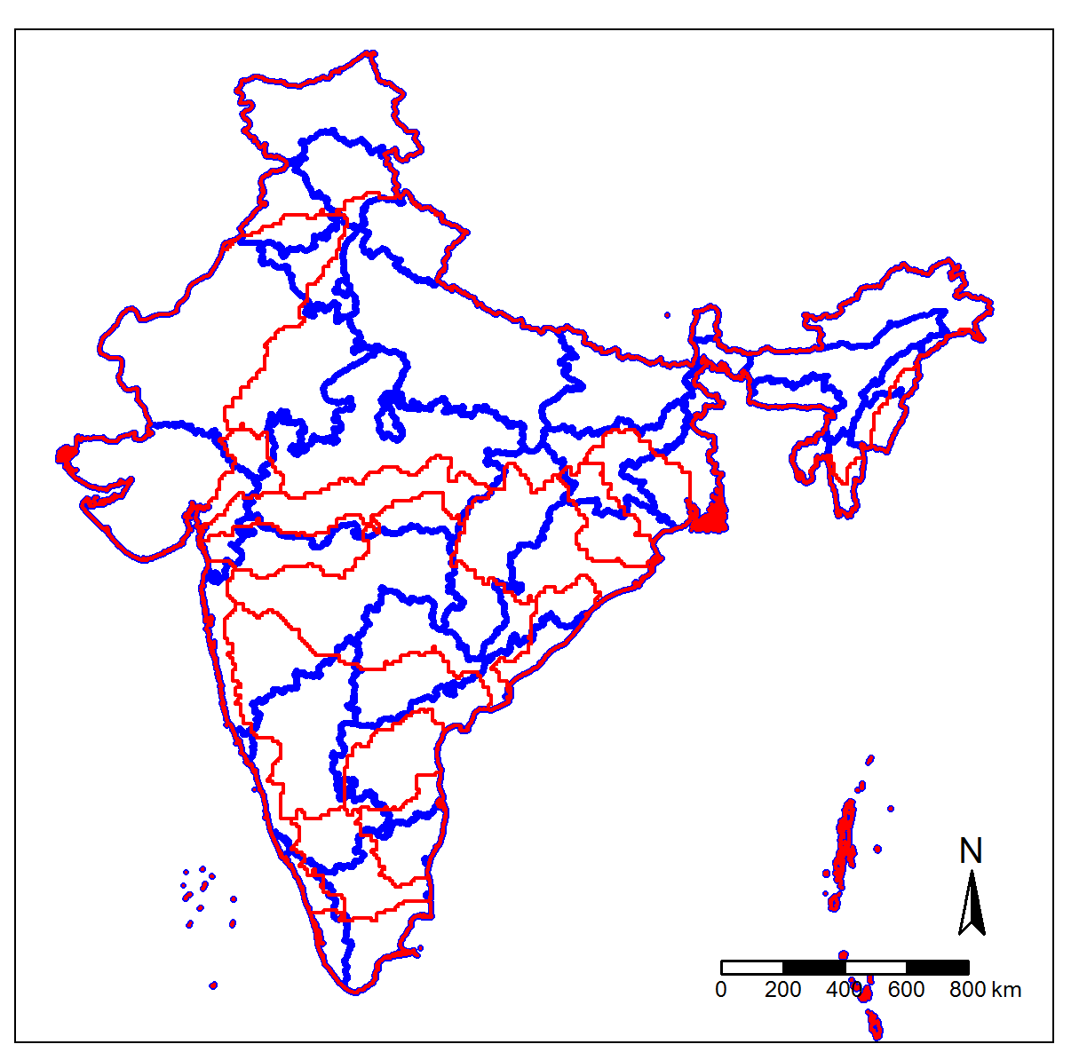
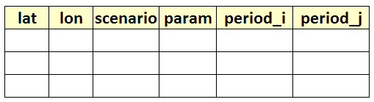
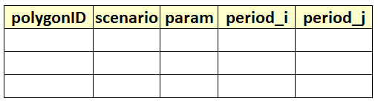
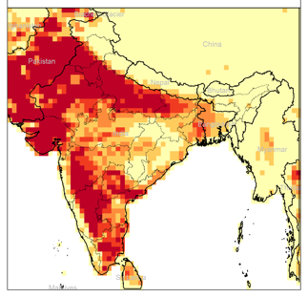
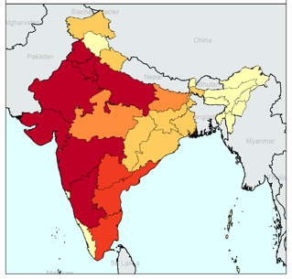
Standardized Tables
1. Default Values
2. Blank Template for users
GCAM database
Query File
srn.readgcam.R
Any Standardized Table
Charts
srn.chartsProcess.R
srn.chart.R
Any Standardized Grid Table
Any Shapefile
Standardized Polygon Tables
1. Default Values
2. Blank Template for users
srn.grid2poly.R
Any Standardized Polygon Table
Polygon Shapefile
Maps
1. Gridded
2. Polygons
srn.maps.R

Slide 4


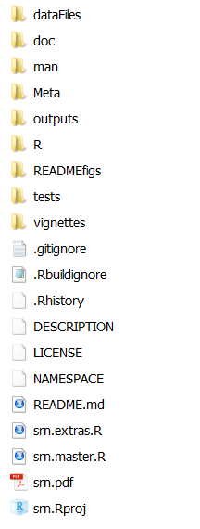
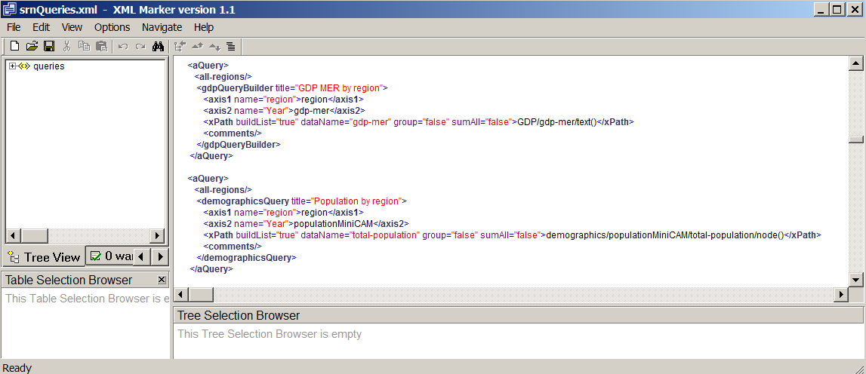
Notes:
Installation Guide

Slide 5
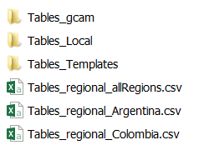

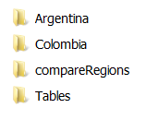

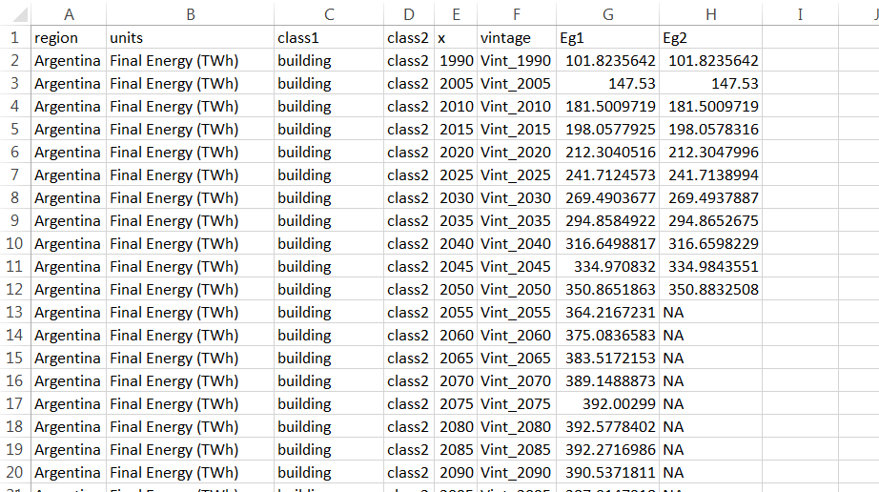
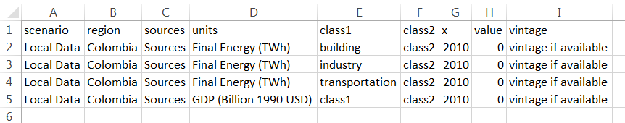
Not created automatically. Need to Add this file after getting data from local stakeholders
Notes:
Installation Guide

Slide 6
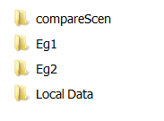
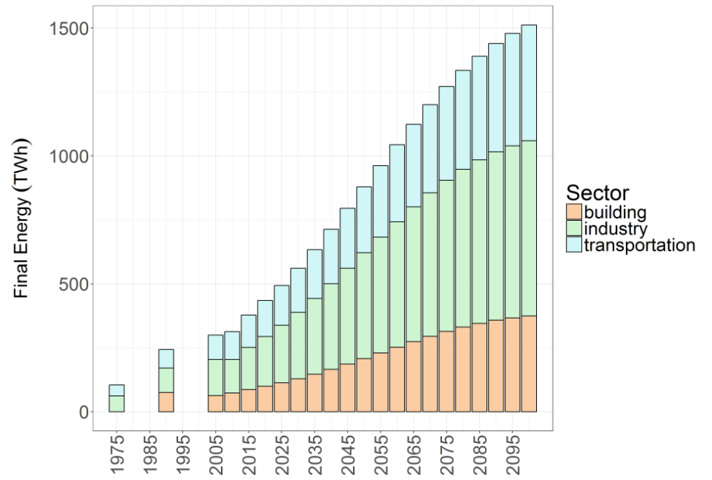

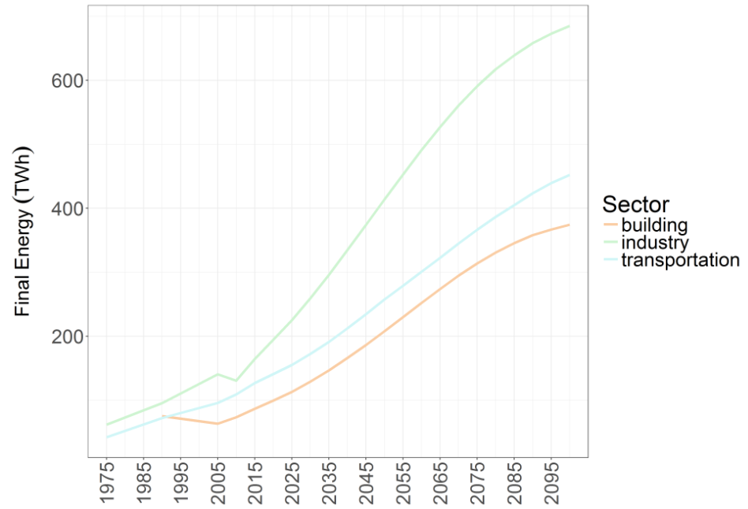
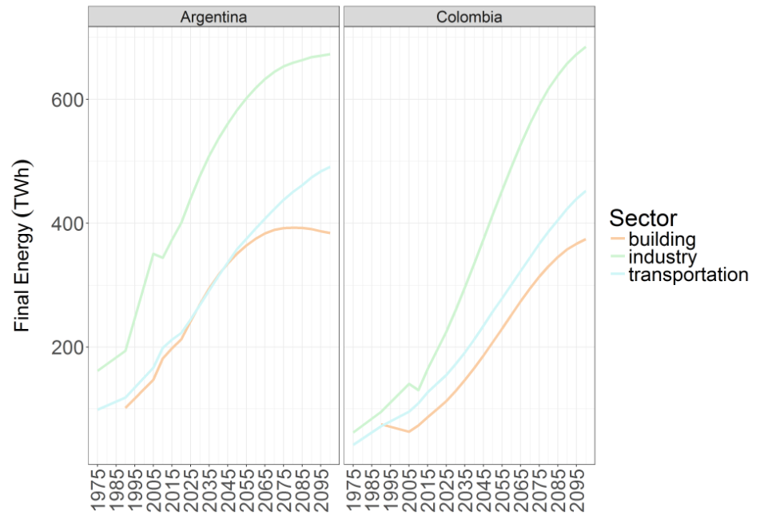
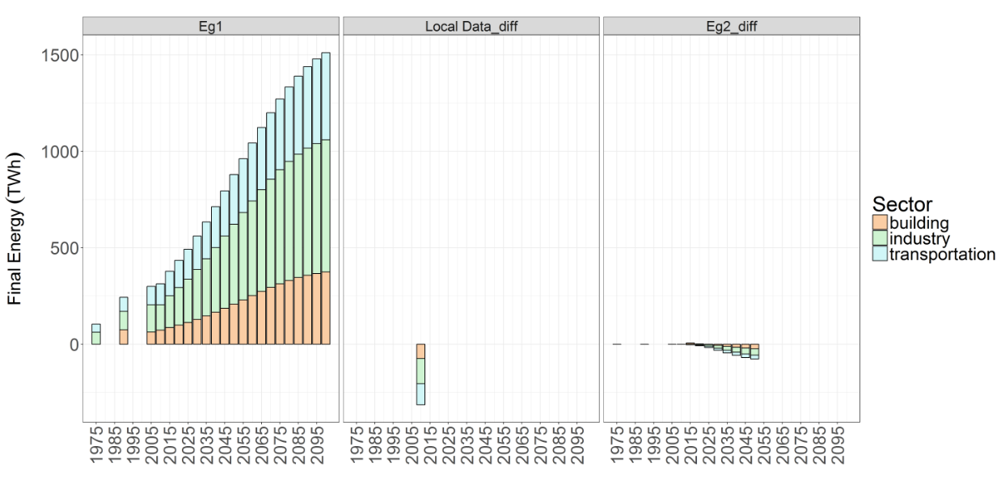
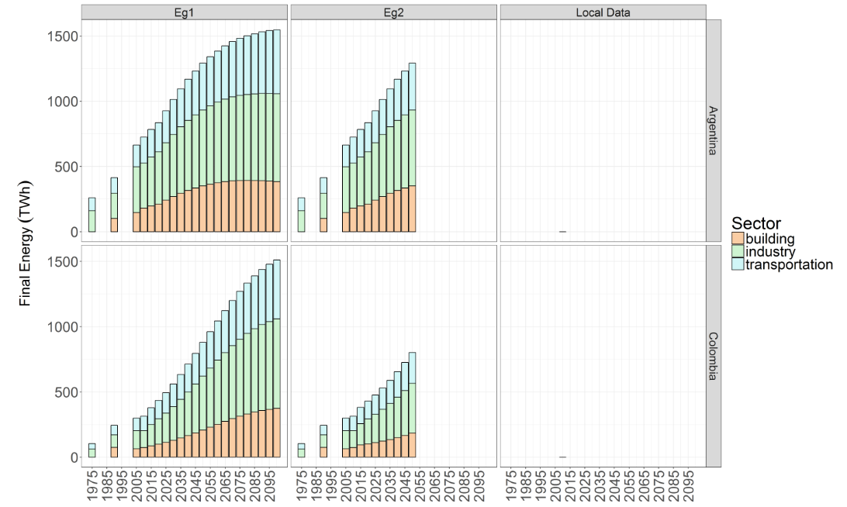
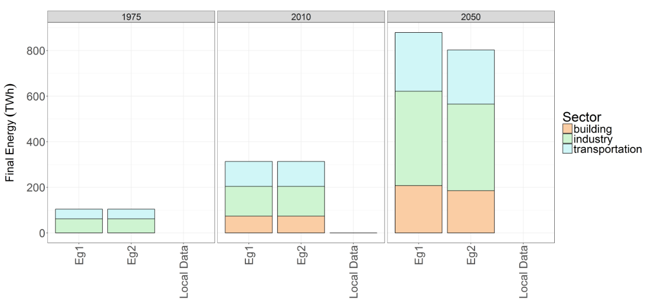
Each Scenario
Compare Regions
Compare Scenarios
Compare Regions
& scenarios
Notes:
Installation Guide

