Slide 1


Figures for Metis documentation

Slide 2
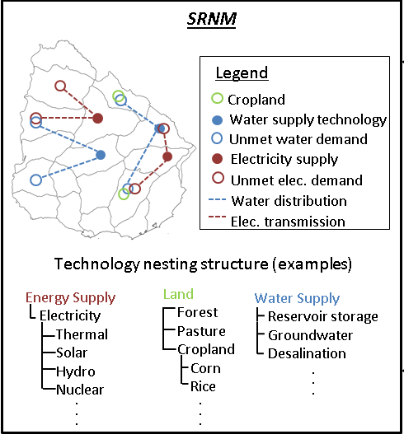
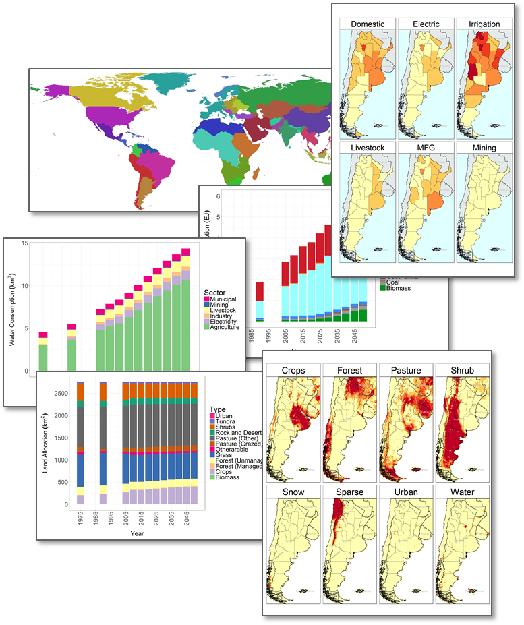
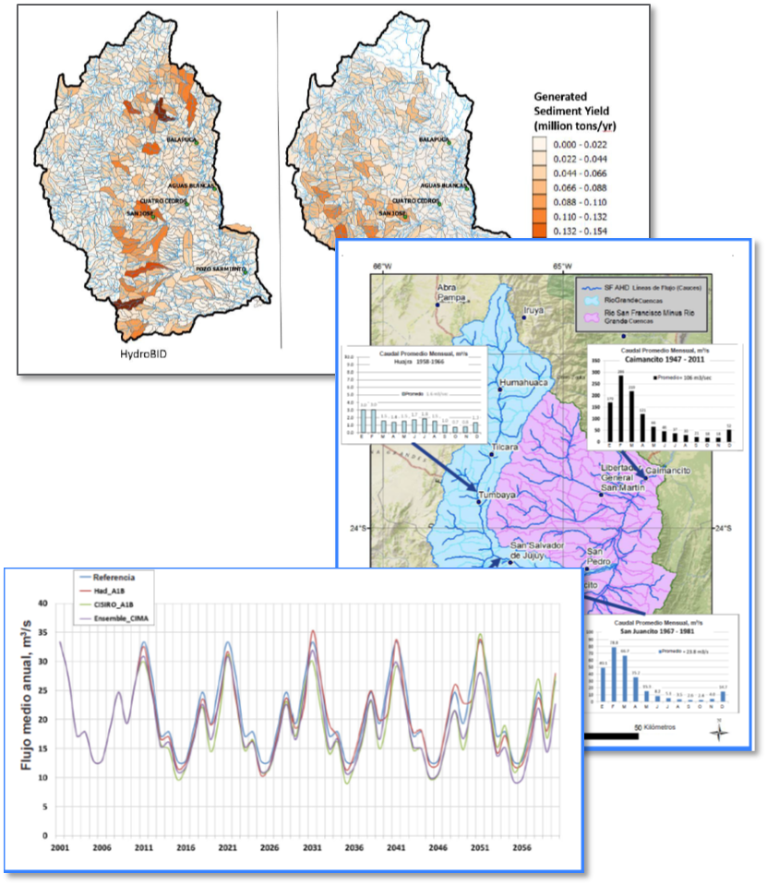
Integrated Assessment Modeling Ecosystems
(e.g., GCAM)
Aggregated Regional Nexus Model
(Metis)
High-Fidelity Sectoral Models
(e.g., HydroBID)
Metis

Slide 3
Metis
Modules
Key Functions
Descriptions
Read GCAM data
Create tables for selected parameters
Create templates for stakeholder local data
GCAM
metis.readgcam.R
metis.chartsProcess.R
metis.chart.R
Create charts for each region, scenario
Create diff-plots to compare scenarios
Create combined plots to compare regions
Charting
metis.grid2poly
metis.mapsProcess.R
metis.map.R
Aggregate gridded data to given boundary shapefile
Create diff maps to compare scenarios
Create combined maps to compare regions
Mapping
Future developments
Create links between different sectors
Harmonize links across sectors, regions and periods
Nexus Links
Future developments
Given changes in one sector, sub-region, period
Forecast changes in other sectors, regions and periods.
Forecasting

Slide 4
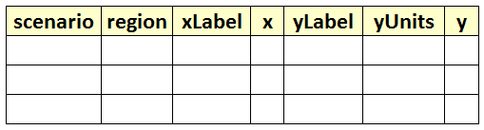
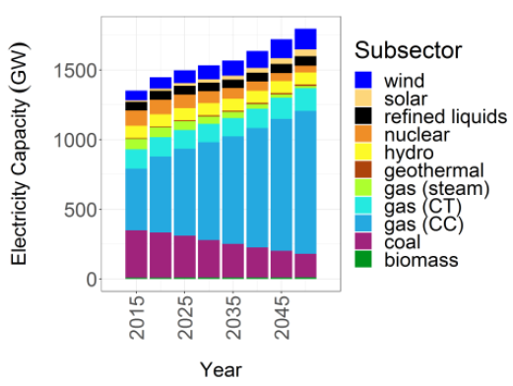
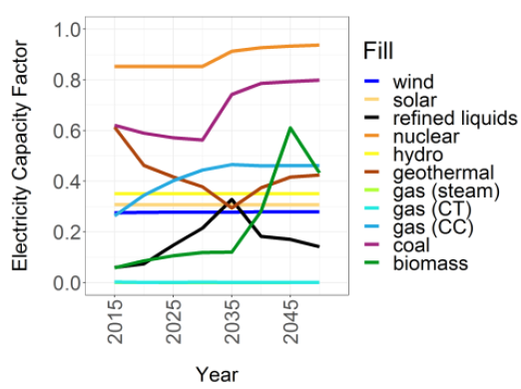
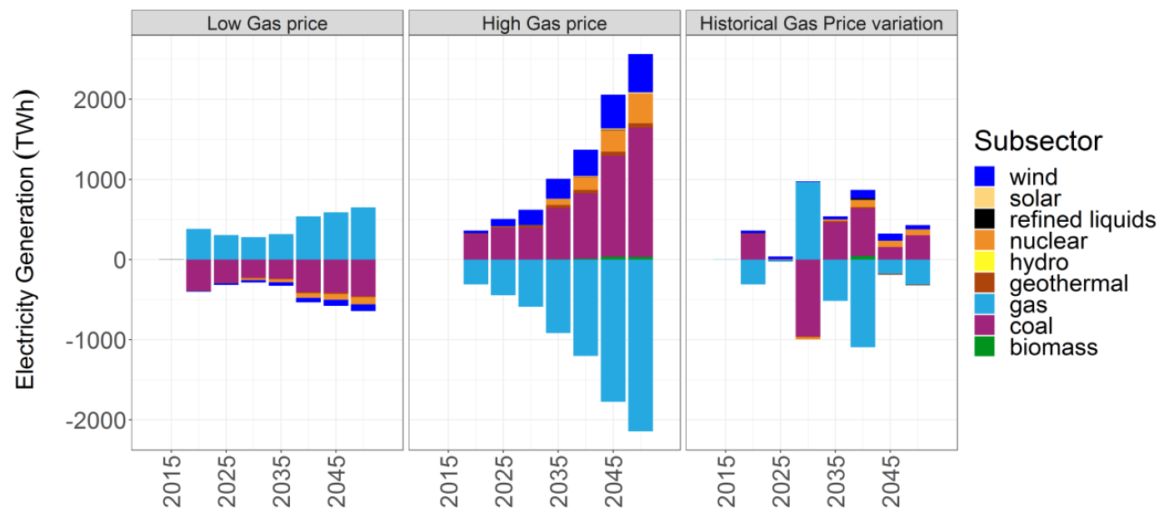
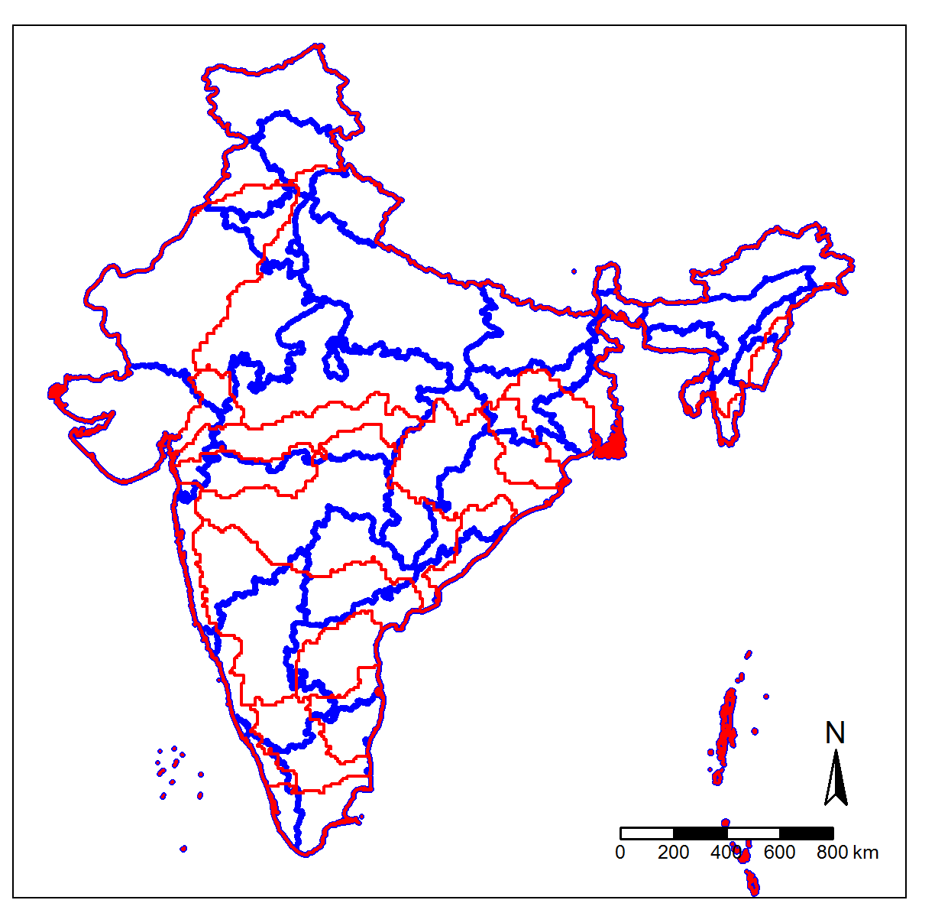
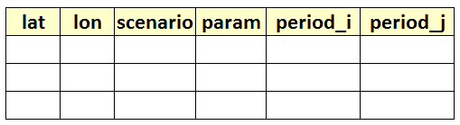
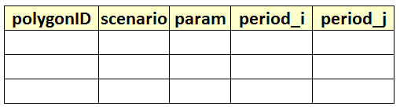
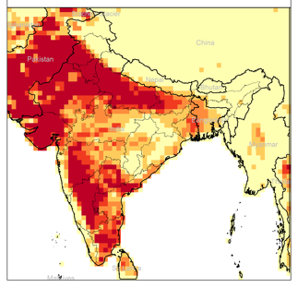
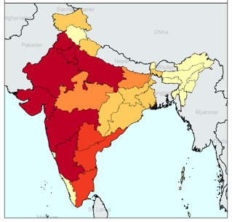
Standardized Tables
1. Default Values
2. Blank Template for users
GCAM database
Query File
metis.readgcam.R
Any Standardized Table
Charts
metis.chartsProcess.R
metis.chart.R
Any Standardized Grid Table
Any Shapefile
Standardized Polygon Tables
1. Default Values
2. Blank Template for users
metis.grid2poly.R
Any Standardized Polygon Table
Polygon Shapefile
Maps
1. Gridded
2. Polygons
metis.maps.R
metis.mapsProcess.R

Slide 5
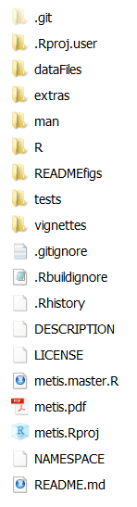
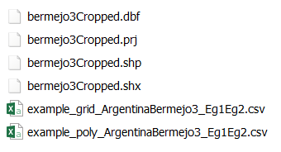
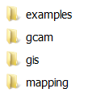

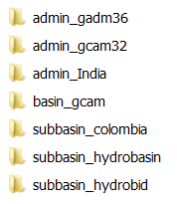

Notes:
Installation Guide

Slide 6
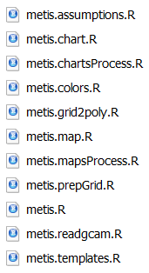

Slide 7
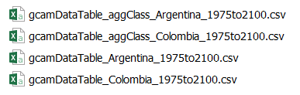
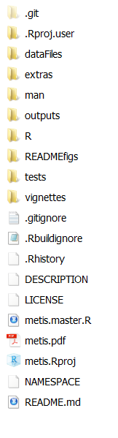
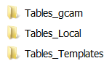

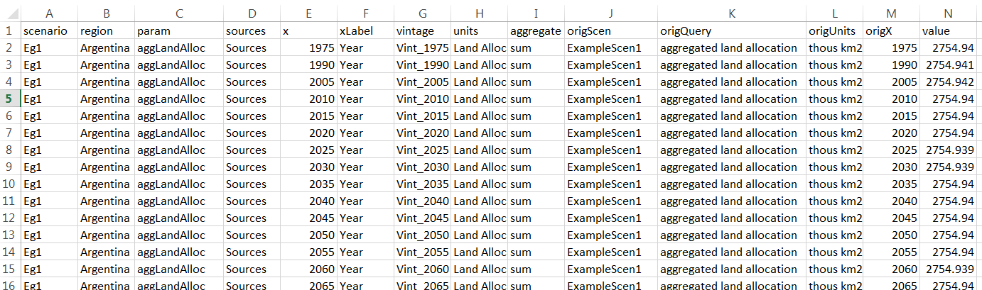


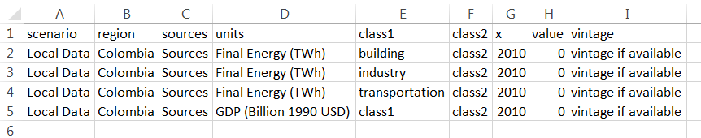
Not created automatically. Need to Add this file after getting data from local stakeholders
Notes:
Installation Guide

Slide 8
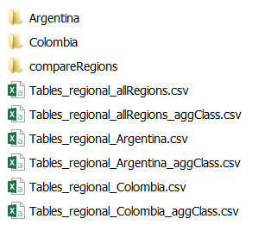
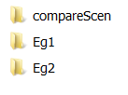

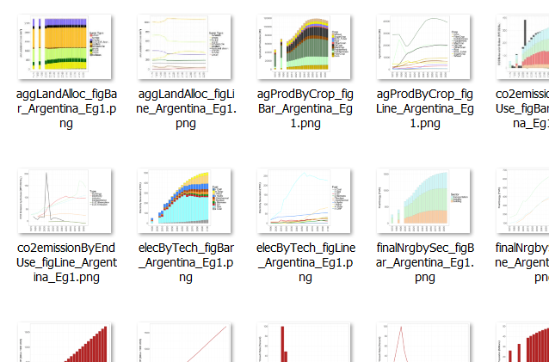
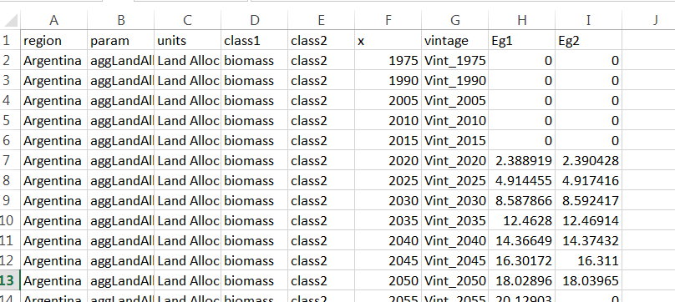
All figures are based on data from these tables
Notes:
Installation Guide

Slide 9
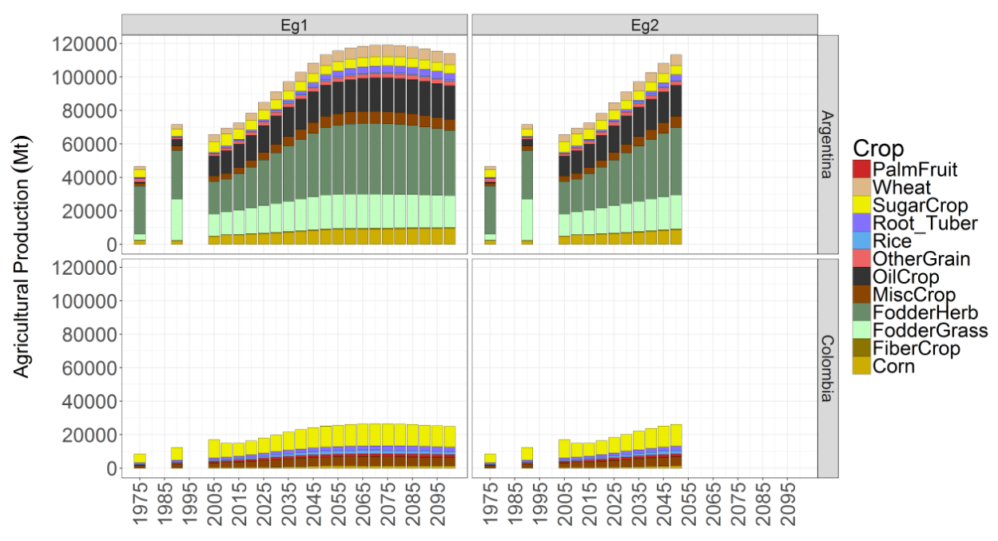
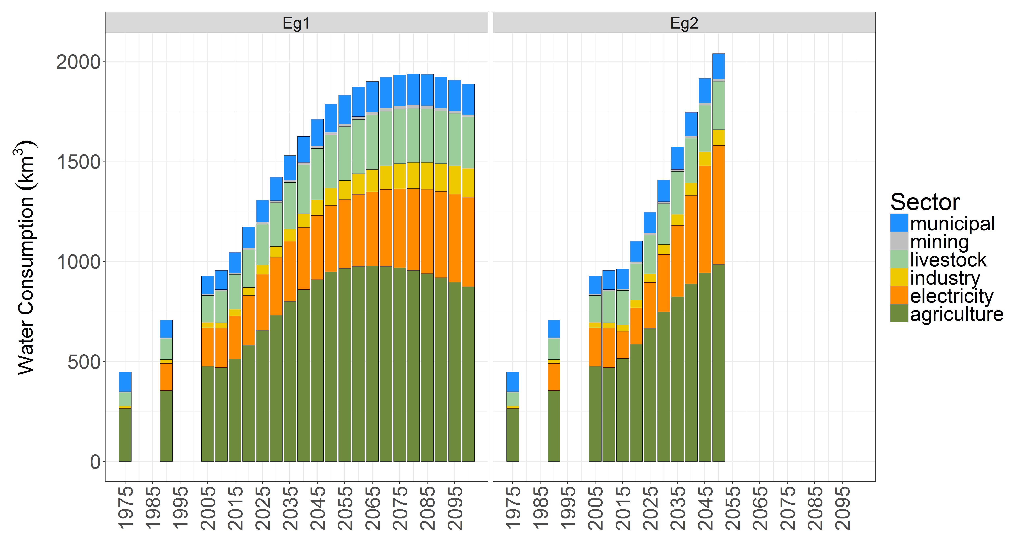
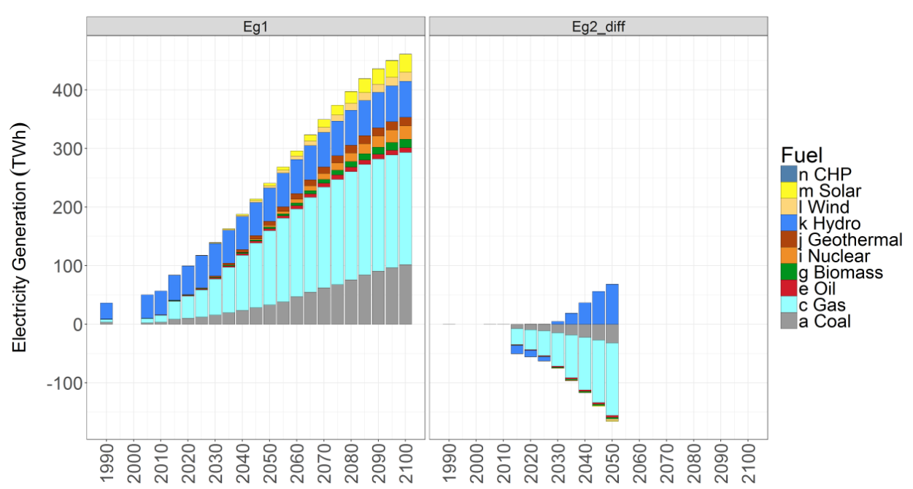
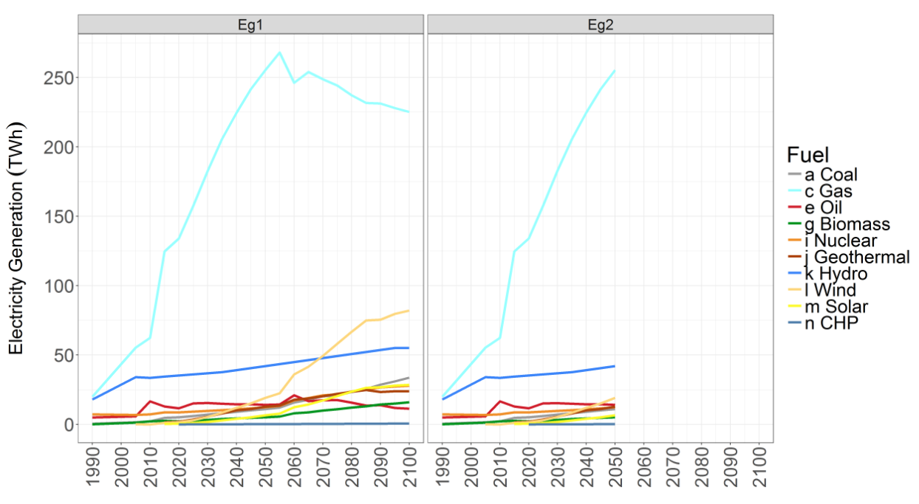
Compare Regions & scenarios
Compare Scenarios
Diff Charts
Line Charts
Notes:
Installation Guide

Slide 10
Example
Grid Cell
Values
Raster Area
Weights
Polygon Area
Weights
90%
10%
1000
60%
50%
50%
100
30%
20%
80%
10
10%
For Vol (e.g. m³) – Sum of Raster Area Weighted
For Depth (e.g. mm) – Mean of Polygon Area Weighted
1000 x 0.9
1000 x 0.6
100 x 0.5
100 x 0.3
10 x 0.2
10 x 0.1
Sum = 900+50+2 = 952 m³
Mean = (600+30+1)/3 = 631/3 = 210.33 mm

Slide 11
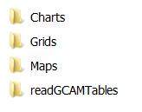


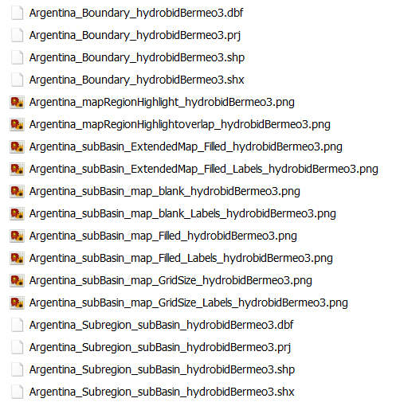



Slide 12
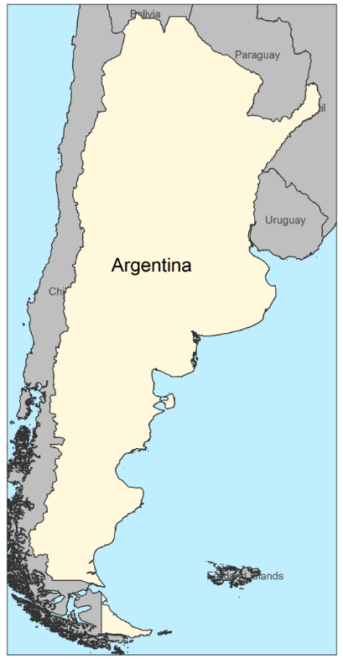
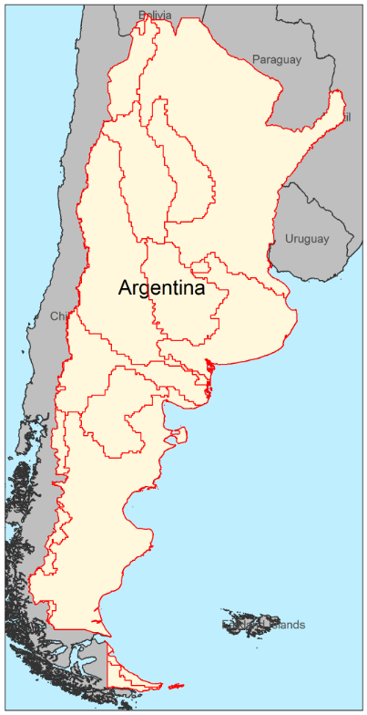
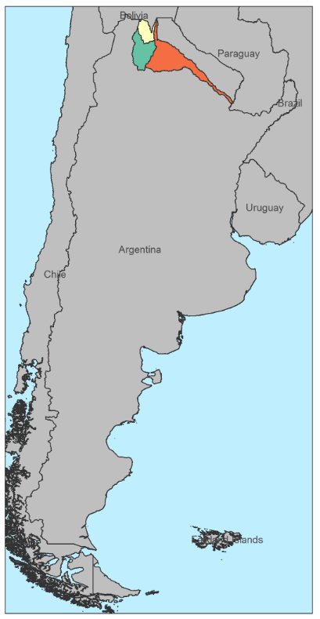
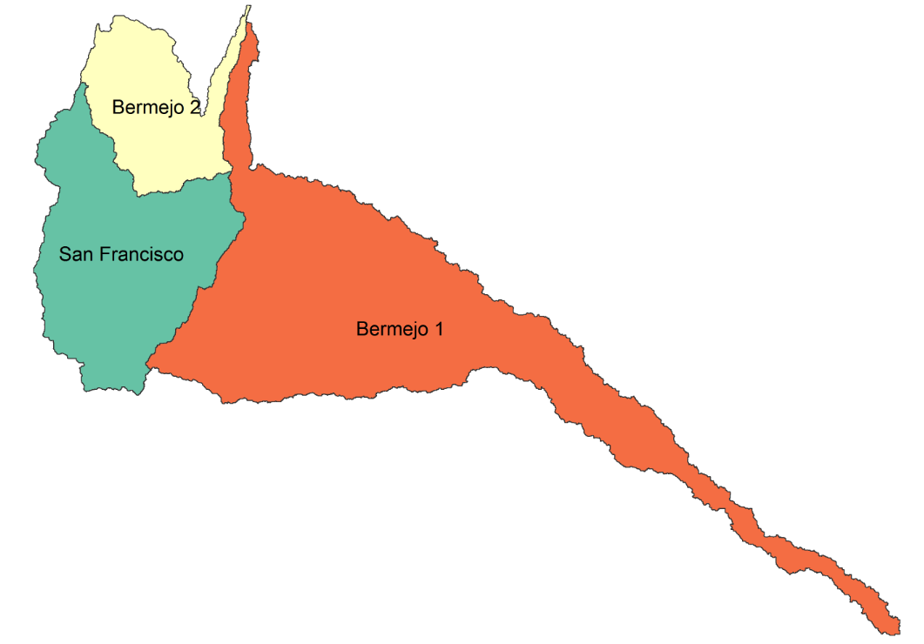
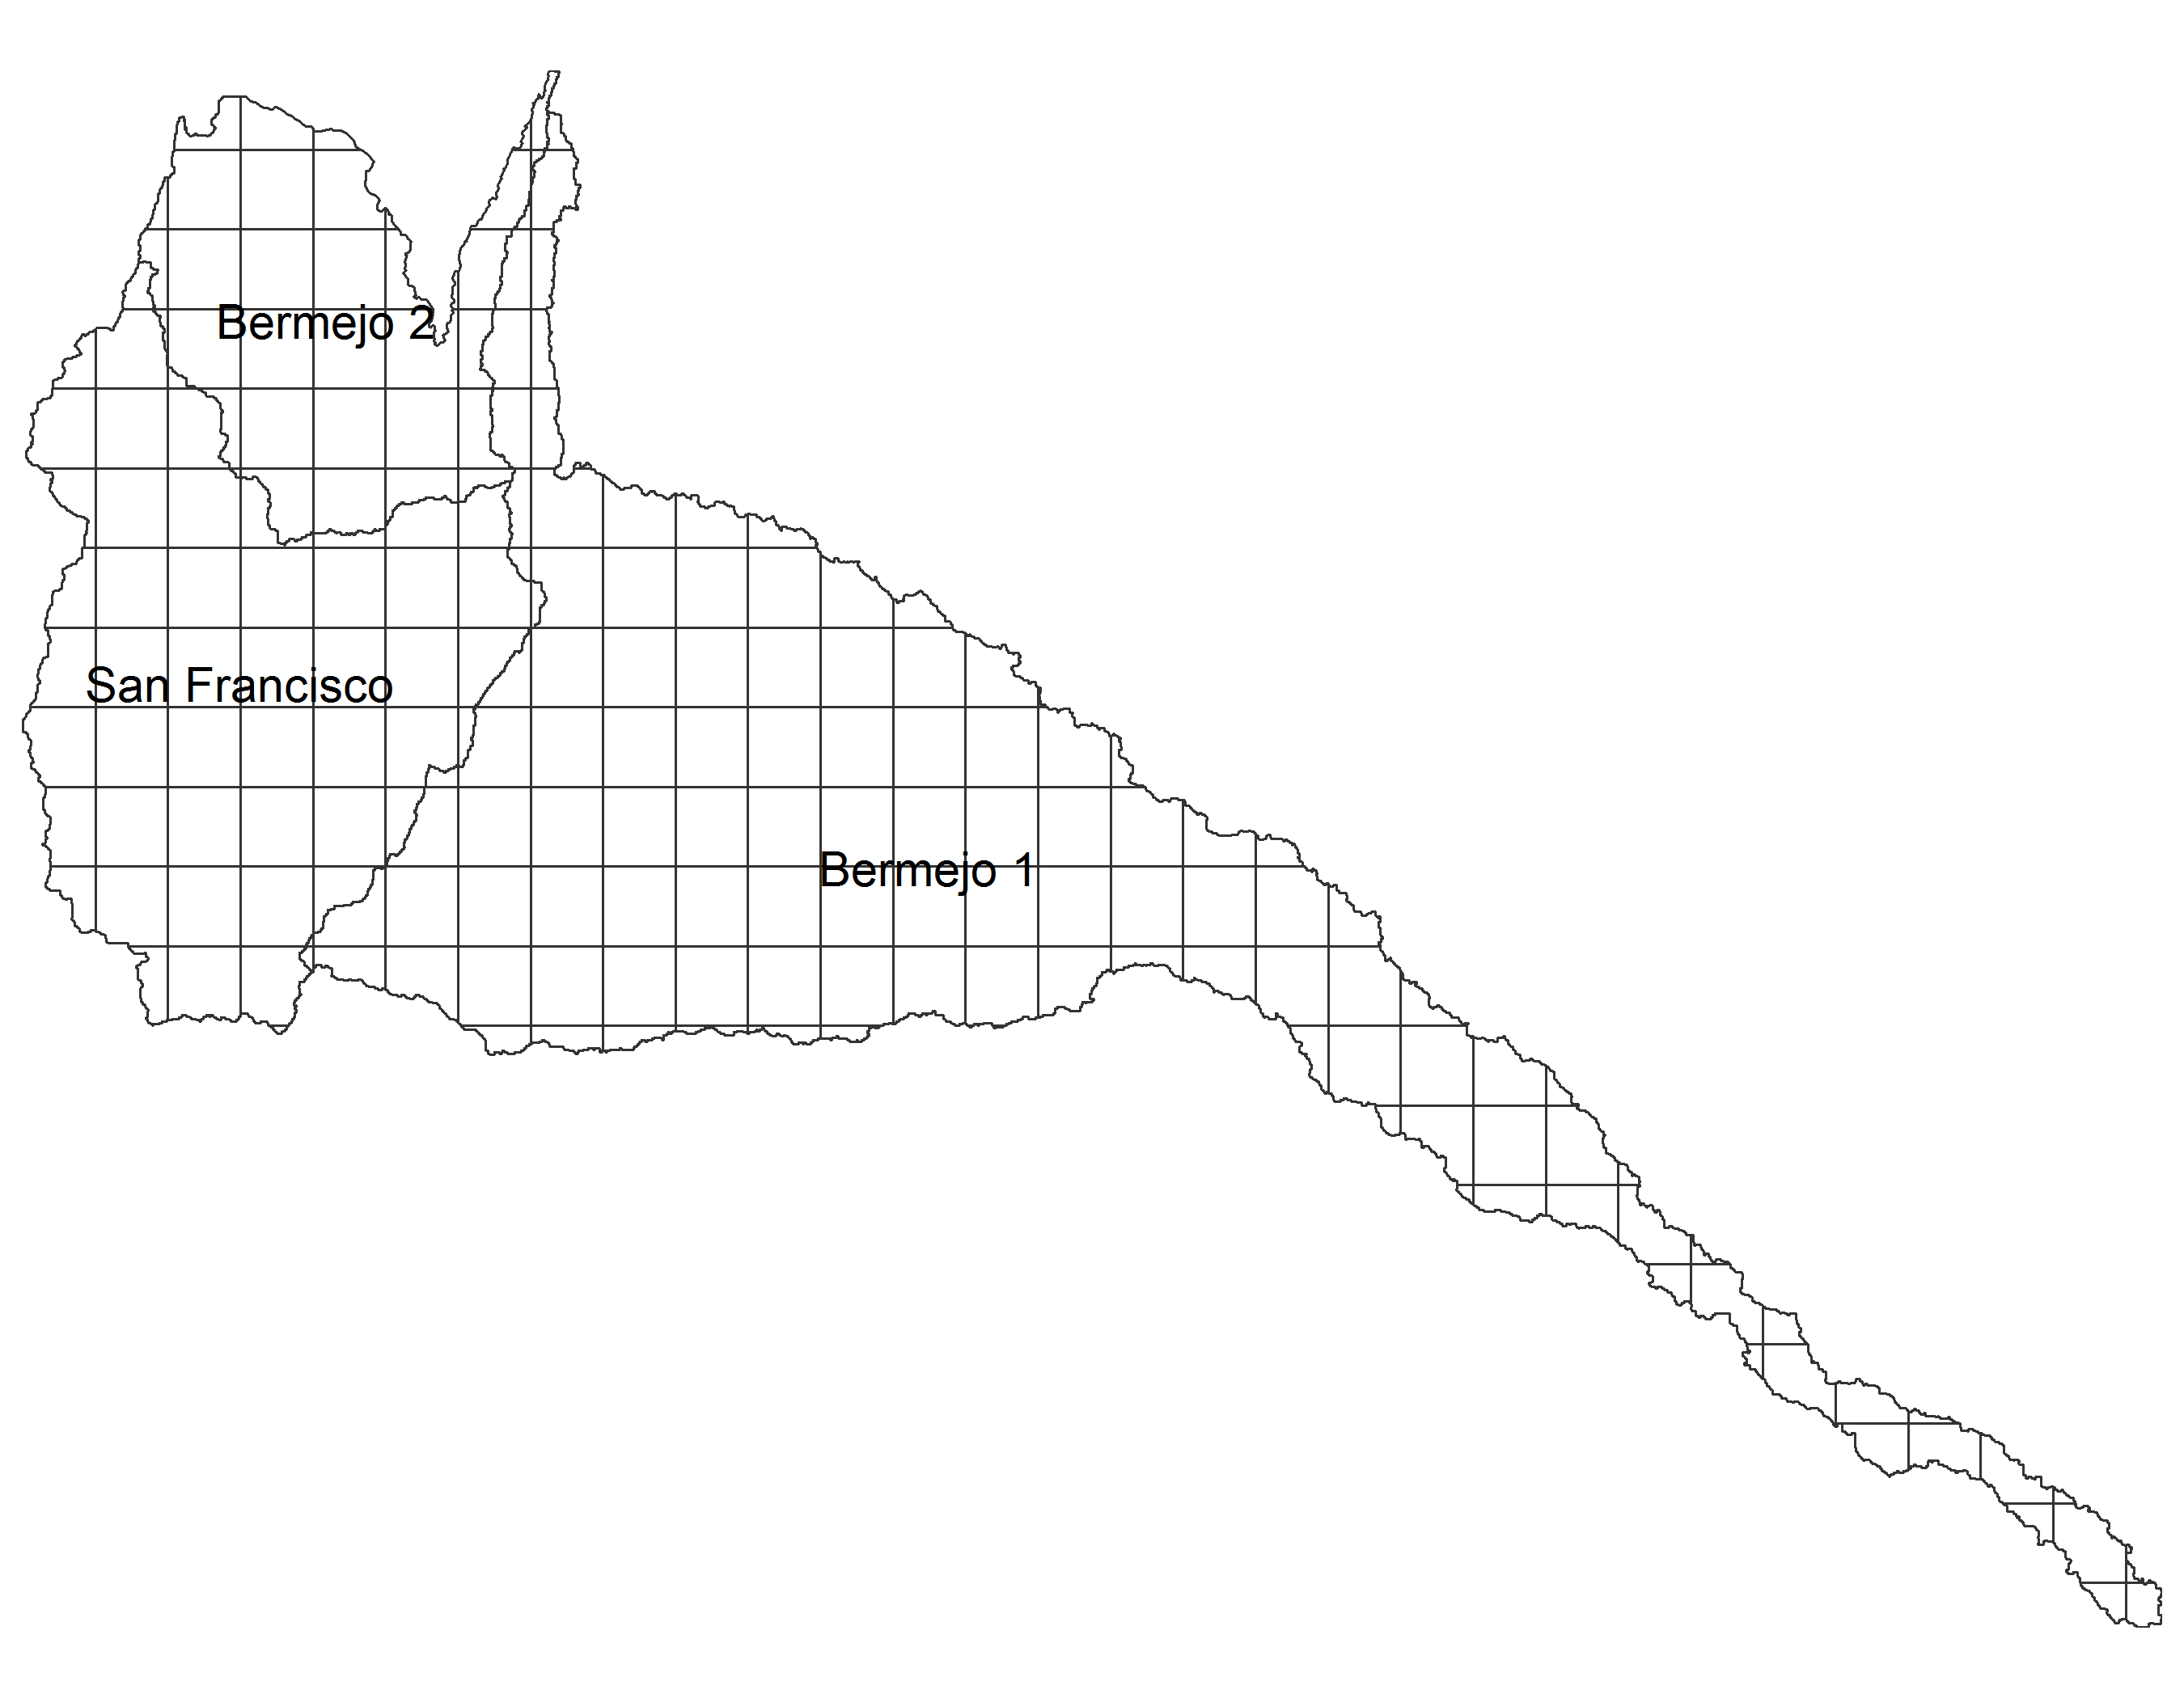
Regional highlight
Overlap Lines
Sub-regions Extended
Sub-regions Close-up
Sub-regions vs Grid Size

Slide 13
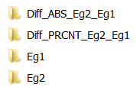


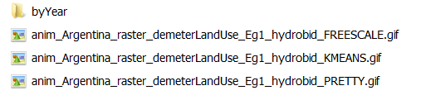
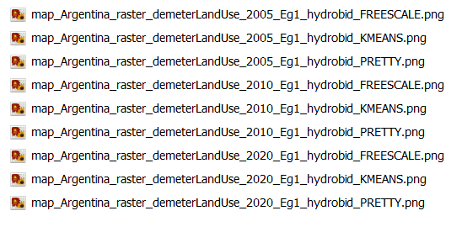

Slide 14
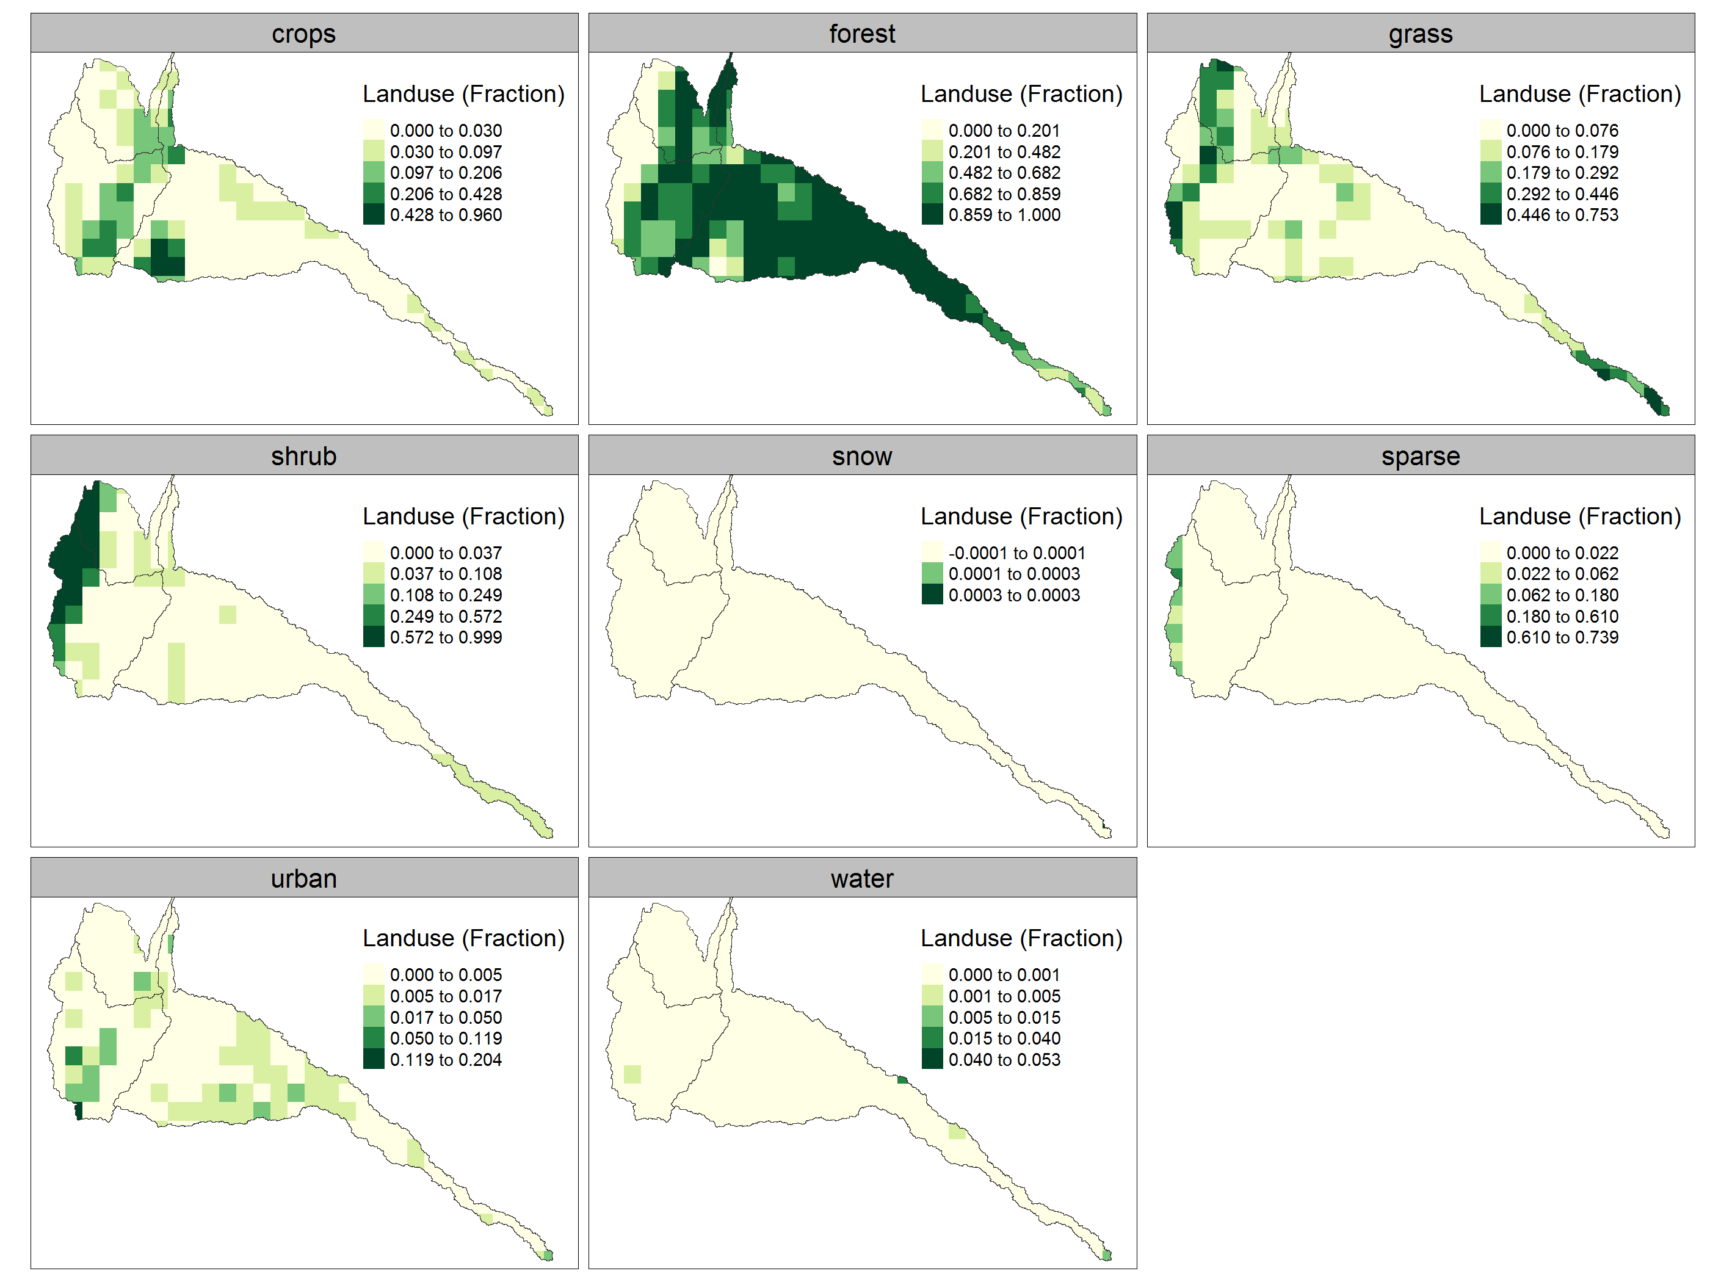
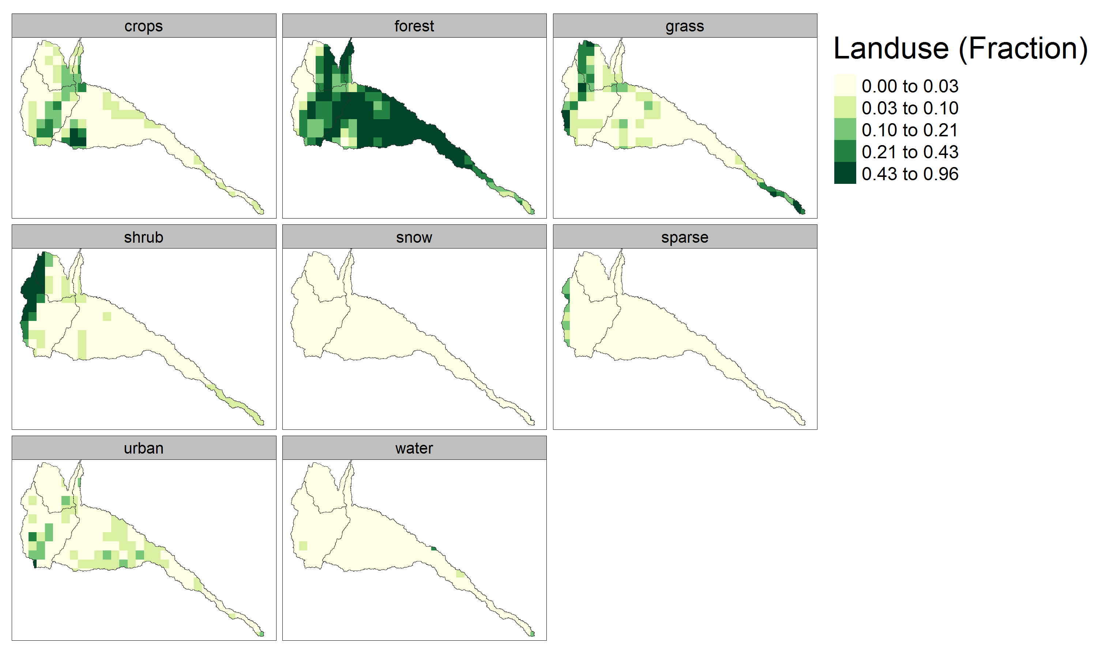
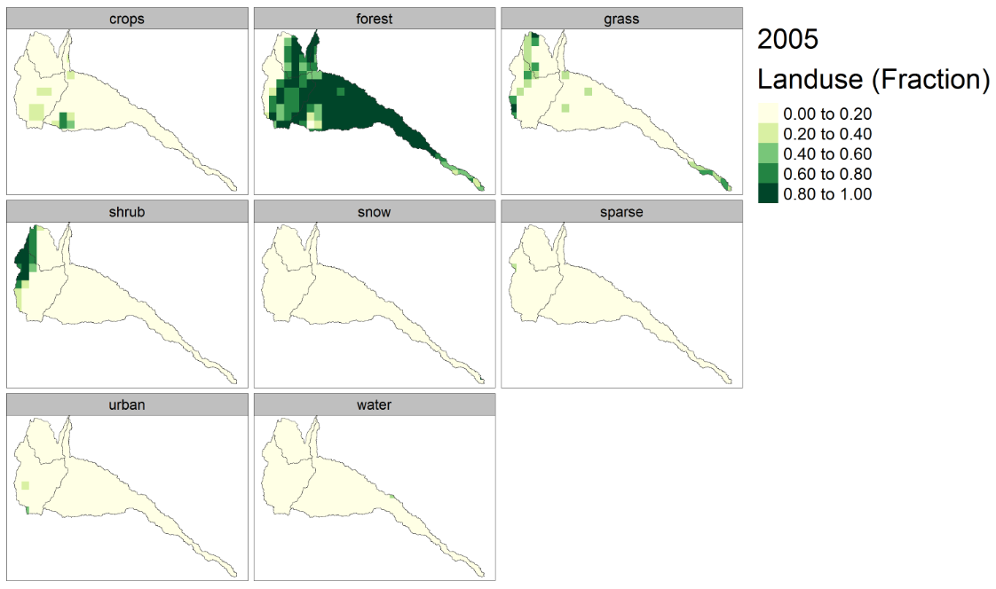
Free Scale
kmeans
Equal breaks

