Slide 1
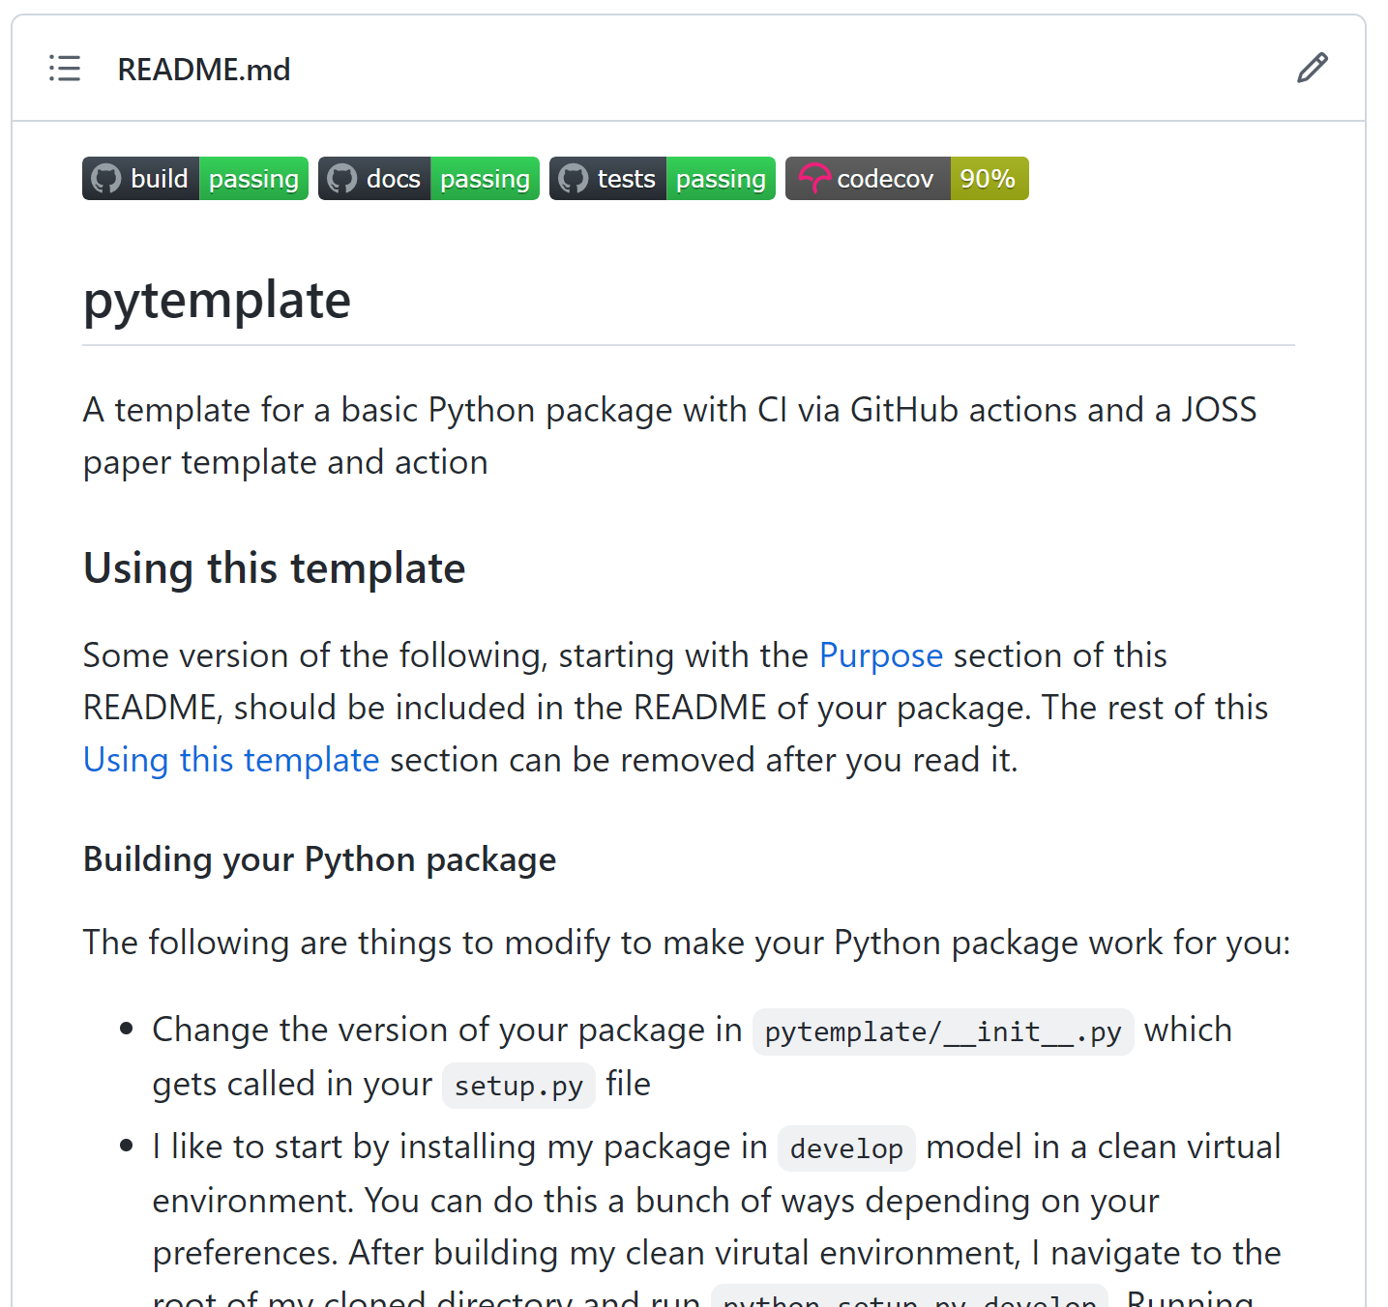
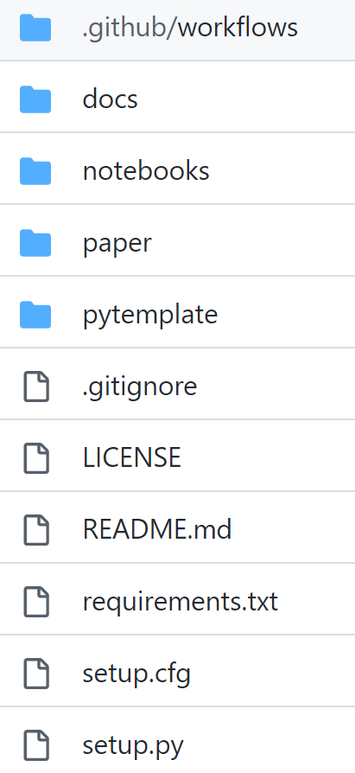
https://github.com/JGCRI/pytemplate

Slide 2
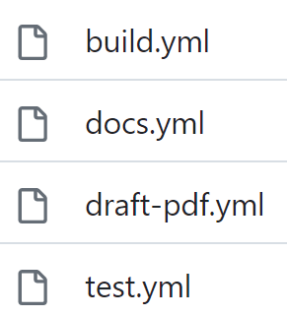
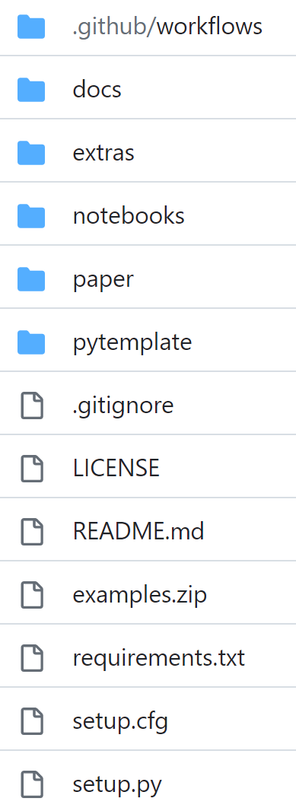
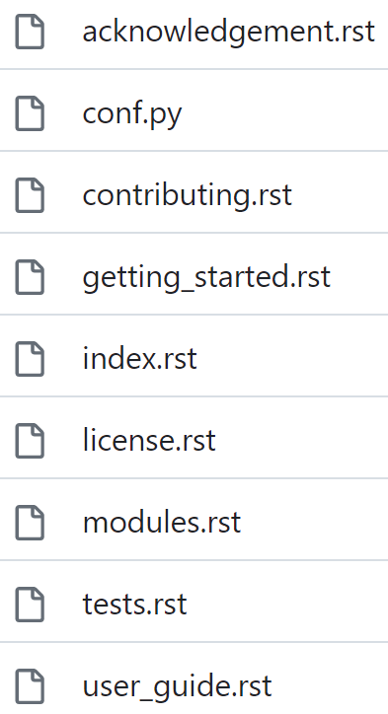
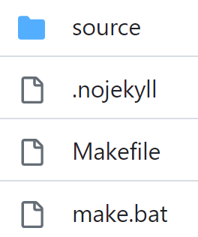
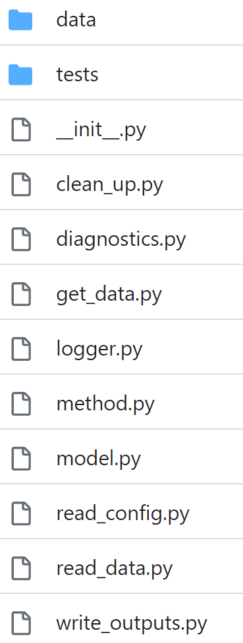
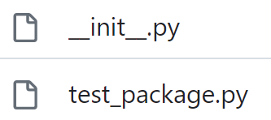

Pytemplate – Key Package Folders
Github Actions
Main Folder
Docs - Pages
Documentation
Model
Tests

Slide 3

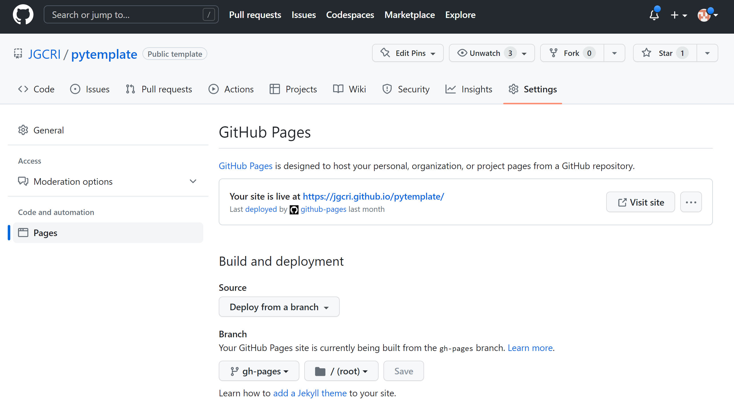
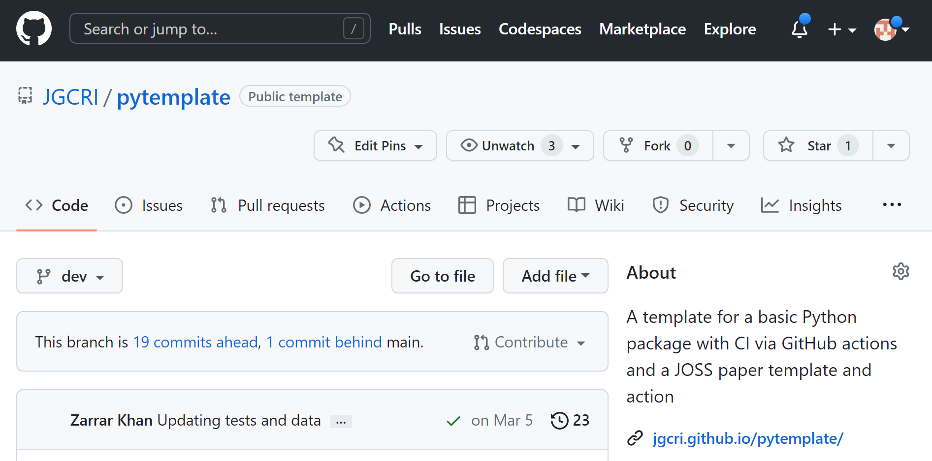
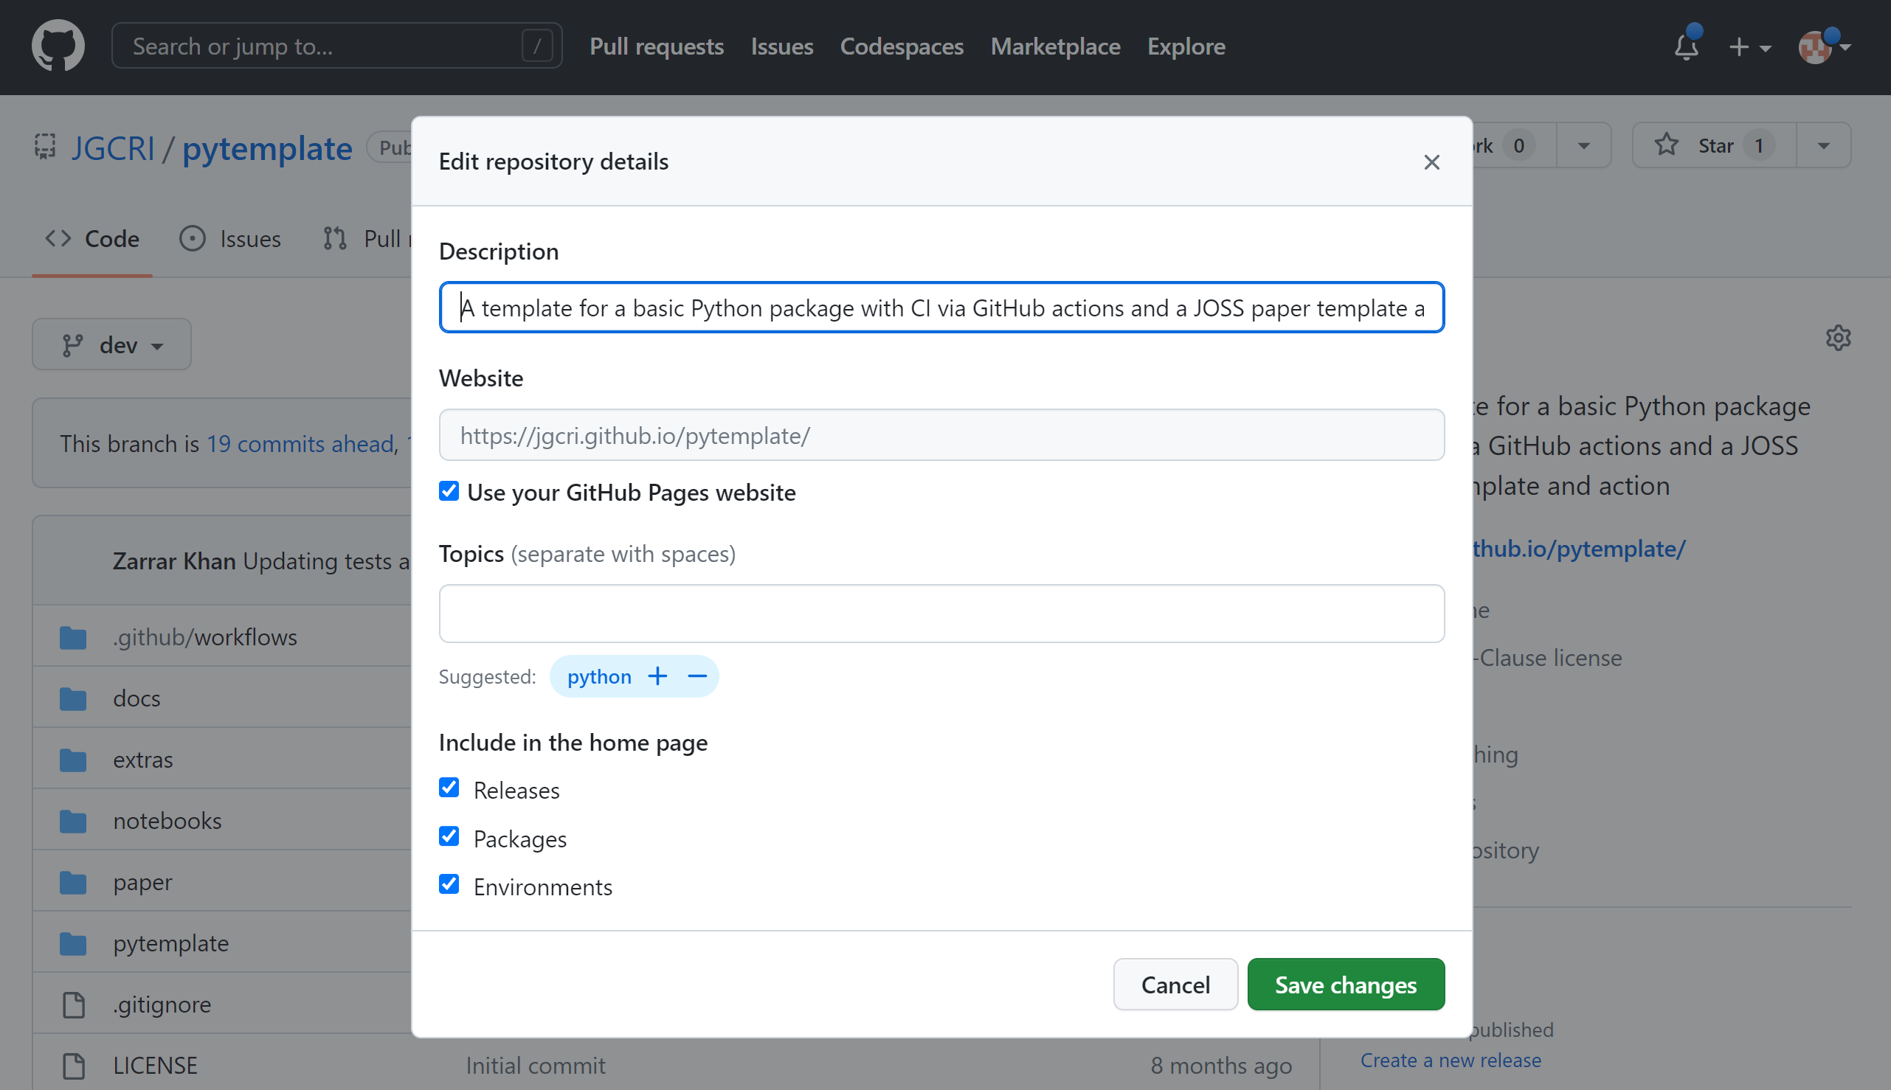
Pytemplate – Activate your documentation Webpage
1
On your page https://github.com/JGCRI/pytemplate/
2
On your page https://github.com/JGCRI/pytemplate/
a
Click Settings
a
Click icon
b
Click Pages
3
Deploy from
branch
a
Add model description
c
d
gh-pages
e
/(root)
a
Click Use your GitHub Pages website

