Slide 1
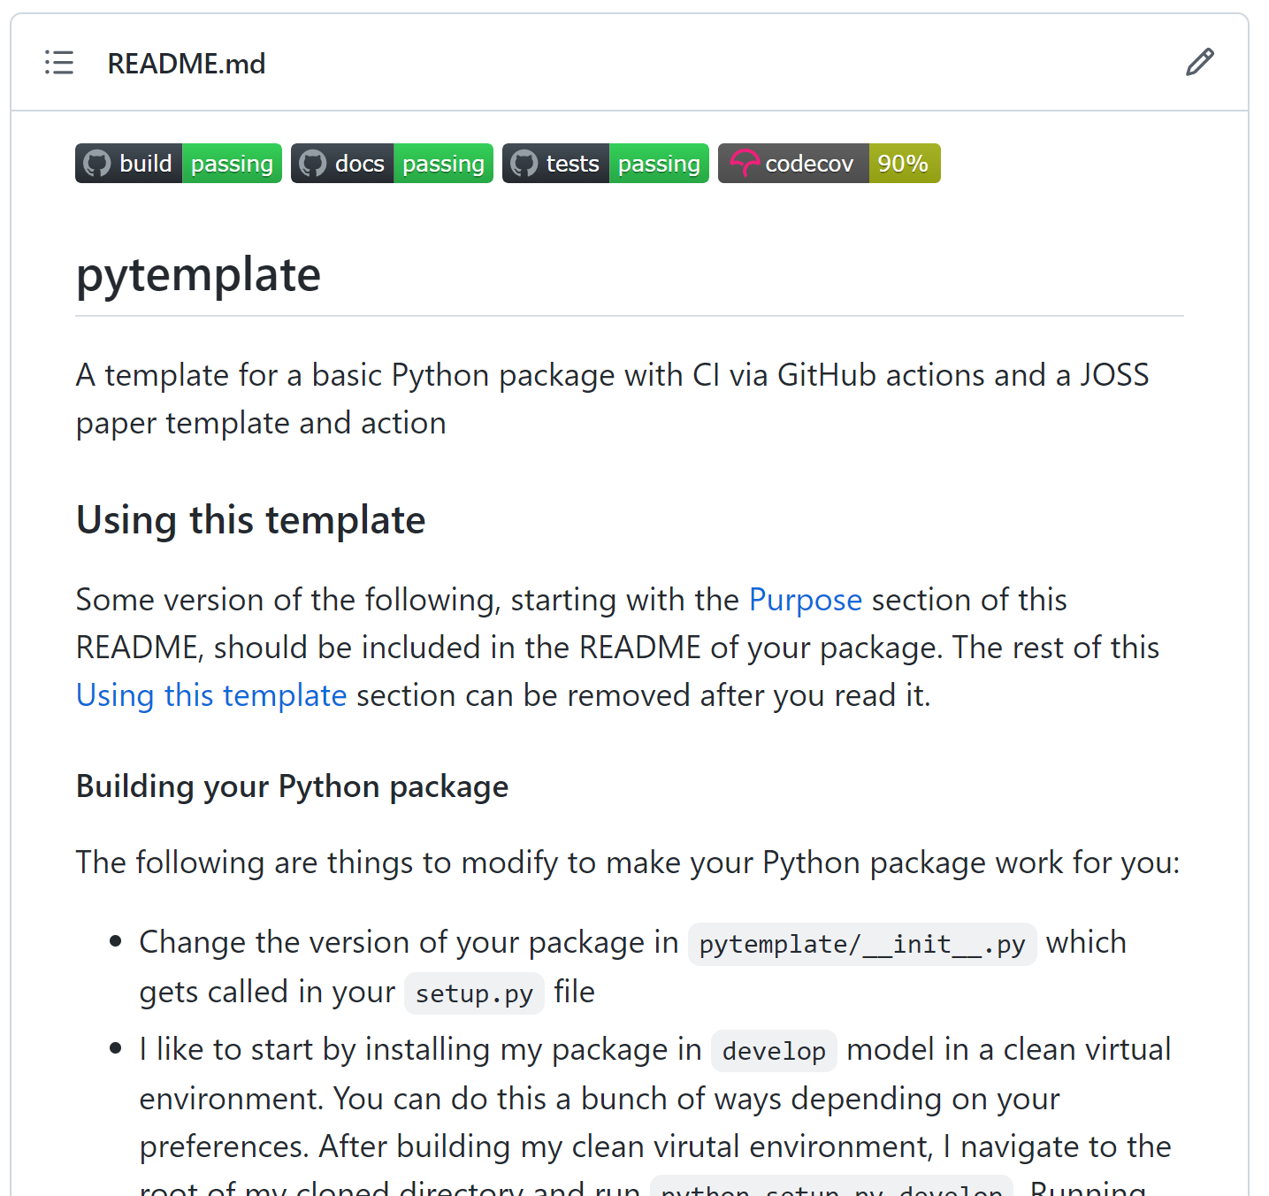
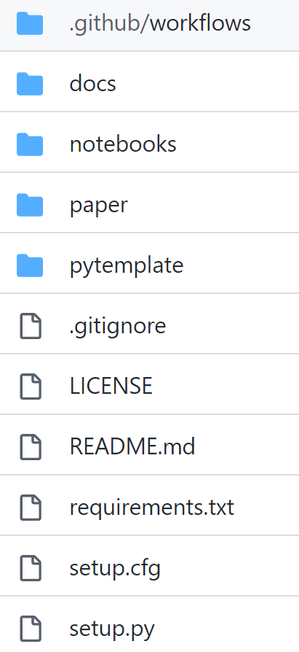
https://github.com/JGCRI/pytemplate

Slide 2


Pytemplate – Build your own python package!
1
Clone or
2
Update Package
Information
3
Update Package
Modules
4
Update
Tests
5
Update Package
Documentation
6
Activate
Github Actions

Slide 3


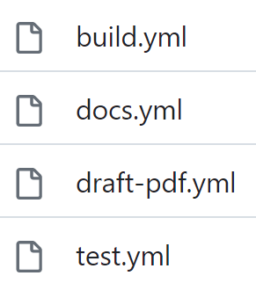
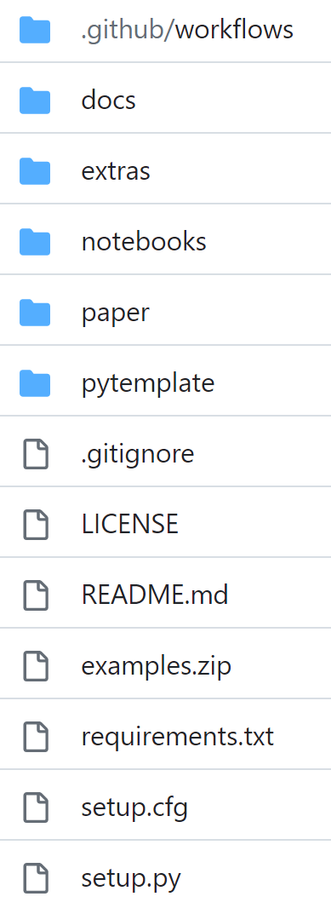
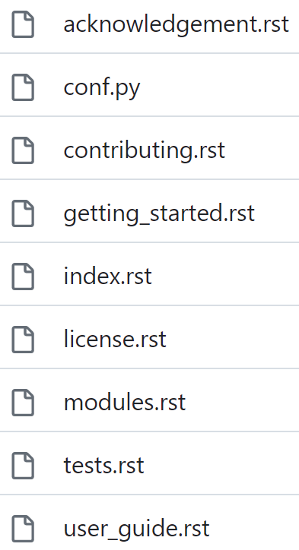
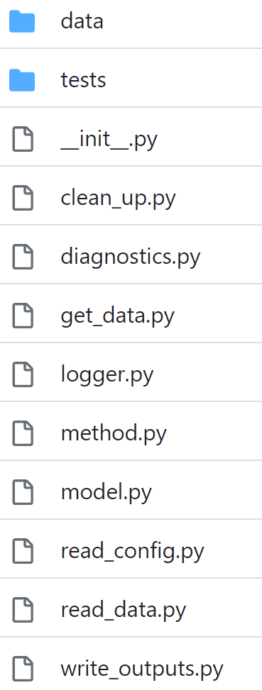
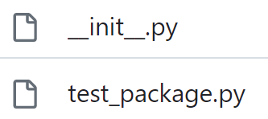
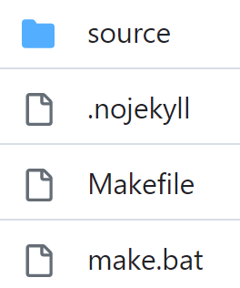
Pytemplate – Key Package Folders & Structure
Github Actions
Main Folder
Docs - Pages
Model
Tests
Documentation

Slide 4


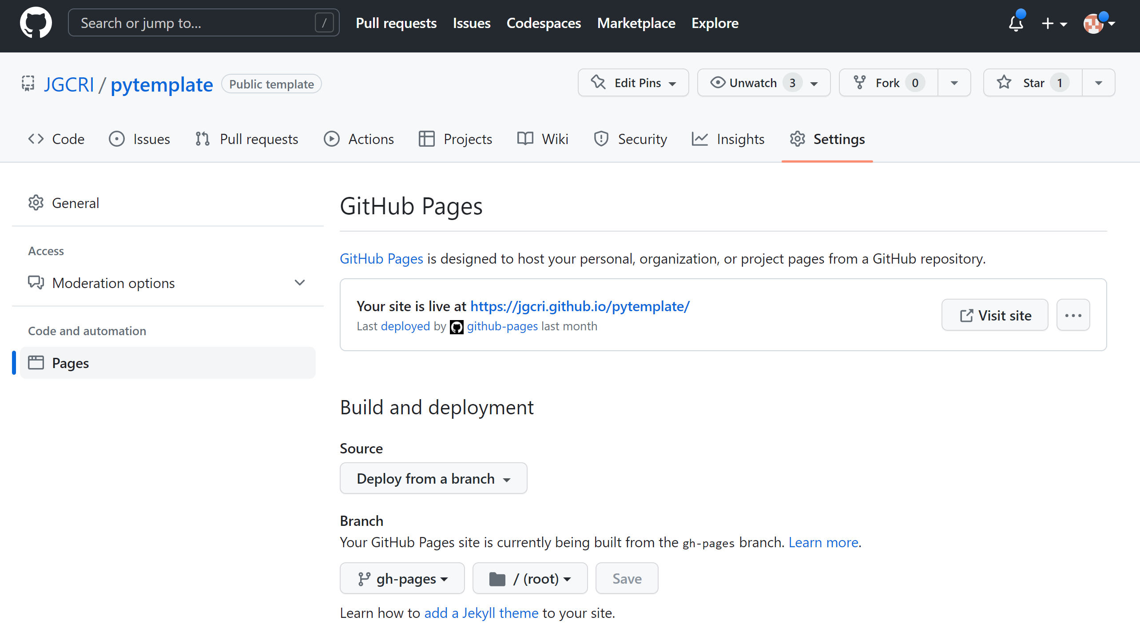
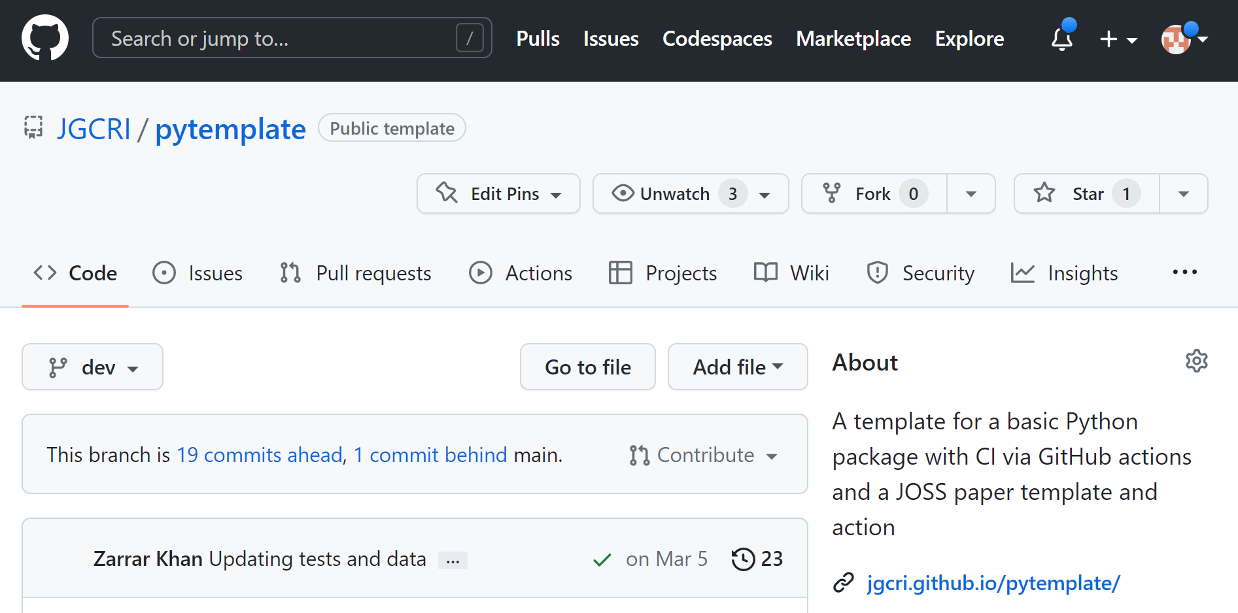
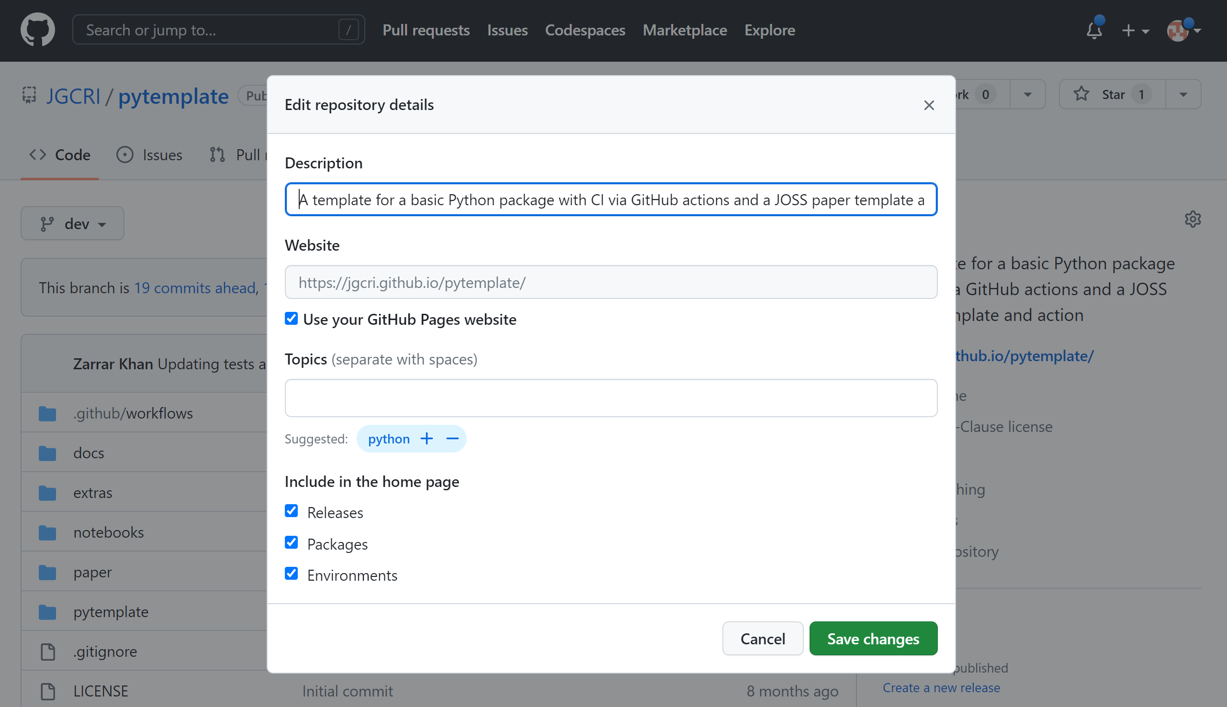
Pytemplate – Activate your documentation Webpage
1
On your page https://github.com/JGCRI/pytemplate/
a
Click Settings
2
On your page https://github.com/JGCRI/pytemplate/
a
Click icon
b
Click Pages
Deploy from
branch
3
c
d
gh-pages
a
Add model description
e
/(root)
b
Click Use your GitHub Pages website

Slide 5

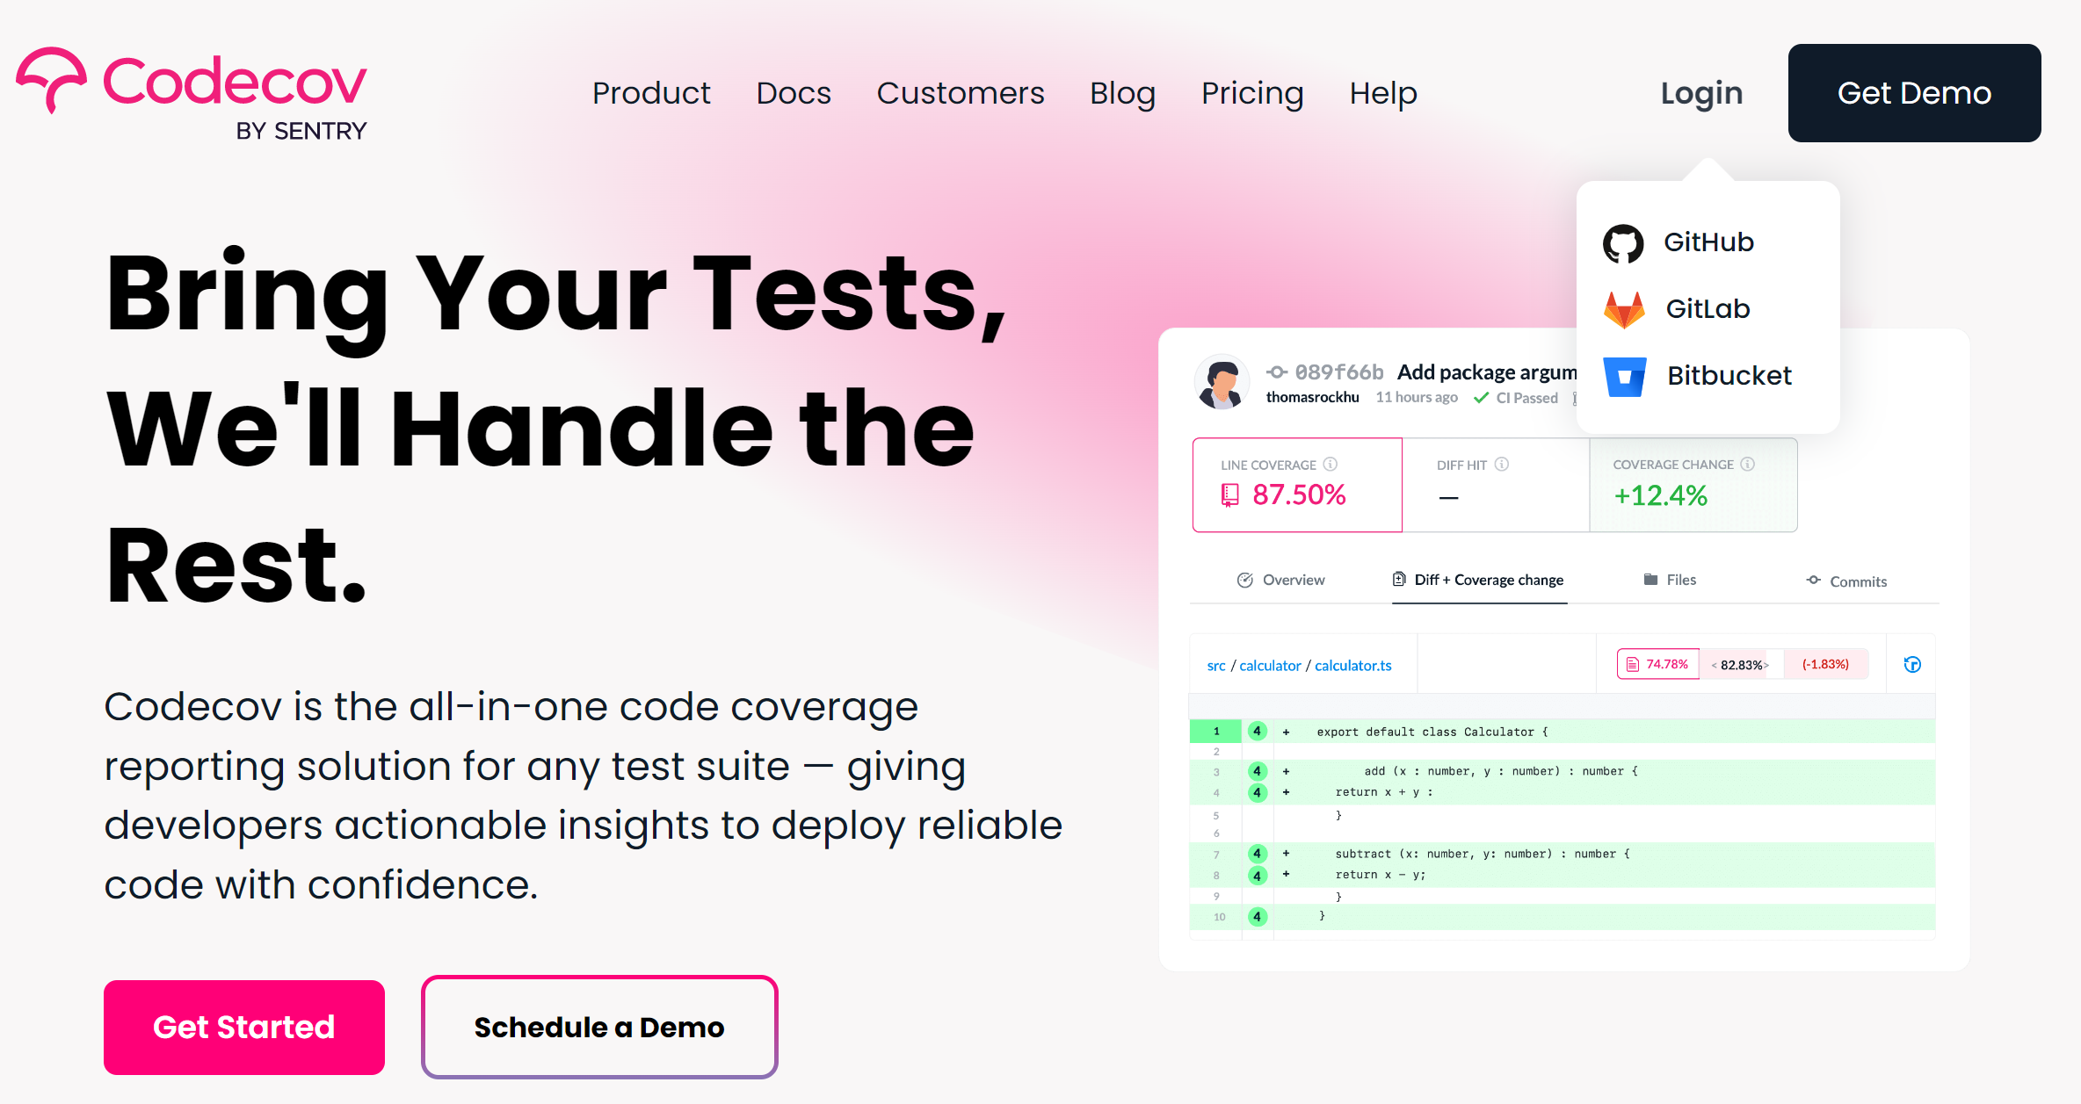
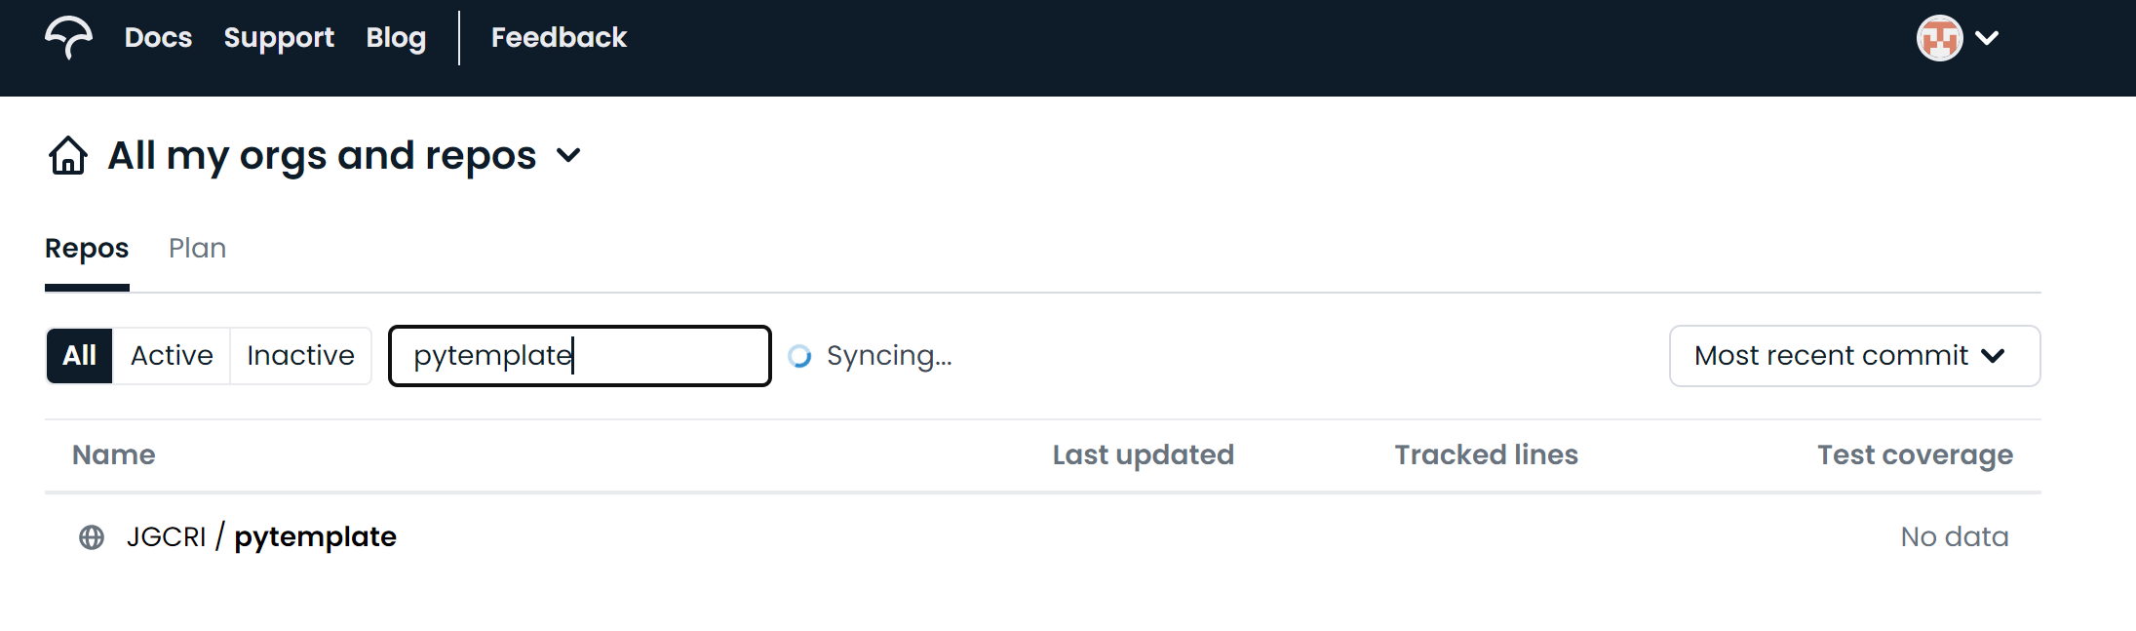
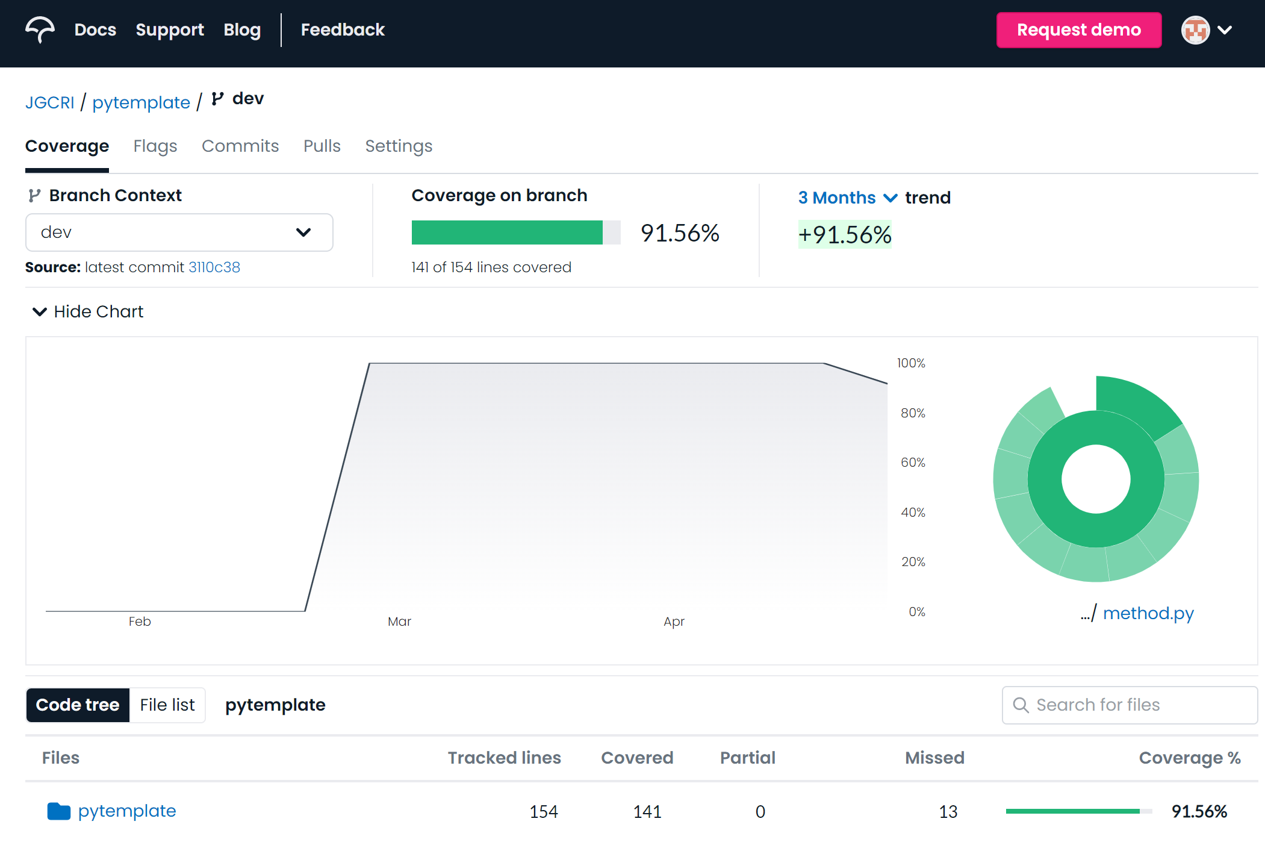
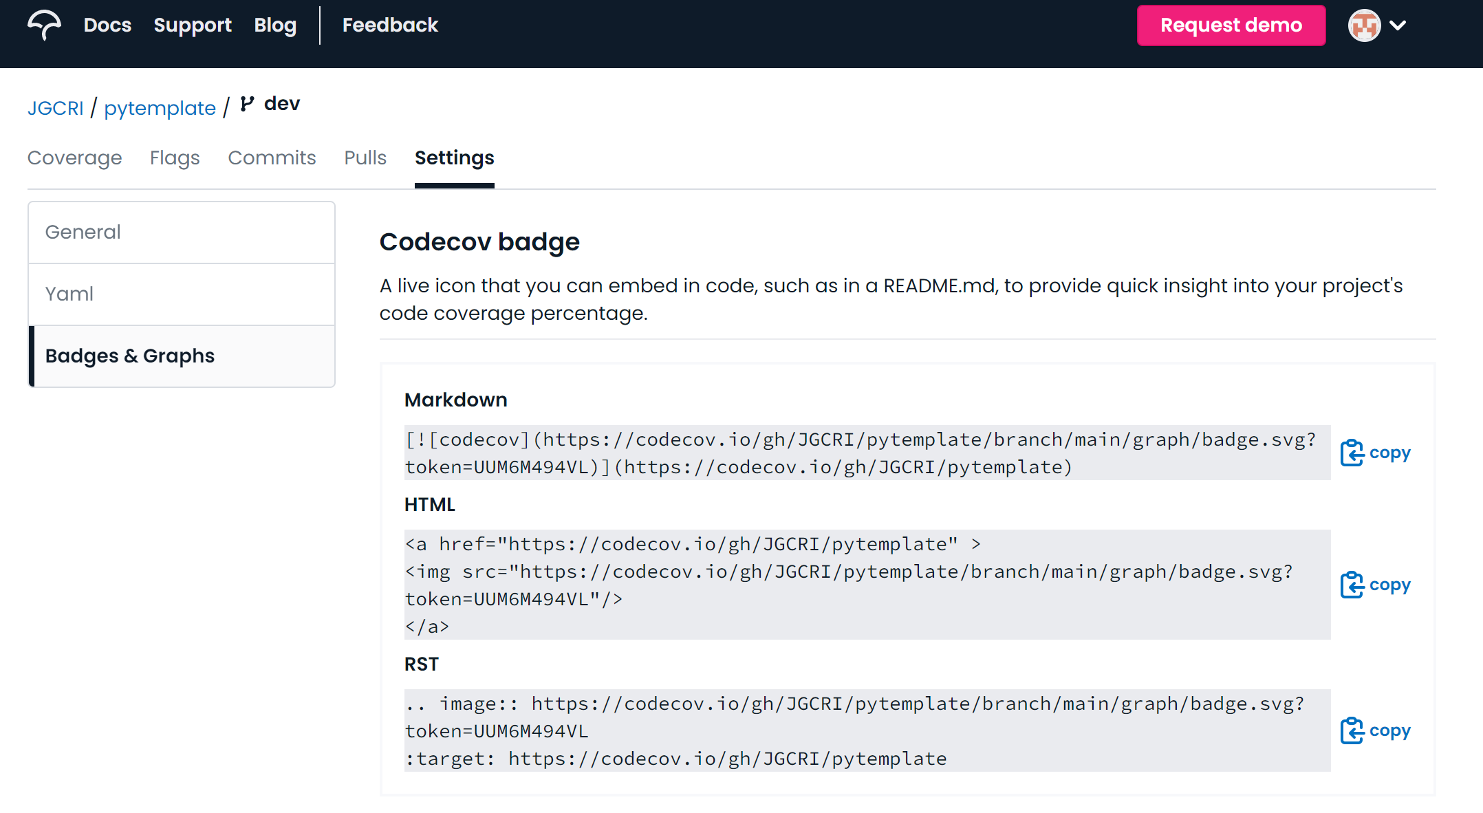
Pytemplate – Connect Codecov to your repo
1
Go to codecov.io and login with your GitHub account
2
Search for your repository and then click on it
4
3
a
Select settings
Explore your
Test coverage
Go to Badges & Graphs
b
Copy the Markdown badge and paste in your README.md
c

