Slide 1
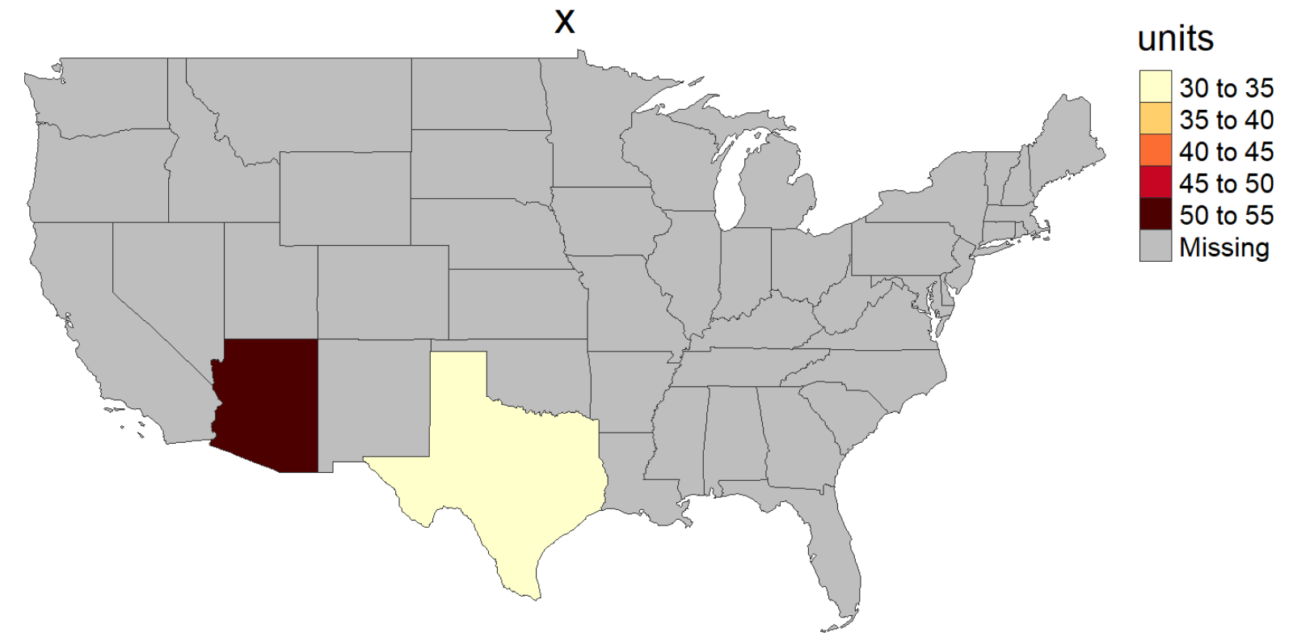
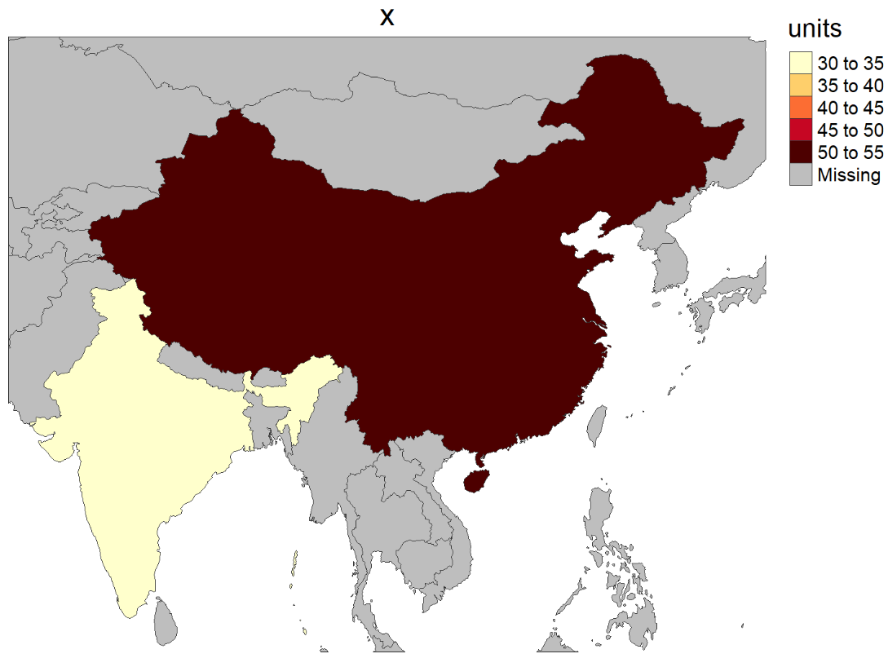
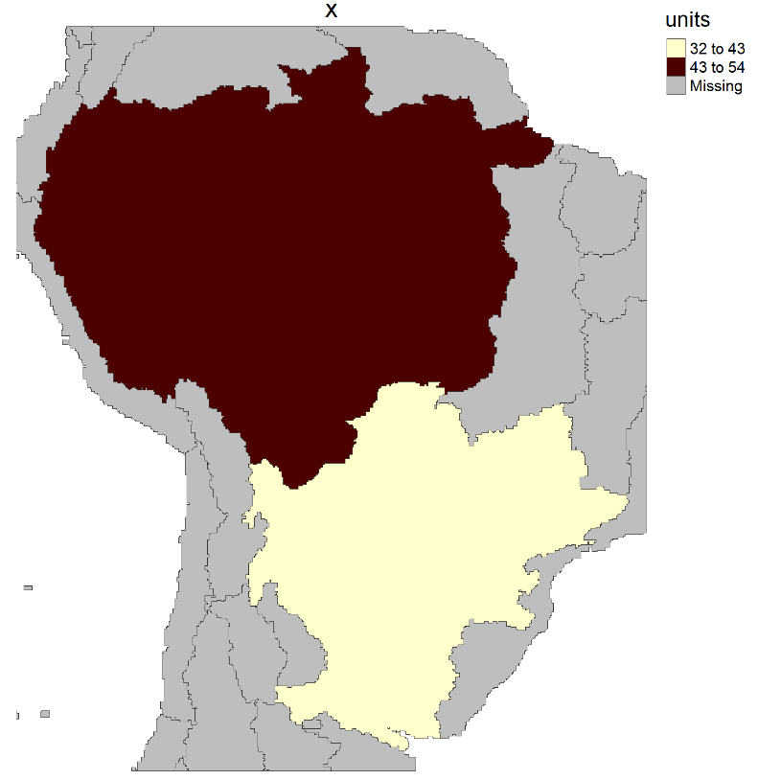
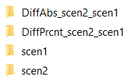
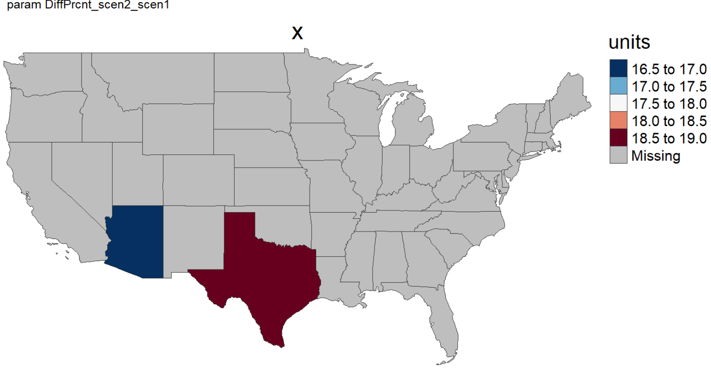
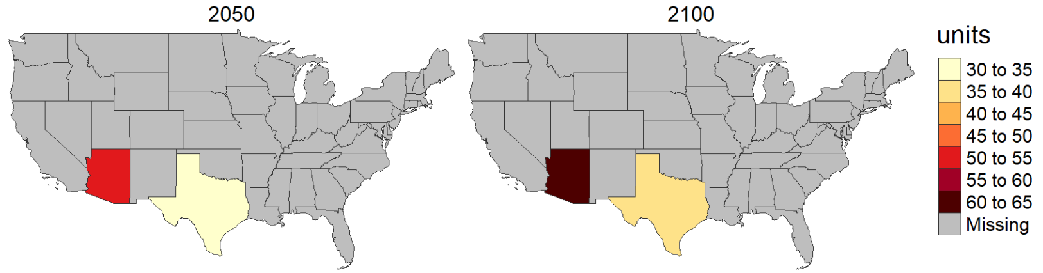
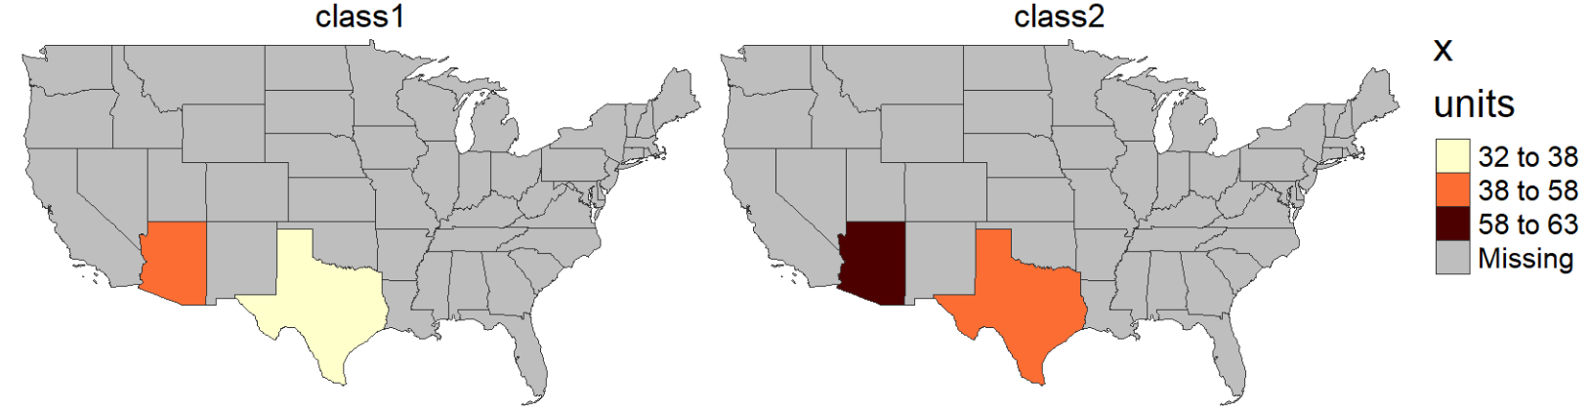
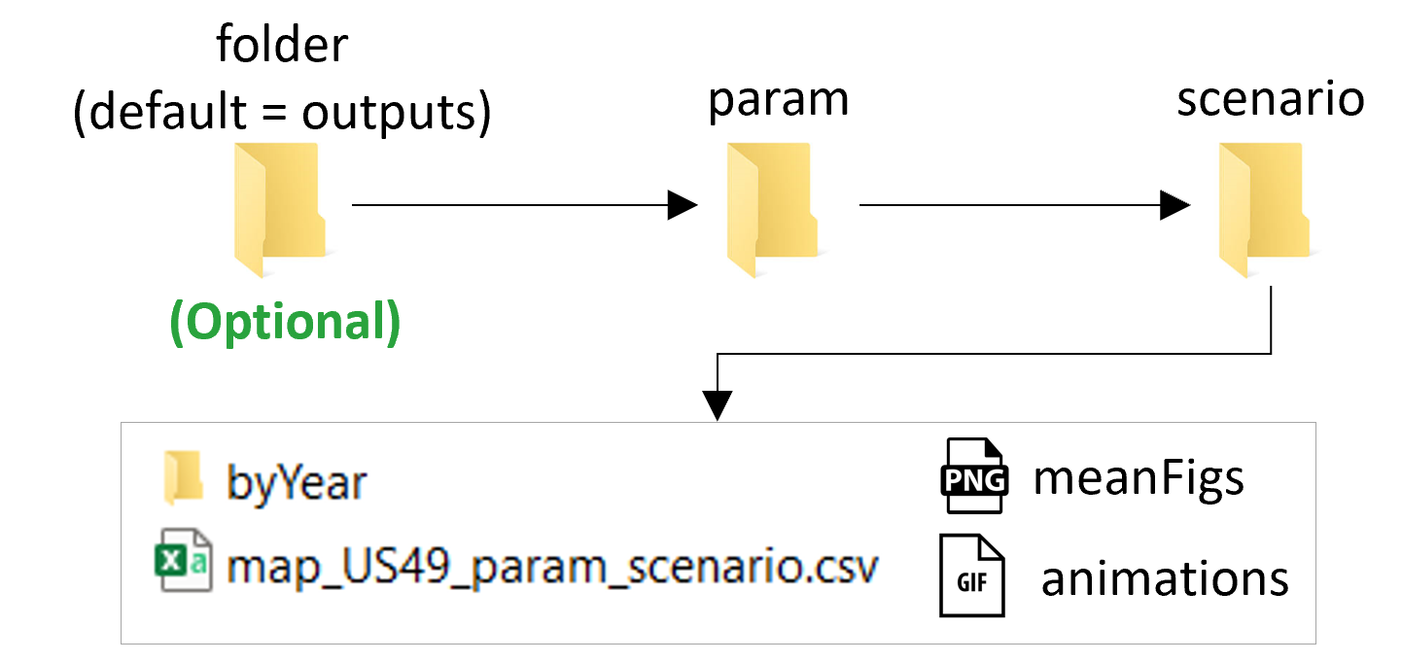
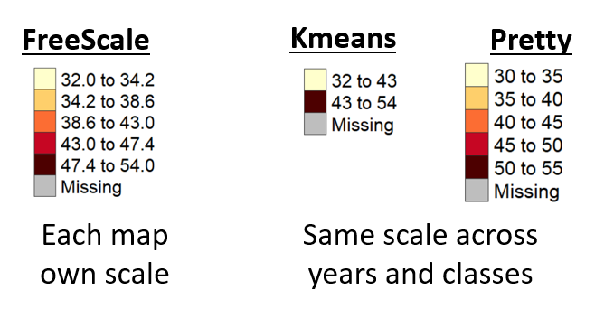
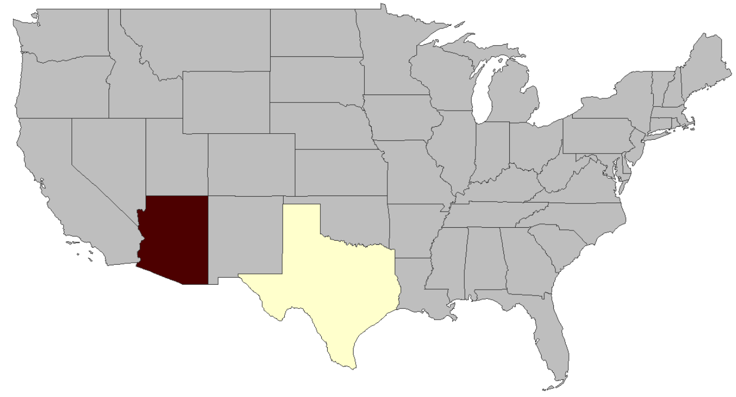
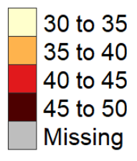
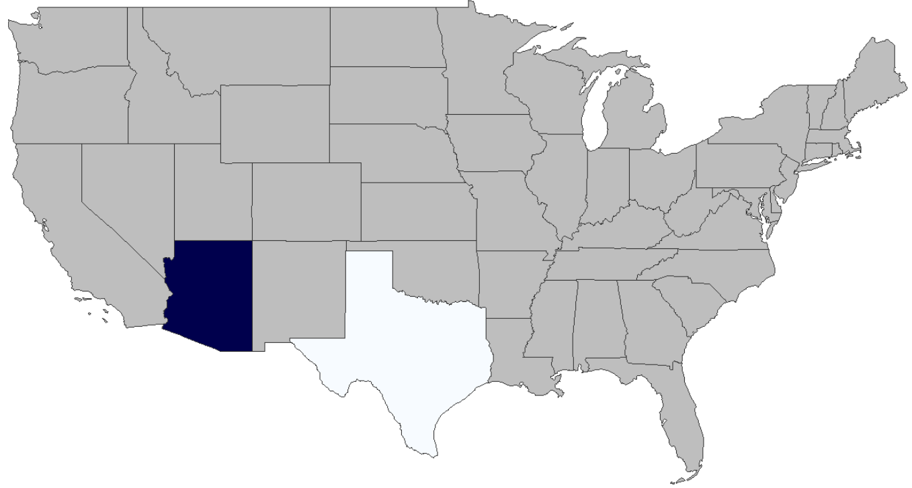
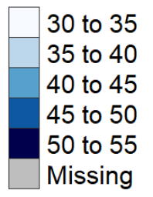
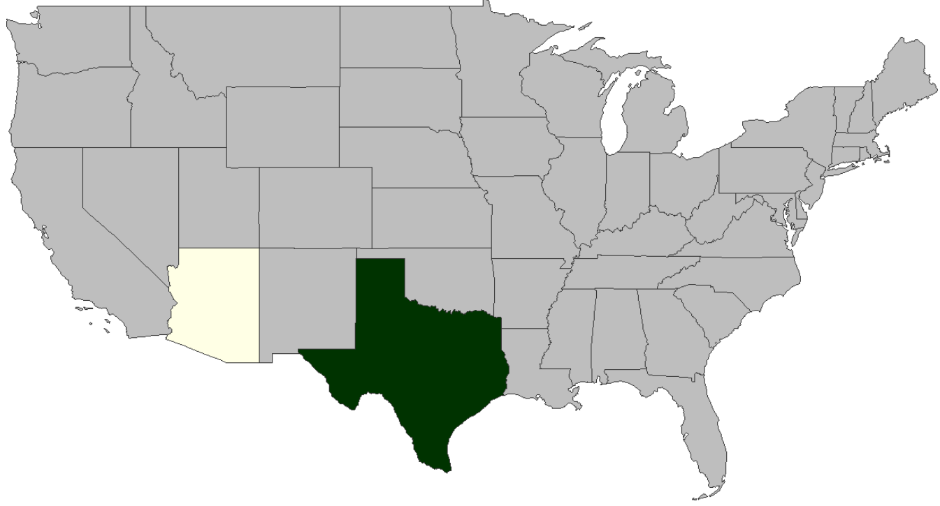
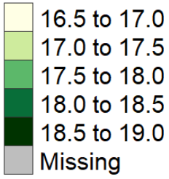
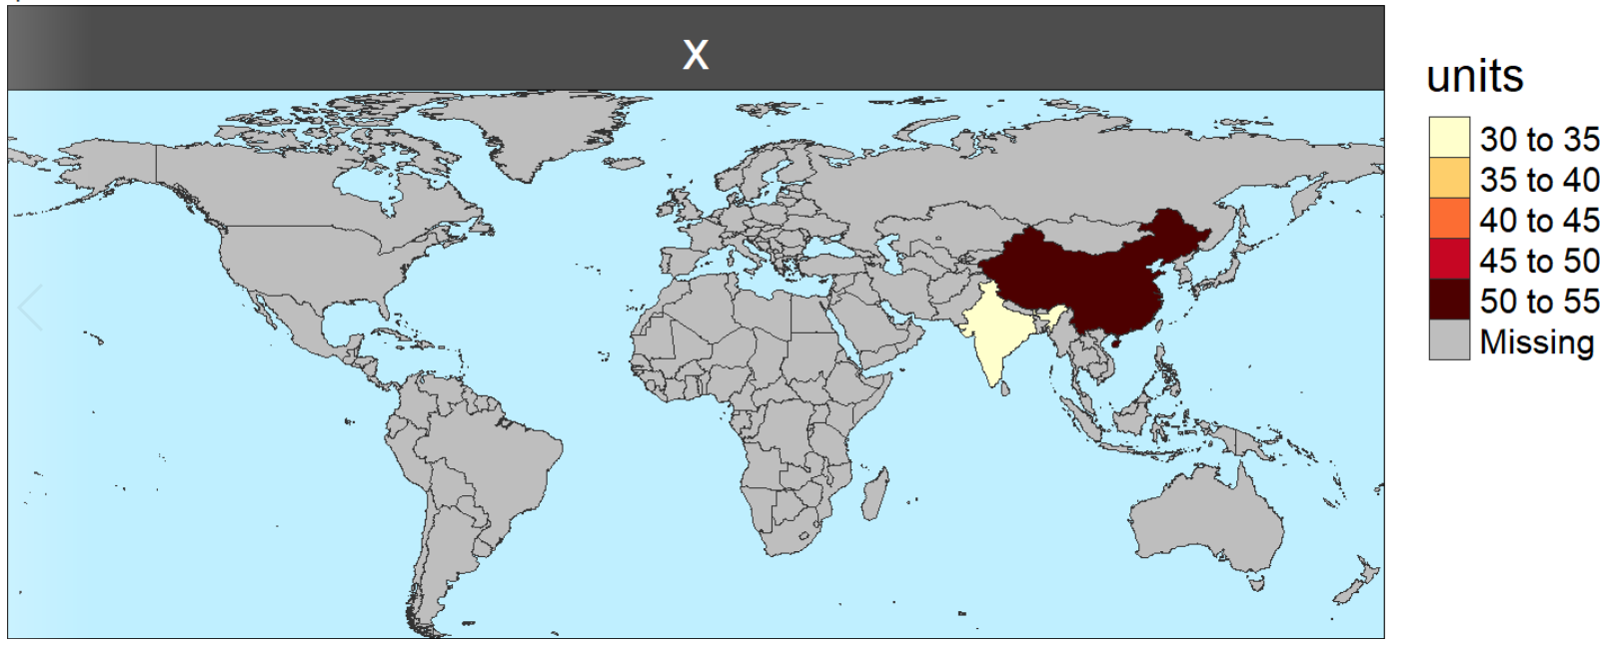
rmap Cheat Sheet
Pre-loaded Maps (Automatically find maps for data if available)
https://github.com/JGCRI/rmap
US49
Countries and cropToBoundary
GCAM Basins
data = data.frame(subRegion = c("TX", "AZ"), value = c(32, 54), year=c(2010,2010))
map(data)
data = data.frame(subRegion = c("India","China"), value = c(32,54))
map(data, cropToBoundary=T)
data = data.frame( subRegion = c("La_Plata","Amazon"),
value = c(32,54))
map(data , cropToBoundary=T)
Structure
KEY INPUTS
myFile.csv file OR R Data Frame
subRegion | value
TX | 32
AZ | 54
data = data.frame(
subRegion = c("TX","AZ"),
value = c(32,54))
Multiple Scenarios, Years and Classes
Optional Columns: param, scenario, year, class, units
Multi-scenario Diff plots
Multi-Year Animantion/Mean
Multi-Class
CODE
# To Install for the first time
# install.packages(devtools); library(devtools);
# devtools::install_github(“JGCRI/rmap");
library(rmap);
map (data) # OR
map("path/To/myFile.csv")
data = data.frame(subRegion = c("TX","TX", "AZ", "AZ"),
scenario = c("scen1","scen2","scen1","scen2"),
value = c(32, 38, 54, 63))
map(data, scenRef="scen1")
data = data.frame(subRegion = c("TX","TX", "AZ", "AZ"),
year = c("2050","2100","2050","2100"), value = c(32, 38, 54, 63))
map(data, folderName="multiyear")
data = data.frame(subRegion = c("TX","TX", "AZ", "AZ"),
class = c("class1","class2","class1","class2"),
value = c(32, 38, 54, 63))
map(data)
KEY OUTPUTS
Maps saved in the working directory as follows:
Customize Scales, Colors, Background
Set scale ranges
Change Palettes
Extended Boundary
data = data.frame(subRegion = c("TX","TX", "AZ", "AZ"),
scenario = c("scen1","scen2","scen1","scen2"),
value = c(32, 38, 54, 63))
map(data,
scaleRange = c(30,50), scaleRangeDiffPrcnt = c(10,30))
data = data.frame(subRegion = c("TX","TX", "AZ", "AZ"),
scenario = c("scen1","scen2","scen1","scen2"),
value = c(32, 38, 54, 63))
map(data, scenRef= "scen1",
classPalette = "pal_wet", classPaletteDiff = "pal_green")
data = data.frame(
subRegion = c("India","China"), value = c(32,54))
map(data,
background = T)

Slide 2
rmap Cheat Sheet
Details
https://github.com/JGCRI/rmap
Inputs
Coming soon …

