Slide 1


Figures for Vignettes

Slide 2
Figures for colorsMapsParams

Slide 3
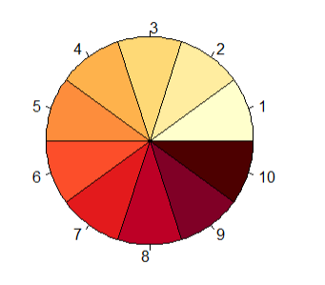
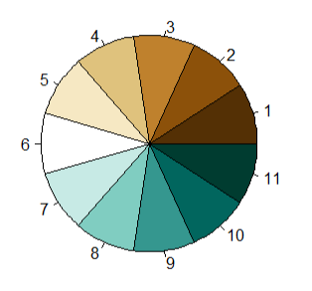
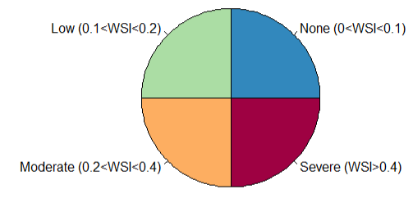
Color palette
pal_hot
pal_div_BrGn
pal_ScarcityCat

Slide 4
Param List
electricity
elecByTechTWh
elecCapByFuel
elecFinalBySecTWh
elecFinalByFuelTWh
elecNewCapCost
elecNewCapGW
elecAnnualRetPrematureCost
elecAnnualRetPrematureGW
elecCumCapCost
elecCumCapGW
elecCumRetPrematureCost
elecCumRetPrematureGW
transport
transportPassengerVMTByMode
transportFreightVMTByMode
transportPassengerVMTByFuel
transportFreightVMTByFuel
socioecon
gdpPerCapita
gdp
gdpGrowthRate
pop
ag
agProdbyIrrRfd
agProdBiomass
agProdForest
agProdByCrop
livestock
livestock_MeatDairybyTechMixed
livestock_MeatDairybyTechPastoral
livestock_MeatDairybyTechImports
livestock_MeatDairybySubsector
land
landIrrRfd
landIrrCrop
landRfdCrop
landAlloc
landAllocByCrop
emissions
emissNonCO2BySectorGWPAR5
emissNonCO2BySectorGTPAR5
emissNonCO2BySectorOrigUnits
emissLUC
emissCO2BySectorNoBio
emissNonCO2ByResProdGWPAR5
emissMethaneBySourceGWPAR5
emissByGasGWPAR5FFI
emissByGasGWPAR5LUC
emissBySectorGWPAR5FFI
emissBySectorGWPAR5LUC
emissNonCO2ByResProdGTPAR5
emissMethaneBySourceGTPAR5
emissByGasGTPAR5FFI
emissByGasGTPAR5LUC
emissBySectorGTPAR5FFI
emissBySectorGTPAR5LUC
water
watConsumBySec
watWithdrawBySec
watWithdrawByCrop
watBioPhysCons
watIrrWithdrawBasin
watIrrConsBasin
watSupRunoffBasin

Slide 5
Figures for readGCAM

Slide 6


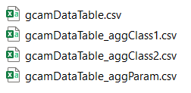
dirOutput
readGCAM

Slide 7
Figures for mapsProcess

Slide 8



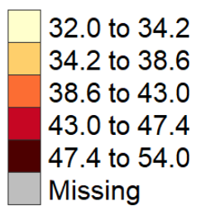
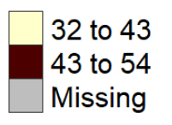
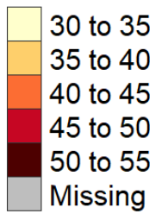
folder
(default = outputs)
param
scenario
(Optional)
meanFigs
animations
FreeScale
Kmeans
Pretty
Each map own scale
Same scale across years and classes

Slide 9
fileName.csv
OR
R Data
subRegion | value
CA | 5
FL | 10
ID | 15
MO | 34
TX | 2
WY | 7
data = data.frame(
subRegion = c(“CA",“FL“,”ID”,”MO”,”TX”,”WY”),
value = c(5,10,15,34,2,7))
Minimum
subRegion | value | param | scenario | class | year | units
CA | 5
FL | 10
ID | 15
MO | 34
TX | 2
WY | 7
Optional Columns

Slide 10
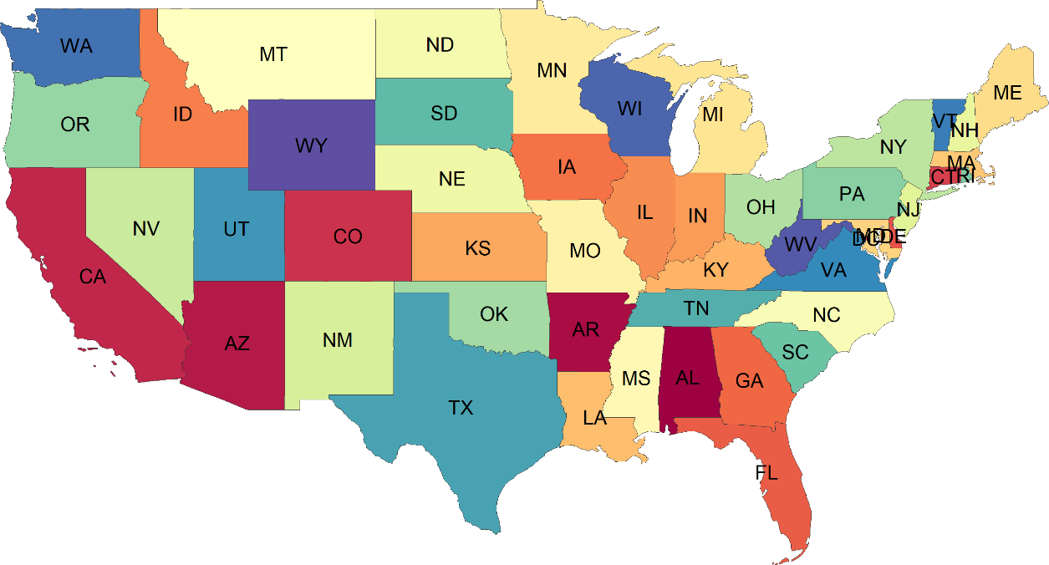
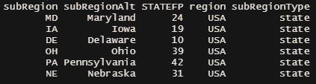
rmap::map(mapUS49, labels=T)
head(mapUS49@data)

Slide 11
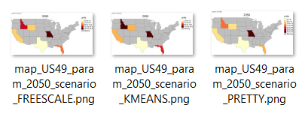
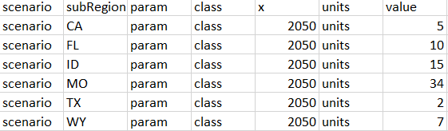
outputs
vignetteMaps
param
scenario
Working Dir:

Slide 12
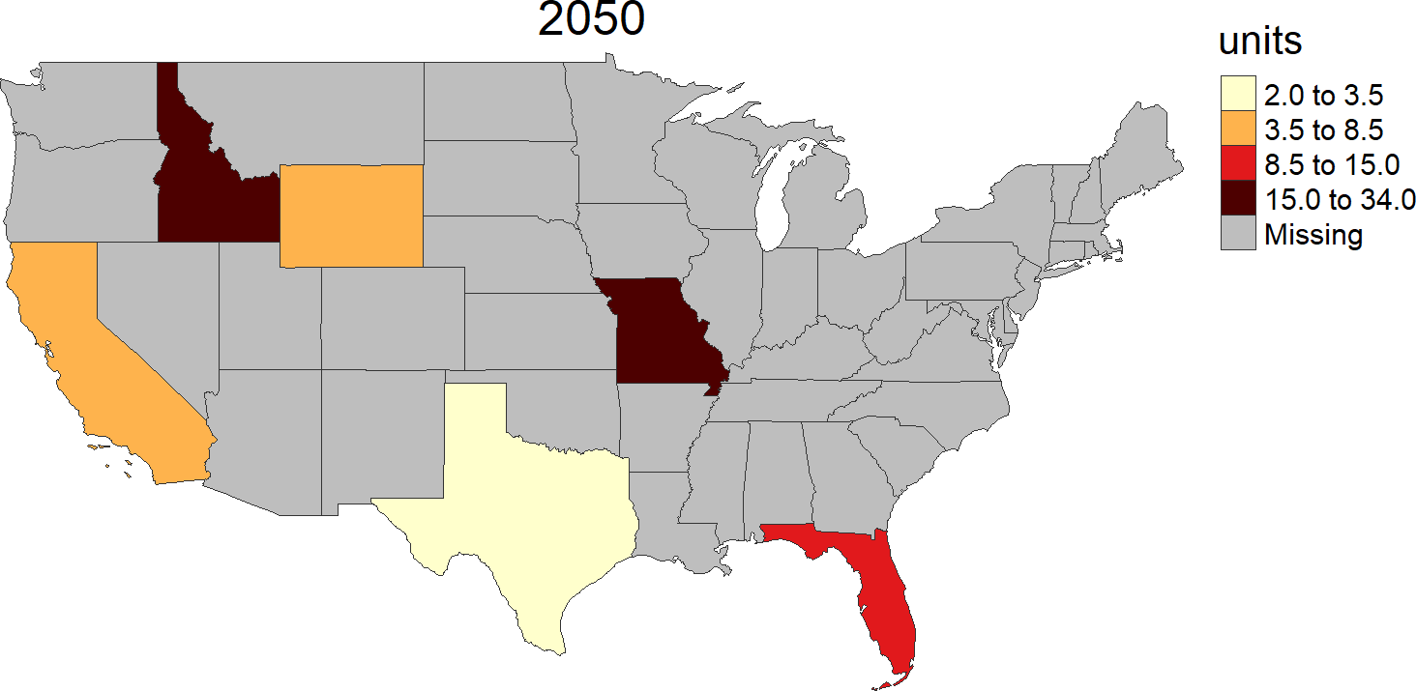
US 49

Slide 13
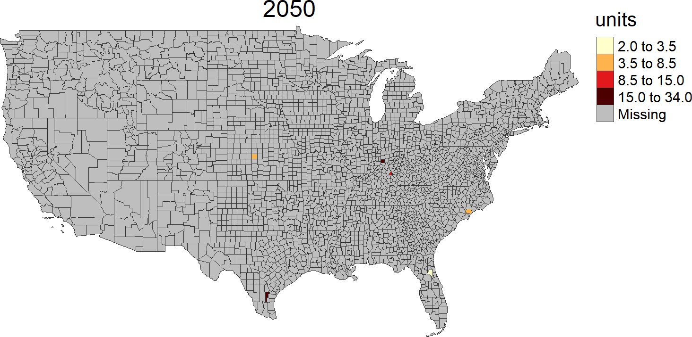
US 49 Counties

Slide 14
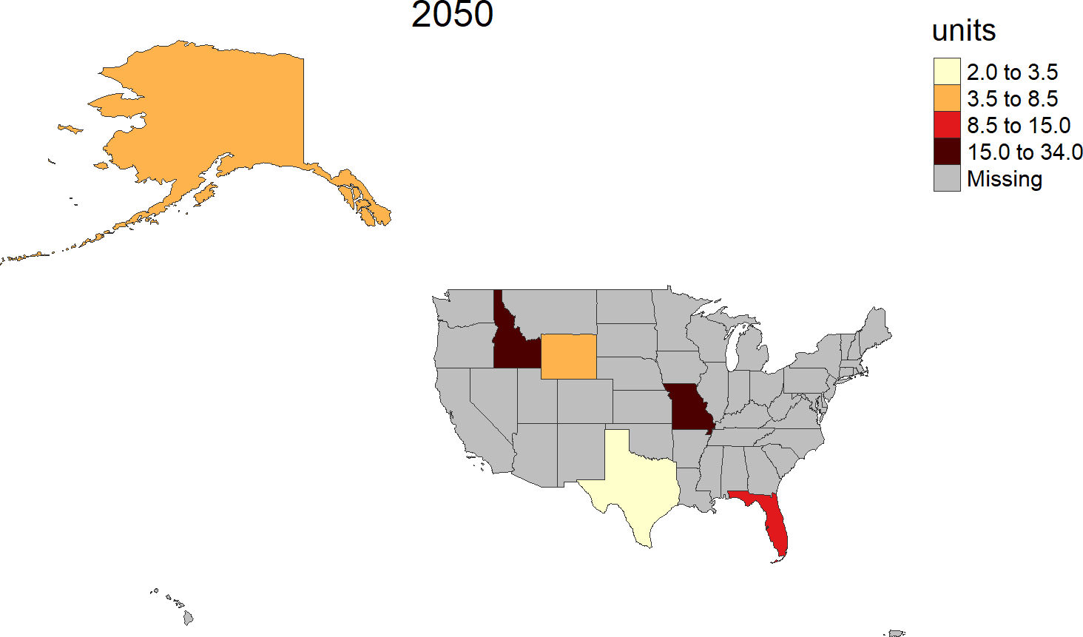
US 52

Slide 15
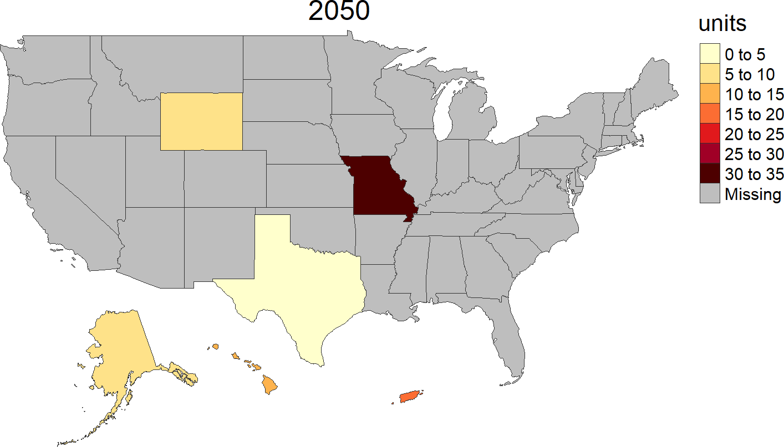
US 52 Compact

Slide 16
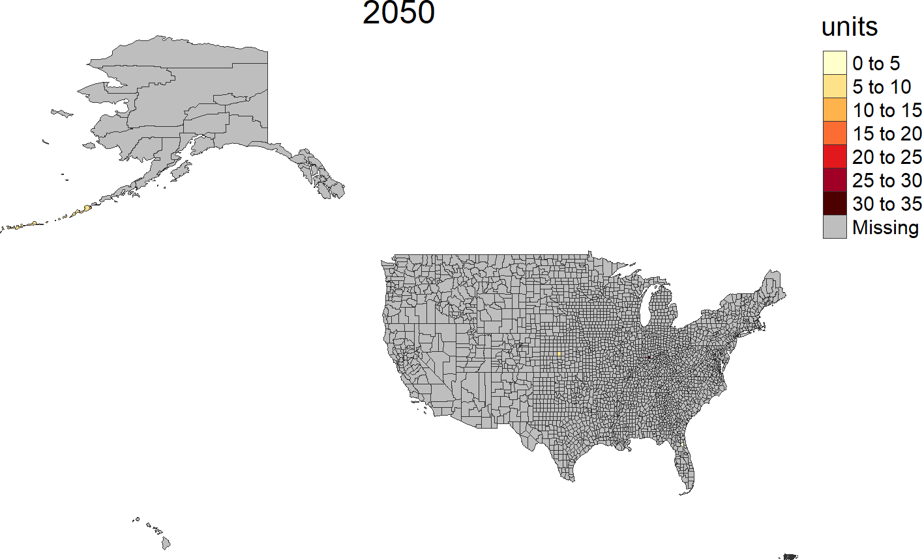
US 52 Counties

Slide 17
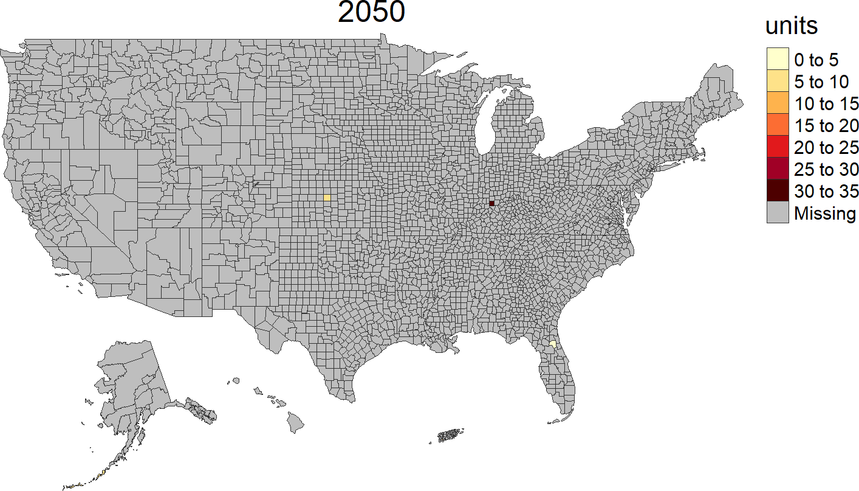
US 52 Counties Compact

Slide 18
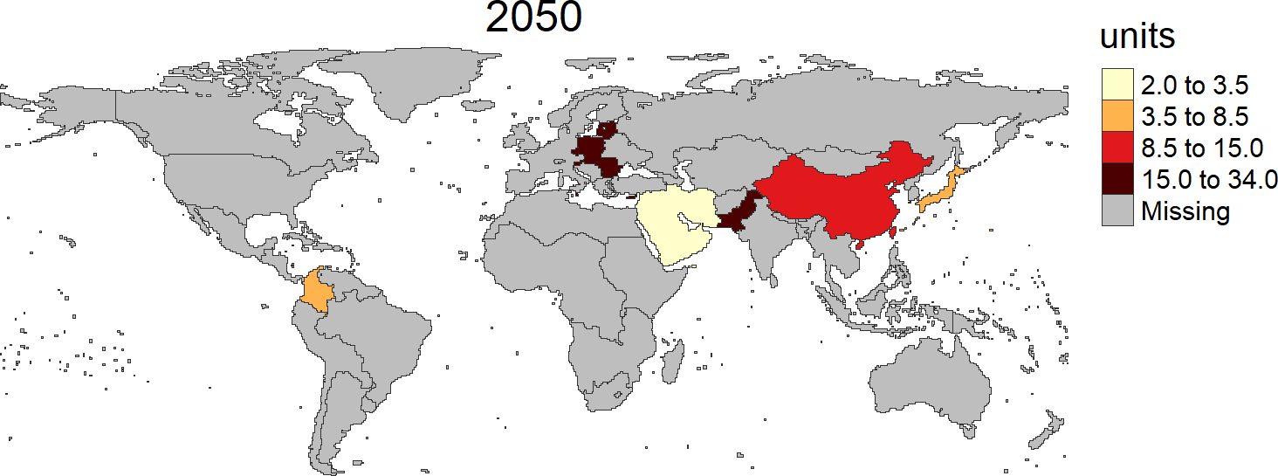
GCAM Reg 32

Slide 19
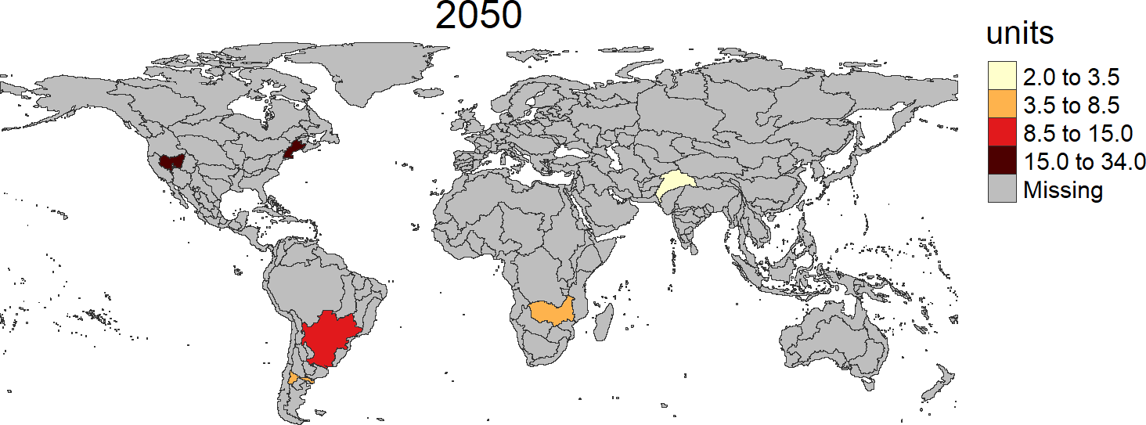
GCAM Basin

Slide 20
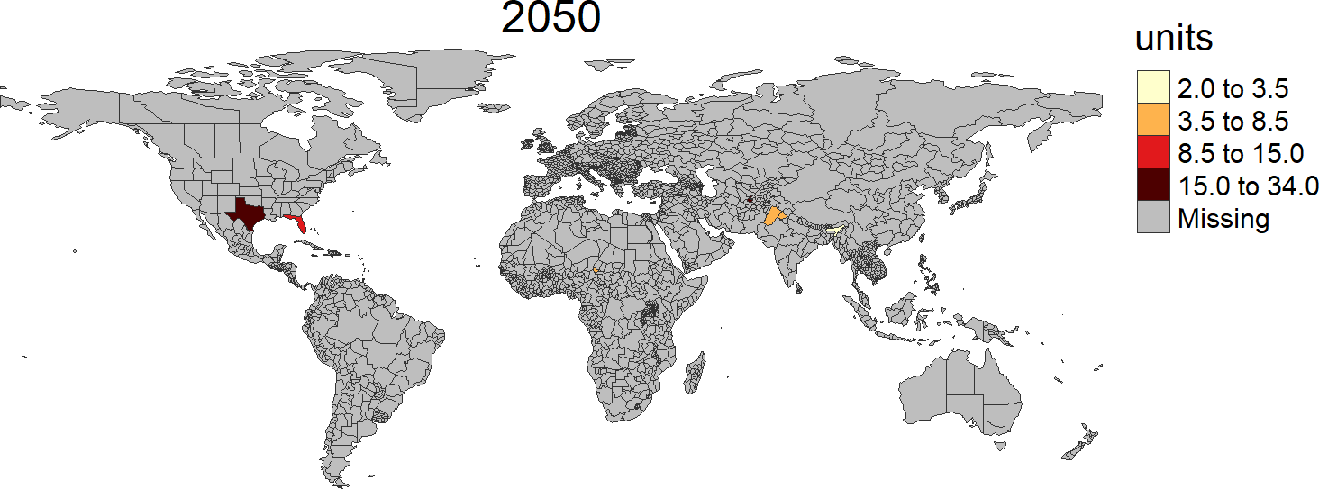
World Countries

Slide 21
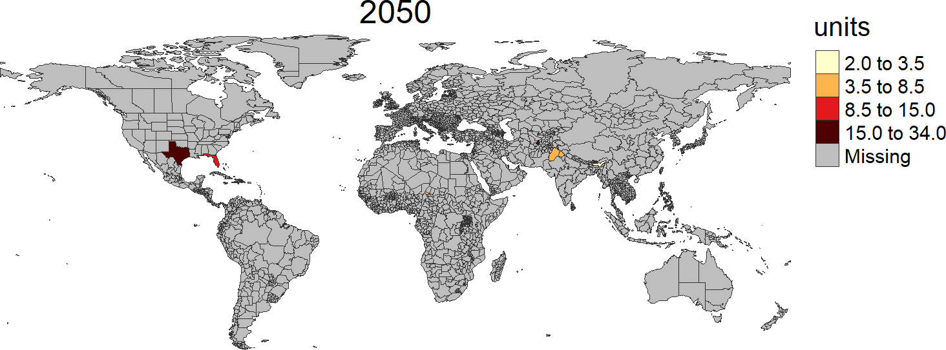
World States

Slide 22
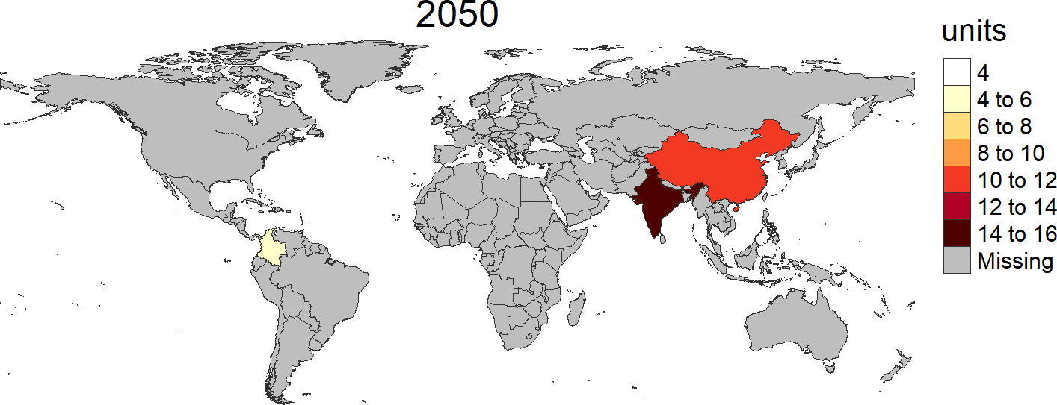
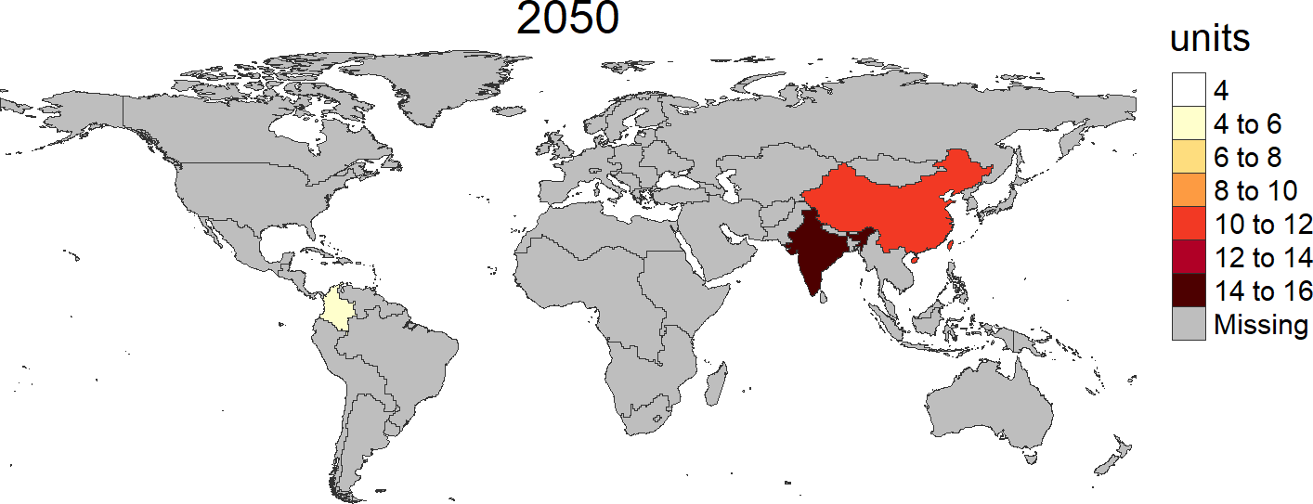
selectMap
shape not assigned auto selects a map
shape = rmap::mapGCAMReg32

Slide 23
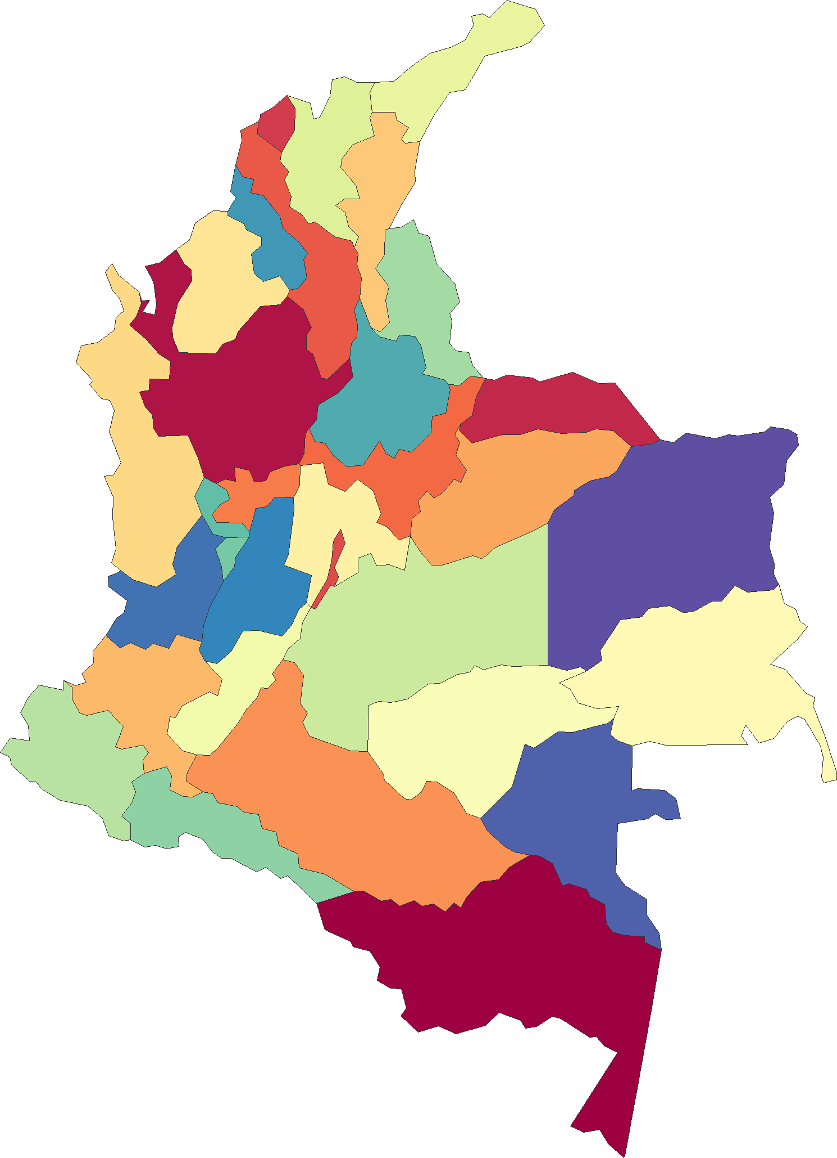
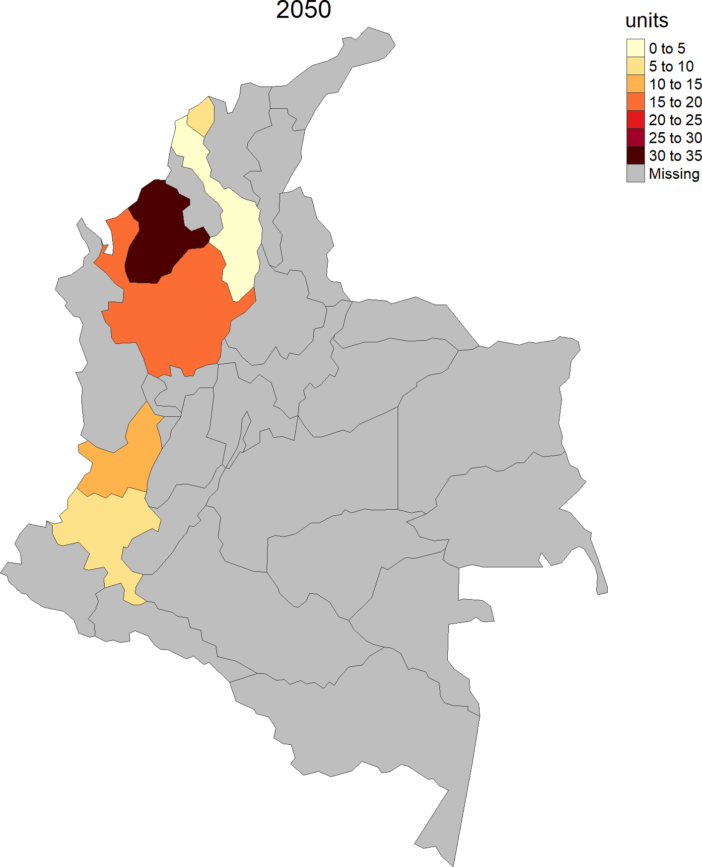
Custom Shape - subSetShape
data = dataframe
shape = shapeSubset
data = shapeSubset

Slide 24
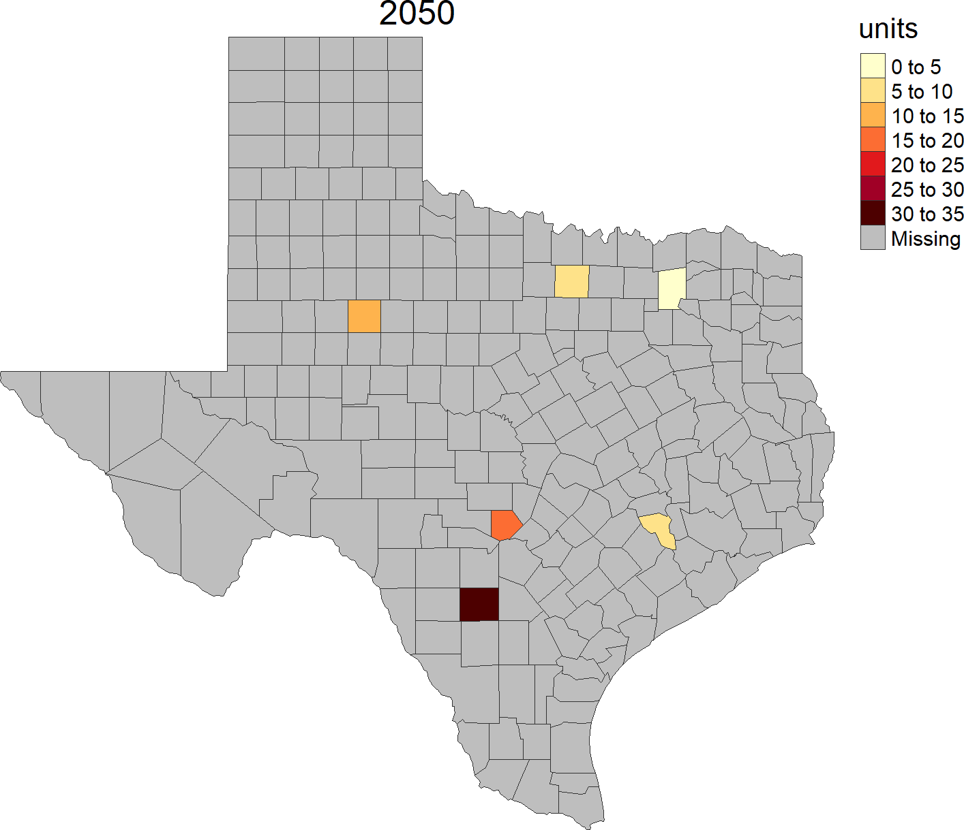
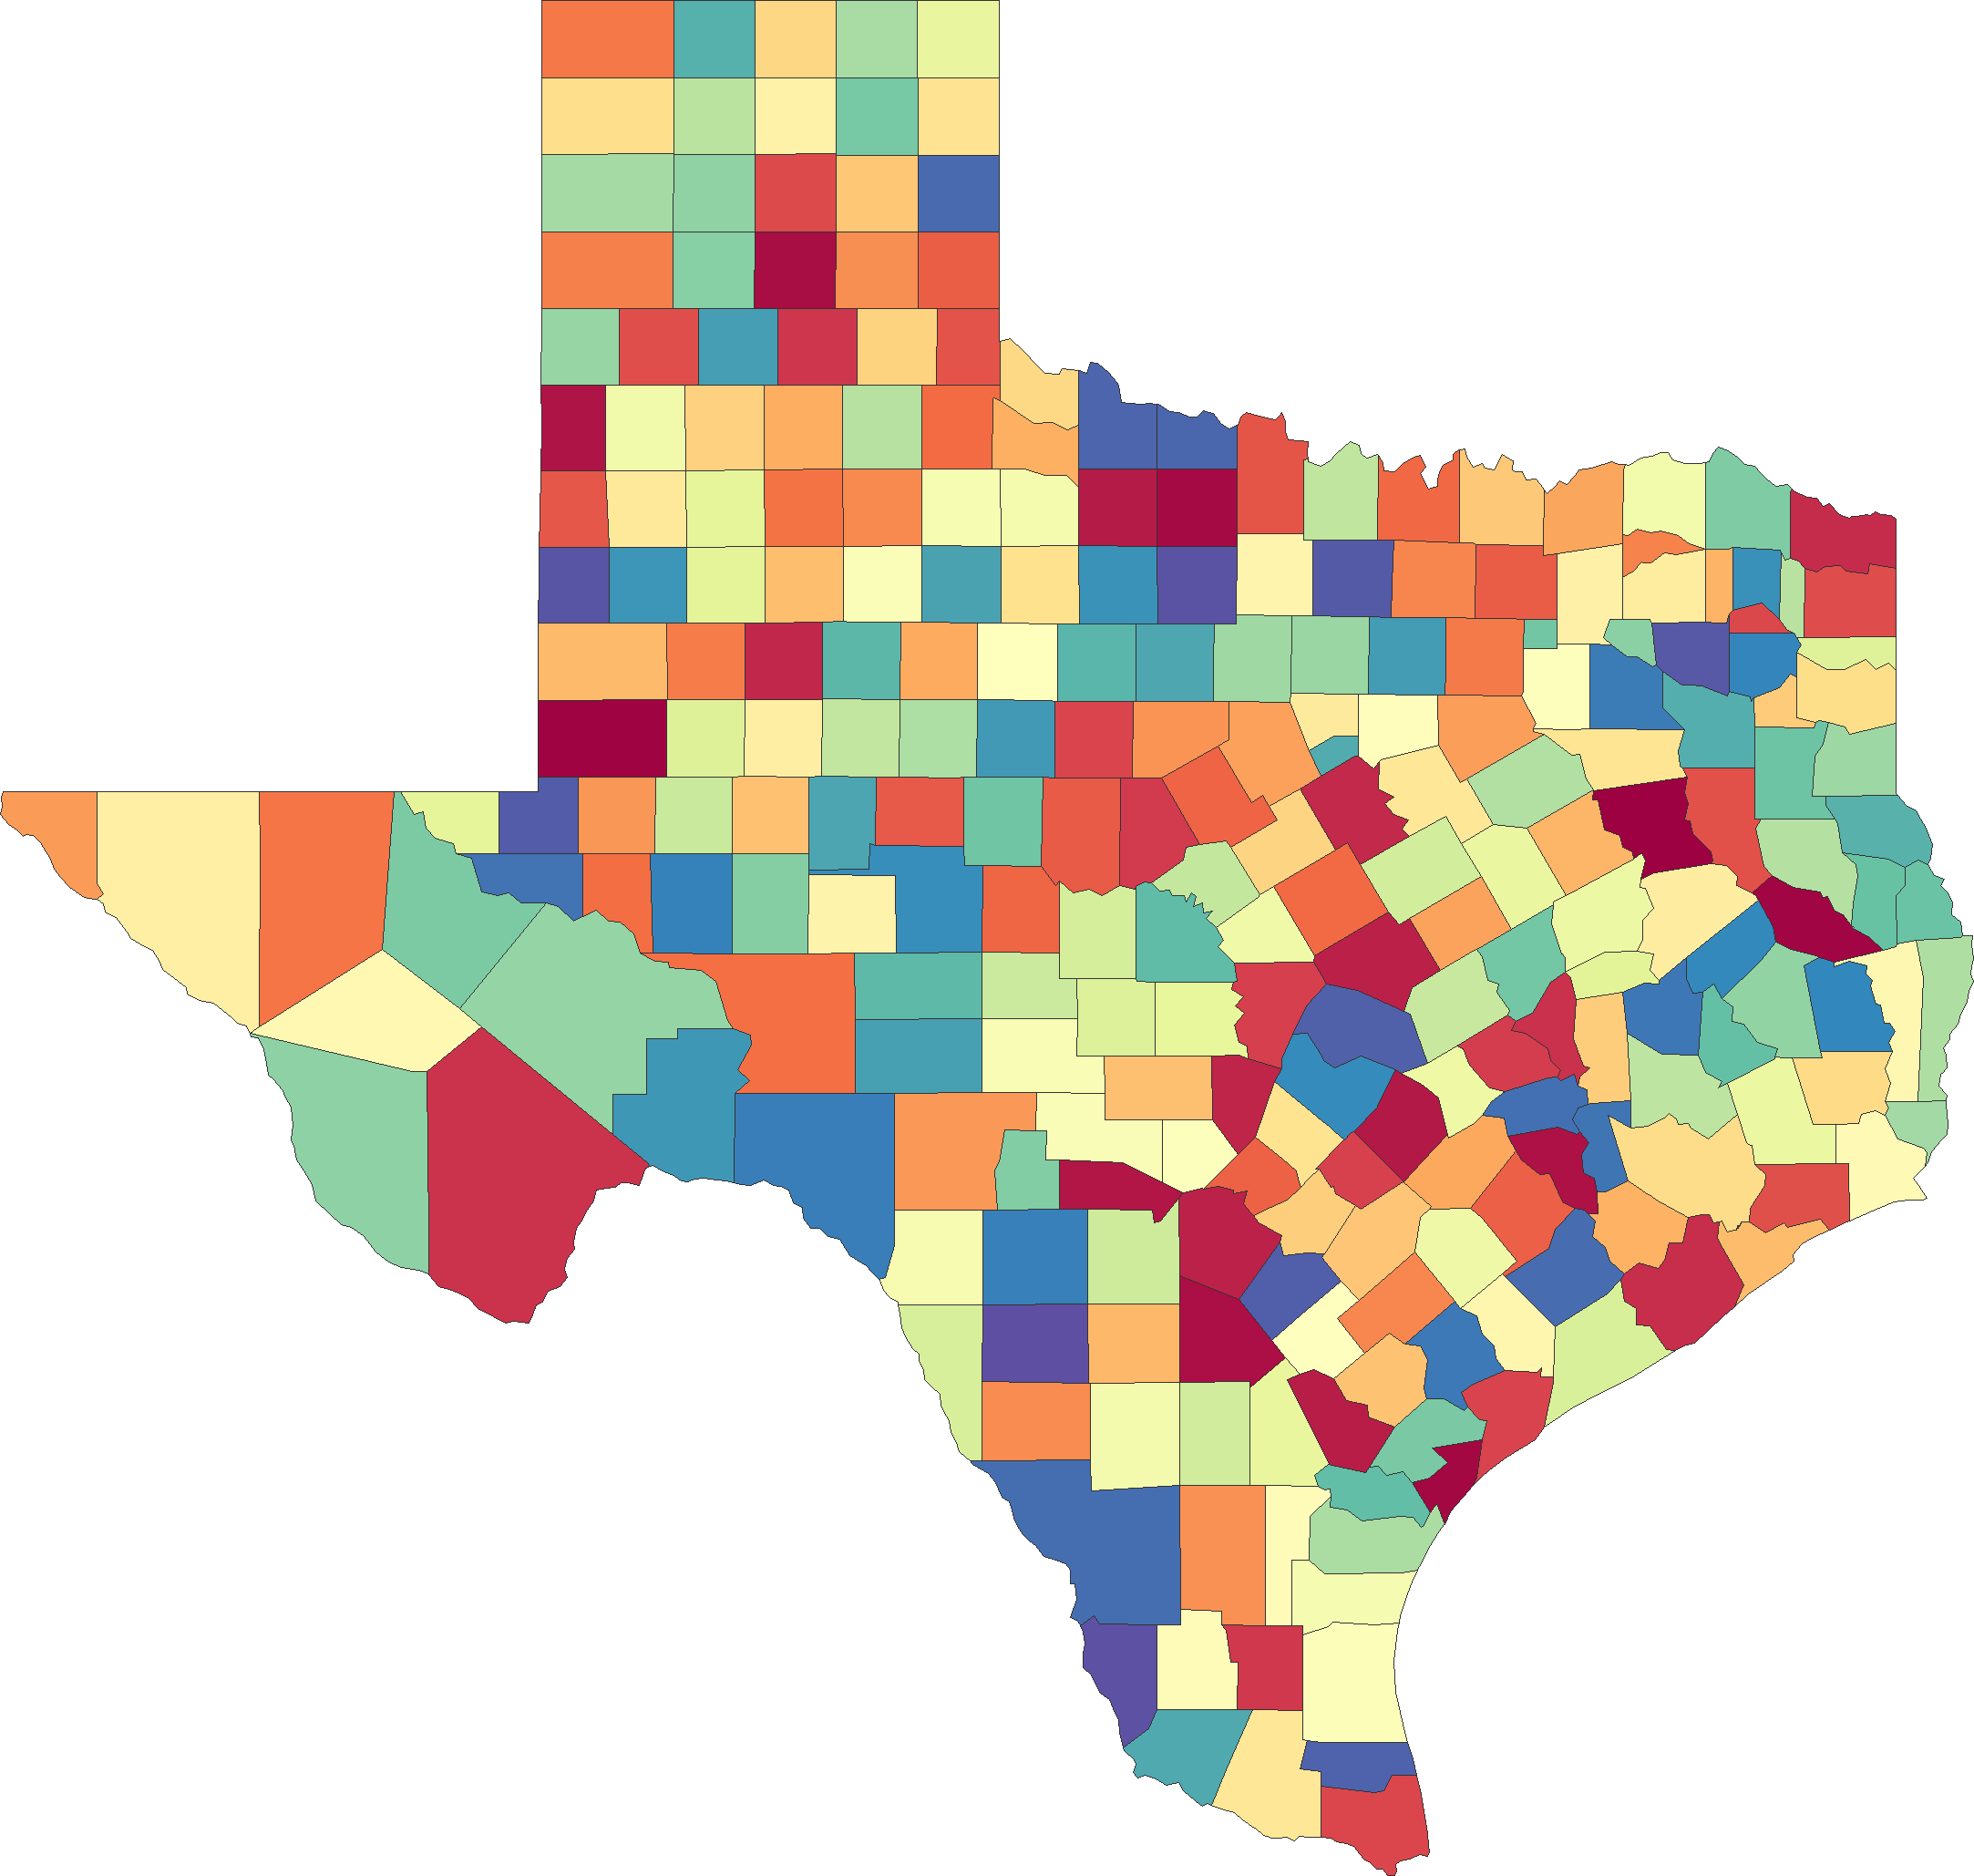
Custom Shape - cropShape
data = dataframe
shape = shapeCrop
data = shapeCrop

Slide 25
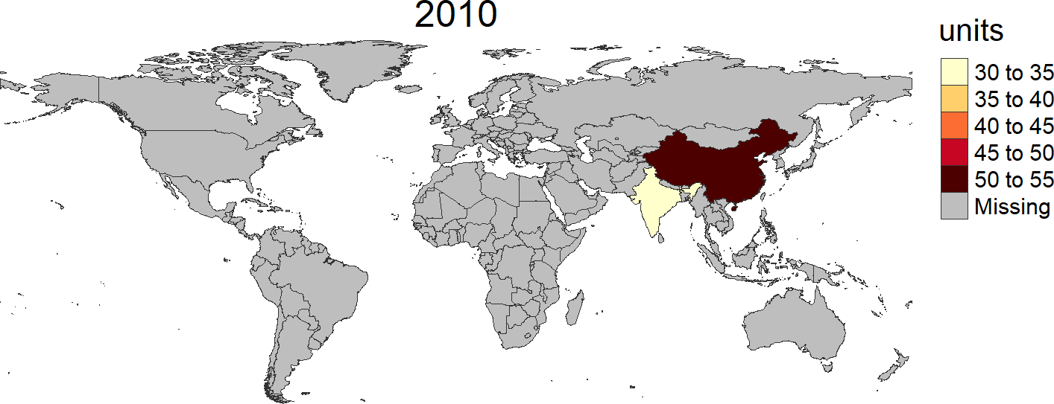
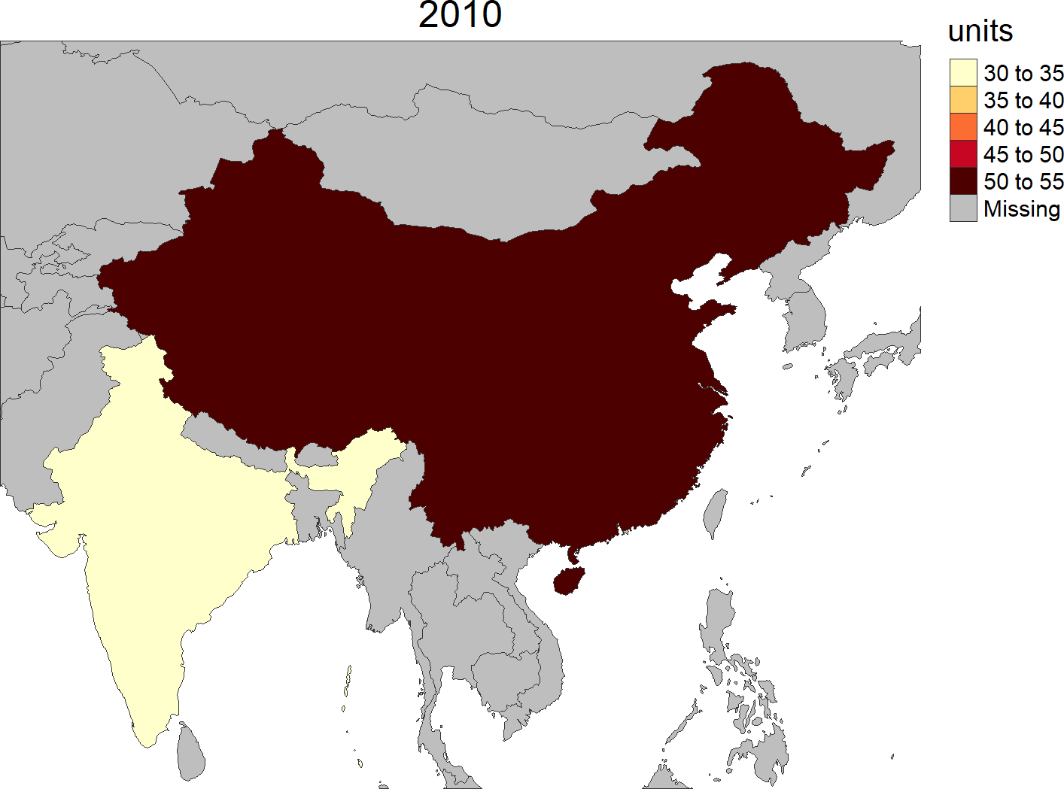
Crop to Boundary
cropToBoundary=F (Default)
cropToBoundary=T

Slide 26
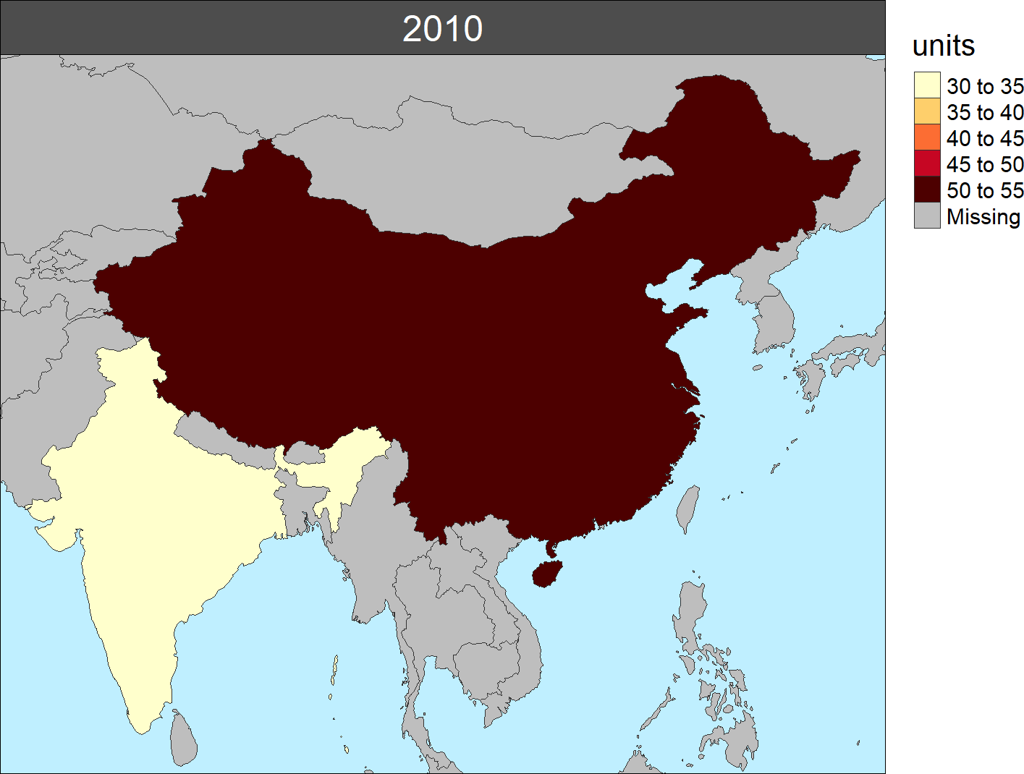
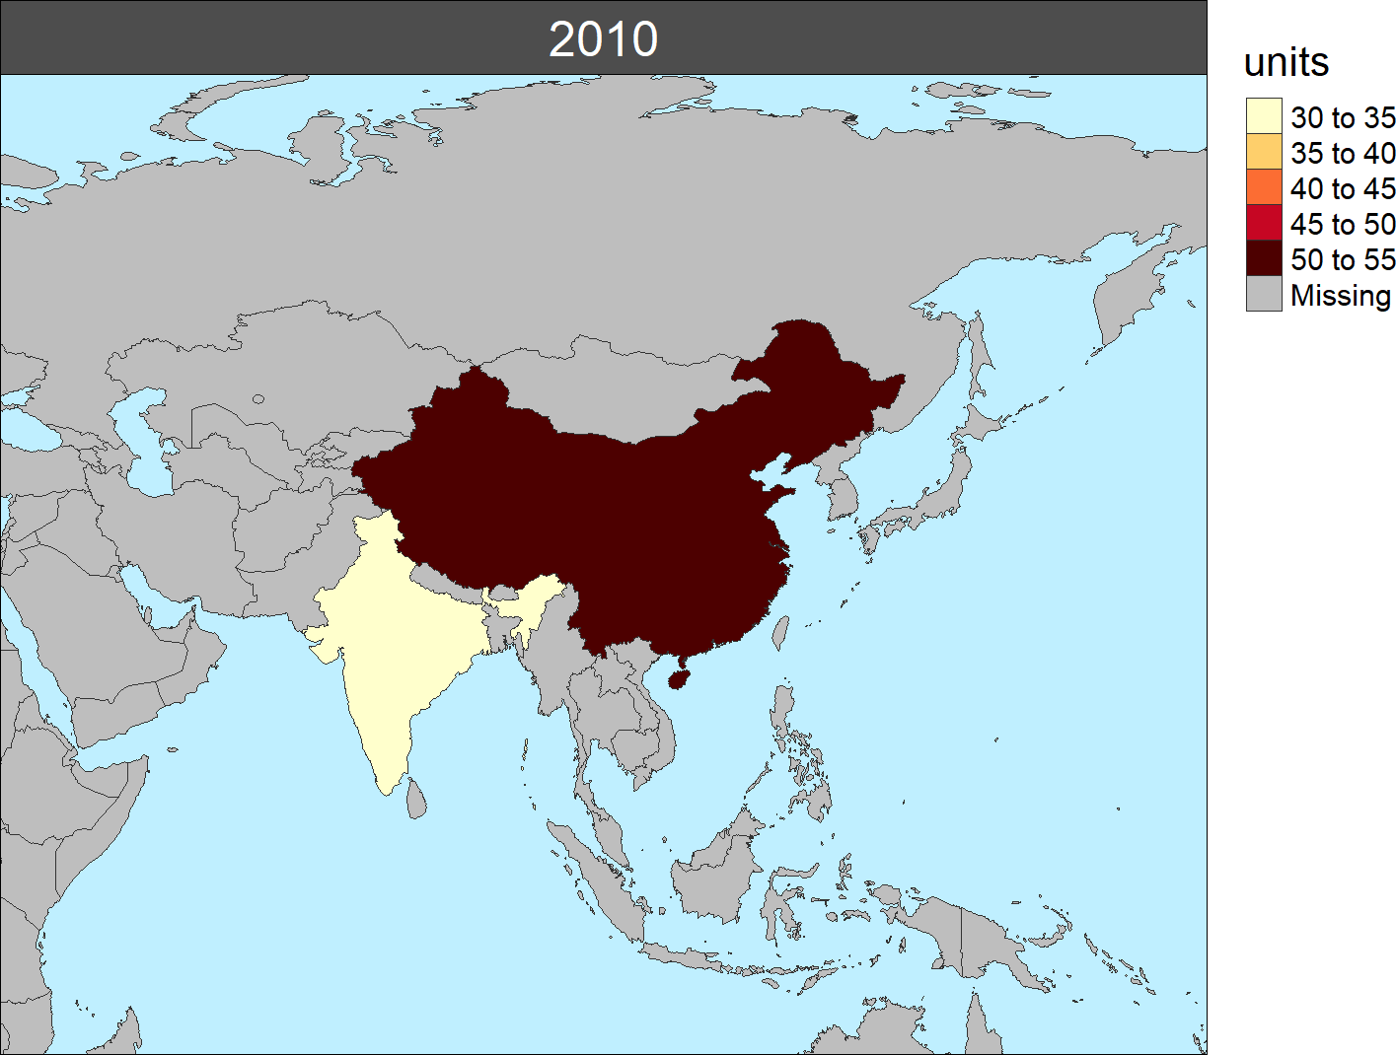
Extended
extension = T
expandPercent = 50
extension = F
extension = T

Slide 27
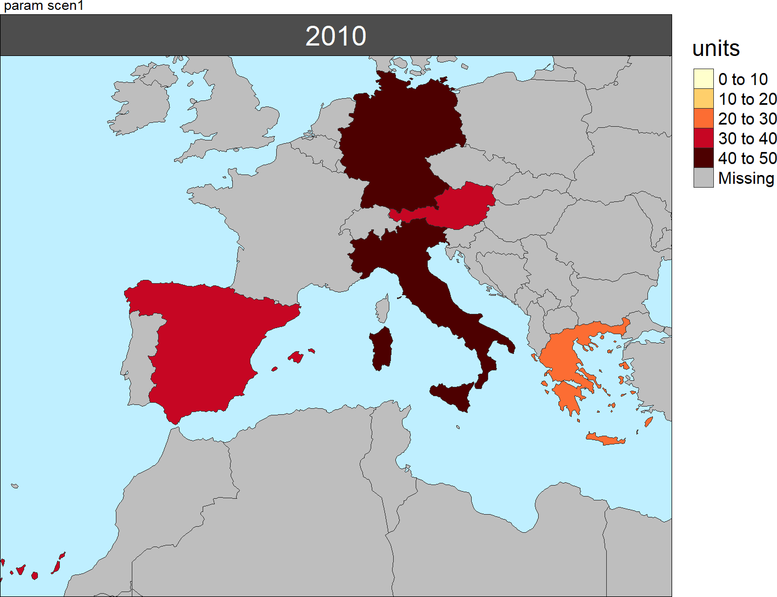
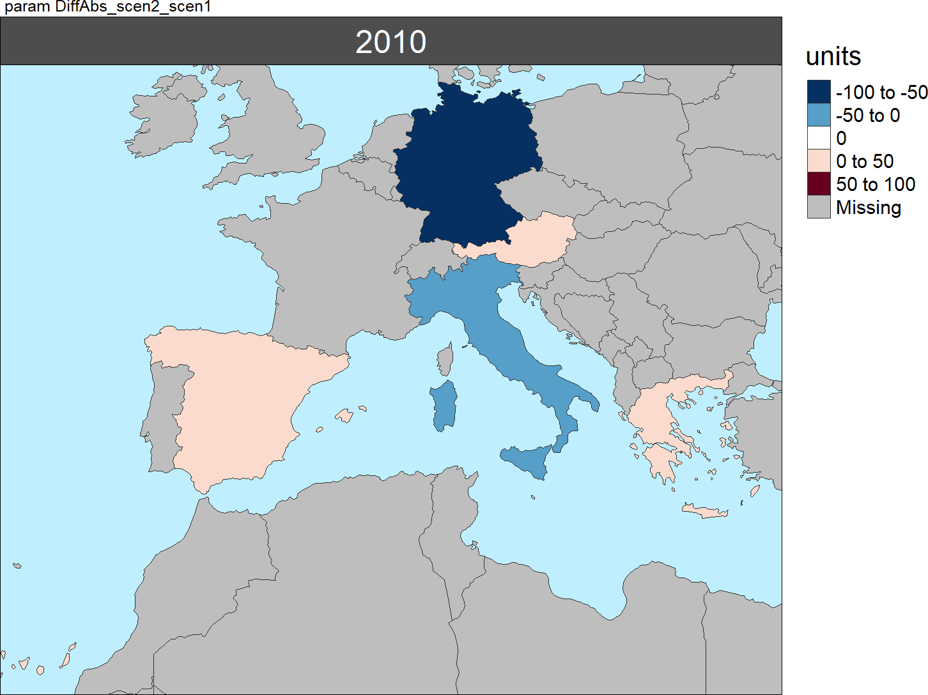
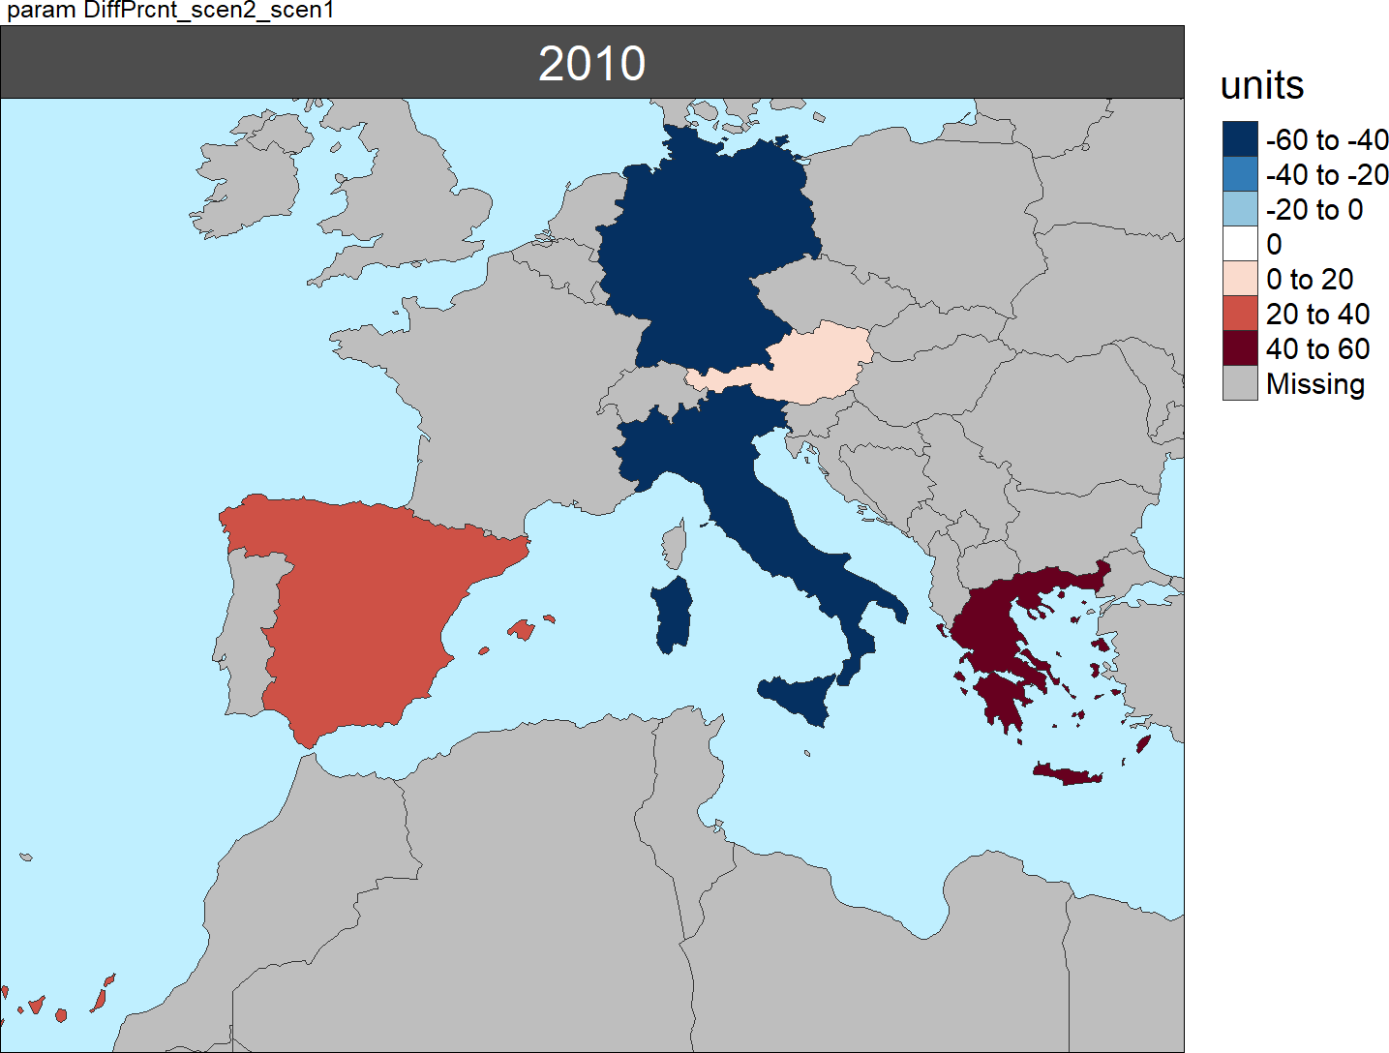
Scale Range
Absolute Difference
Scen2 – Scen1
(using scaleRangeDiffAbs)
Absolute Difference
Scen2 – Scen1
(using scaleRangeDiffPrcnt)
Scen1
(uses scaleRange)

Slide 28
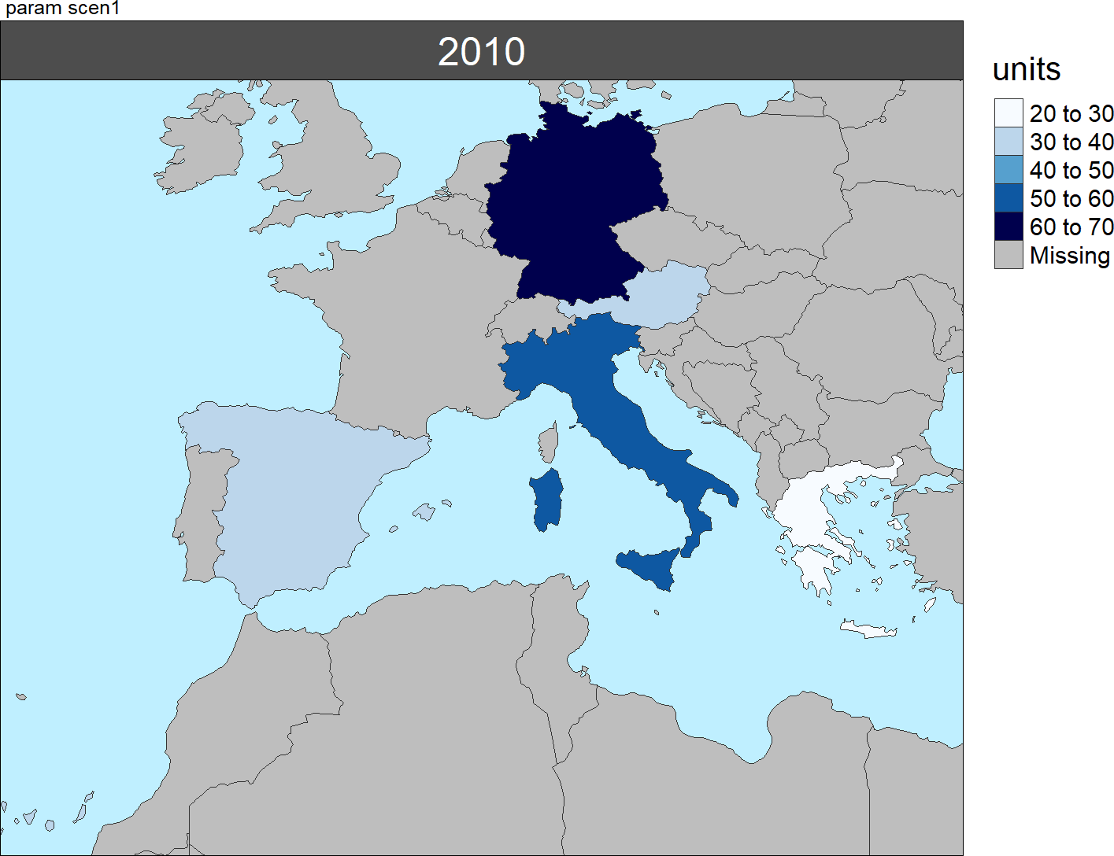
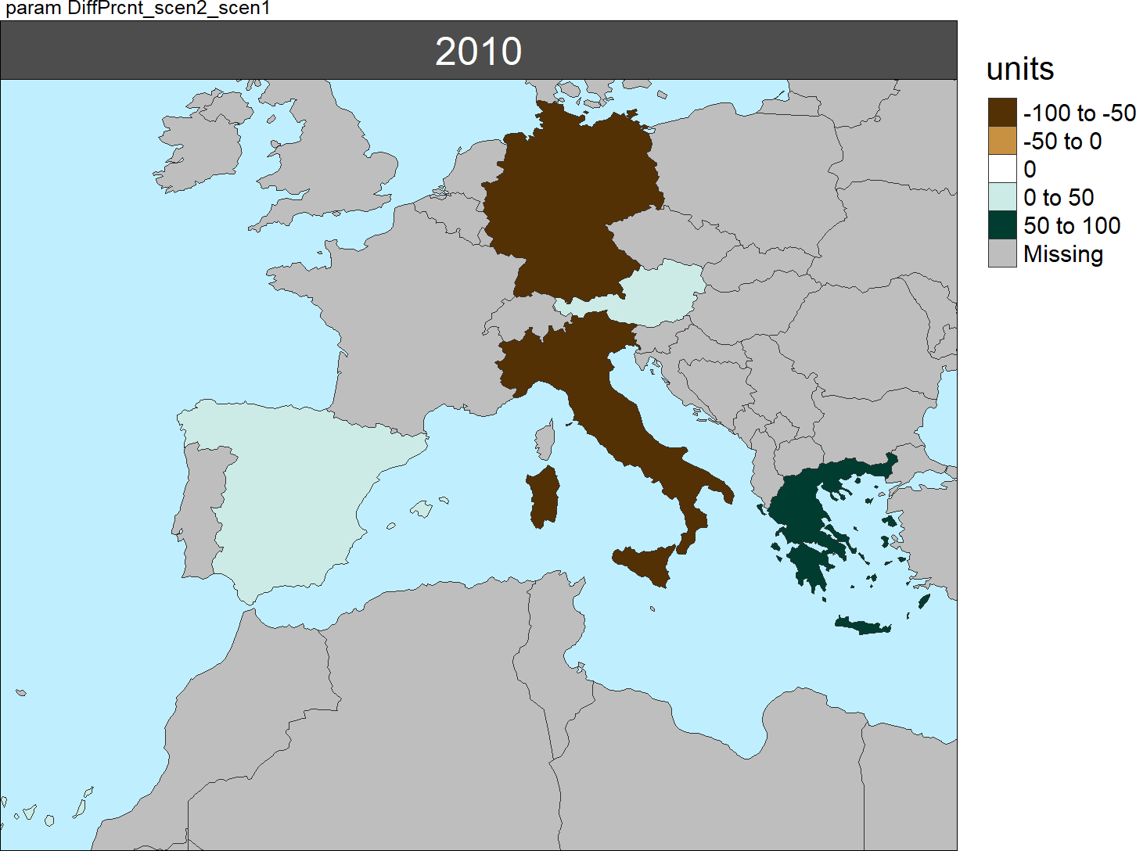
Color Palettes
Scen1
(using classPalette)
Diff Plots
(using classPaletteDiff)

Slide 29
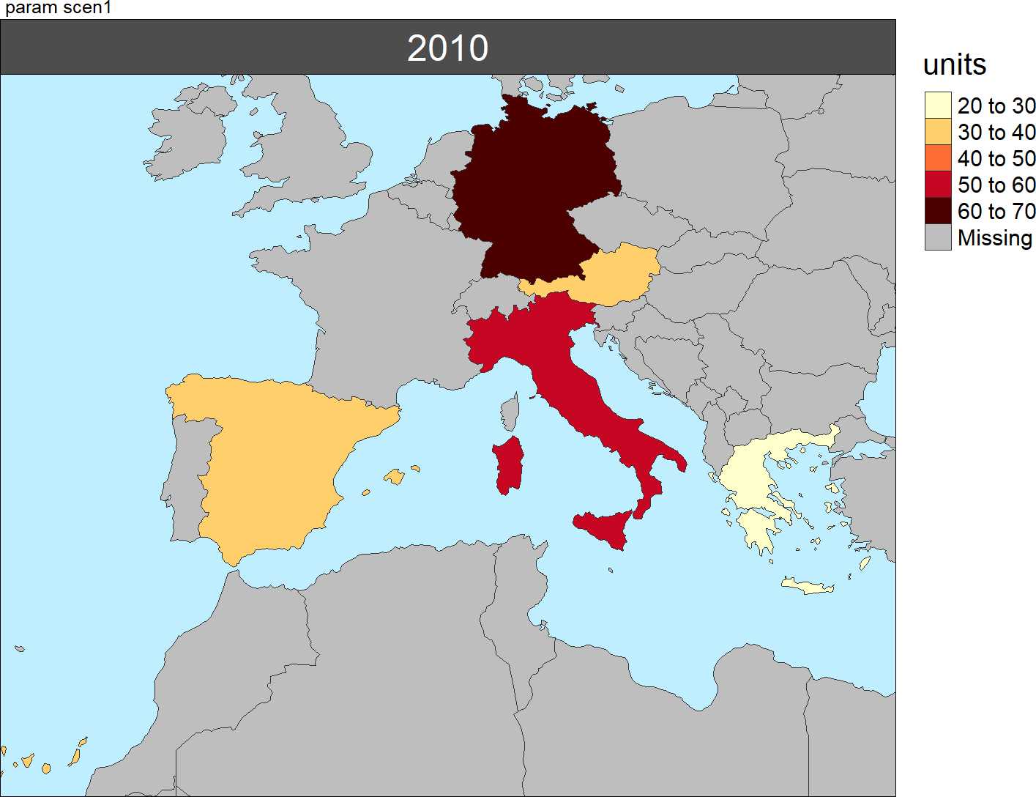
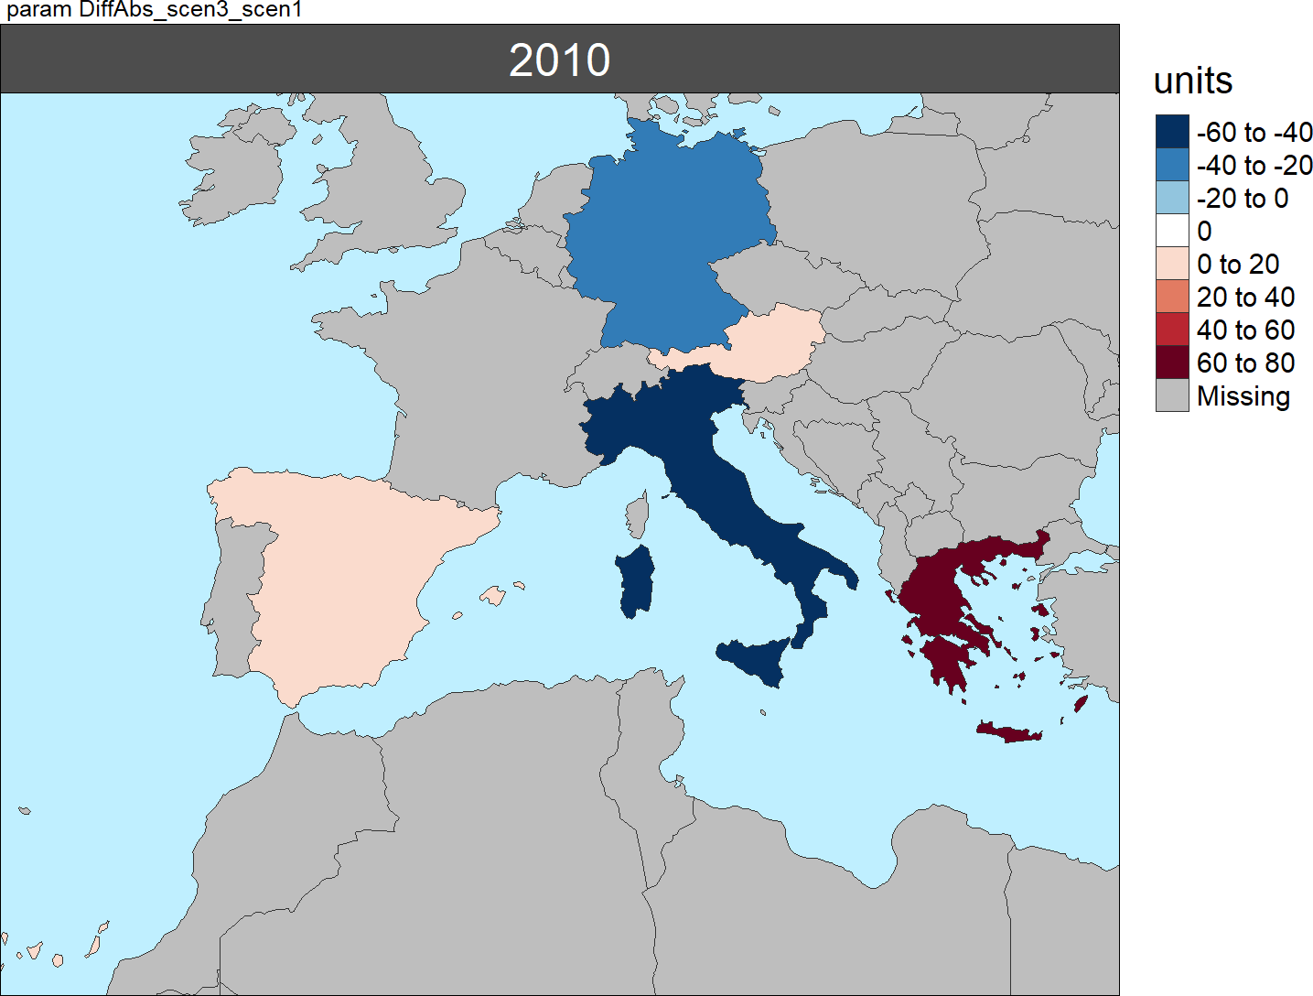
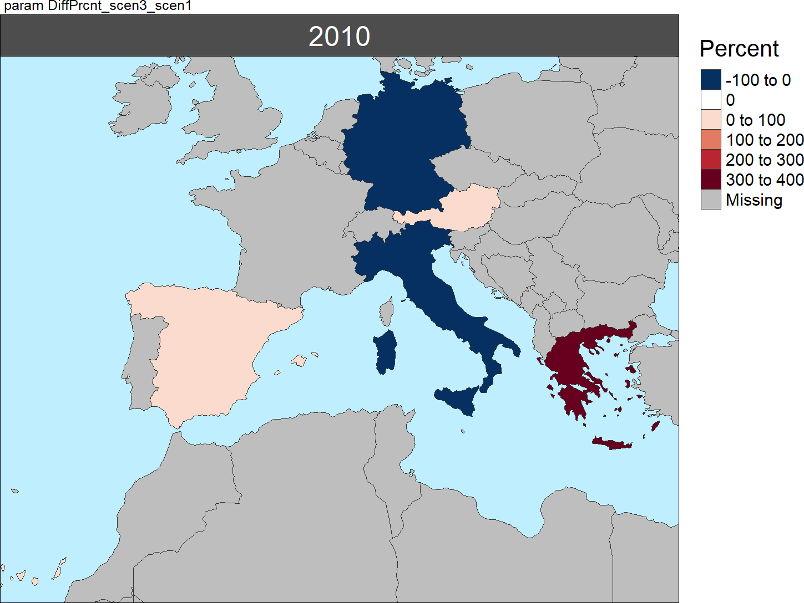
Multi-Scenario
Absolute Difference Scen3 – Scen1
% Difference
Scen3 – Scen1
scen1

Slide 30
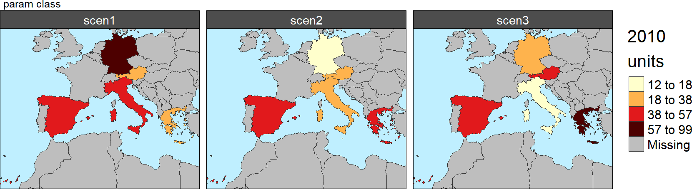
Multi-Scenario

Slide 31
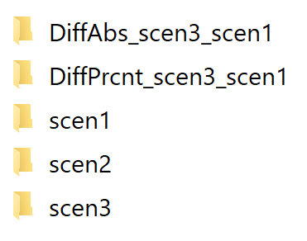
Multi-Scenario Folders
dirOutputs
multiScenario
param

Slide 32
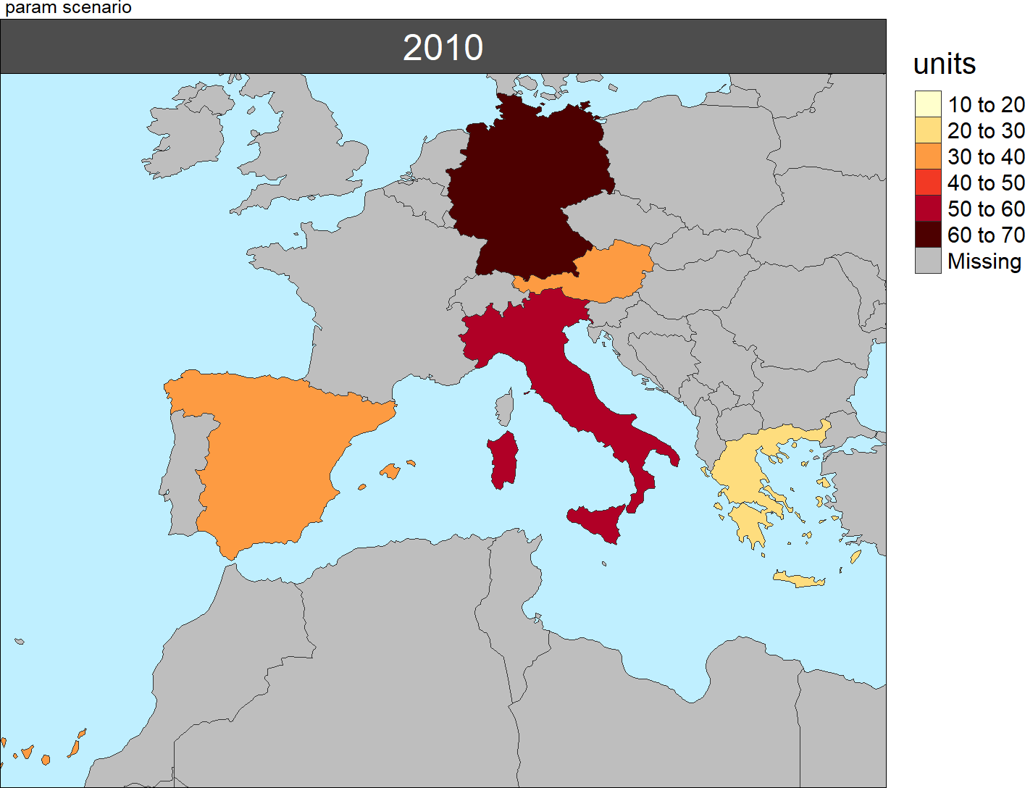
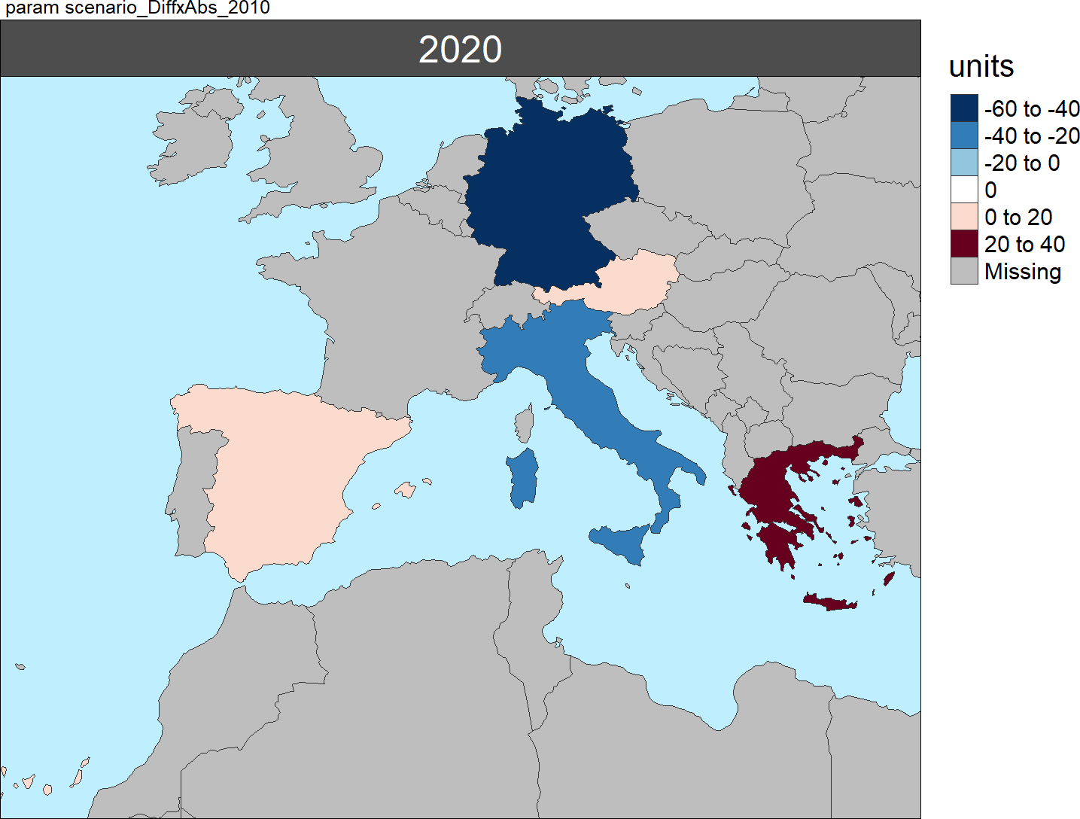
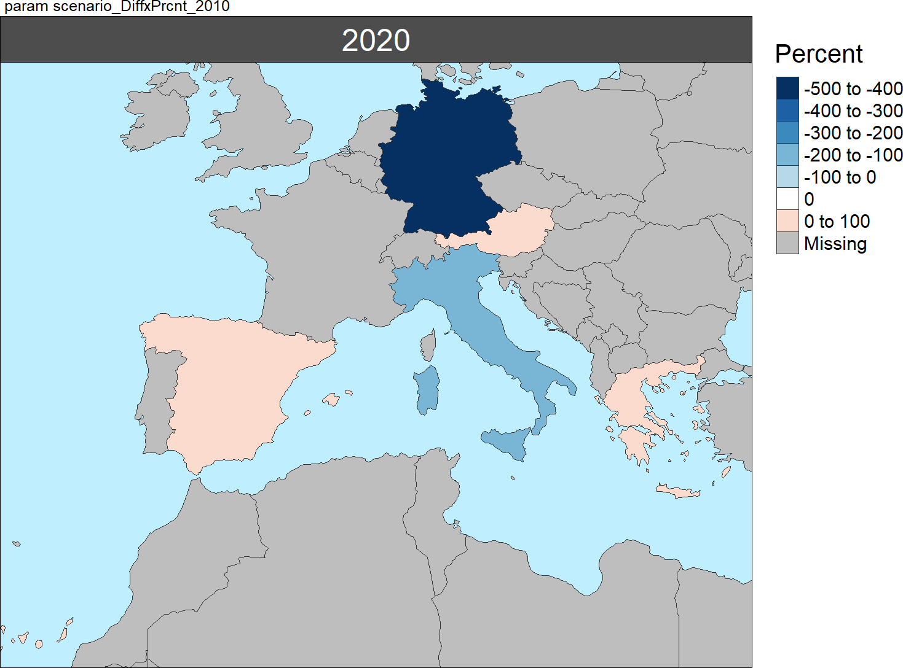
Multi-Year Diff
Absolute Difference 2020 - 2010
% Difference
2020 – 2010
2010

Slide 33
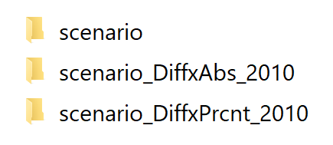
Multi-Year Folders
dirOutputs
multiScenario
param

Slide 34
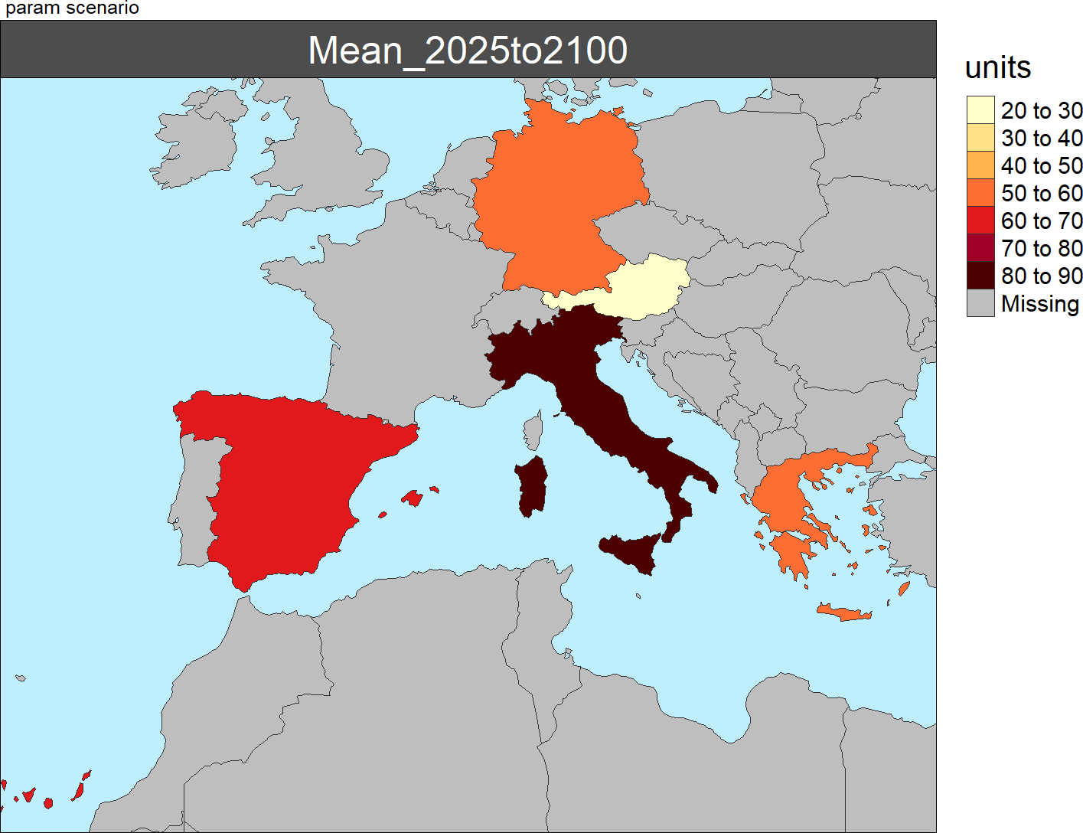
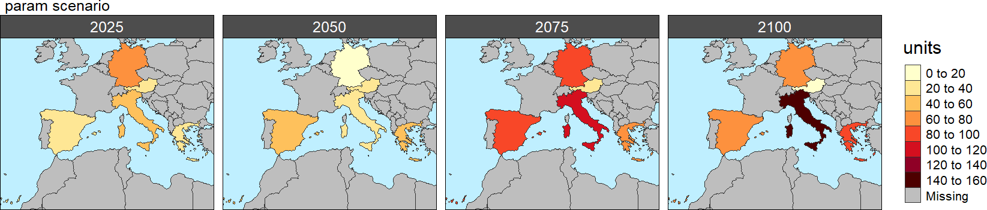
Multi-Year
Mean Plot
Combined Year Plots

Slide 35
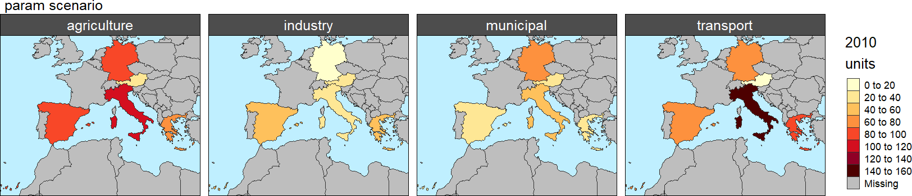
Multi-Class

Slide 36
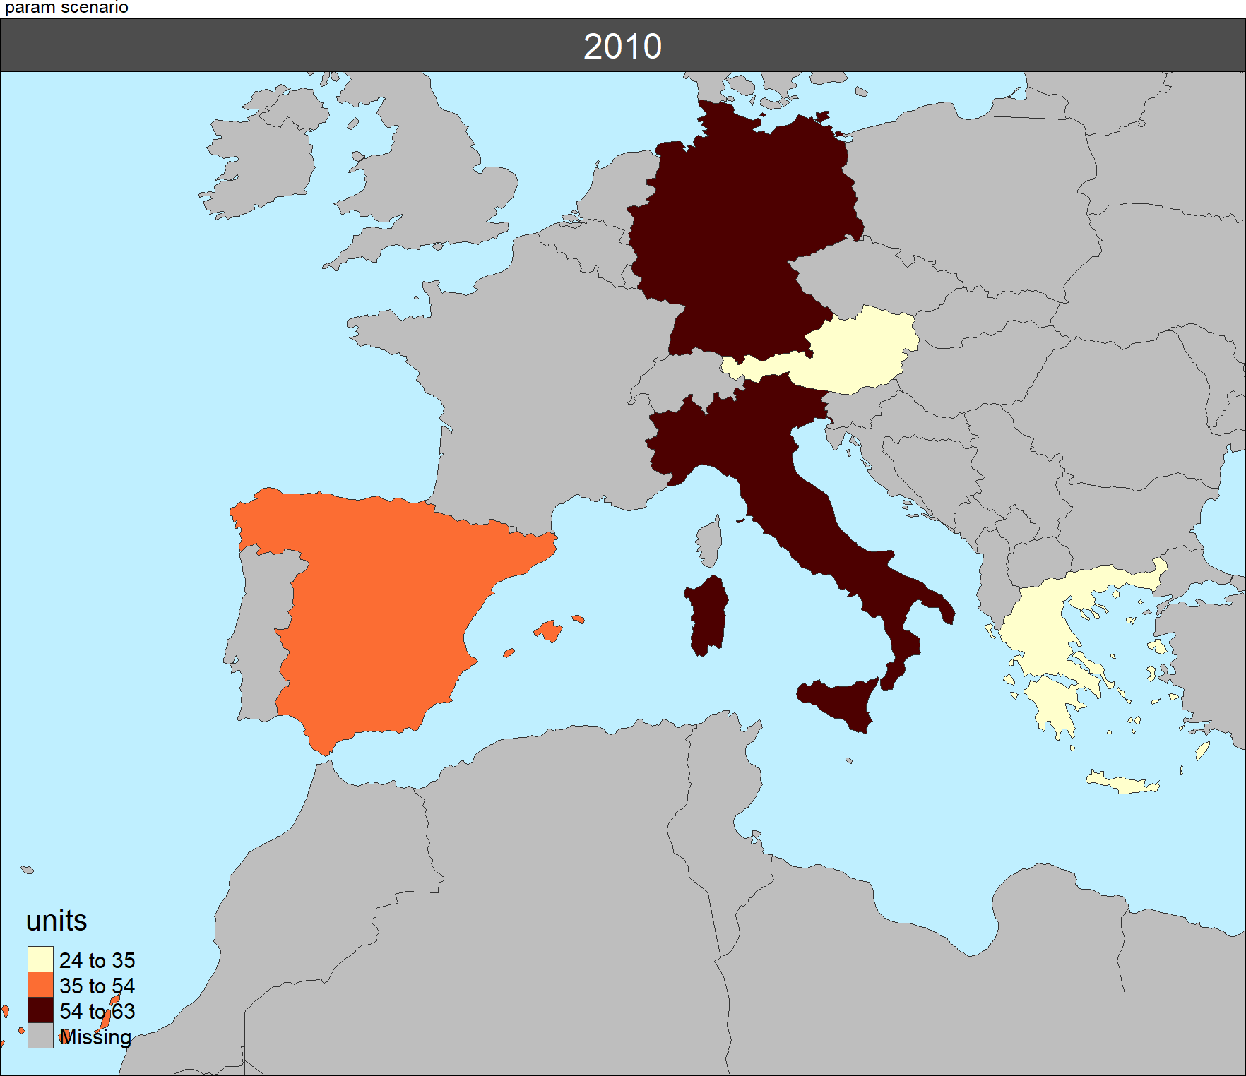
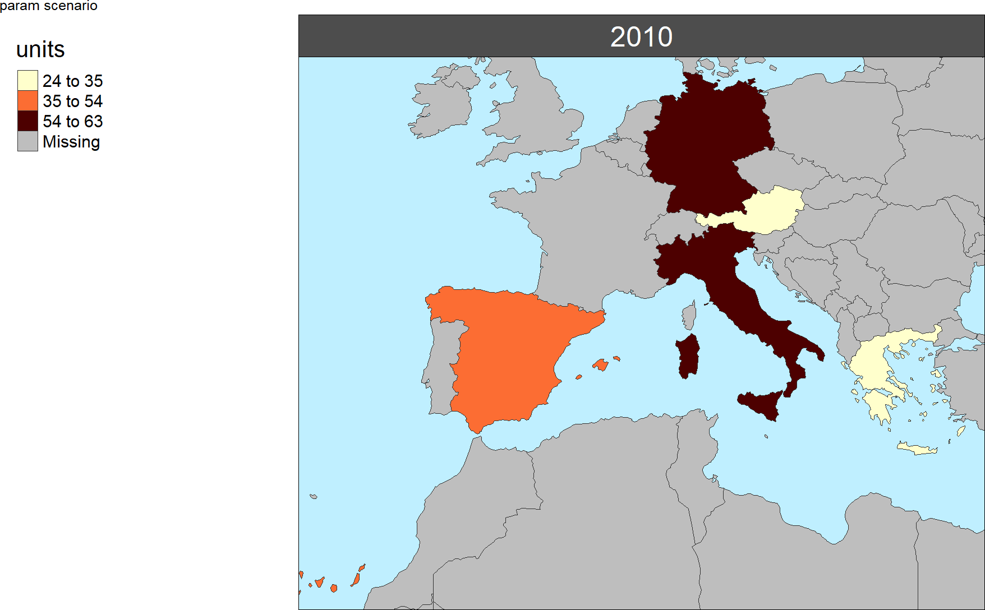
Legend Customization Position Single Facet
legendOutsideSingle = F,
legendPosition = c('left','bottom'),
legendOutsideSingle = T,
legendOutsidePosition = "left",

Slide 37


Legend Customization Position Multi Facet
legendOutsidePosition = "left“ for KMEANS or PRETTY Maps
legendPosition = c('left','bottom’) for FREESCALE Maps

Slide 38






Legend Customization Breaks
Freescale
Pretty
Kmeans
legendFixedBreaks = 3
Freescale
Pretty
Kmeans
legendFixedBreaks = 3

Slide 39




Multi-Scenario
Fixed
Freescale
Kmeans
Pretty

Slide 40


Numeric2Cat

Slide 41





GCAM Results Folder
folderName
params
Working Dir:
Animation, Mean and by Year
Scenarios

Slide 42





GCAM by Param Figs
Population by Year SSP3
Absolute Difference in Population by Year
(SSP5 – SSP3)
Land Allocation SSP5
(Mean 2010 to 2050)
Runoff by Basin 2050
Percentage Diff Elec Gen
(SSP5 – SSP3)

Slide 43


GCAM by Class Figs
Electricity Generation SSP5 by Class 2040
Land Allocation SSP5 by Class 2040

Slide 44
Figures for grid2poly

Slide 45
fileName.csv
OR
R Data
lat | lon | value
-18.25 | -81.25 | 5
-17.75 | -80.75 | 10
-17.25 | -80.25 | 15
-16.75 | -79.75 | 34
-16.25 | -79.25 | 2
… | … | 7
lat = seq(from=-18.25,to=-0.25,by=0.5); lat
lon = seq(from=-81.25,to=-68.75,by=0.5); lon
gridx <- expand.grid ( lat, lon ) %>%
dplyr::mutate(value = runif( length(lat) * length(lon))) %>%
dplyr::rename(lat=Var1,lon=Var2)
Minimum
lat | lon | value | param | scenario | class | year | units
-18.25 | -81.25 | 5
-17.75 | -80.75 | 10
-17.25 | -80.25 | 15
-16.75 | -79.75 | 34
-16.25 | -79.25 | 2
… | … | 7
Optional Columns

Slide 46

dirOutputs
folderName
Grid2Poly
(Optional)
(Optional)
Original list of grid cells
Aggregated data by polygons
List of params and classes

Slide 47
Grid Cell
Values
Polygon
Shape
Raster Area
Weights
Polygon Area
Weights
1000
90%
10%
60%
100
50%
50%
30%
10
20%
80%
10%
aggType = “vol” (e.g. km³/yr.)
Grid Cell Area Weighted
aggType = “depth” (mm/yr.)
Polygon Area Weighted
1000 x 0.9
1000 x 0.6
100 x 0.5
100 x 0.3
10 x 0.2
10 x 0.1
Sum = 900+50+2 = 952
Mean = 600+30+1 = 631

