Slide 1
input_format.png
R Data Frame
OR
Read in CSV into R
data = data.frame(subRegion = c(“CA",“FL“,”ID”,”MO”,”TX”,”WY”),
value = c(5,10,15,34,2,7))
data = read.csv (“path/to/csv/file.csv”, header = T)
.csv Files templates
Minimum Columns
Optional Columns
subRegion | value | param | scenario | class | year | units
CA | 5
FL | 10
TX | 7
MN | 2
Polygon Data
Minimum Columns
Optional Columns
Latitude | Longitude | value | param | scenario | class | year | units
34.04 | -118 | 5
28 | -83 | 10
28 | -95.4 | 7
45 | -93.3 | 2
Gridded Data

Slide 2
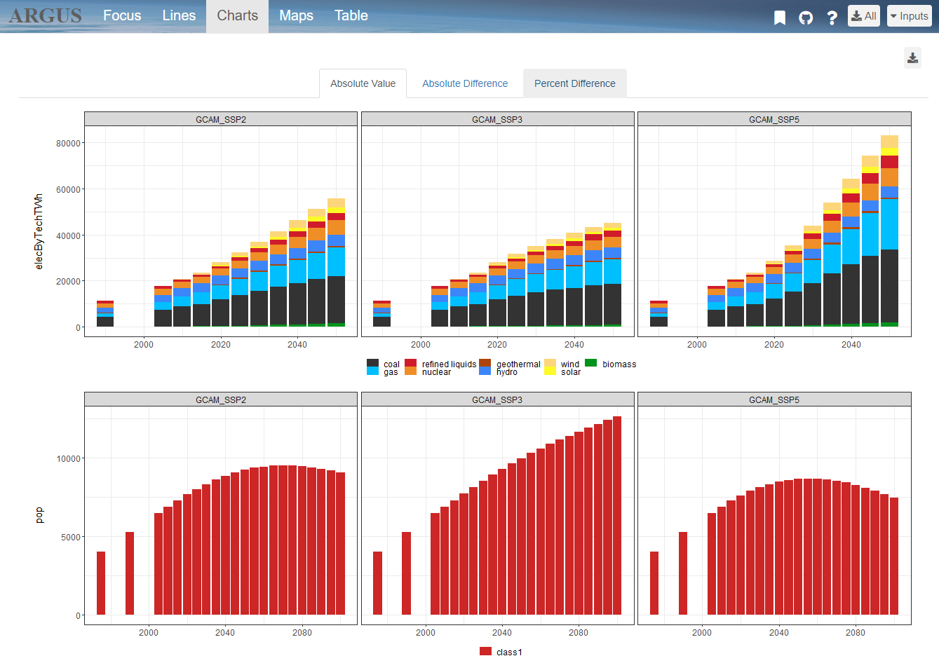
Story board
MY TITLE
Existing scientific literature shows that health and agricultural impacts attributable to air pollution are significant and should be considered in the integrated analysis of human and Earth-system interactions. The implementation of policies that affect the power sector, the composition of the vehicle fleet or the investments and deployment of different energy sources will in turn result in different levels of air pollution. Even though the various methodologies for estimating the impacts of air pollution, such as exposure-response functions, are extensively applied by the scientific community, they are normally not
Title (Optional):
Enter optional title here …
Story:
Add your story here …

