Slide 1
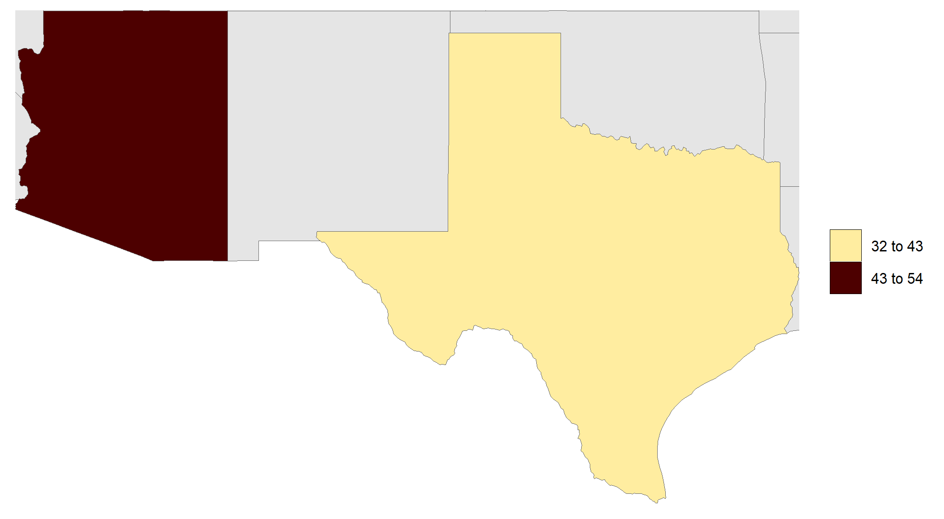
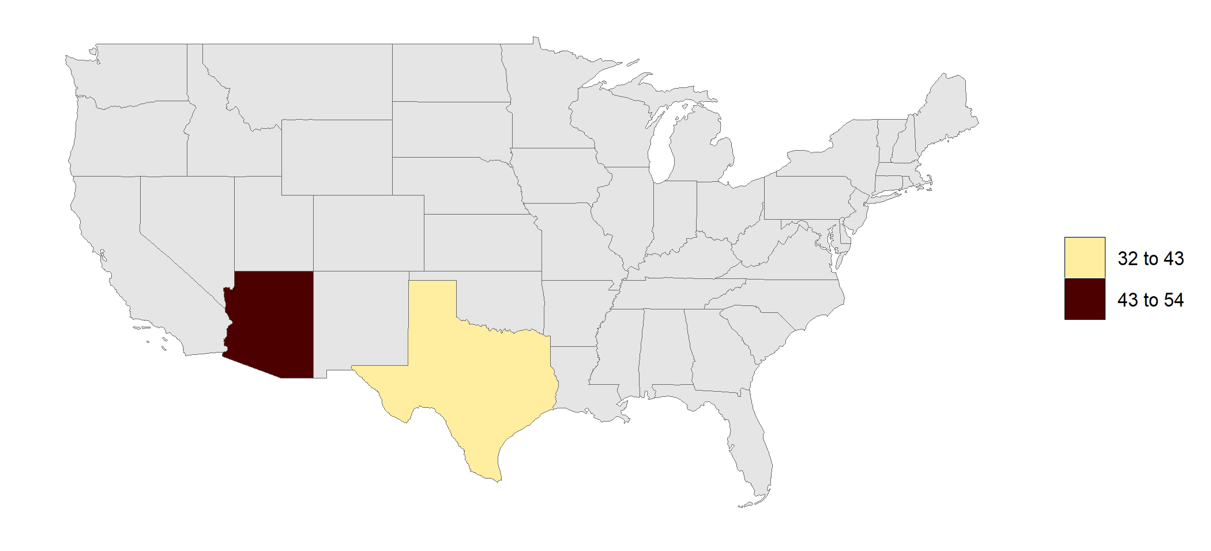
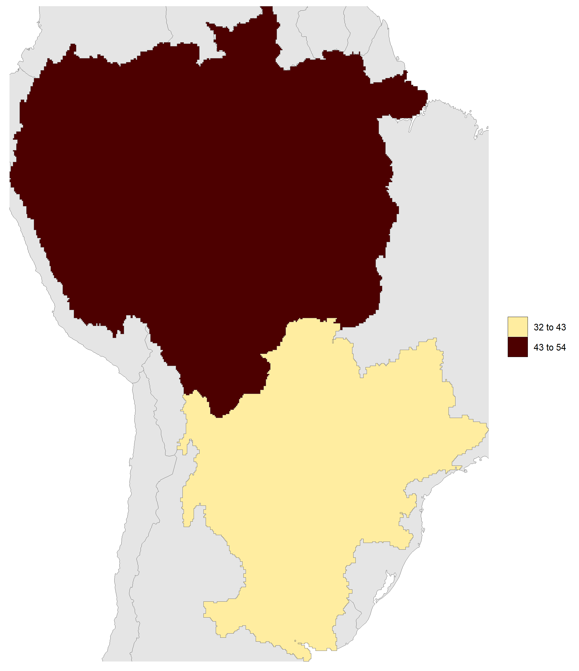
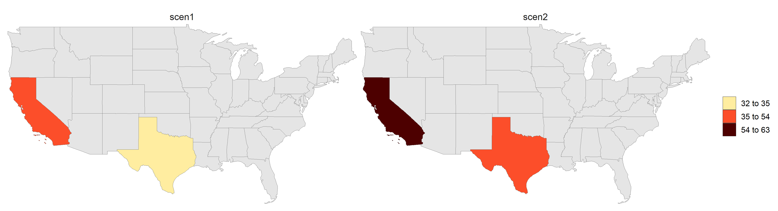
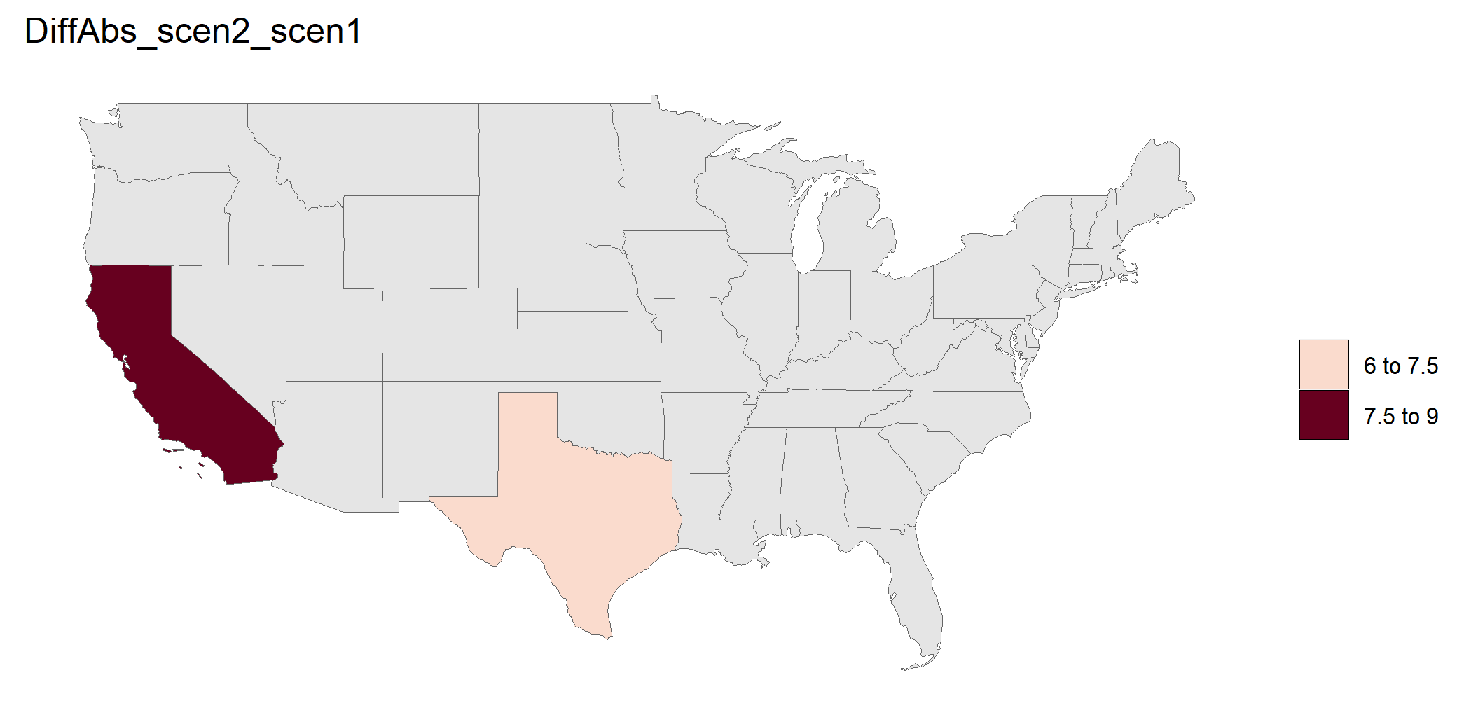
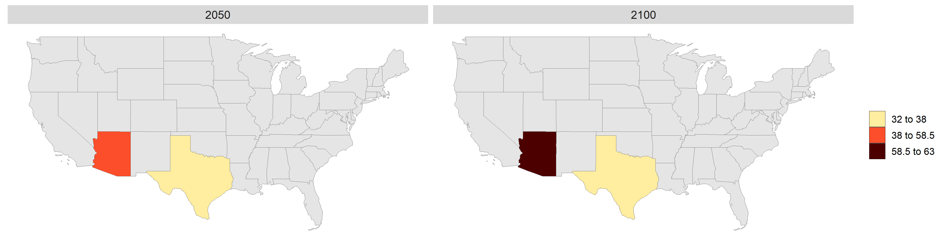

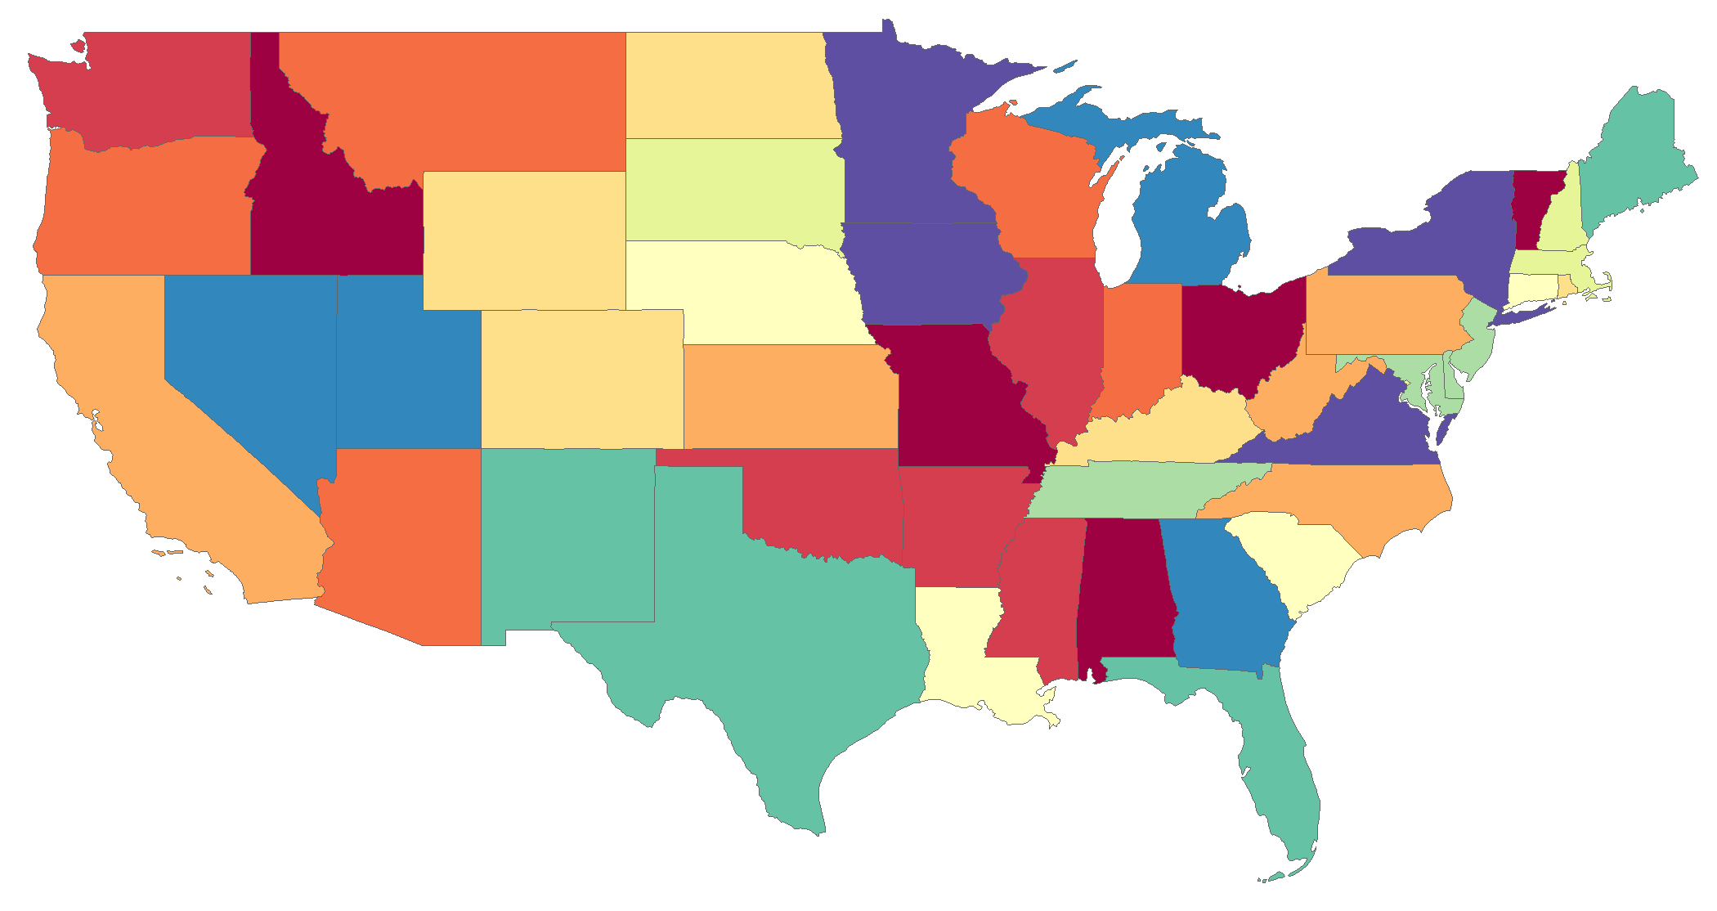
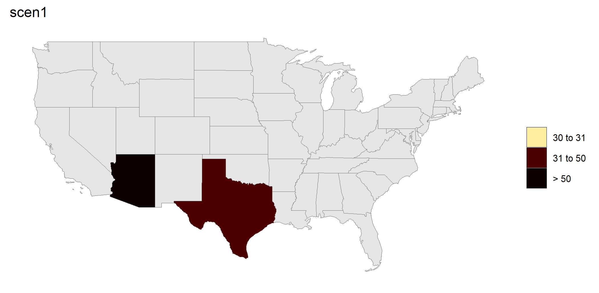
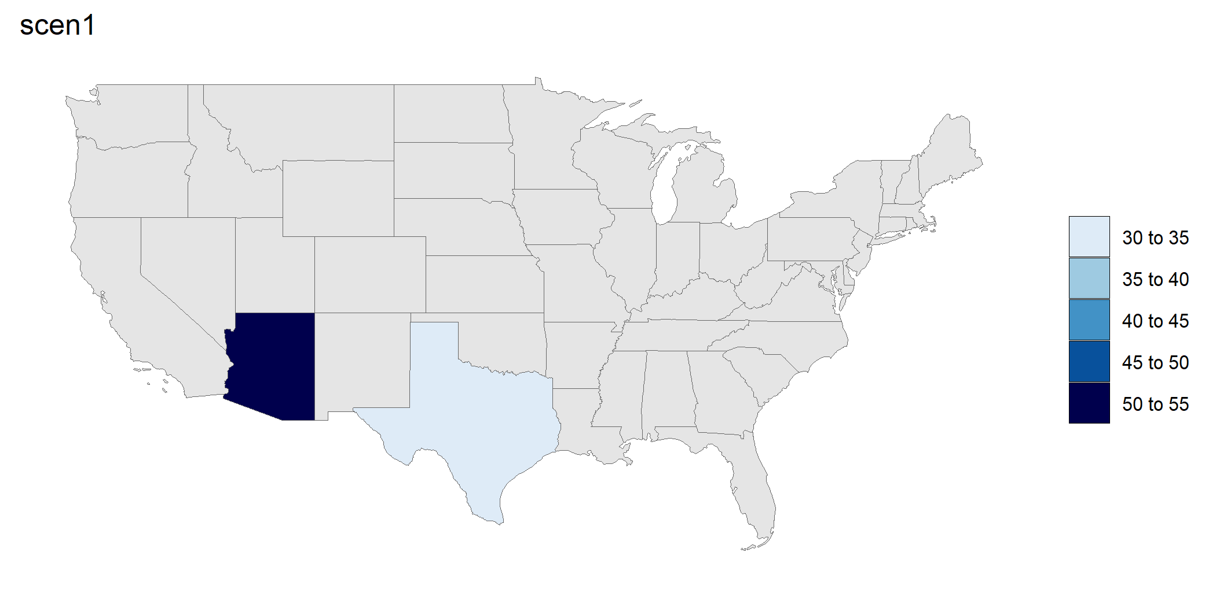
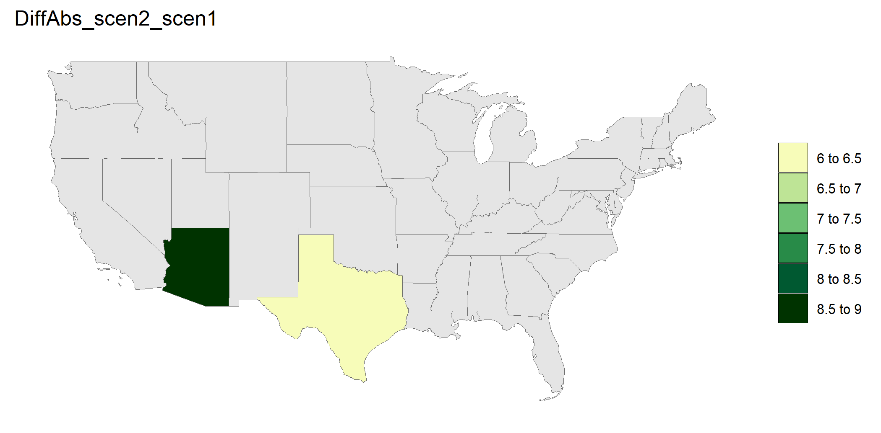
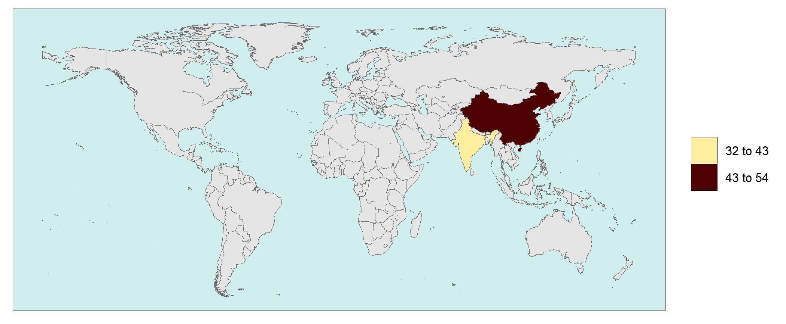
rmap Cheat Sheet
Pre-loaded Maps (Automatically find maps for data if available)
Github User Guide
US49
Crop
GCAM Basins
data = data.frame(subRegion = c("TX", "AZ"), value = c(32, 54))
map(data, underLayer = mapUS49)
data = data.frame(subRegion = c("TX", "AZ"), value = c(32, 54))
map(data, underLayer = mapUS49, crop = F)
data = data.frame( subRegion = c("La_Plata","Amazon"),
value = c(32,54))
map(data, underLayer = mapCountries )
Structure
KEY INPUTS FORMATS
my_polygon_file.csv OR R Data Frame
subRegion | value
TX | 32
AZ | 54
data = data.frame(
subRegion = c("TX","AZ"),
value = c(32,54))
Multiple Scenarios, Years and Classes
my_gridded_file.csv
Multi-scenario Diff plots
Multi-Year Animantion/Mean
Multi-Class
lat | lon | value
65.2 | -180 | 32
65.8 | -180 | 54
50 | -175 | 34
… | …. | …..
data = data.frame(subRegion = c("TX","TX", "CA", "CA"),
scenario = c("scen1","scen2","scen1","scen2"),
value = c(32, 38, 54, 63))
map(data, scenRef="scen1", underLayer = mapUS49, crop=F)
data = data.frame(subRegion = c("TX","TX", "AZ", "AZ"),
year = c("2050","2100","2050","2100"), value = c(32, 38, 54, 63))
map(data, folder="multiyear", underLyer=mapUS49, crop=F)
data = data.frame(subRegion = c("TX","TX", "AZ", "AZ"),
class = c("class1","class2","class1","class2"),
value = c(32, 38, 54, 63))
map(data, underLayer=mapUS49, crop=F)
NOTE: Works for regularly spaced gridded data
Optional Columns: param, scenario, year, class, units
INSTALLATION
# To Install for the first time
# install.packages(devtools); library(devtools);
# devtools::install_github(“JGCRI/rmap");
Customize Scales, Legend Type, Colors, Background
Set scale ranges
Change Palettes & Legend Type
Background
data = data.frame(subRegion = c("TX","TX", "AZ", "AZ"),
scenario = c("scen1","scen2","scen1","scen2"),
value = c(32, 38, 54, 63))
map(data, underLayer = mapUS49, crop=F , scenRef="scen1",
scaleRange = c(30,50), scaleRangeDiffPrcnt = c(10,30))
data = data.frame(subRegion = c("TX","TX", "AZ", "AZ"),
scenario = c("scen1","scen2","scen1","scen2"),
value = c(32, 38, 54, 63))
map(data, scenRef= "scen1", underLayer = mapUS49, crop=F,
palette = "pal_wet", paletteDiff = "pal_green " , legendType="pretty")
data = data.frame(
subRegion = c("India","China"), value = c(32,54))
map(data, underLayer = mapCountries, crop=F,
background = T)
RUN BASIC MAP WITHOUT DATA
library(rmap)
# List of all available maps:
# https://jgcri.github.io/rmap/reference/index.html
map(mapUS49)

