Slide 1



Thailand
Malaysia
Vietnam

Slide 2
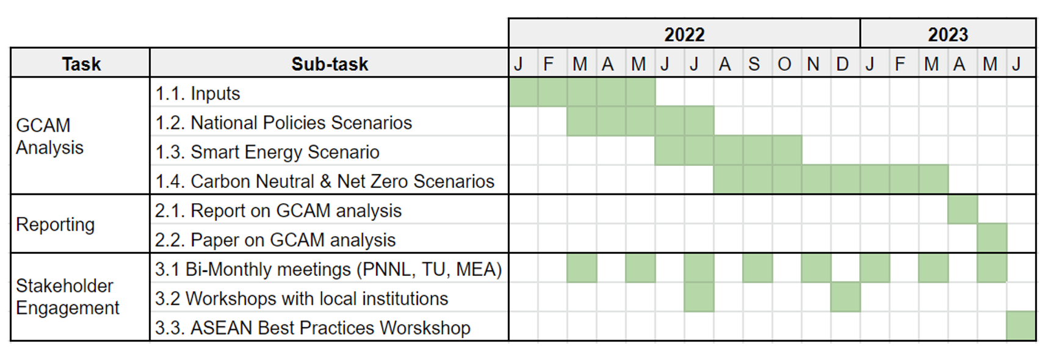
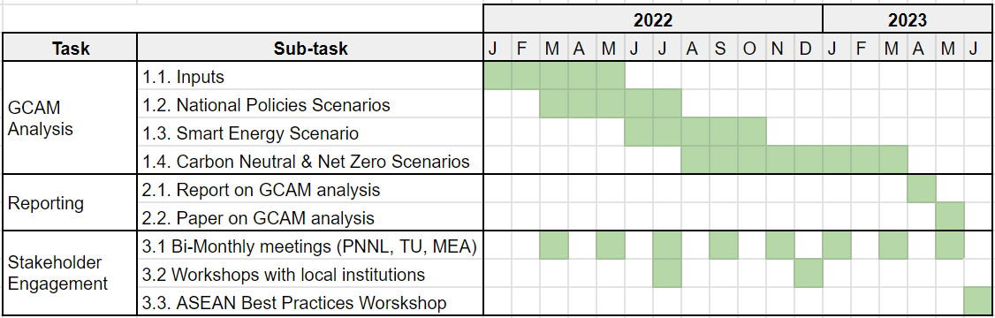

Slide 3
Background Motivation
US/ASEAN connections
Link to PNNL -> Thammasat/MEA/BMA -> Vision Prime Minster Ministries office etc.

Slide 4
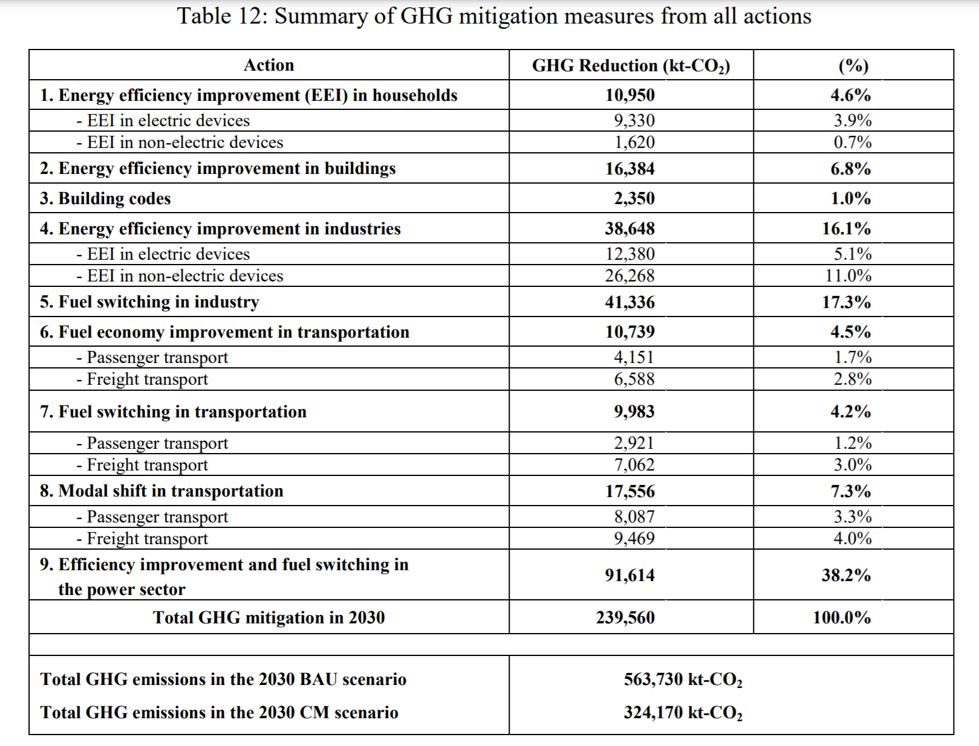
Mandatory
Extended
Smart
Mandatory
Extended
Smart
Action 1
Action 2
Action 1
Action 2
Action 1
Action 2

Slide 5







Slide 6


USASCP
US-ASEAN Smart Cities Partnership

Slide 7
USASCP
US-ASEAN Smart Cities Partnership
USASCP
US-ASEAN Smart Cities Partnership
Modeling & Analysis
Smart Grid Planning
Modeling & Analysis
Smart Grid Planning

Slide 8






Smart Grid Components
National Power Development Goals
MEA Focus Areas
Green Energy
Distributed Energy Resources
Supply Reliability
Energy Security
Meet demand
Ensure stability
Economy
Low costs
High efficiency
Environment
Support RE
Efficient production & consumption
Generation
Transmission & Distribution
Monitoring & Control
Data Analytics
Consumption
Customer Engagement

Slide 9
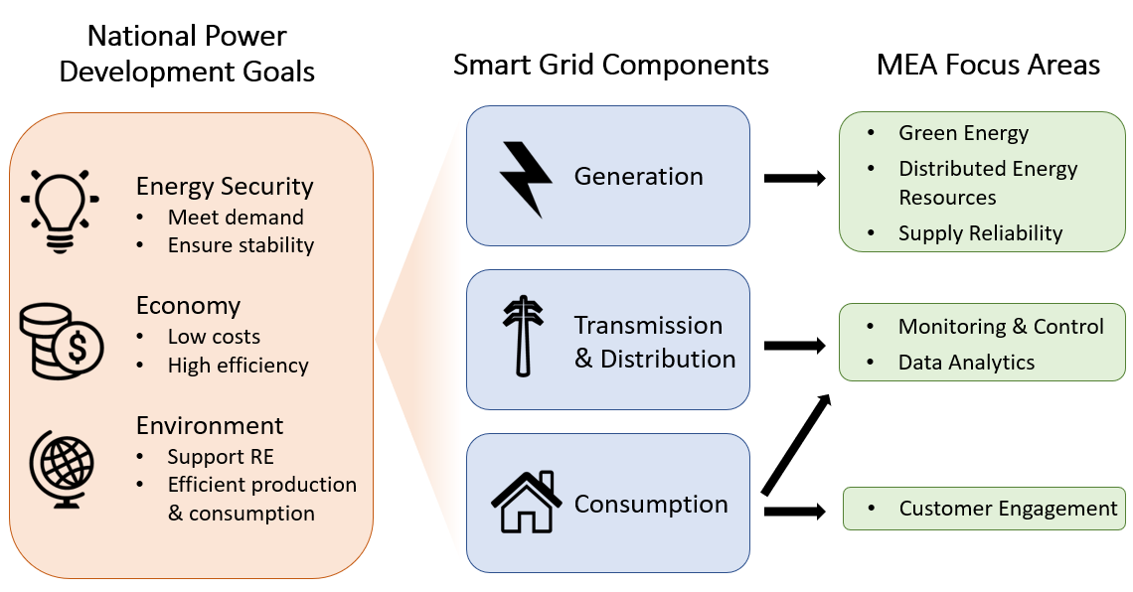

Slide 10
Thailand’s long-term low emissions development strategy

