Slide 1
PNNL-Thammasat Project Meeting
PNNL
Notes:
Stock Image

Slide 2
Agenda
Teams
PNNL team
Thammasat team
Other involved parties
Subcontract & timeline
Planning sheet
PNNL updates & webpage overview
Thammasat updates & questions
Next steps
Thammasat: share team members memo; start reviewing socioeconomic input data
PNNL: share other input data & assumptions; begin sharing scenario 1 details

Slide 3
Teams
Taryn Waite: Post- Bachelors Research Assistant
Zarrar Khan: Computational Scientist
Sha Yu: Earth Scientist
Meredydd Evans: Earth Scientist
Add photos?
Notes:
Both teams plus box w/ other people involved (include MEA, state dept)

Slide 4
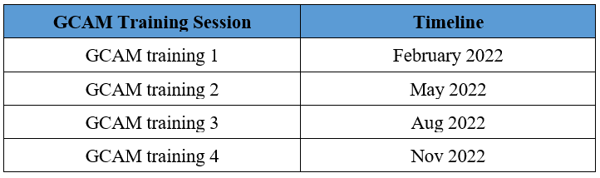
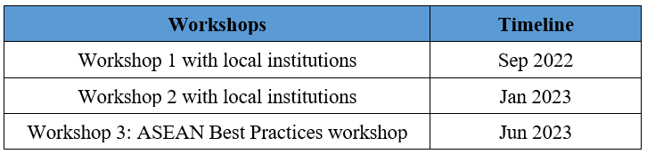
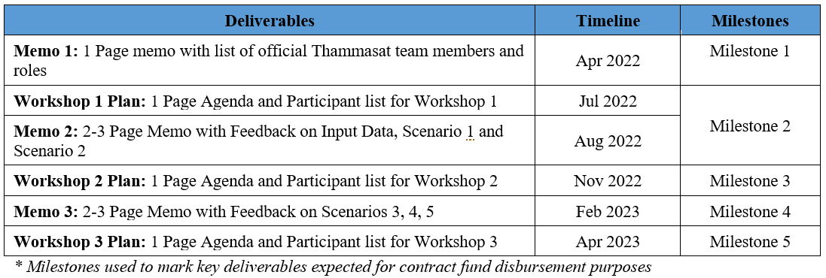
Subcontract Timelines

Slide 5
Project Updates
Shared project planning sheet: https://docs.google.com/spreadsheets/d/1jQSXzPSaTvditNO_GQzb6GlRBUEq08xXi0v8oyY403E/edit#gid=887696545
Notes:
Add planning sheet link

Slide 6
Next Steps
Continue monthly meetings
Subcontract?
Thammasat next steps
Team members memo
Start reviewing socioeconomic input data & assumptions
PNNL next steps
Share other input data & assumptions
Continue Scenario 1 development

