Slide 1

Modeling Carbon Neutral Pathways in Thailand and Bangkok
Zarrar Khan,
Taryn Waite, Maridee Weber,
Leeya Pressburger, Meredydd Evans
Pacific Northwest National Laboratory (PNNL)
Notes:
Stock Image

Slide 2
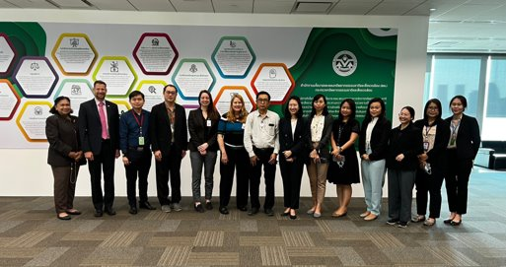
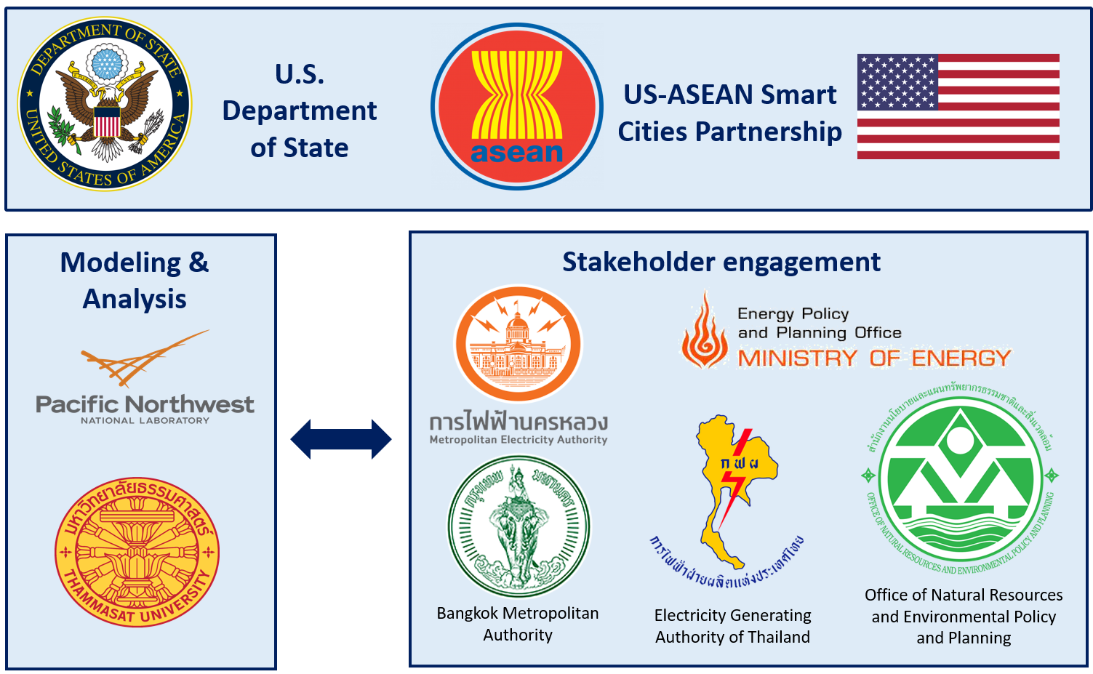
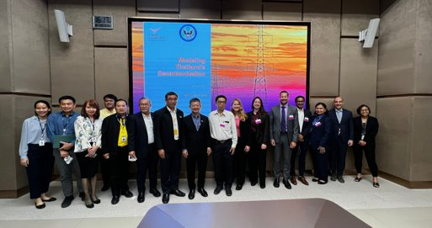
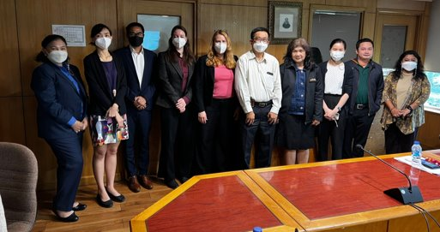
Strong US-Thai Collaboration: Partnering with Policy Makers and University Experts
PNNL team visit to Thailand (Jan 2023)
Thammasat University
Notes:
This project is funded by the US Department of State’s Bureau of Energy Resources or ENR. Aine Shiozaki from the State Department leads and guides this project which falls under the umbrella of the broader US-ASEAN Smart Cities Program.
I have to say, that more than the technical advancements, about which I will speak later, we are most proud of the genuine spirit of collaboration and teamwork that has flourished throughout this project.
On the technical front, we have fostered a very strong relationship with our colleagues from Thammasat University where Professor Bundit and his dedicated team have guided the development of our scenarios and model inputs throughout the modeling exercise. Through a series of highly interactive workshops and regular monthly meetings we successfully created a platform for the fruitful exchange of knowledge and capacity building on both sides. Our Thai colleagues have acquired commendable proficiency in operating a state of the art integrated assessment model, while our dedicated US team has made substantial strides in refining the model's inputs, calibration, and sectoral representations, all thanks to the invaluable feedback received from our local partners.
It is important to recognize that model development and analysis has been only one-half of the project and a key determinant of its success has been the interaction and guidance from our policy and decision makers on the ground responsible for implementing the findings. We are especially appreciative of the time, through reviews and feedback we received from our esteemed colleagues from both national and city scale organizations. At the national scale this included EPPO – the Energy Policy and Planning Office, EGAT – the Electricity Generating Authority of Thailand and ONEP – the office of Natural Resources and Environmental Policy and Planning. At the city scale this included MEA – the Metropolitan Electricity Authority and BMA – the Bangkok Metropolitan Authority.
On the left are some pictures from our teams visit to Thailand in January of this year where we were very warmly welcomed by all of the various entities just mentioned. We are very excited to be going back this August, to delve deeper into the results of our analysis and to forge even stronger ties with our counterparts.

Slide 3
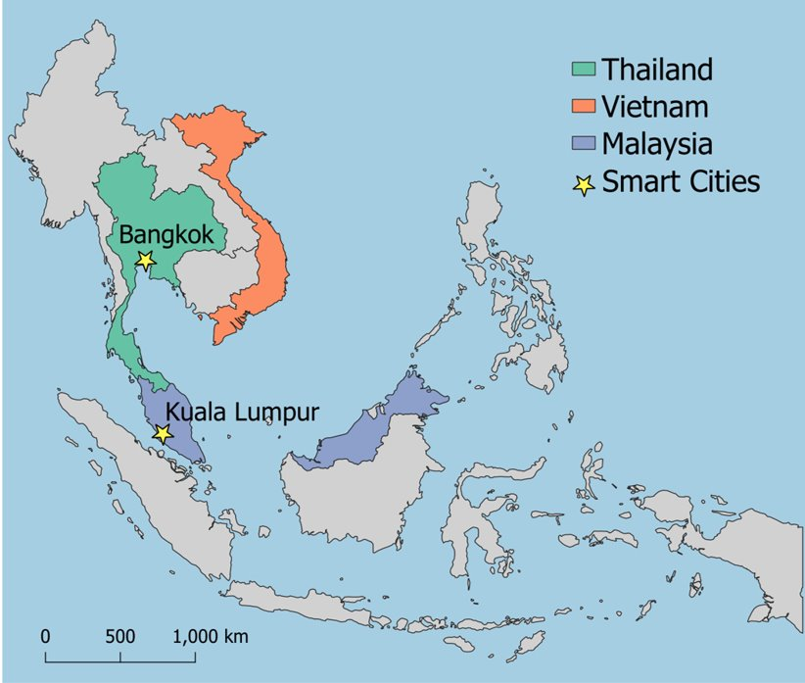
Integrated Multi-sector/Multi-scale Modeling in Smart Cities
Cities play an important role in decarbonization, and through meaningful stakeholder engagement and capacity building, this project helps enable smart city development in a net-zero context.
Using a global integrated model (GCAM) used by IPCC in all its reports and analysis:​
Earth systems (temperature, precipitation, yields etc.)​
Human systems (population, income, prices and preferences)​
Policies (mitigation, subsidies, taxes and building codes)
Helps identify the most beneficial decarbonization pathways at the city and national level
A map showing the location of the Smart Cities included in this pilot project.

Slide 4
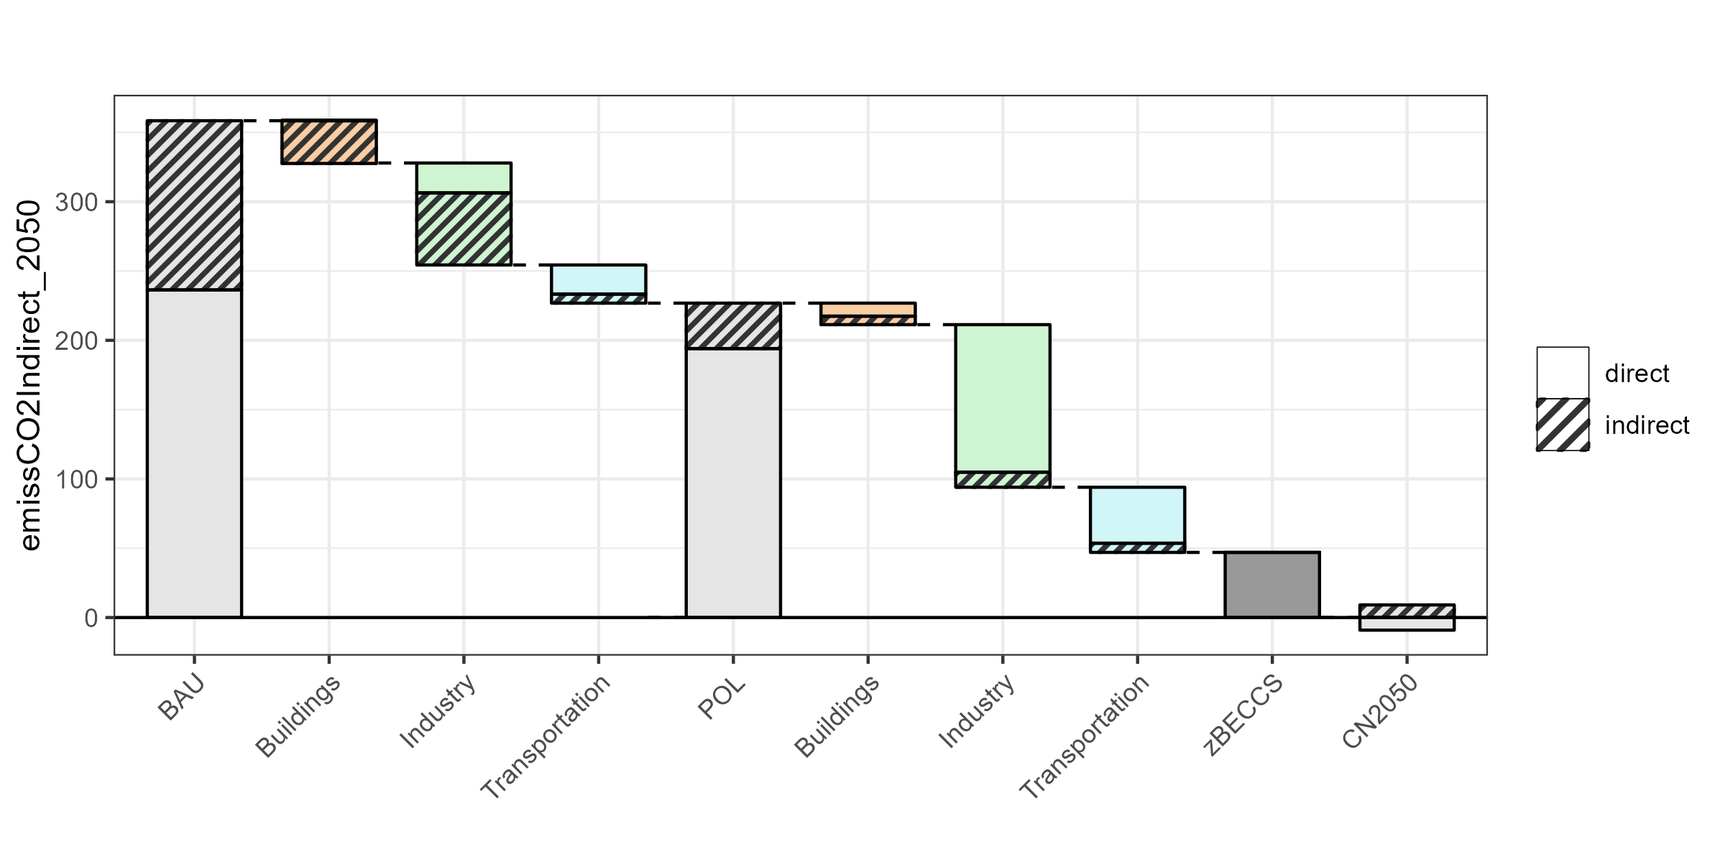


Thailand - Carbon Neutrality in 2050
Buildings
Air conditioner efficiency
Building envelope efficiency
Phase-out of non-LED lighting
Industry
Industrial energy efficiency improvement
Hydrogen fuels
Transportation
Electric vehicle cost reduction
Internal combustion engine vehicle phase-out
Buildings
Cooking electrification
Industry
Electrification
Increased use of hydrogen
Direct emissions
Direct and indirect CO₂ emissions (MTCO₂) in 2050
Indirect emissions from electricity consumption
BAU emissions
Policies residual emissions
Transportation
Further electrification
Carbon Neutral
Power
Solar, wind, and biomass development
Coal phase-out
CCS with gas
BECCS
Bangkok’s share of Thailand’s total 2050 emissions (grey) and share of emissions mitigation (colored)
BAU | Buildings | Industry | Transport | Policies | Buildings | Industry | Transport
10% | 29% | 8% | 5% | 6% | 26% | 4% | 2%
BECCS = Bioenergy carbon capture and storage

Slide 5





Key Insights
Electrification across sectors, accompanied by decarbonization of the power sector, will be key drivers for reaching carbon neutrality by 2050
Energy efficiency and demand-side measures will play a crucial role in decarbonization at the city and national levels
Hard-to-mitigate sectors will require carbon capture and storage (CCS); some emissions in these sectors will need to be offset using bioenergy with carbon capture and storage (BECCS) or other carbon sequestration technologies.
The Bangkok metropolitan area will play a key role in reaching national decarbonization targets
The extent of carbon sequestration achieved in the land use change (LUC) sector will have major implications for mitigation efforts needed in other sectors

Slide 6

https://jgcri.github.io/seasia
Zarrar Khan
zarrar.khan@pnnl.gov

