Slide 1

Modeling Carbon Neutral Pathways in Malaysia and Kuala Lumpur
Maridee Weber,
Leeya Pressburger, Taryn Waite,
Zarrar Khan, Meredydd Evans
Pacific Northwest National Laboratory
Notes:
Stock Image

Slide 2
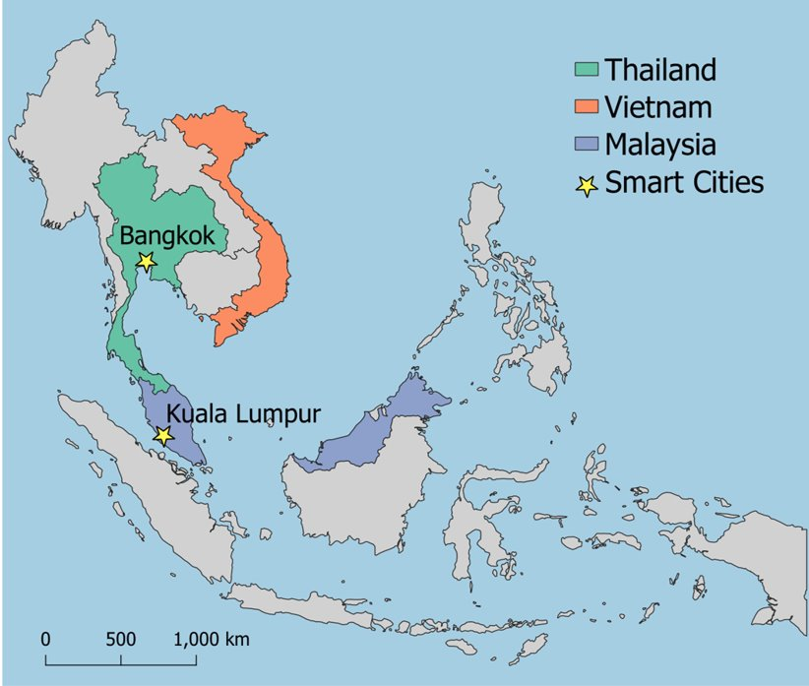




Integrated Multi-sector/Multi-scale Modeling in Smart Cities
Cities play an important role in decarbonization, and through meaningful stakeholder engagement and capacity building, this project helps enable smart city development in a net-zero context.
A global integrated model (GCAM) used by IPCC in all its reports and analysis:​
Earth systems (temperature, precipitation, yields etc.)​
Human systems (population, income, prices and preferences)​
Policies (mitigation, subsidies, taxes and building codes)
Helps identify the most beneficial decarbonization pathways at the city and national level
A map showing the location of the Smart Cities included in this pilot project.

Slide 3
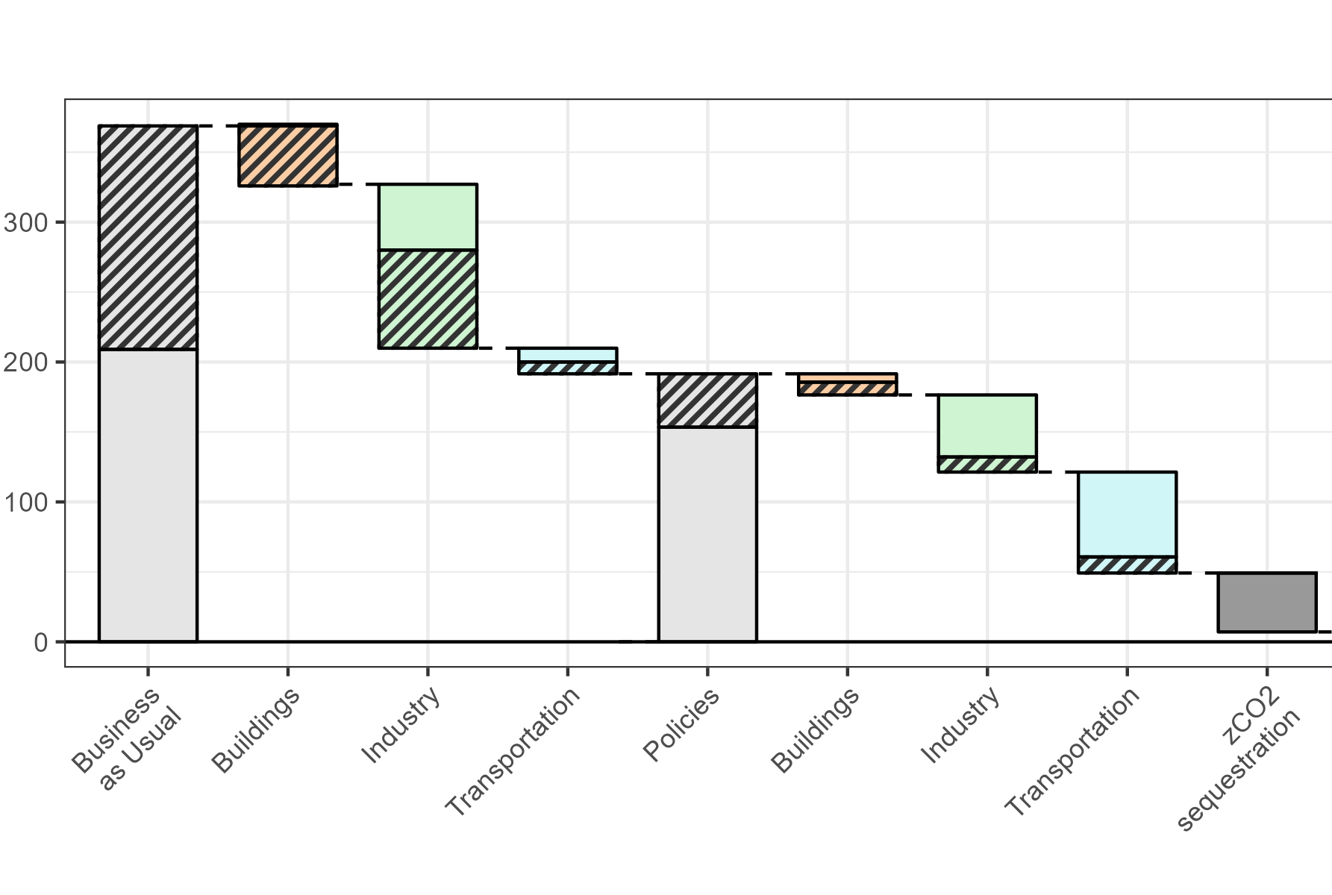


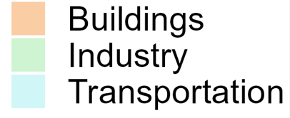
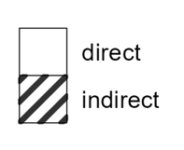
Malaysia - Carbon Neutrality 2050
Direct and indirect CO₂ emissions (MTCO₂) in Malaysia in 2050
Buildings
Further electrification
Buildings
Appliance efficiency
Building envelope efficiency
Phase-out of non-LED lighting
Industry
Increased use of hydrogen
Transportation
Further electrification
Industry
Industrial energy efficiency improvement
Hydrogen
Transportation
Modal shift
EV cost reduction
Carbon Neutral Malaysia
Power
Solar, hydro, and biomass development
Coal phase-out
Kuala Lumpur’s share of Malaysia’s total 2050 emissions (grey) and share of mitigation between scenarios (colored)
Business as Usual | Buildings | Industry | Transport | Policies | Buildings | Industry | Transport | Carbon Neutral
4% | 11% | 3% | 1% | 3% | 11% | 1% | 3% | 3%

Slide 4




Key Points
Strategies to reach net zero emissions by 2050 rely heavily on electrification across sectors and decarbonization of the power sector.
Energy efficiency and demand-side measures will majorly contribute to decarbonization efforts.
Hard-to-mitigate sectors will require the use of advanced technologies like carbon capture and storage and hydrogen fuel.
Cities will play a key role in national decarbonization strategies.

Slide 5
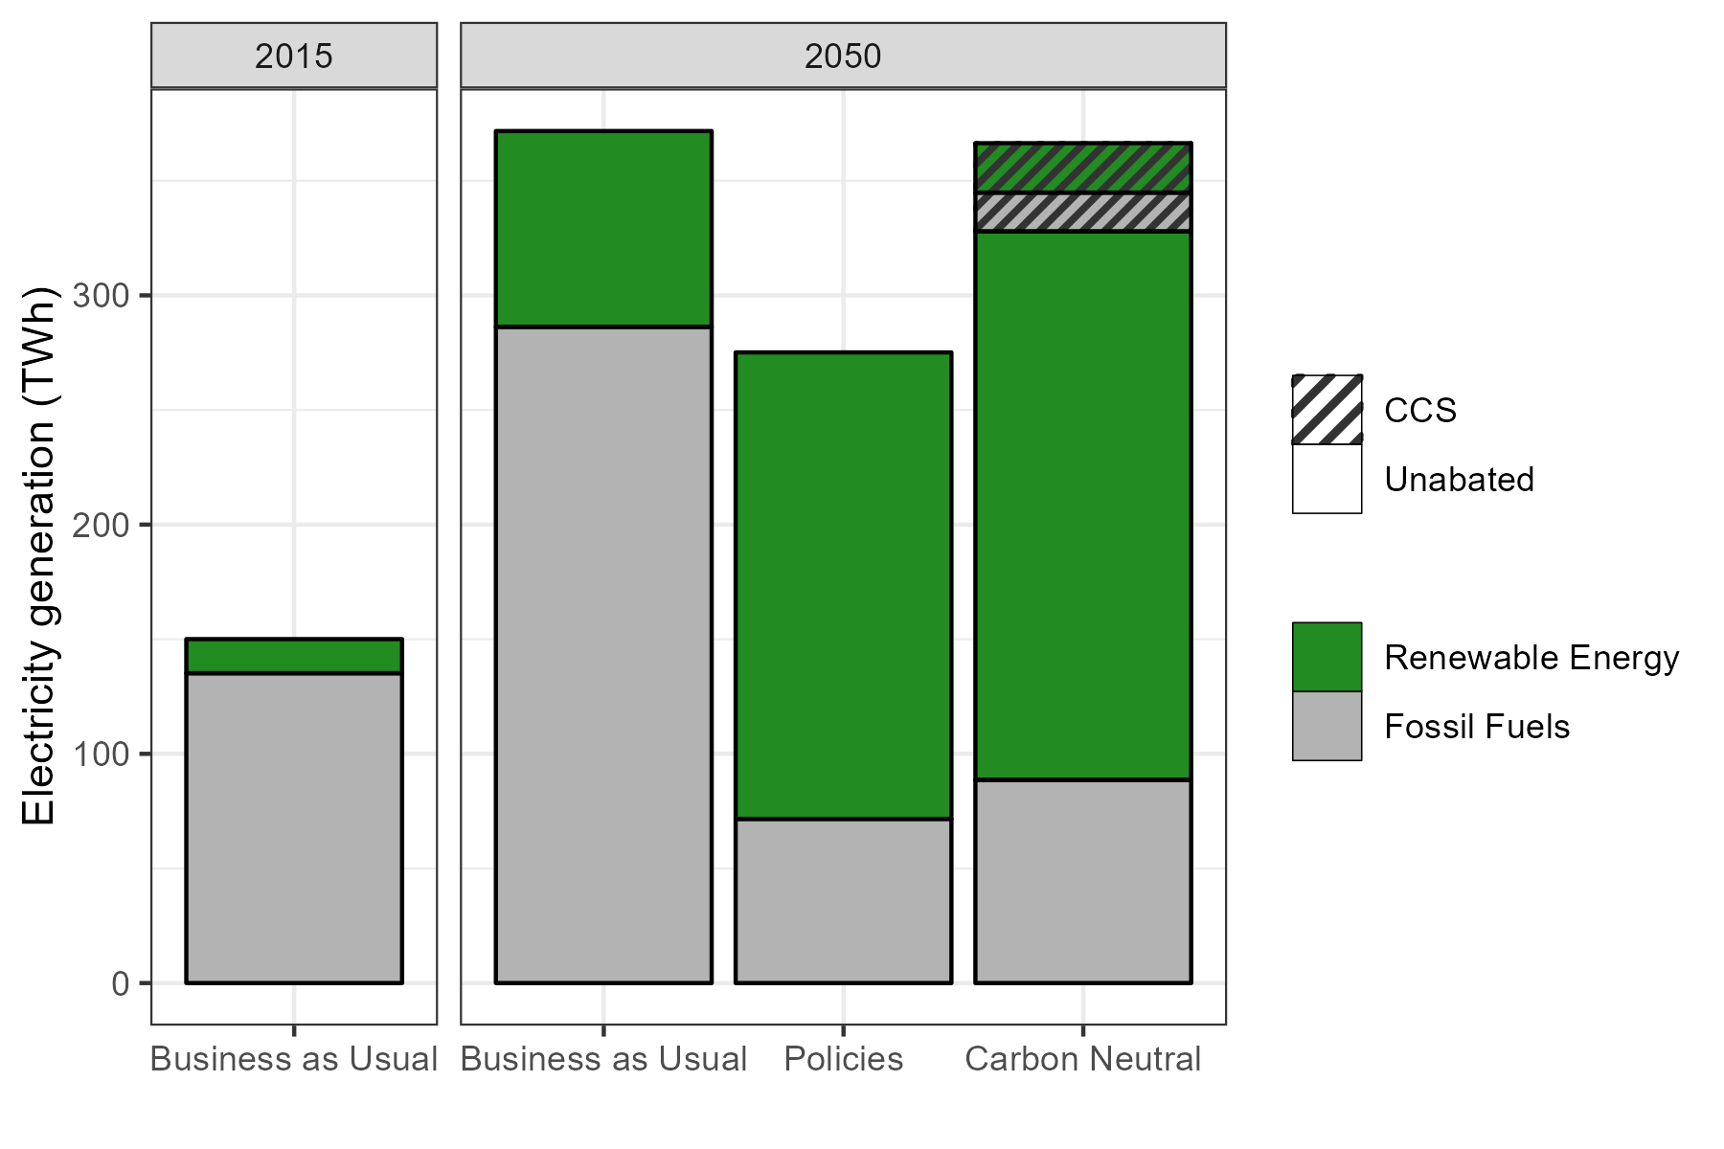
Widespread electrification and decarbonization of the power sector are critical for carbon neutrality.
Malaysia’s largest source of emissions is electricity. In a carbon neutral scenario, 42% of total emission reductions come from the power sector.

Slide 6
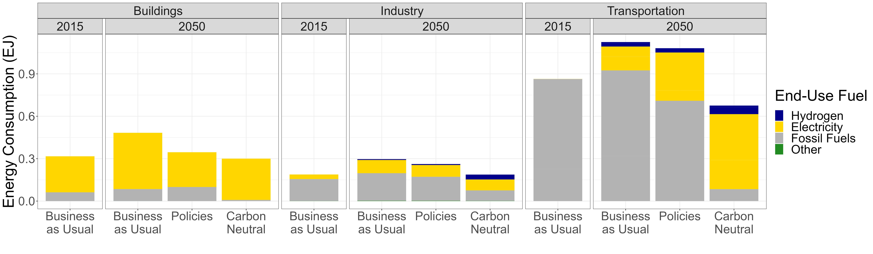
Energy efficiency and demand-side measures will majorly contribute to decarbonization efforts.
*
Energy consumption reductions stem from digitalization, smart technologies, and improved energy efficiency.
This includes high-efficiency appliances/lighting, industrial energy efficiency, greater use of electric vehicles, and a private-to-public transportation modal shift.

Slide 7
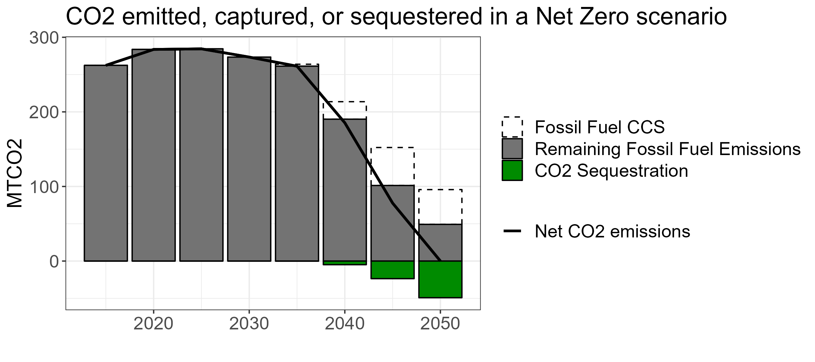
Hard-to-abate sectors require advanced technologies like carbon capture and storage and hydrogen.
CO₂ emitted, captured, or sequestered in a Carbon Neutral scenario
In a carbon neutral scenario:
Captured emissions are more than one quarter of 2050 BAU emissions.
Hydrogen is nearly one fifth of industrial and one tenth of transportation energy consumption.

Slide 8
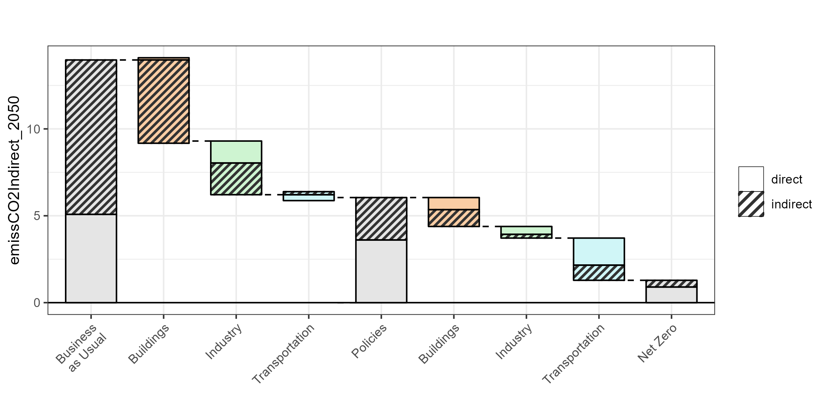





Kuala Lumpur plays a key role in national decarbonization.
Direct and indirect CO₂ emissions (MTCO₂) in Kuala Lumpur in 2050
MTCO₂
Carbon Neutral Malaysia
Kuala Lumpur’s share of Malaysia’s total 2050 emissions (grey) and share of mitigation between scenarios (colored)
Business as Usual | Buildings | Industry | Transport | Policies | Buildings | Industry | Transport | Carbon Neutral
4% | 11% | 3% | 1% | 3% | 11% | 1% | 3% | 3%
Kuala Lumpur makes up 2% of Malaysia’s emissions in 2020 and contributes 4% of the reductions required to achieve carbon neutrality in Malaysia.

Slide 10


Demand Side Implications of Malaysian Carbon Neutrality
Direct and indirect CO₂ emissions (MTCO₂) in Malaysia in 2050
Buildings
Further electrification
Buildings
Appliance efficiency
Building envelope efficiency
Phase-out of non-LED lighting
Industry
Increased use of hydrogen
Transportation
Further electrification
Industry
Industrial energy efficiency improvement
Hydrogen
Transportation
Modal shift
EV cost reduction
Net Zero Malaysia
Power
Solar, hydro, and biomass development
Coal phase-out
Kuala Lumpur’s share of Malaysia’s total 2050 emissions (grey) and share of mitigation between scenarios (colored)
BAU | Buildings | Industry | Transport | Policies | Buildings | Industry | Transport | Net Zero
4% | 11% | 3% | 1% | 3% | 11% | 1% | 3% | 3%

Slide 11



Kuala Lumpur plays a key role in national decarbonization.
Direct and indirect CO₂ emissions (MTCO₂) in Kuala Lumpur in 2050
BAU emissions
MTCO₂
Residual emissions
Malaysia
Kuala Lumpur’s share of Malaysia’s total 2050 emissions (grey) and share of mitigation between scenarios (colored)
BAU | Buildings | Industry | Transport | Policies | Buildings | Industry | Transport | Net Zero
4% | 11% | 3% | 1% | 3% | 11% | 1% | 3% | 3%
Kuala Lumpur makes up 2% of Malaysia’s emissions in 2020 and contributes 4% of the reductions required to achieve carbon neutrality in Malaysia.

