Slide 1
PNNL-Thammasat Project Meeting
PNNL
Notes:
Stock Image

Slide 2
Agenda
Subcontract
Upcoming deliverables
Population & GDP data discussion
Additional GCAM questions
Energy consumption
EEP2018 sector names
Stakeholder Engagement (MEA, BMA, EPPO, EGAT)
Next steps

Slide 3
Subcontract
Project Time Period: 02 May 2022 to 30 June 2023
Objective: Explore policy and technology pathways to carbon neutrality (2050) and net-zero emission (2065) in Bangkok through technical analysis and engagement with local stakeholders and experts.
GCAM Training Session | Timeline
GCAM training | Jun 2022
GCAM training | Sep 2022
GCAM training | Dec 2022
Workshops | Timeline
Workshop 1 with local institutions | Sep 2022
Workshop 2 with local institutions | Jan 2023
Workshop 3: ASEAN Best Practices workshop | Jun 2023
Deliverables | Timeline | Milestones
Memo 1: 1 Page memo with list of official Thammasat team members and roles | May 2022 | Milestone 1
Workshop 1 Plan: 1 Page Agenda and Participant list for Workshop 1 | Jul 2022
Memo 2: 2-3 Page Memo with Feedback on Input Data, Scenario 1 and Scenario 2 | Aug 2022 | Milestone 2
Workshop 2 Plan: 1 Page Agenda and Participant list for Workshop 2 | Nov 2022
Memo 3: 2-3 Page Memo with Feedback on Scenarios 3, 4, 5 | Feb 2023 | Milestone 3
Workshop 3 Plan: 1 Page Agenda and Participant list for Workshop 3 | Apr 2023 | Milestone 4

Slide 4
Upcoming Deliverables
Memo 1 (Official list of team and roles)
Person of Contact?
Workshop 1
Content (introductory)
Possible dates & times
Who to invite
Planning sheet

Slide 5

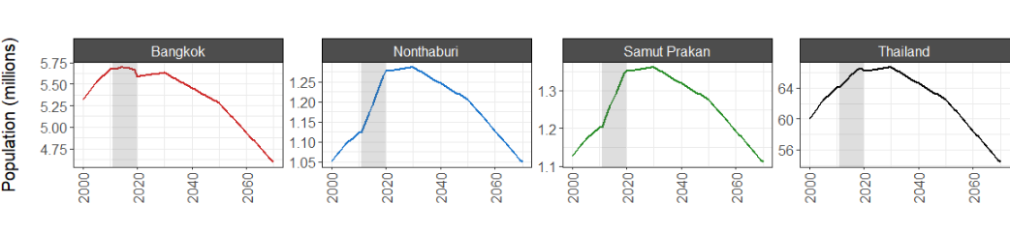
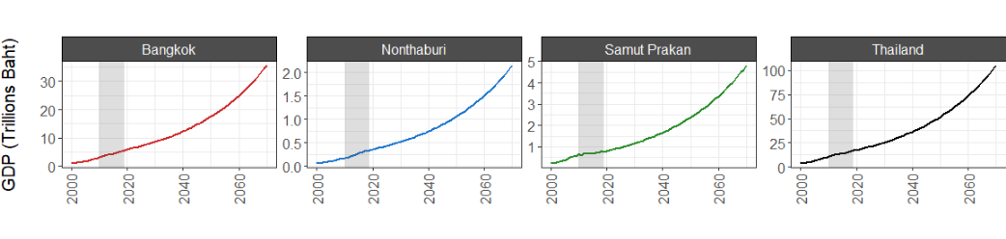
Population & GDP data
Raw Data: https://github.com/JGCRI/seasia/tree/main/data/Thailand/socioeconomic_inputs
Variable | Assumptions | Data Sources
Population | Pre-2010 and post-2019 population growth rates consistent between regions | All regions 2010-2019: NSO Pre-2010 & post-2020 growth rates: UN
GDP | Pre-2011 and post-2020 GDP growth rates consistent between regions | All regions 2011-2020: NSO Pre-2011 growth rates: WB 2021-2037 growth rates: PDP2018
 | Post-2037 GDP growth rate constant everywhere

Slide 6
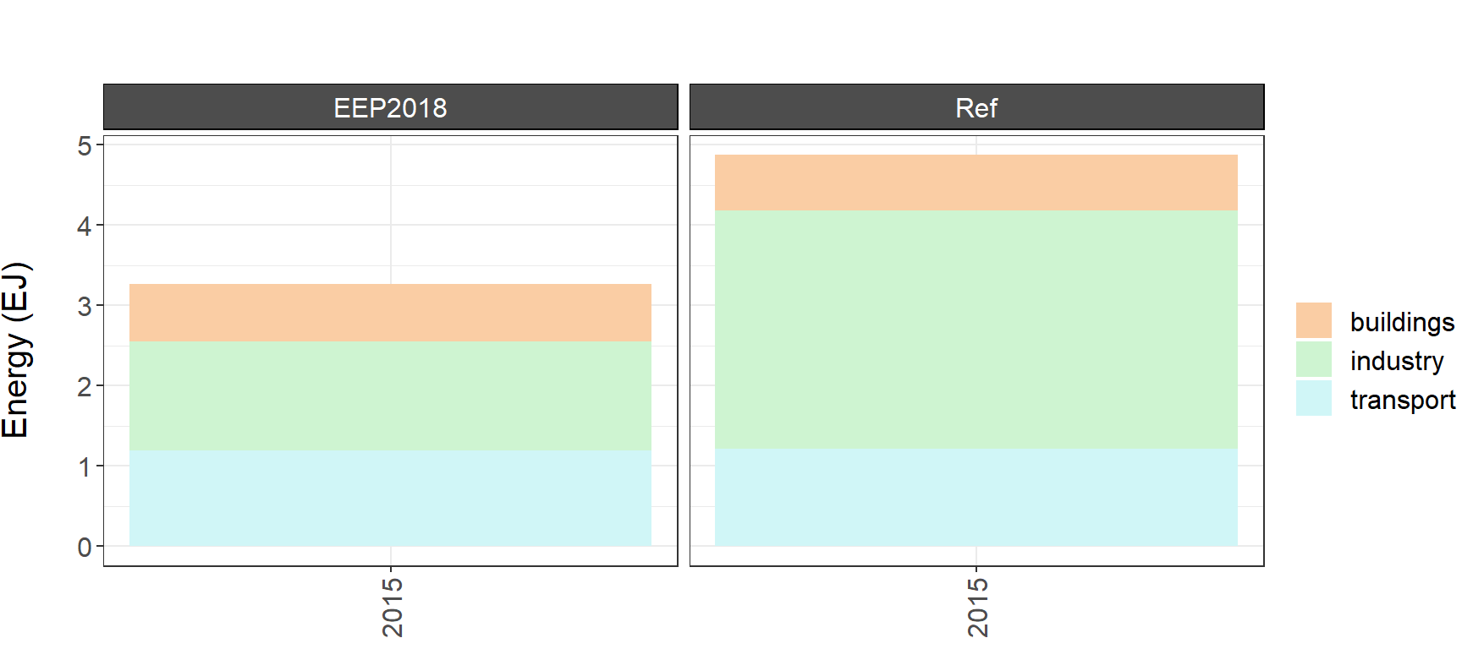
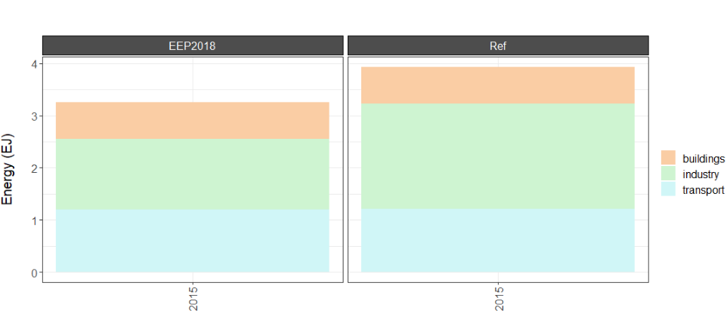
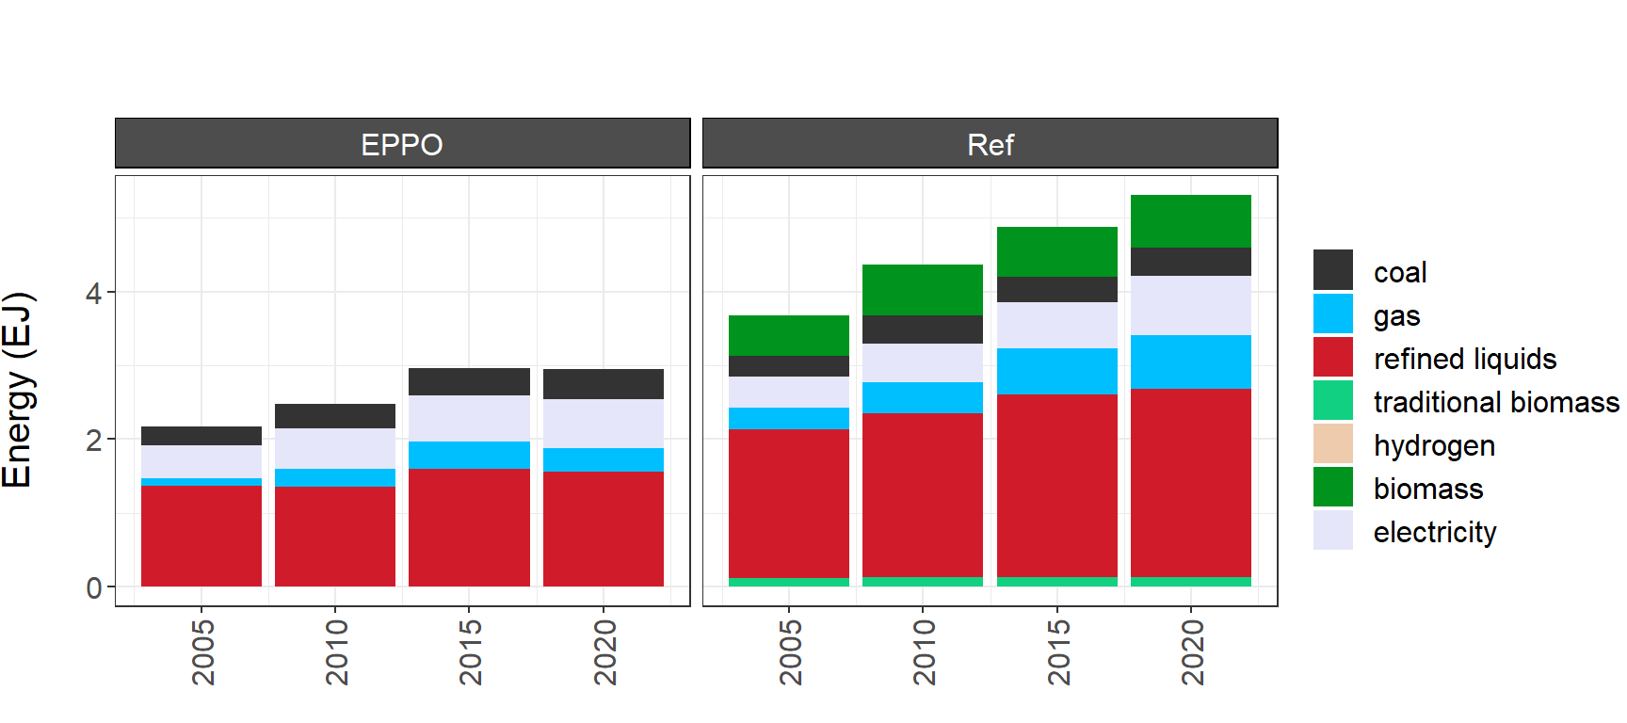
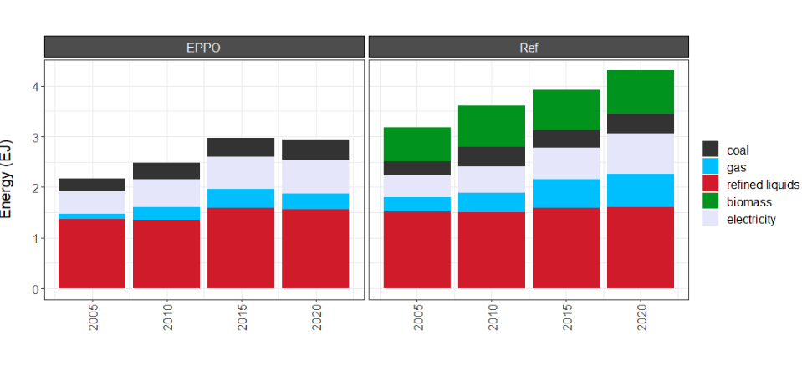
Energy consumption
All Raw Data: https://github.com/JGCRI/seasia/tree/main/data/Thailand/scenario_outputs/initial_diagnostics
Local Data Sources: EPPO (by fuel) and EEP2018 (by sector)
With industrial feedstocks (Ref)
Without industrial feedstocks (Ref)

Slide 7
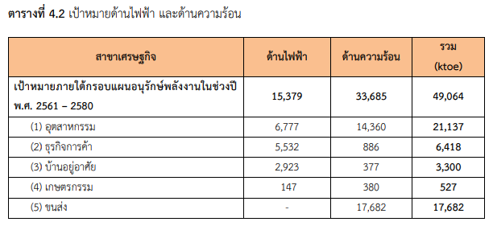
EEP2018 Energy Consumption Sectors
GCAM sectors
EEP2018
Industry
Buildings (commercial)?
Buildings (residential)
Industry (agriculture)
Transport
Energy Efficiency Plan 2018-2037 (EEP 2018): https://www.dede.go.th/ewt_w3c/ewt_dl_link.php?filename=index&nid=54495

Slide 8
Stakeholder Engagement
MEA
Invite Khun Nattanont to next PNNL-Thammasat meeting to give update?
Follow up with:
BMA:
Aine responded to Khun Akkarapol and BMA by email about their request for further info (28 Mar 2022)
EPPO:
Khun Por sent email on 3 Mar 2022 saying that EPPO wanted to talk to Prof. Bundit.
EGAT:
Email received from EGAT (Siripan) on 24 Mar 2022 acknowledging receipt and that they will respond about collaboration

Slide 9
Next Steps
PNNL
Integrate feedback
Continue developing Scenario 1
Thammasat
Memo 1 (Official list of team and roles)
Workshop 1
Planning sheet

