Slide 1
PNNL-Thammasat Project Meeting
PNNL
Notes:
Stock Image

Slide 2
Agenda
Teams
PNNL team
Thammasat team
Other involved parties
Subcontract & timeline
Planning sheet
PNNL updates & webpage overview
Thammasat updates & questions
Next steps
Thammasat: share team members memo; start reviewing socioeconomic input data
PNNL: share other input data & assumptions; begin sharing scenario 1 details

Slide 3
Teams
PNNL
Sha Yu: Earth Scientist
Meredydd Evans: Earth Scientist
Zarrar Khan: Computational Scientist
Taryn Waite: Post- Bachelors Research Assistant
Thammasat University
Bundit Limmechokchai
Bijay Bahadur Pradhan, Post-doctorate Student
Salony Rajbhandari, Post-doctorate Student
Achiraya, Doctorate Student
Lorm Rathana, Masters Student
Piti Pita, Research Assistant
Pornphomon Winyuchakrit, Senior Research Assistant
Daranee Jareemit, Department of Architecture and Planning
Other parties involved
MEA (Point of Contact: Khun Nattanont)
US Department of State (Point of Contact: Aine Shiozaki)

Slide 4
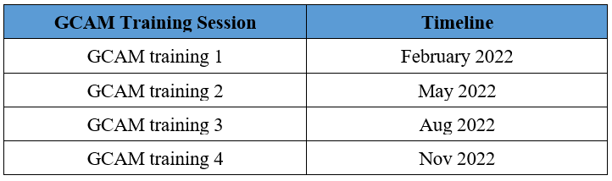
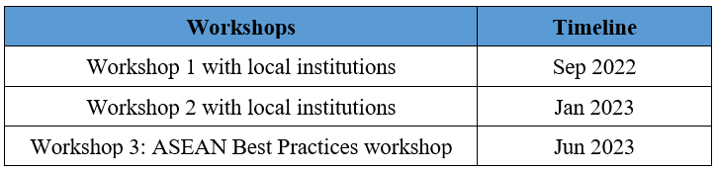
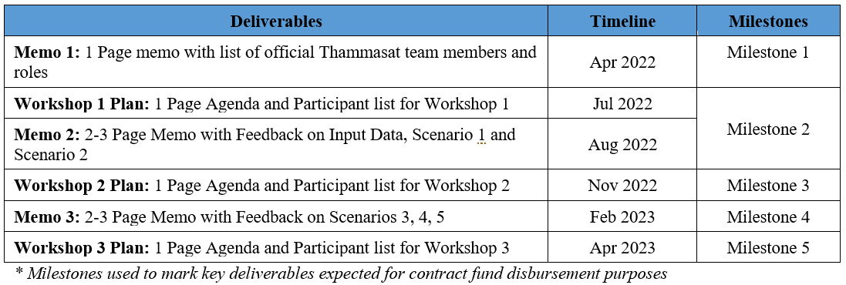
Subcontract Timelines

Slide 5
Project Updates
Shared project planning sheet: https://docs.google.com/spreadsheets/d/1jQSXzPSaTvditNO_GQzb6GlRBUEq08xXi0v8oyY403E/edit#gid=887696545

Slide 6
Next Steps
Continue monthly meetings
Subcontract questions/ concerns
Thammasat next steps
Team members memo
Start reviewing socioeconomic input data & assumptions
PNNL next steps
Share other input data & assumptions
Continue Scenario 1 development

