Slide 1
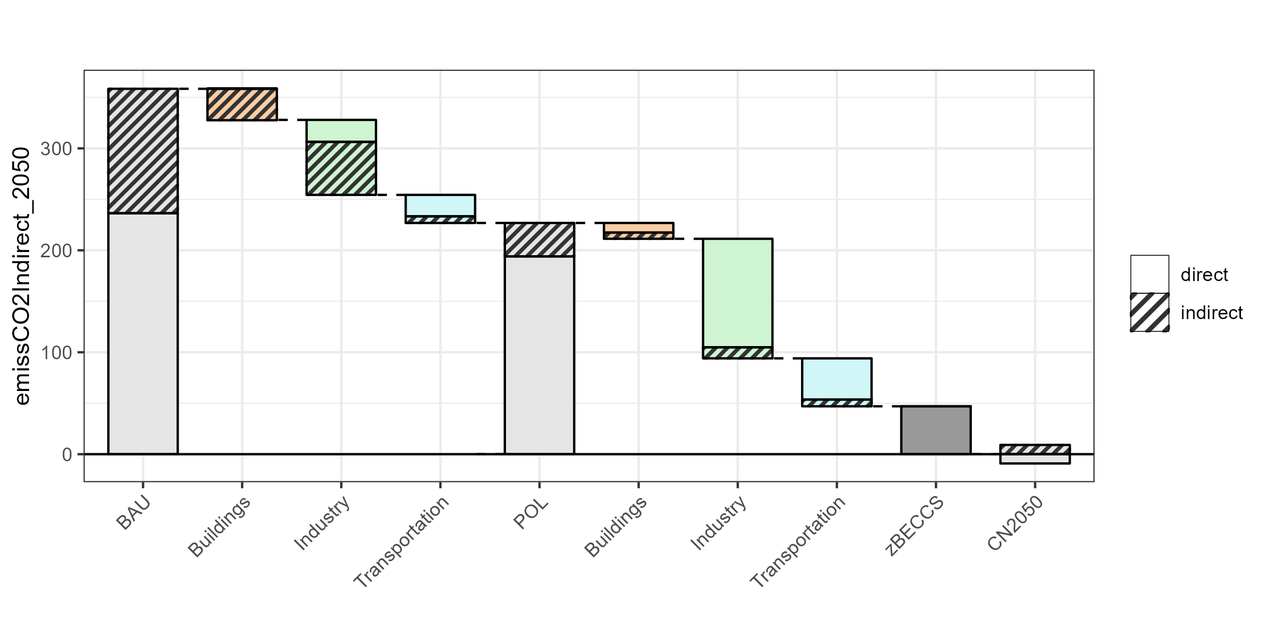
Buildings
Air conditioner efficiency
Building envelope efficiency
Phase-out of non-LED lighting
Industry
Industrial energy efficiency improvement
Hydrogen fuels
Transportation
Electric vehicle cost reduction
Internal combustion engine vehicle phase-out
Buildings
Cooking electrification
Industry
Electrification
Increased use of hydrogen
Direct emissions
Direct and indirect CO₂ emissions (MTCO₂) in 2050
Indirect emissions from electricity consumption
BAU emissions
Policies residual emissions
Transportation
Further electrification
Carbon Neutral
Power
Solar, wind, and biomass development
Coal phase-out
CCS with gas
BECCS
Bangkok’s share of Thailand’s total 2050 emissions (grey) and share of emissions mitigation (colored)
BAU | Buildings | Industry | Transport | Policies | Buildings | Industry | Transport
10% | 29% | 8% | 5% | 6% | 26% | 4% | 2%
BECCS = Bioenergy carbon capture and storage
Notes:
Version 1: without sectoral breakdown of total emissions in the BAU and Policies bar

Slide 2


Buildings
Air conditioner efficiency
Building envelope efficiency
Phase-out of non-LED lighting
Industry
Industrial energy efficiency improvement
Hydrogen fuels
Transportation
Electric vehicle cost reduction
Internal combustion engine vehicle phase-out
Buildings
Cooking electrification
Industry
Electrification
Increased use of hydrogen
Direct emissions
Direct and indirect CO₂ emissions (MTCO₂) in 2050
Indirect emissions from electricity consumption
BAU emissions
Policies residual emissions
Transportation
Further electrification
Carbon Neutral
Power
Solar, wind, and biomass development
Coal phase-out
CCS with gas
BECCS
Bangkok’s share of Thailand’s total 2050 emissions (grey) and share of emissions mitigation (colored)
BAU | Buildings | Industry | Transport | Policies | Buildings | Industry | Transport
10% | 29% | 8% | 5% | 6% | 26% | 4% | 2%
BECCS = Bioenergy carbon capture and storage
Notes:
Version 2: with sectoral breakdown of total emissions in the BAU and Policies bar (too busy?)

Slide 3





Electrification across sectors, accompanied by decarbonization of the power sector, will be key drivers for reaching carbon neutrality by 2050
Energy efficiency and demand-side measures will play a crucial role in decarbonization at the city and national levels
Hard-to-mitigate sectors will require carbon capture and storage (CCS); some emissions in these sectors will need to be offset using bioenergy with carbon capture and storage (BECCS).
The Bangkok metropolitan area will play a key role in reaching national decarbonization targets
The extent of carbon sequestration achieved in the land use change (LUC) sector will have major implications for mitigation efforts needed in other sectors

Slide 4
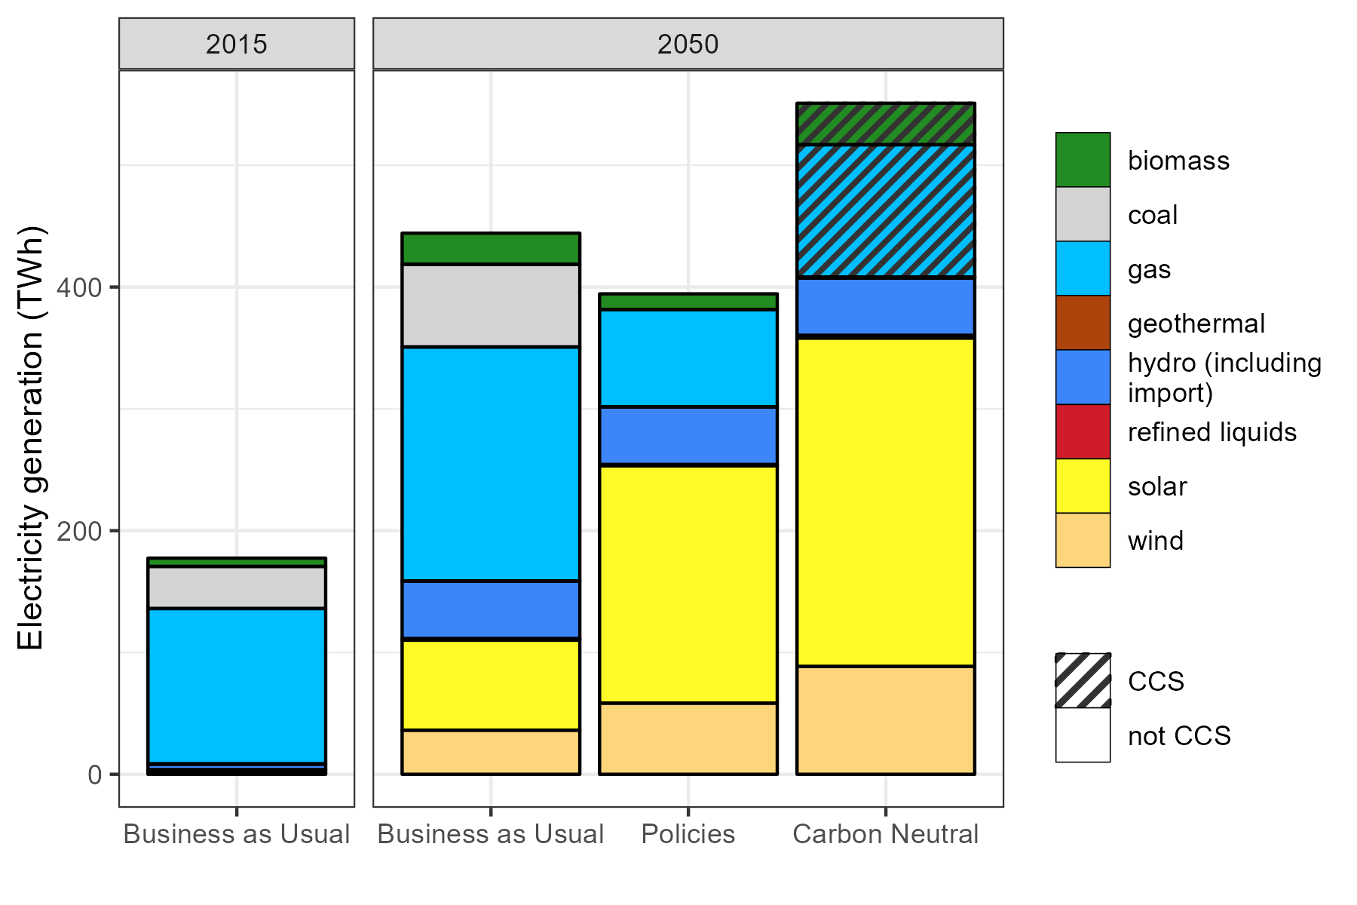


Electrification and power sector decarbonization will play a key role in reaching carbon neutrality
CCS
Unabated
Wind and solar expansion, as well as CCS at gas and biomass power plants, will be needed to decarbonize the power sector. End-use electrification will increase the total demand for electricity.

Slide 5
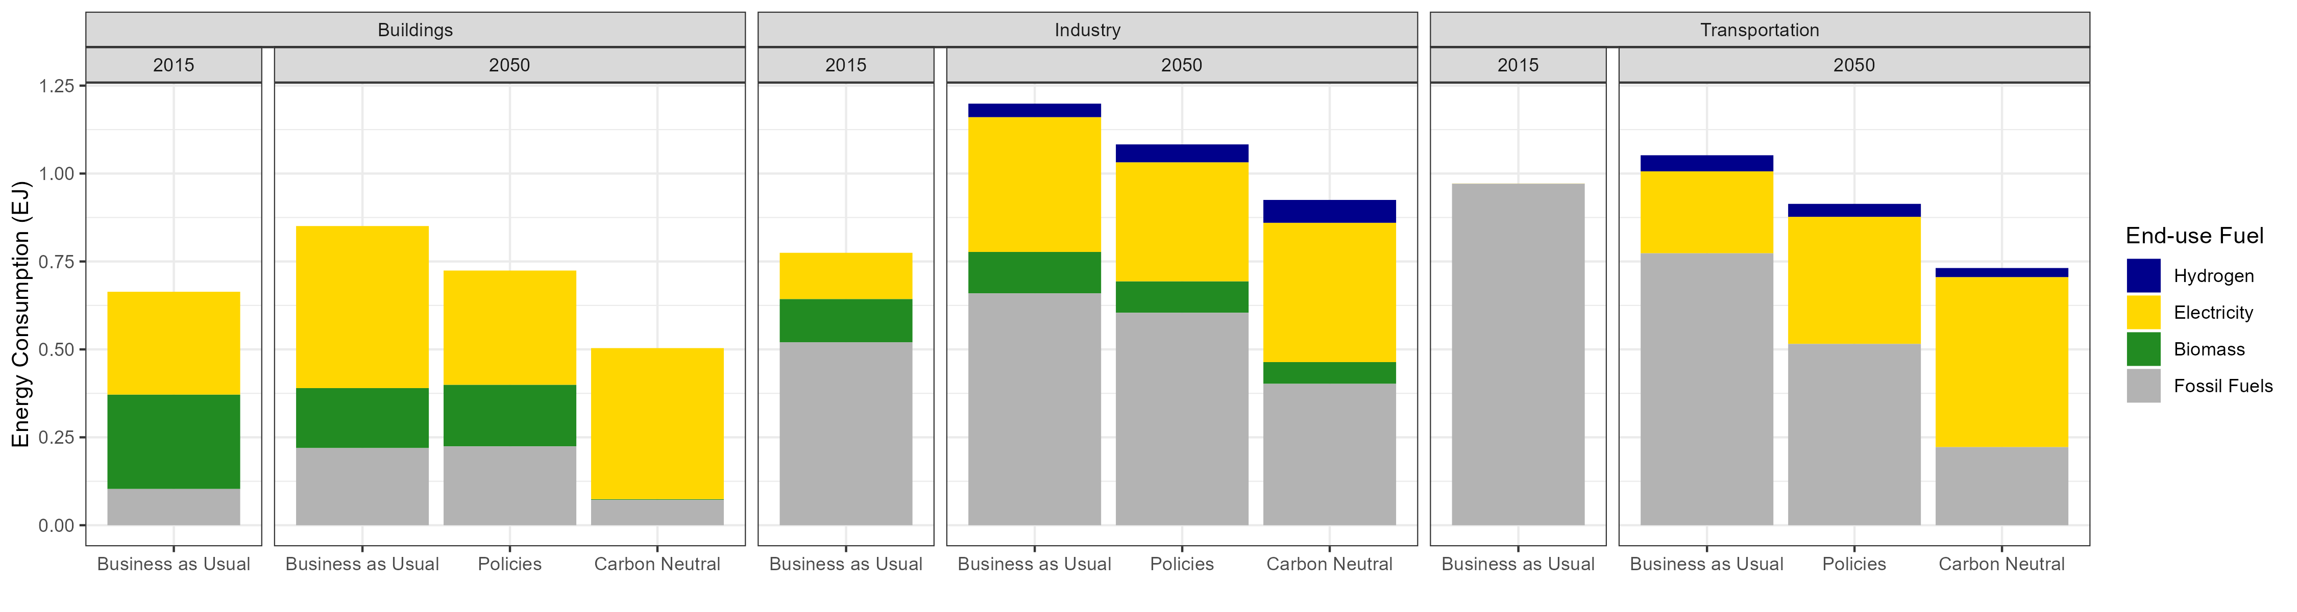


Extensive energy efficiency and demand- side measures are needed
z
Transport electrification:
Efficient lighting, air conditioners, and building envelopes
Efficient industrial processes and electrification
86%
Of cars and motorcycles
26%
Of buses
78%
Electric cookstoves
Hydrogen fuel and CCS in hard-to-abate industries
95%
Of freight trucks
Notes:
This is the version that does not include industrial feedstocks (“non-energy” use)

Slide 6
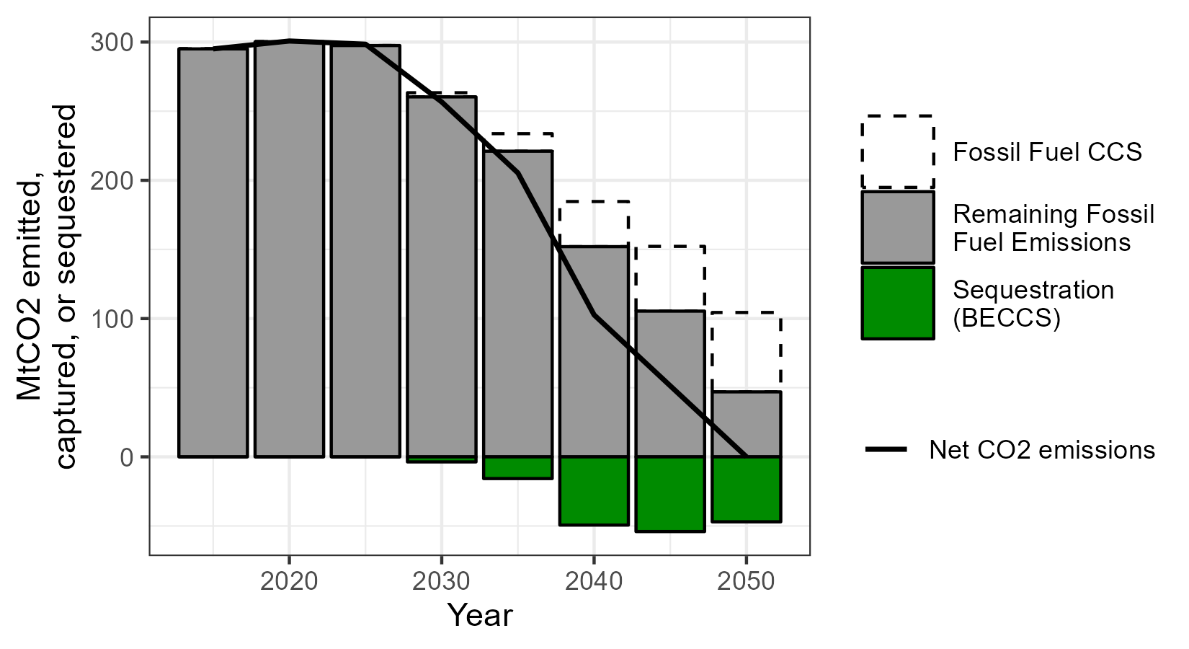
Carbon capture and storage (CCS) and CO2 sequestration will mitigate hard-to-abate CO2 emissions
Natural gas power plants with CCS
Industrial CCS technologies
Hard-to-abate CO₂ emissions
Aviation
Heavy industries
Bioenergy with CCS
Direct air capture
Others
Notes:
Version 1: without sectoral breakdown of (direct) fossil fuel emissions

Slide 7
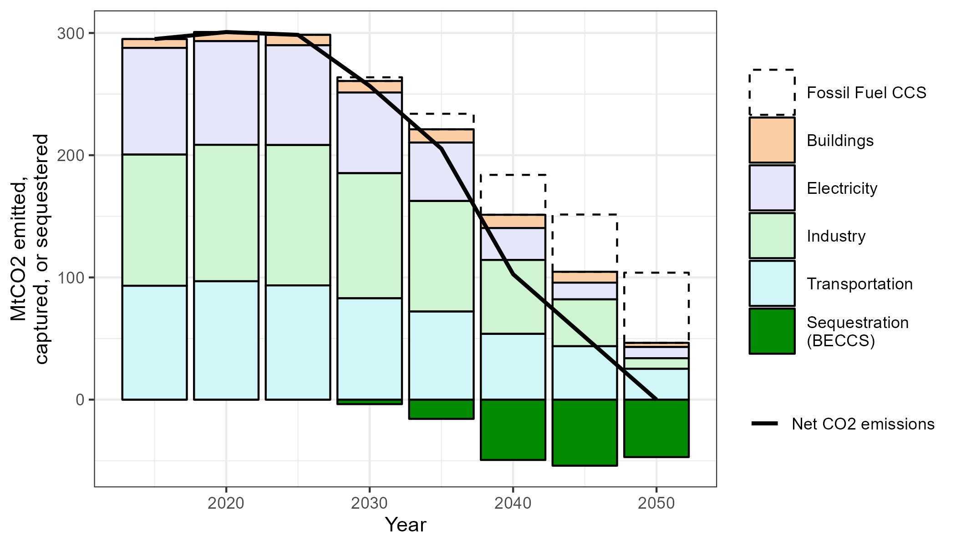
Carbon capture and storage (CCS) and CO2 sequestration will mitigate hard-to-abate CO2 emissions
Natural gas power plants with CCS
Industrial CCS technologies
Unabated direct CO₂ emissions
Bioenergy with CCS (BECCS)
Direct air capture
Others
Notes:
Version 2: with sectoral breakdown of (direct) fossil fuel emissions – emphasizes how the “hard-to-abate” sectors are split up (e.g., transportation is the largest part of remaining emissions in 2050, due to aviation being hard to abate)

Slide 8
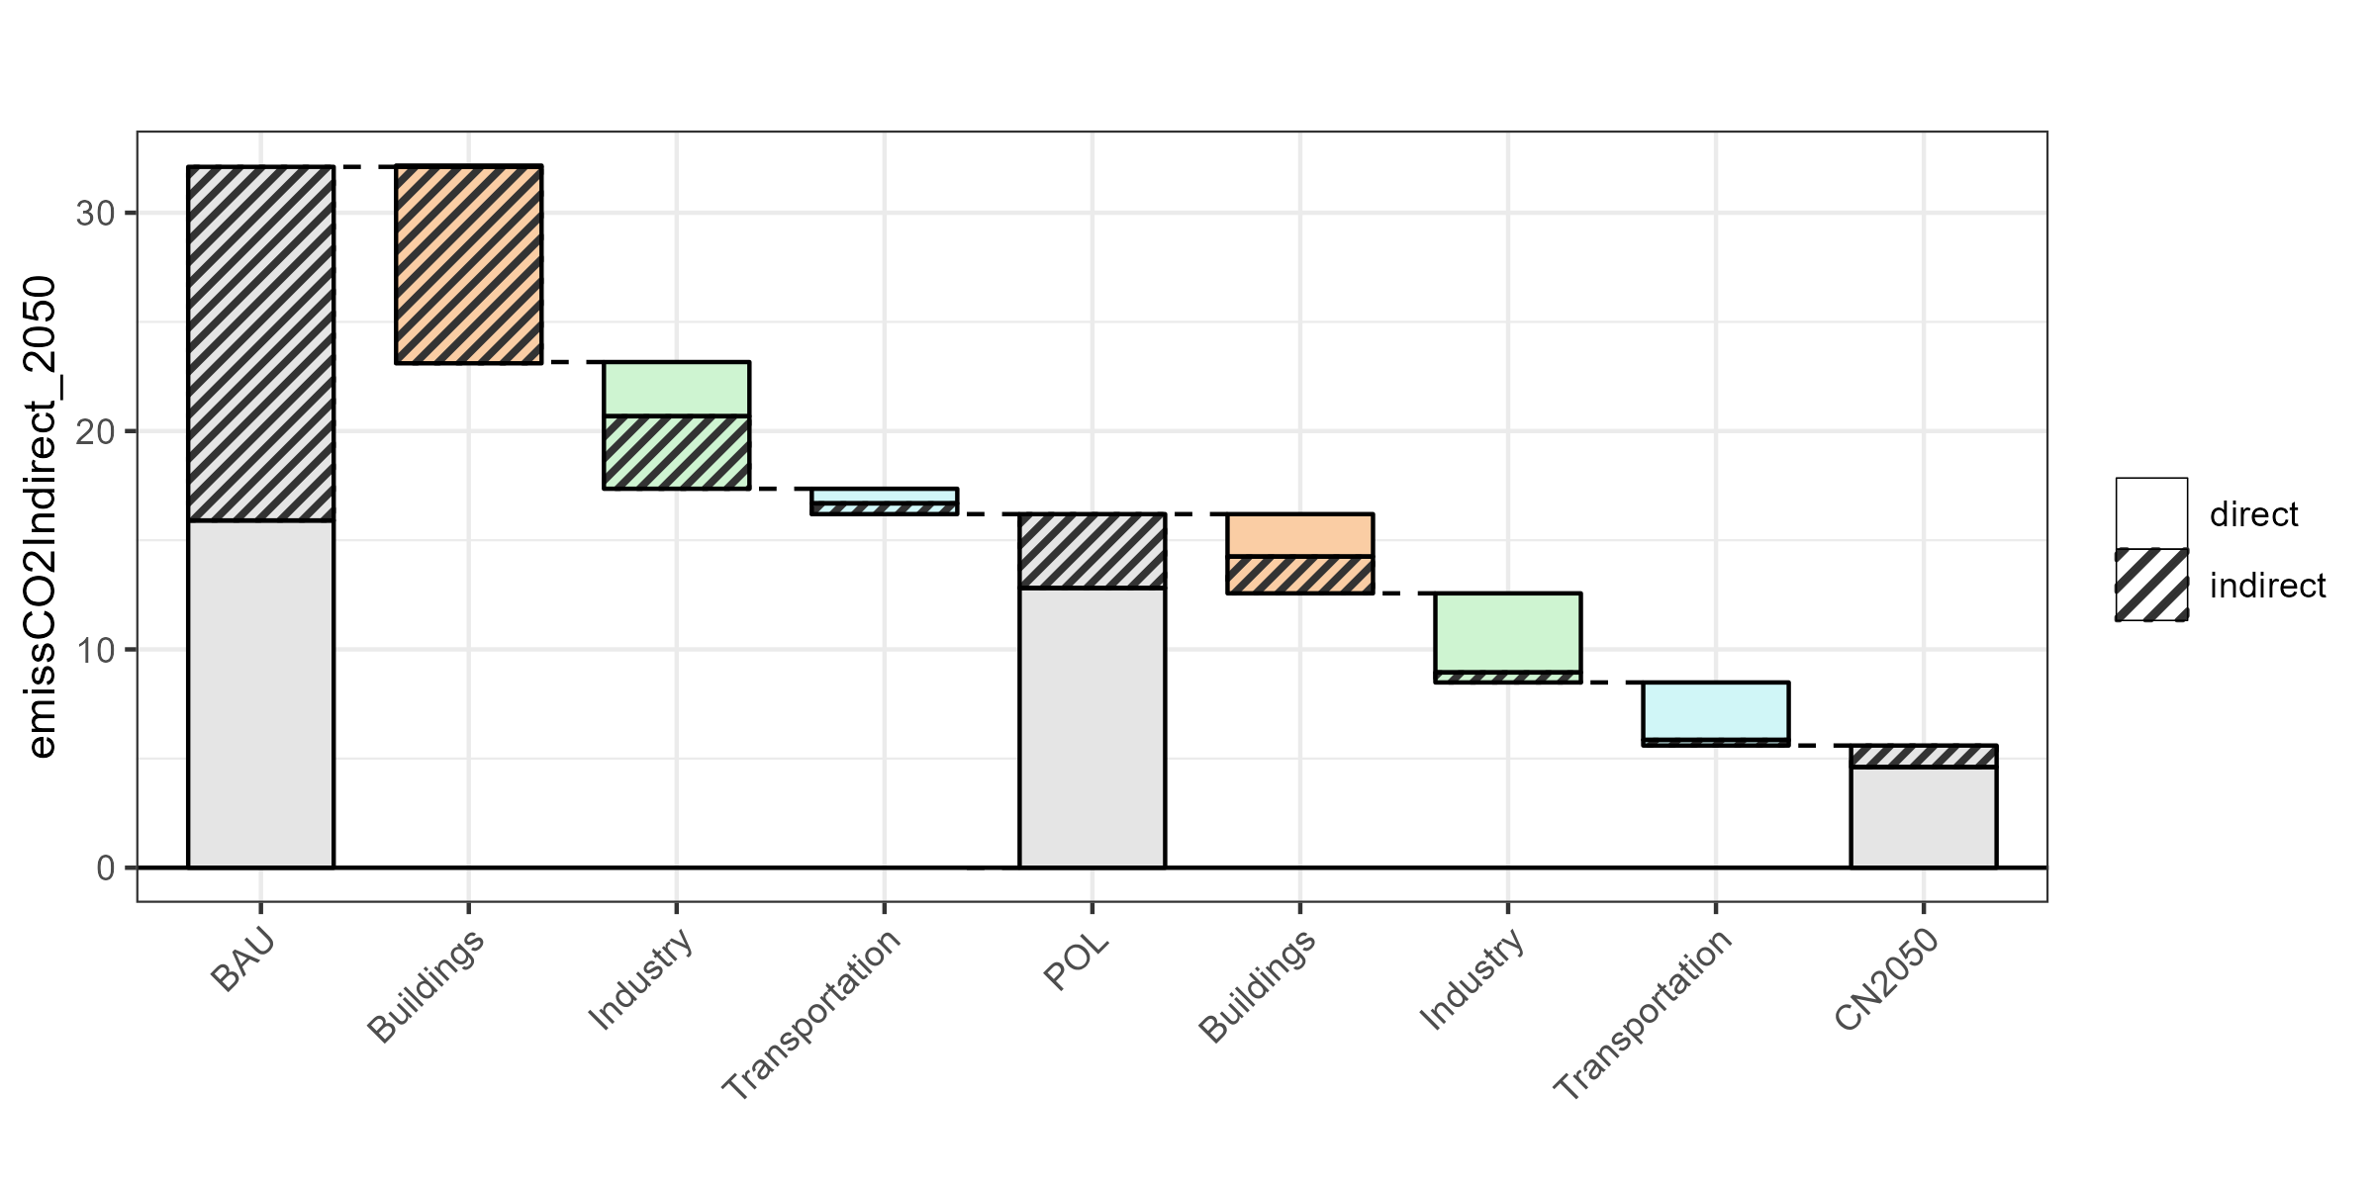
Bangkok’s actions will play a vital role in meeting Thailand’s climate goals
Direct and indirect CO₂ emissions (MTCO₂) in 2050
Direct emissions
Indirect emissions from electricity consumption
BAU emissions
Policy scenario residual emissions
Net Zero Thailand
Bangkok’s share of Thailand’s total 2050 emissions (grey) and share of emissions mitigation (colored)
BAU | Buildings | Industry | Transport | Policies | Buildings | Industry | Transport
10% | 29% | 8% | 5% | 6% | 26% | 4% | 2%

Slide 9
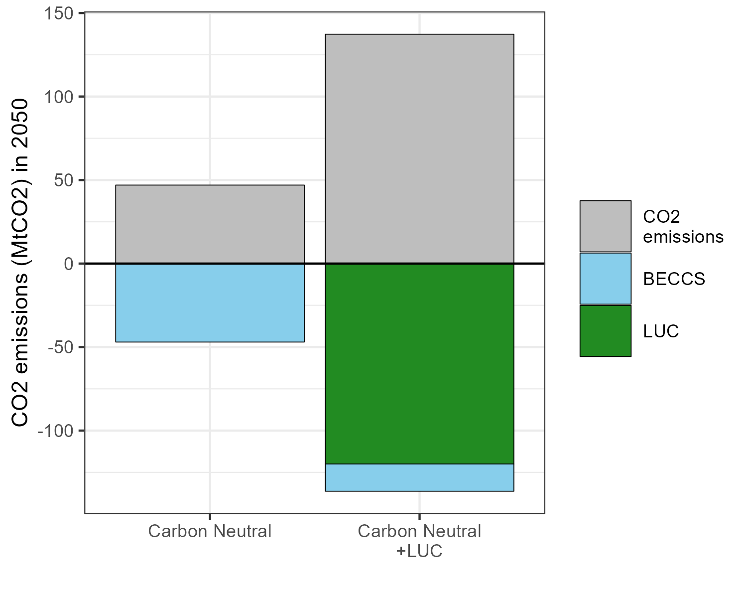
Land use change has major implications for decarbonization pathways
CO₂ emissions
Thailand:
Bangkok:
195%
112%
BECCS
Thailand:
66%
Electricity demand
Thailand:
Bangkok:
21%
18%

