Slide 2
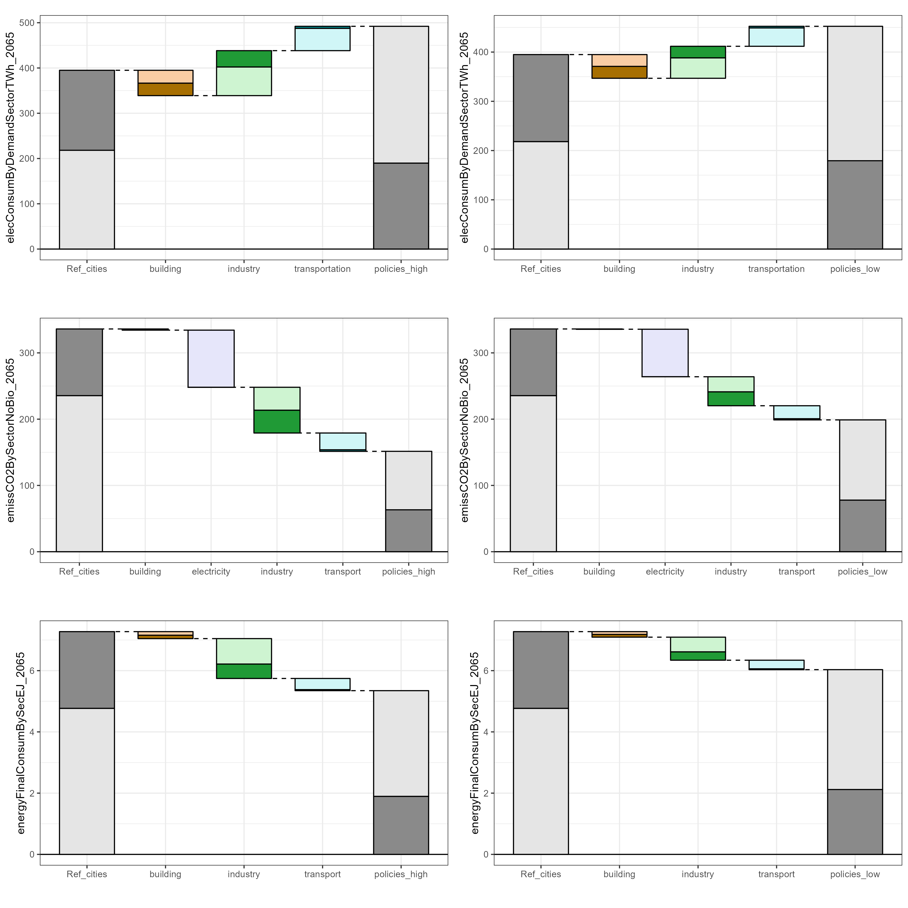
CO2 emissions in 2050
Scenario 1: Moderate ambition
Scenario 2: Ambitious Bangkok
Key insights
What role does Bangkok play within national trajectory in each scenario?
Which sectors are the most impactful in Bangkok? Rest of Thailand?
How much mitigation is needed beyond the sectoral policies? Where does this mitigation come from and how does this differ between scenarios?

Slide 3
GHG emissions in 2065
Scenario 1: Moderate ambition
Scenario 2: Ambitious Bangkok
Key insights
What role does Bangkok play within national trajectory in each scenario?
Which sectors are the most impactful in Bangkok? Rest of Thailand?
How much mitigation is needed beyond the sectoral policies? Where does this mitigation come from and how does this differ between scenarios?

Slide 4
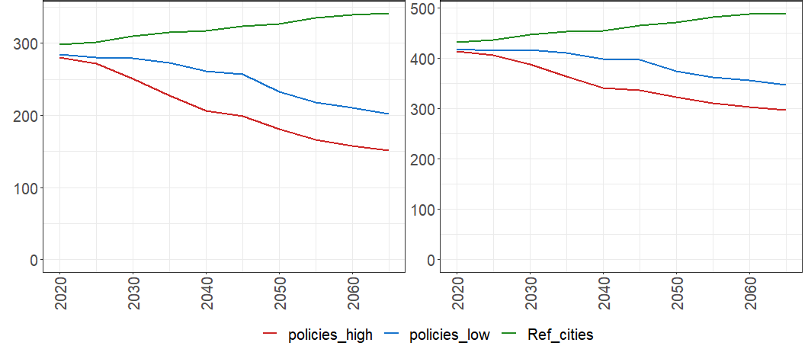
Pathway to carbon neutral/ net-zero
CO2
GHG
moderate ambition (national)
moderate ambition (national)
+ ambitious cities
+ ambitious cities
Emissions (MTCO2eq)
+ carbon neutral 2050 constraint
+ net zero GHG 2065 constraint
Key insights
How does ambitious city action impact the timing of the trajectories?

Slide 5
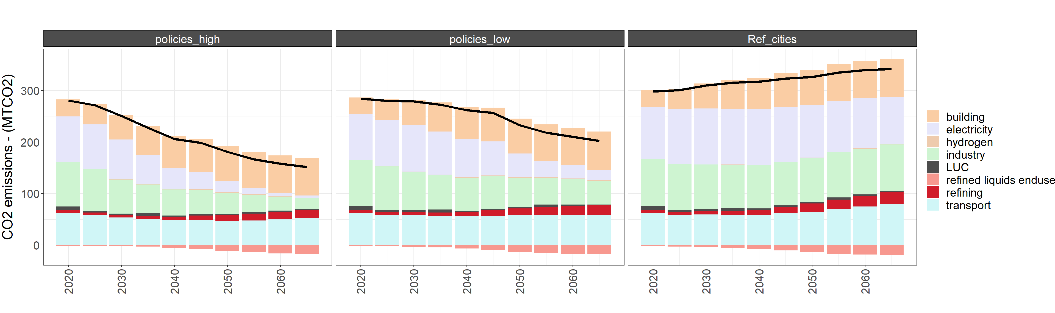
Pathway to carbon neutral/ net-zero (sectoral)
Key insights

