Slide 1
Model-base testing
Mesw – tvvs
Notes:
Good morning, My name is Jose and this is Ricardo. We are here to present model based testing.
As many of you were here in the last lesson. Professor Faria explains us model based testing and how it works. As a result we are going to try pass the theory very quickly so we can procced to demonstrations and finally exercises.

Slide 2
Model-based testing
What is model-based testing?
Why is this used?
What is the model?
Which tool I use?
Exercise demonstration
Now is your turn
José Esteves e Ricardo Malafaya – 03 December 2016
Notes:
This are the question we are going to address this questions

Slide 3
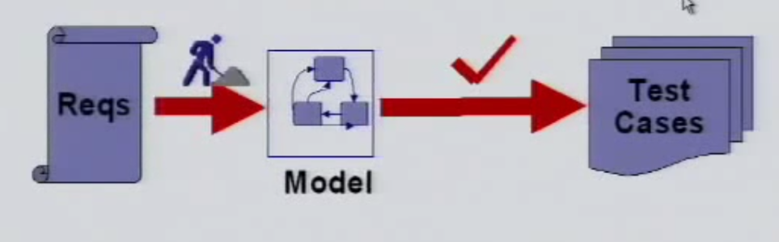
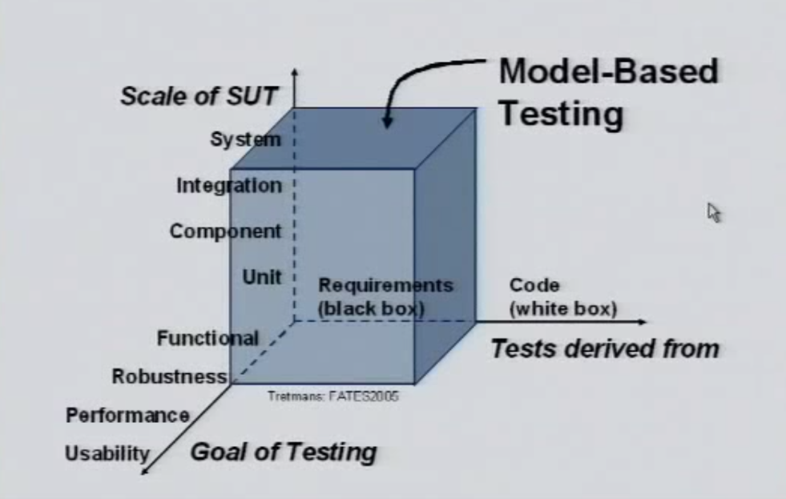
What is model-based testing?
Model-based testing (MBT) is the automatic generation of software test procedures, using models of system requirements and behavior.
Almost synonyms
Model-driven testing
Test generation
Hardware in the loop
Approaches
Online MBT
Offline MBT
José Esteves e Ricardo Malafaya – 03 December 2016
Notes:
- Emerging trend in software industry
- Handle system complexity
- Deviation from traditional development
- Support requirements change
- Support for highly distributed systems
- Improve consistency
- Provide quality solutions
- Improve the productivity

Slide 4
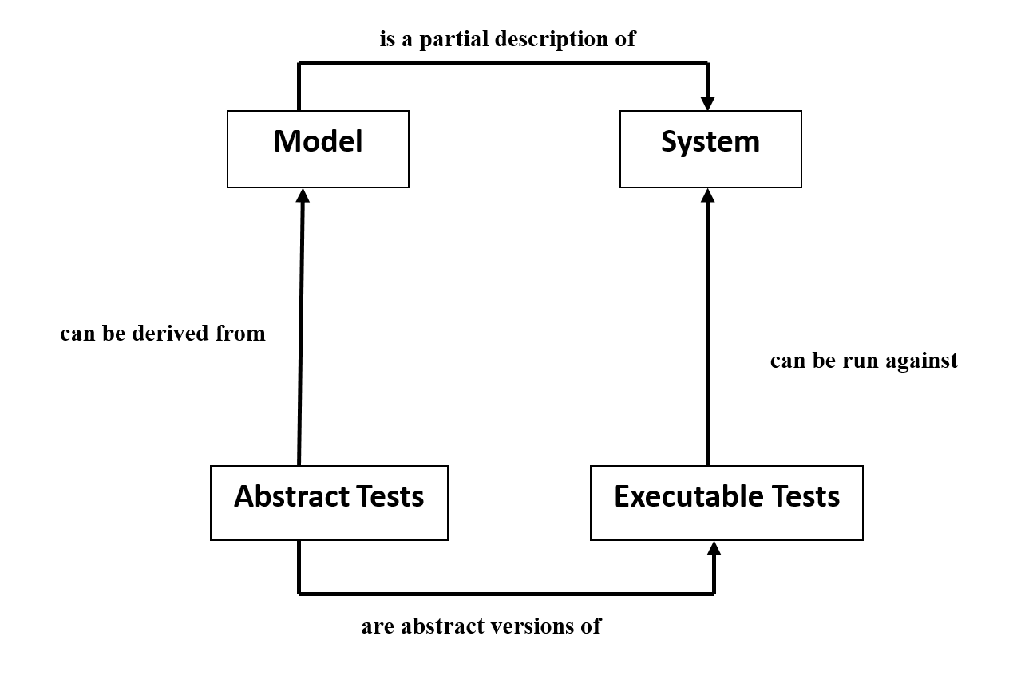
What is model-based testing?
“Model-based testing is black box testing process for derivation of test cases from a model that describe functional aspects of the system under test and executing those test cases.”
José Esteves e Ricardo Malafaya – 03 December 2016
Notes:
- Emerging trend in software industry
- Handle system complexity
- Deviation from traditional development
- Support requirements change
- Support for highly distributed systems
- Improve consistency
- Provide quality solutions
- Improve the productivity

Slide 5
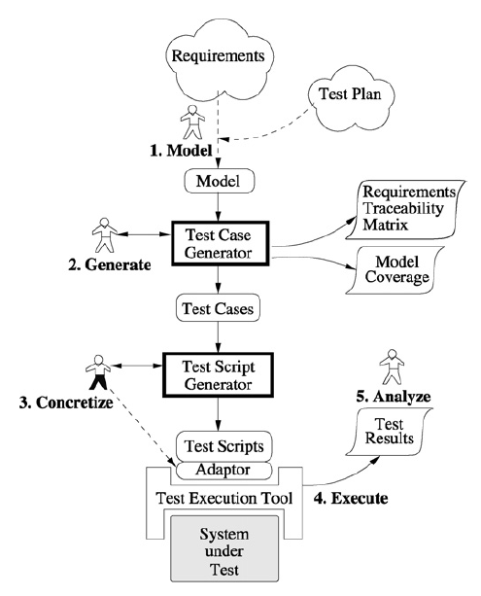
What is model-based testing?
Model the SUT
Generate abstract tests from the model.
Concretize the abstract tests to make them executable
Execute the tests on the SUT and assign verdicts.
Analyze the test results.
José Esteves e Ricardo Malafaya – 03 December 2016

Slide 6

What is model-based testing?
Offline MBT
Online MBT
Automate test case generation
Offline MBT means generating a finite set of tests and execute those later
This allows automatic test execution in third party test execution platform
Makes possible to create a tool chain:
Test case generation and execution in motion
•Next step is design after the output receiving
Testing nondeterministic systems
Infinite test suite running

Slide 7
Why is this used?
Rules are specified once.
Project maintenance is lower
Design is fluid
Design more and code less
High coverage
Model authoring is independent of implementation and actual testing
José Esteves e Ricardo Malafaya – 03 December 2016
Notes:
Rules are specified once.
Project maintenance is lower. You do not need to write new tests for each new feature. Once you have a model it is easier to generate and re-generate test cases than it is with hand-coded test cases.
Design is fluid. When a new feature is added, a new action is added to the state machine to run in combination with existing actions. A simple change can automatically ripple through the entire suite of test cases.
Design more and code less.
High coverage. Tests continue to find bugs, not just regressions due to changes in the code path or dependencies.
Model authoring is independent of implementation and actual testing so that these activities can be carried out by different members of a team concurrently.

Slide 8
What is the model?
Data Flow
Control Flow
Dependency Graphs
Decision Tables
State transition machines
José Esteves e Ricardo Malafaya – 03 December 2016
Notes:
A Model is an abstract representation of the system

Slide 9
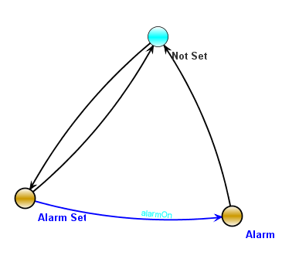
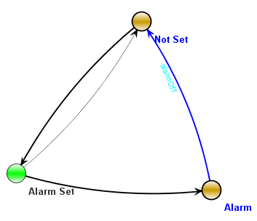
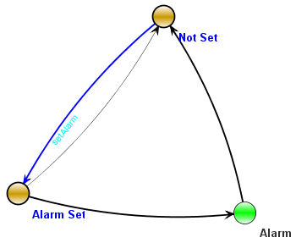
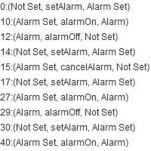
What is the model?
José Esteves e Ricardo Malafaya – 03 December 2016
Notes:
A Model is an abstract representation of the system

Slide 10
Which tool I use?
Tool | Modified | Input format | Type
Spec Explorer | 2013 | model programs in C# | Commercial
MaTeLo | 2013 | Markov chains | Commercial
GraphWalker | 2014 | FSM | Open source
Uppaal |  |  | Not specified
Conformiq Creator | 2016 | Activity Diagrams, DSL | Commercial
Conformiq Designer | 2014 | UML State Machines, QML | Commercial
TopCased |  |  | Apache 2.0
MISTA | 2013 | PrT net | Academic
NModel
fMBT | 2014 | Custom (AAL) | Open source
T-VEC | 2013 | Simulink | Commercial
MoMuT::UML | 2014 | UML state machines, OOAS | Academic
Tcases | 2015 | Custom | Open source
TestCast | 2014 | UML State Machines | Commercial
JUMBL |  |  | Univ of Tennesse
4Test | 2016 | Custom (Gherkin based) | Commercial
BPM-Xchange | 2014 | BPMN, UML... | Commercial
DTM | 2013 | custom activity model | Commercial
JSXM | 2014 | EFSM (Stream X-machines) | Academic
José Esteves e Ricardo Malafaya – 03 December 2016

Slide 11


Which tool I use?
Mista
GraphWalker
José Esteves e Ricardo Malafaya – 03 December 2016

Slide 12
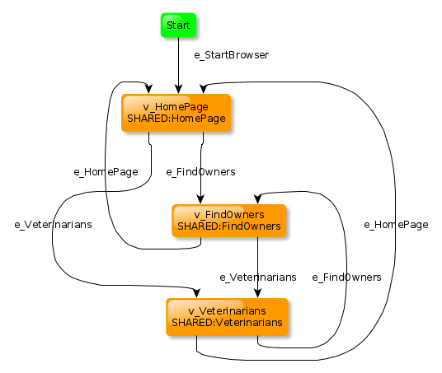

Which tool I use?
GraphWalker
José Esteves e Ricardo Malafaya – 03 December 2016

Slide 13
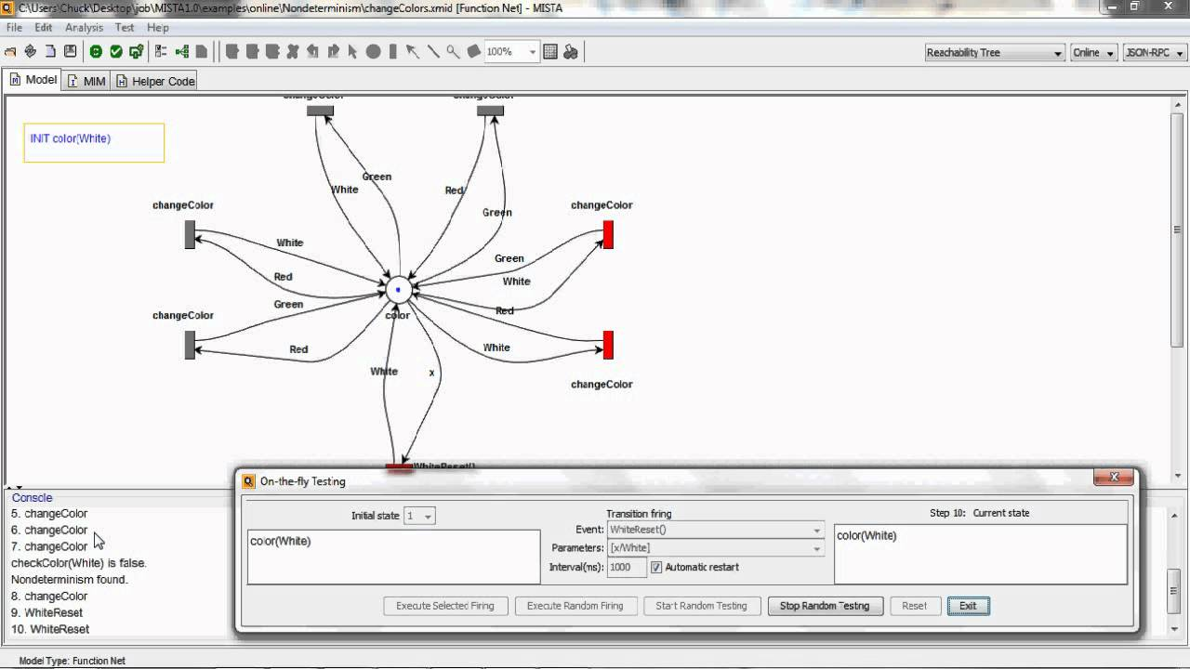
Which tool I use?
MISTA
José Esteves e Ricardo Malafaya – 03 December 2016

Slide 14
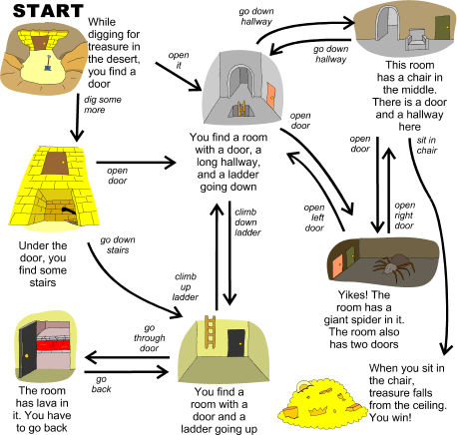
Exercise demonstration

Slide 15
Now is your turn

