Slide 1
Model-base testing
Mesw – tvvs
Notes:
Good morning, My name is Jose and this is Ricardo. We are here to present model based testing.
As many of you were here in the last lesson. Professor Faria explains us model based testing and how it works. As a result we are going to try pass the theory very quickly so we can procced to demonstrations and finally exercises.

Slide 2
Model-based testing
What is model-based testing?
Why is this used?
What is the model?
Which tool I use?
Exercise demonstration
Now is your turn
José Esteves e Ricardo Malafaya – 02 December 2016
Notes:
This are the question we are going to address this questions

Slide 3
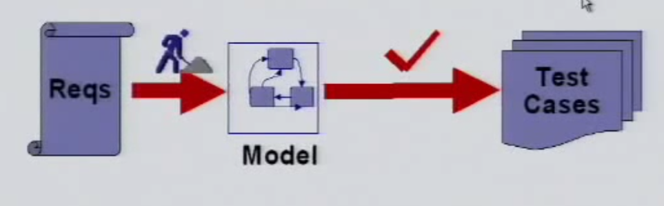
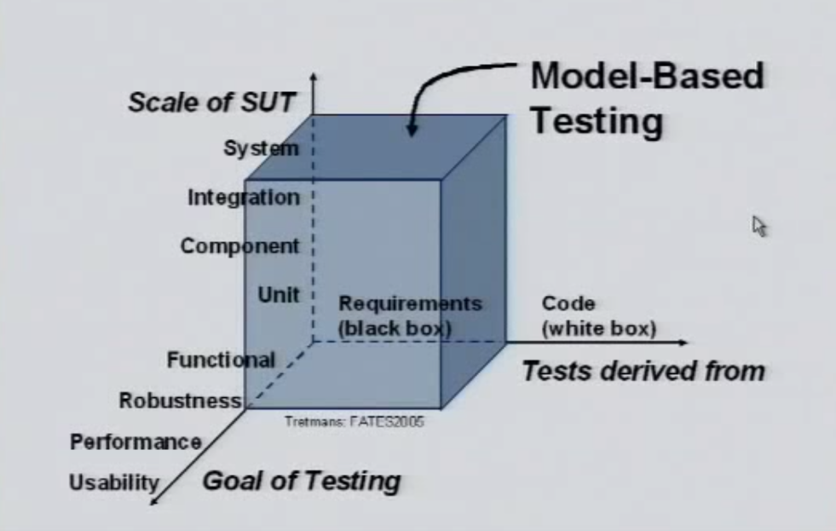
What is model-based testing?
Model-based testing (MBT) is the automatic generation of software test procedures, using models of system requirements and behavior.
Almost synonyms
Model-driven testing
Test generation
Hardware in the loop
Approaches
Online MBT
Offline MBT
José Esteves e Ricardo Malafaya – 02 December 2016
Notes:
- Emerging trend in software industry
- Handle system complexity
- Deviation from traditional development
- Support requirements change
- Support for highly distributed systems
- Improve consistency
- Provide quality solutions
- Improve the productivity

Slide 4
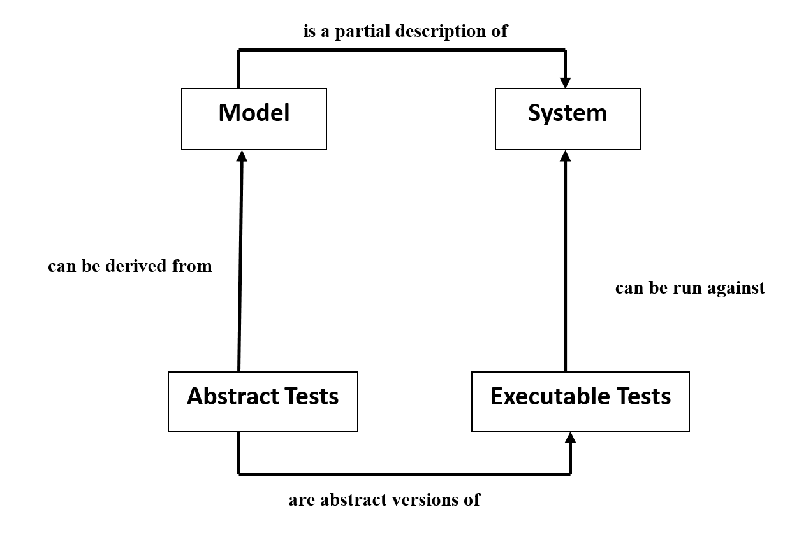
What is model-based testing?
“Model-based testing is black box testing process for derivation of test cases from a model that describe functional aspects of the system under test and executing those test cases.”
José Esteves e Ricardo Malafaya – 02 December 2016
Notes:
- Emerging trend in software industry
- Handle system complexity
- Deviation from traditional development
- Support requirements change
- Support for highly distributed systems
- Improve consistency
- Provide quality solutions
- Improve the productivity

Slide 5
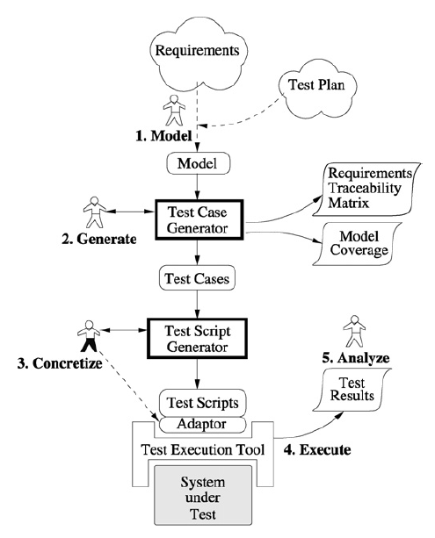
What is model-based testing?
Model the SUT
Generate abstract tests from the model.
Concretize the abstract tests to make them executable
Execute the tests on the SUT and assign verdicts.
Analyze the test results.
José Esteves e Ricardo Malafaya – 02 December 2016

Slide 6

What is model-based testing?
Offline MBT
Online MBT
Automate test case generation
Offline MBT means generating a finite set of tests and execute those later
This allows automatic test execution in third party test execution platform
Makes possible to create a tool chain:
Test case generation and execution in motion
Next step is design after the output receiving
Testing nondeterministic systems
Infinite test suite running
José Esteves e Ricardo Malafaya – 02 December 2016

Slide 7
Why is this used?
Rules are specified once.
Project maintenance is lower
Design is fluid
Design more and code less
High coverage
Model authoring is independent of implementation and actual testing
José Esteves e Ricardo Malafaya – 02 December 2016
Notes:
Rules are specified once.
Project maintenance is lower. You do not need to write new tests for each new feature. Once you have a model it is easier to generate and re-generate test cases than it is with hand-coded test cases.
Design is fluid. When a new feature is added, a new action is added to the state machine to run in combination with existing actions. A simple change can automatically ripple through the entire suite of test cases.
Design more and code less.
High coverage. Tests continue to find bugs, not just regressions due to changes in the code path or dependencies.
Model authoring is independent of implementation and actual testing so that these activities can be carried out by different members of a team concurrently.

Slide 8
What is the model?
Data Flow
Control Flow
Dependency Graphs
Decision Tables
State transition machines
José Esteves e Ricardo Malafaya – 02 December 2016
Notes:
A Model is an abstract representation of the system

Slide 9
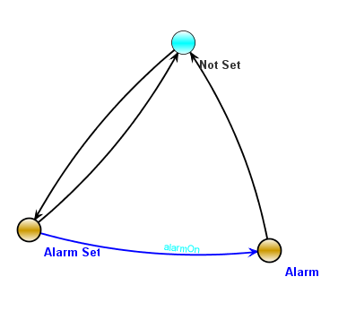
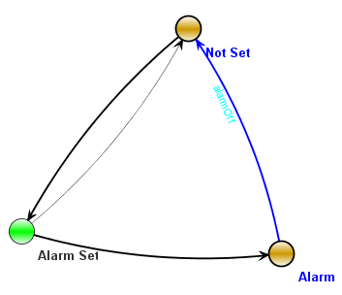
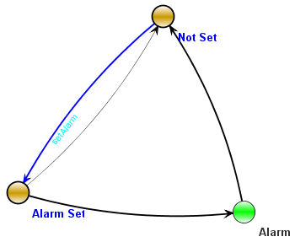
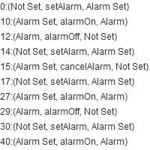
What is the model?
José Esteves e Ricardo Malafaya – 02 December 2016
Notes:
A Model is an abstract representation of the system

Slide 10
Which tool I use?
Tool | Modified | Input format | Type
Spec Explorer | 2013 | model programs in C# | Commercial
MaTeLo | 2013 | Markov chains | Commercial
GraphWalker | 2014 | FSM | Open source
Uppaal |  |  | Not specified
Conformiq Creator | 2016 | Activity Diagrams, DSL | Commercial
Conformiq Designer | 2014 | UML State Machines, QML | Commercial
TopCased |  |  | Apache 2.0
MISTA | 2013 | PrT net | Academic
NModel
fMBT | 2014 | Custom (AAL) | Open source
T-VEC | 2013 | Simulink | Commercial
MoMuT::UML | 2014 | UML state machines, OOAS | Academic
Tcases | 2015 | Custom | Open source
TestCast | 2014 | UML State Machines | Commercial
JUMBL |  |  | Univ of Tennesse
4Test | 2016 | Custom (Gherkin based) | Commercial
BPM-Xchange | 2014 | BPMN, UML... | Commercial
DTM | 2013 | custom activity model | Commercial
JSXM | 2014 | EFSM (Stream X-machines) | Academic
José Esteves e Ricardo Malafaya – 02 December 2016

Slide 11
Which tool I use?
Tool Name | Functionality | Reliability | Usability | Efficiency | Maintainability | Portability | Licensing and pricing
UPPAAL | Suitability: supports MBT Interoperability: models nor testcases cannot be interchanged between tools | Fault tolerance: Only if the model is created and simulated without any errors testing is possible. Each phase is completely depended on previous phase | Yes, graphical user interface and drag and drop approach | Time, effort and resource used : less | Analyzability: Yes Changeability: Yes Testability: Yes | Installability: easy | Open source and academic tool
CowSuite | Suitability: supports MBT Interoperability: models nor test cases cannot be interchanged between tools |  | Yes, graphical user interface and drag and drop approach | Time, effort and resource used : less | Analyzability: Yes Changeability: Yes Testability: Yes | Installability: easy | Open source and academic tool
JUMBL | Suitability: supports MBT Interoperability: models nor testcases cannot be interchanged between tools |  | No, a new language called TTL has to be mastered for modeling | Time, effort and resource used : High | Analyzability: No Changeability: Yes Testability: Yes | Installability: time consuming | Open source and academic tool
José Esteves e Ricardo Malafaya – 02 December 2016
Notes:
UPPAAL; Academic ; UML; Windows
CowSuite; Research; UML; Windows
JUMBL; Academic ; TML; Windows /Unix
Enterprise Architect;Commercial; UML; Only for Modeling and does not support model based testing;;;
Spec Explorer ; Research ; SPEC # and ASML Windows
Model Junit;Academic ; Java ; Windows

Slide 12
Which tool I use?
Tool Name | Functionality | Reliability | Usability | Efficiency | Maintainability | Portability | Licensing and pricing
Enterprise Architect | Suitability: Supports only modeling and not MBT |  | Yes, graphical user interface and drag and drop approach | Time, effort and resource used : less | Analyzability: Yes Changeability: Yes Testability: Yes | Installability: easy | Commercial tool
Spec Explorer | Interoperability : Databases parts of states, transitions and test suites can be exported to an XML file but not the State machine diagram as whole. So interoperability is not achieved in this tool. | Fault Tolerance: Tool does not support this. Recoverability: If the application crashes it can be recovered as data is stored locally. | Easy to operate with good GUI. But application does not support lower versions Microsoft word 2007. | An efficient MBT tool supporting all phases of MBT – modeling to result comparison | Easy to analyze the application behavior. | Installability: Simple and Easy to install instructions are provided. | Open Source
Model J Unit | There is a provision for user to add his new test generation algorithms. | Recoverability: If the application crashes it can be recovered as data is stored locally. | GUI that is downloaded from internet is not working | Supports all phases of MBT | Since GUI is not working we could not analyze the entire application. | Installability: Easy | Open source
José Esteves e Ricardo Malafaya – 02 December 2016
Notes:
UPPAAL; Academic ; UML; Windows
CowSuite; Research; UML; Windows
JUMBL; Academic ; TML; Windows /Unix
Enterprise Architect;Commercial; UML; Only for Modeling and does not support model based testing;;;
Spec Explorer ; Research ; SPEC # and ASML Windows
Model Junit;Academic ; Java ; Windows

Slide 13


Which tool I use?
Mista
GraphWalker
José Esteves e Ricardo Malafaya – 03 December 2016

Slide 14
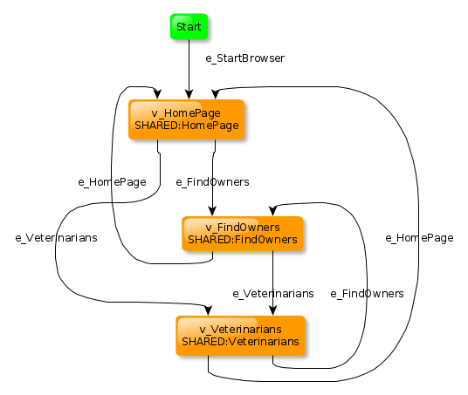

Which tool I use?
GraphWalker
José Esteves e Ricardo Malafaya – 02 December 2016

Slide 15
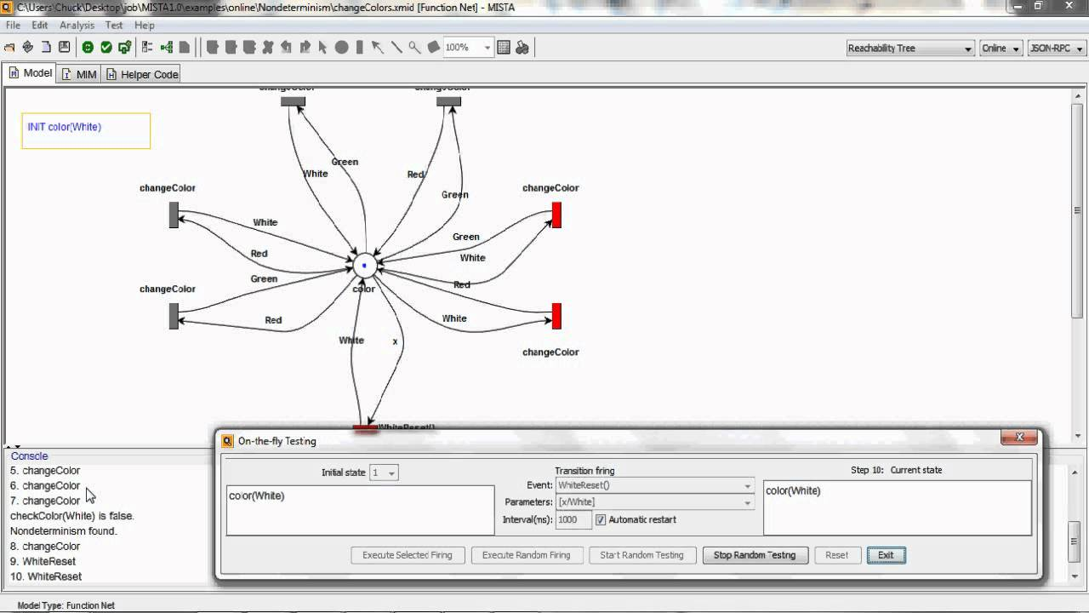
Which tool I use?
MISTA
José Esteves e Ricardo Malafaya – 02 December 2016

Slide 16
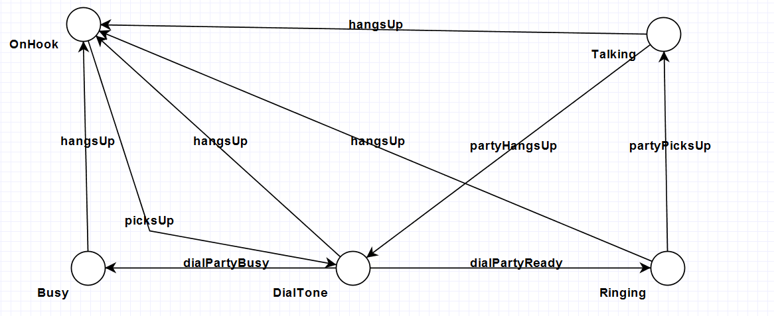
Exercise demonstration
José Esteves e Ricardo Malafaya – 02 December 2016

Slide 17
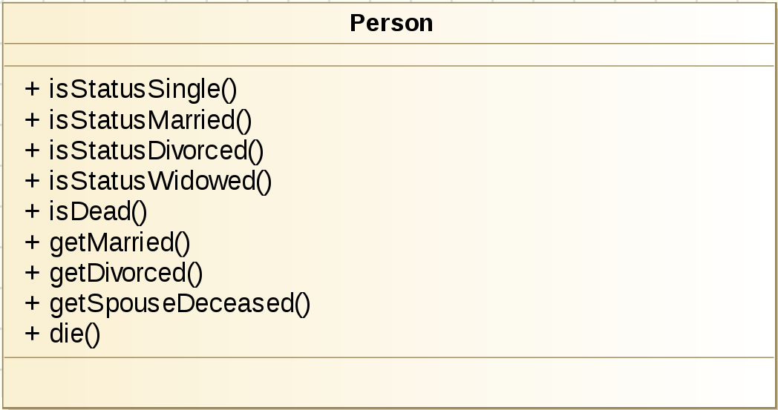
Now is your turn – Civil State | GraphWalker
Using the file GraphWalkerTestIntro.java.
Create a State Diagram.
Run tests: Vertex Coverage.
Run tests: Edge Coverage.
José Esteves e Ricardo Malafaya – 02 December 2016

Slide 18
Now is your turn – Civil State | MISTA
Create a New State Machine.
Define a State Diagram.
Run tests: Reachability Tree.
Run tests: Reachability Tree + Invalid Paths
José Esteves e Ricardo Malafaya – 02 December 2016

Slide 19
Thank You
José Esteves e Ricardo Malafaya – 02 December 2016

