Slide 1
Model-base testing
Mesw – tvvs

Slide 2
What is model-based testing?
What is model-based testing?
Why is this used?
What is the model?
Which tool I use?
Exercise demonstration
Now is your turn
José Esteves e Ricardo Malafaya – 03 December 2016

Slide 3
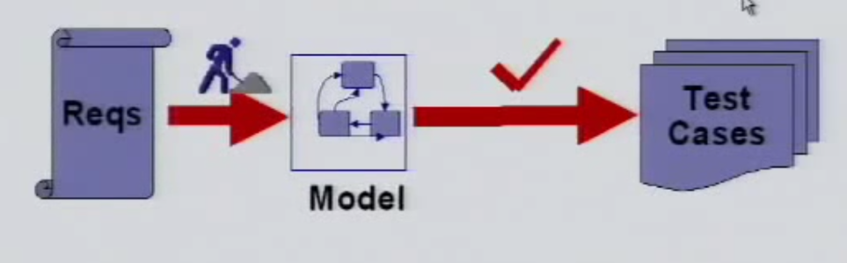
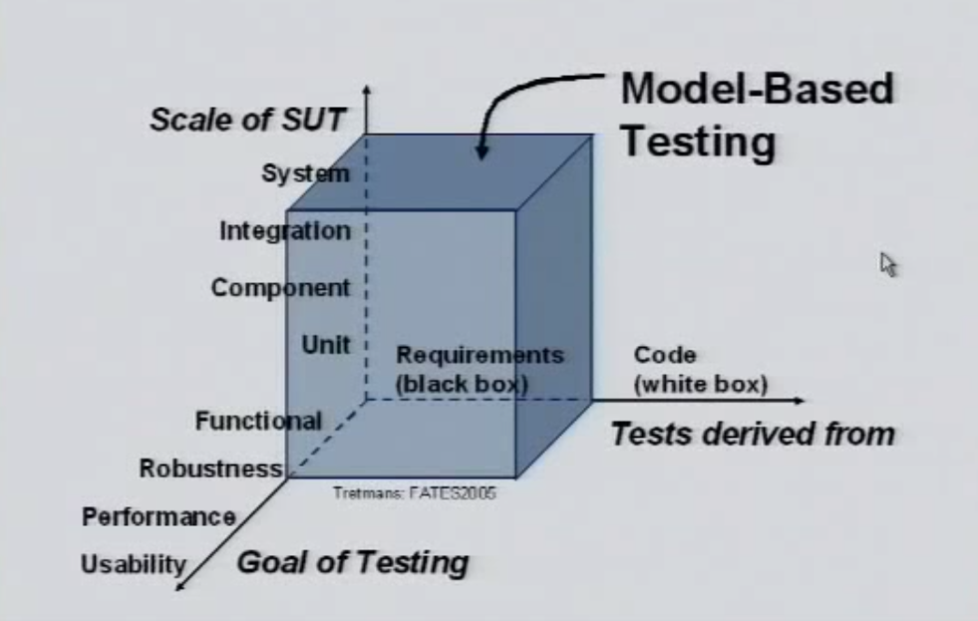
What is model-based testing?
Model-based testing (MBT) is the automatic generation of software test procedures, using models of system requirements and behaviour.
Almost synonyms
Model-driven testing
Test generation
Hardware in the loop
Approachs
Online MBT
Offline MBT
José Esteves e Ricardo Malafaya – 03 December 2016

Slide 4

What is model-based testing?
Offline MBT
Online MBT
Automate test case generation
Offline MBT means generating a finite set of tests and execute those later
This allows automatic test execution in third party test execution platform
Makes possible to create a tool chain:
Test case generation and execution in motion •Next step is design after the output receiving
Testing nondeterministic systems
Infinite test suite running

Slide 5
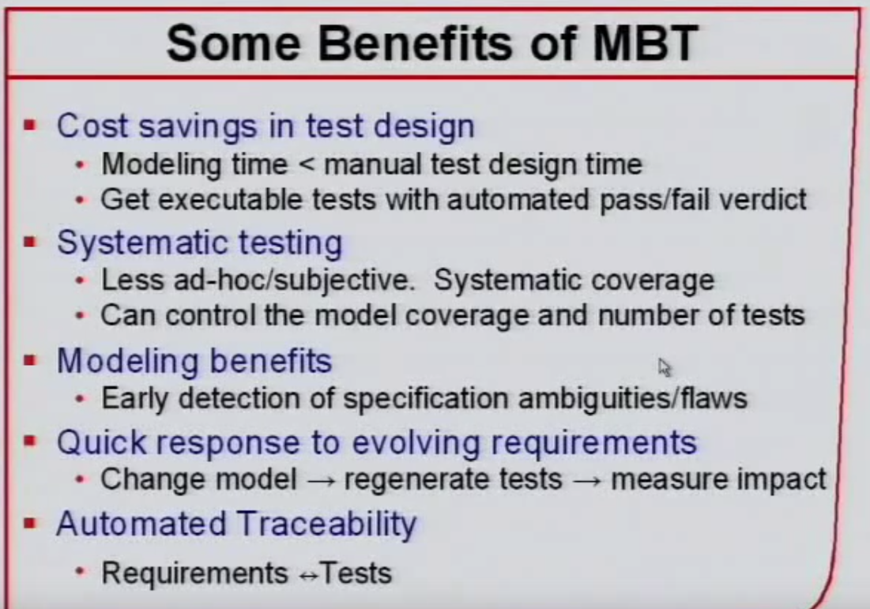
Why is this used?
Rules are specified once.
Project maintenance is lower
Design is fluid
Design more and code less
High coverage
Model authoring is independent of implementation and actual testing
José Esteves e Ricardo Malafaya – 03 December 2016
Notes:
Rules are specified once.
Project maintenance is lower. You do not need to write new tests for each new feature. Once you have a model it is easier to generate and re-generate test cases than it is with hand-coded test cases.
Design is fluid. When a new feature is added, a new action is added to the state machine to run in combination with existing actions. A simple change can automatically ripple through the entire suite of test cases.
Design more and code less.
High coverage. Tests continue to find bugs, not just regressions due to changes in the code path or dependencies.
Model authoring is independent of implementation and actual testing so that these activities can be carried out by different members of a team concurrently.

Slide 6
What is the model?
Data Flow
Control Flow
Dependency Graphs
Decision Tables
State transition machines
José Esteves e Ricardo Malafaya – 03 December 2016

Slide 7
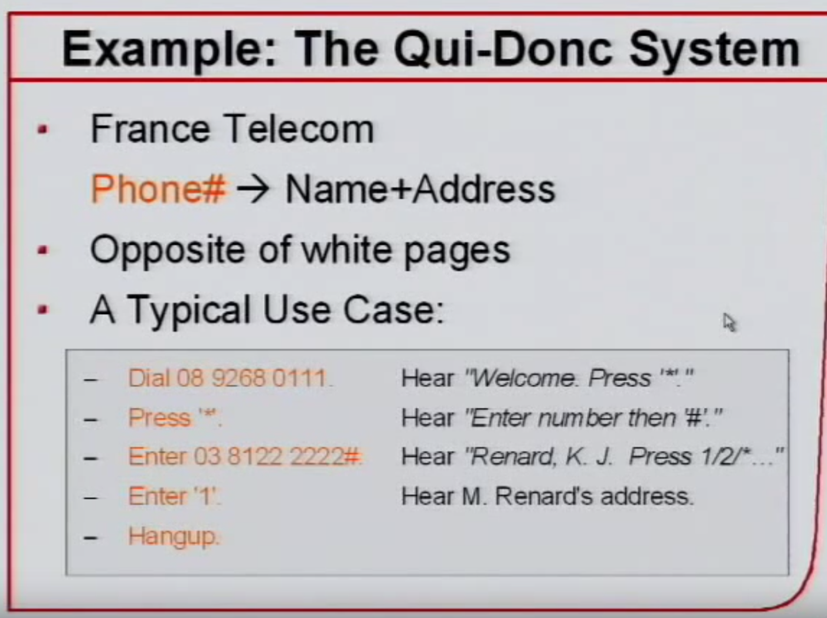
What is the model?
Example
José Esteves e Ricardo Malafaya – 03 December 2016

Slide 8
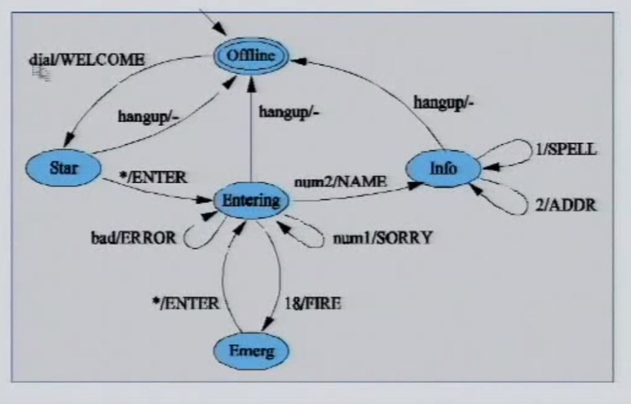
What is the model?
Example
José Esteves e Ricardo Malafaya – 03 December 2016

Slide 9
Which tool I use?
Tool | Modified | Input format | Type
4Test | 2016 | Custom (Gherkin based) | Commercial
BPM-Xchange | 2014 | BPMN, UML... | Commercial
Conformiq Creator | 2016 | Activity Diagrams, DSL | Commercial
Conformiq Designer | 2014 | UML State Machines, QML | Commercial
DTM | 2013 | custom activity model | Commercial
fMBT | 2014 | Custom (AAL) | Open source
GraphWalker | 2014 | FSM | Open source
JSXM | 2014 | EFSM (Stream X-machines) | Academic
JTorX | 2014 | LTS | Open source
MaTeLo | 2013 | Markov chains | Commercial
MBTsuite | 2016 | UML or BPMN | Commercial
MISTA | 2013 | PrT net | Academic
Modbat | 2015 | EFSM (Scala-based DSL) | Open source
ModelJUnit | 2014 | EFSM | Open source
MoMuT::UML | 2014 | UML state machines, OOAS | Academic
OSMO | 2014 | model program in Java | Open source
PyModel | 2013 | Python source | Open source
RT-Tester | 2014 | UML/SysML, Matlab | Commercial
Smartesting CertifyIt | 2014 | UML + OCL | Commercial
Spec Explorer | 2013 | model programs in C# | Commercial
Tcases | 2015 | Custom | Open source
TEMPPO | 2014 | Task flow model | Commercial
TestCast | 2014 | UML State Machines | Commercial
TestOptimal | 2013 | (E)FSM | Commercial
T-VEC | 2013 | Simulink | Commercial
José Esteves e Ricardo Malafaya – 03 December 2016

Slide 10

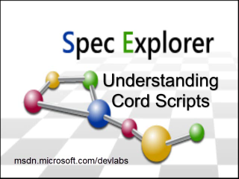

Which tool I use?
GraphWalker
Spec Explorer
Topcased
José Esteves e Ricardo Malafaya – 03 December 2016

Slide 11
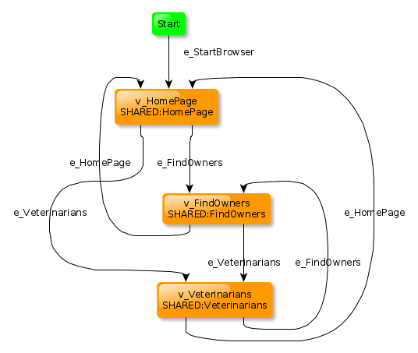

Which tool I use?
GraphWalker
José Esteves e Ricardo Malafaya – 03 December 2016

Slide 12
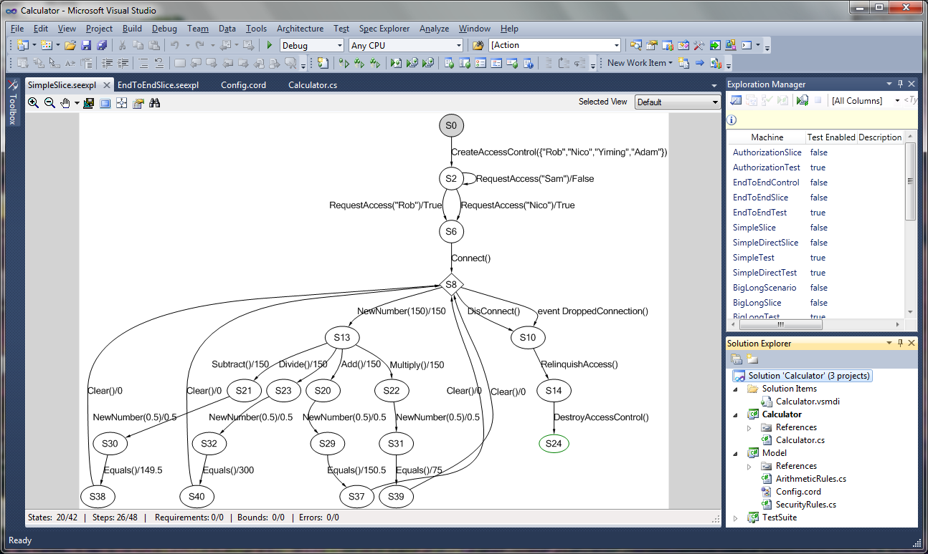
Which tool I use?
Spec Explorer
José Esteves e Ricardo Malafaya – 03 December 2016

Slide 13
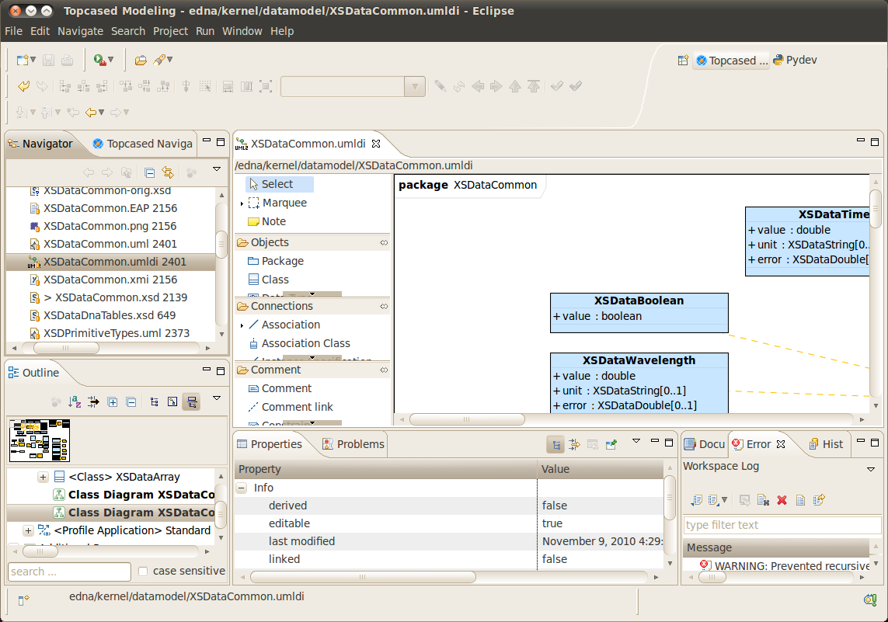
Which tool I use?
Topcased
José Esteves e Ricardo Malafaya – 03 December 2016

Slide 14
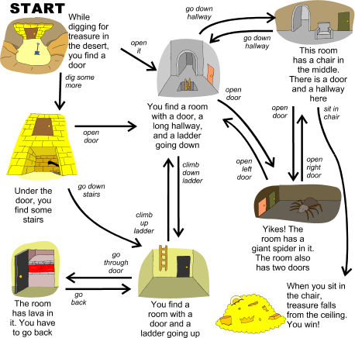
Exercise demonstration

Slide 15
Now is your turn

