Slide 1



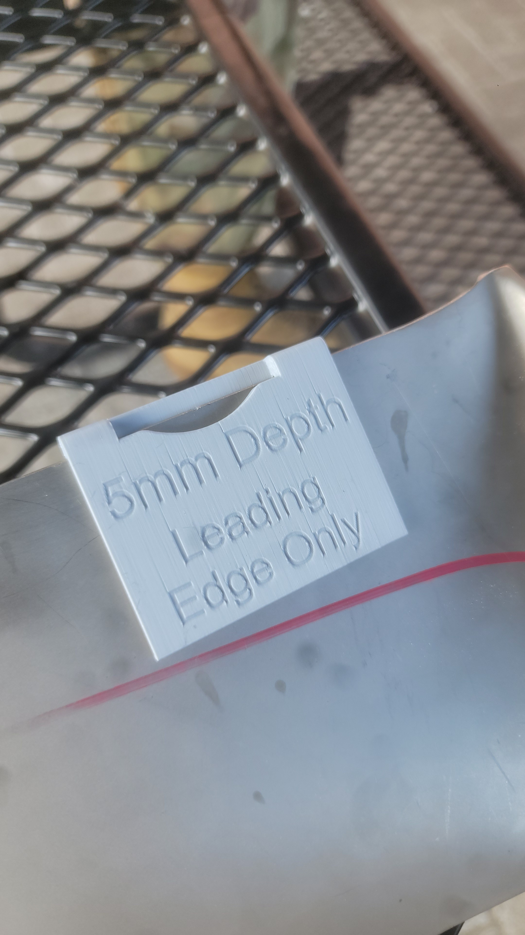


{{title_maximum_6_words}}
1
2
3
PROBLEM
SOLUTION
ROI
{{problem_statement_maximum_100_characters}}
{{solution_statement_maximum_90_characters}}
{{roi_maximum_90_characters}}
Strategic Alignment
[ ] Develop People
[X] Generate Readiness
[ ] Project Power
[X] Develop Capabilities
CONTACT INFO:
{{name}}
{{phone}}
{{email}}
PROJECT SUMMARY
{{short_summary_maximum_100_characters}}
{{long_summary_maximum_600_characters}}
COMMANDER:
{{commanders_name}}

Slide 2

MARKET SUMMARY
“{{generate_fake_quote_of_support}}” – TSgt Snuffy
{{market_summary_do_research_of_user_market_maximum_500_characters}}
DAF MARKET
USERS / SQ’S / $’S
GOVT MARKET
USERS / SQ’S / $’S
INDUSTRY MARKET
USERS / SQ’S / $’S
PROJECT FUTURE
{{project_future_and_milestones_maximum_500_characters}}
TRACTION / SUCCESS
{{sorties_saved}}
{{money_saved}}
{{time_saved}}
TIMELINE
PROJECT START
{{where_and_when_did_project_start}}
EVALUATING
{{evaluating_stage}}
DEC 24
JUL 25
SEP 24
APR 25
PROTOTYPE
END RESULT
{{milestone_1}}
{{future_goal}}
(Replace with picture)
{{rank_firstinitial_lastname}}
{{squadron}}

