Slide 1
Title
Your name

Slide 2
Introduction
We set up variables:
  a = 1
  b = a + 1
In this example: a = 1 and b = 2, or if you want to use math text: $a=1$ and $b=2$.
Math text can also be used for full equations:
  $$E=mc^{2}$$

Slide 3
Working with iris

Slide 4
About the dataset
We will now use the iris dataset:
 | sepal_length | sepal_width | petal_length | petal_width | species
0 | 5.1 | 3.5 | 1.4 | 0.2 | setosa
1 | 4.9 | 3.0 | 1.4 | 0.2 | setosa
2 | 4.7 | 3.2 | 1.3 | 0.2 | setosa
3 | 4.6 | 3.1 | 1.5 | 0.2 | setosa
4 | 5.0 | 3.6 | 1.4 | 0.2 | setosa

Slide 5
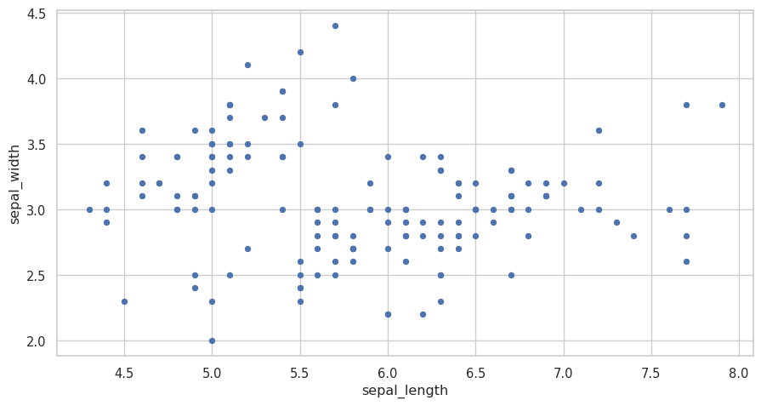
Scatter plot
The full dataset is plotted here:

Slide 6
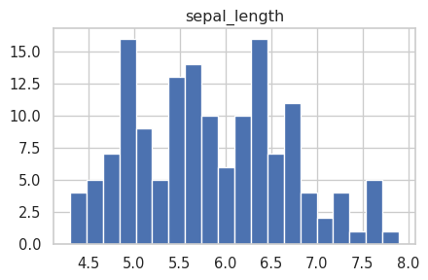
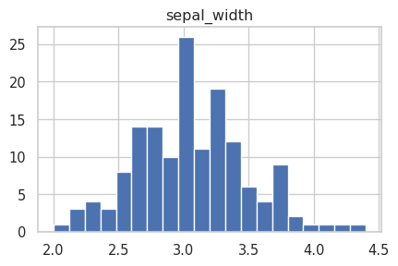
Distributions
sepal length
sepal width

Slide 7

Final slide
We have some references (Zelenka et al. 2024).
And the JGI logo:

Slide 8
Zelenka, Natalie R, Nina Di Cara, Kieren Sharma, Seeralan Sarvaharman, Jasdeep S Ghataora, Fabio Parmeggiani, Jeff Nivala, Zahraa S Abdallah, Lucia Marucci, and Thomas E Gorochowski. 2024. “Data hazards in synthetic biology.” Synthetic Biology, June, ysae010. https://doi.org/10.1093/synbio/ysae010.

