Slide 1
Prepare and plan
Analyse and write
Create and organise Rstudio project.
Edit code and text in RMarkdown
Set up git:
initialise local git repository
set up .gitignore
Commit and push changes
Publish PDF
Add project to GitHub
“Knit” Rmarkdown document to pdf
Set up OSF project:
link Github
Pre-register analysis
Upload preprint to OSF

Slide 2
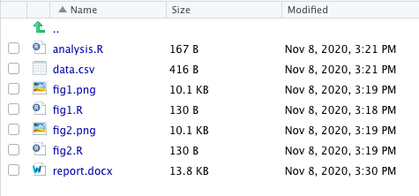
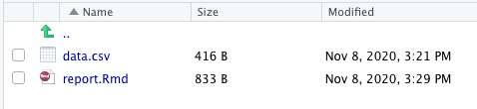
1. Conventional
2. Literate programming

