Slide 1
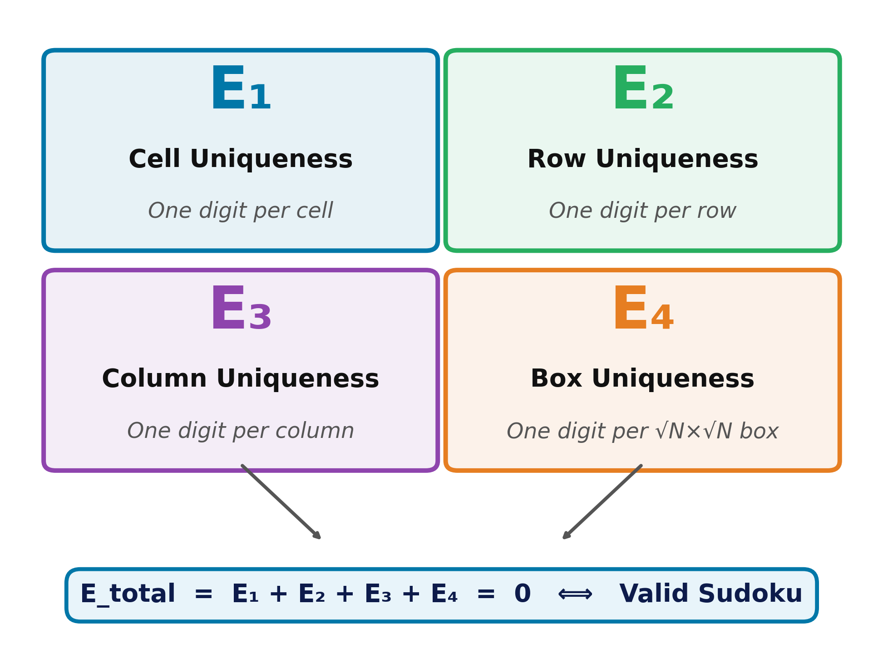
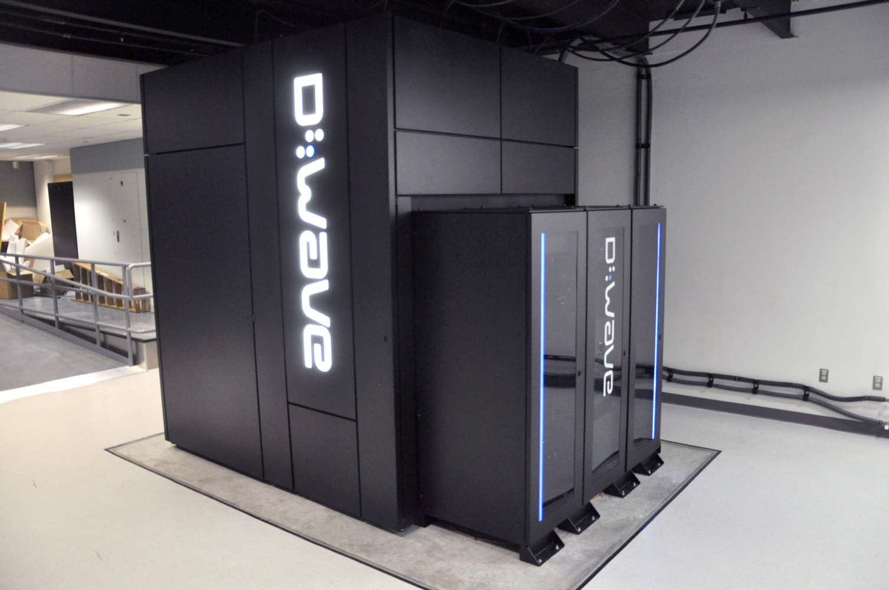
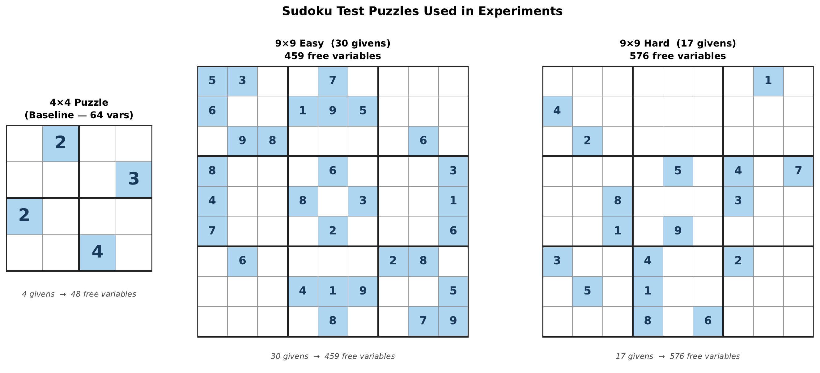
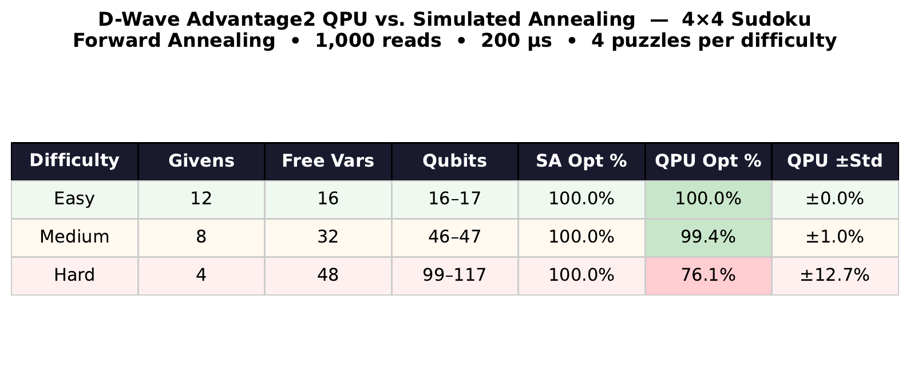
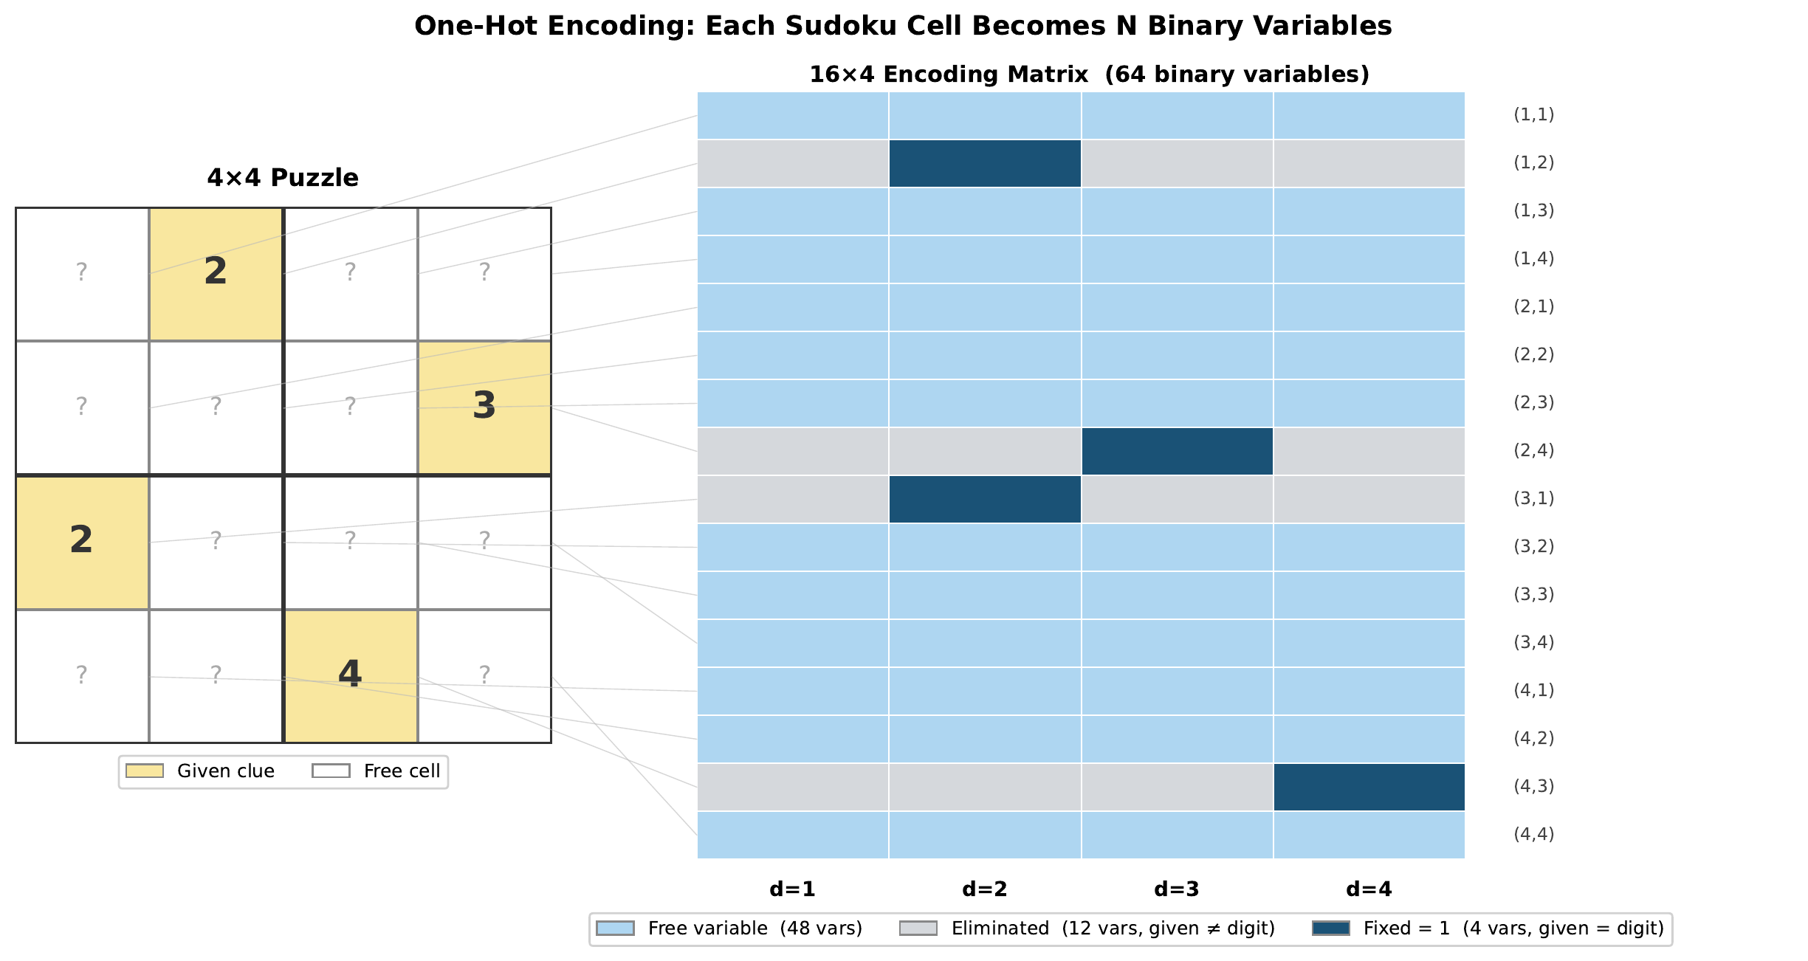
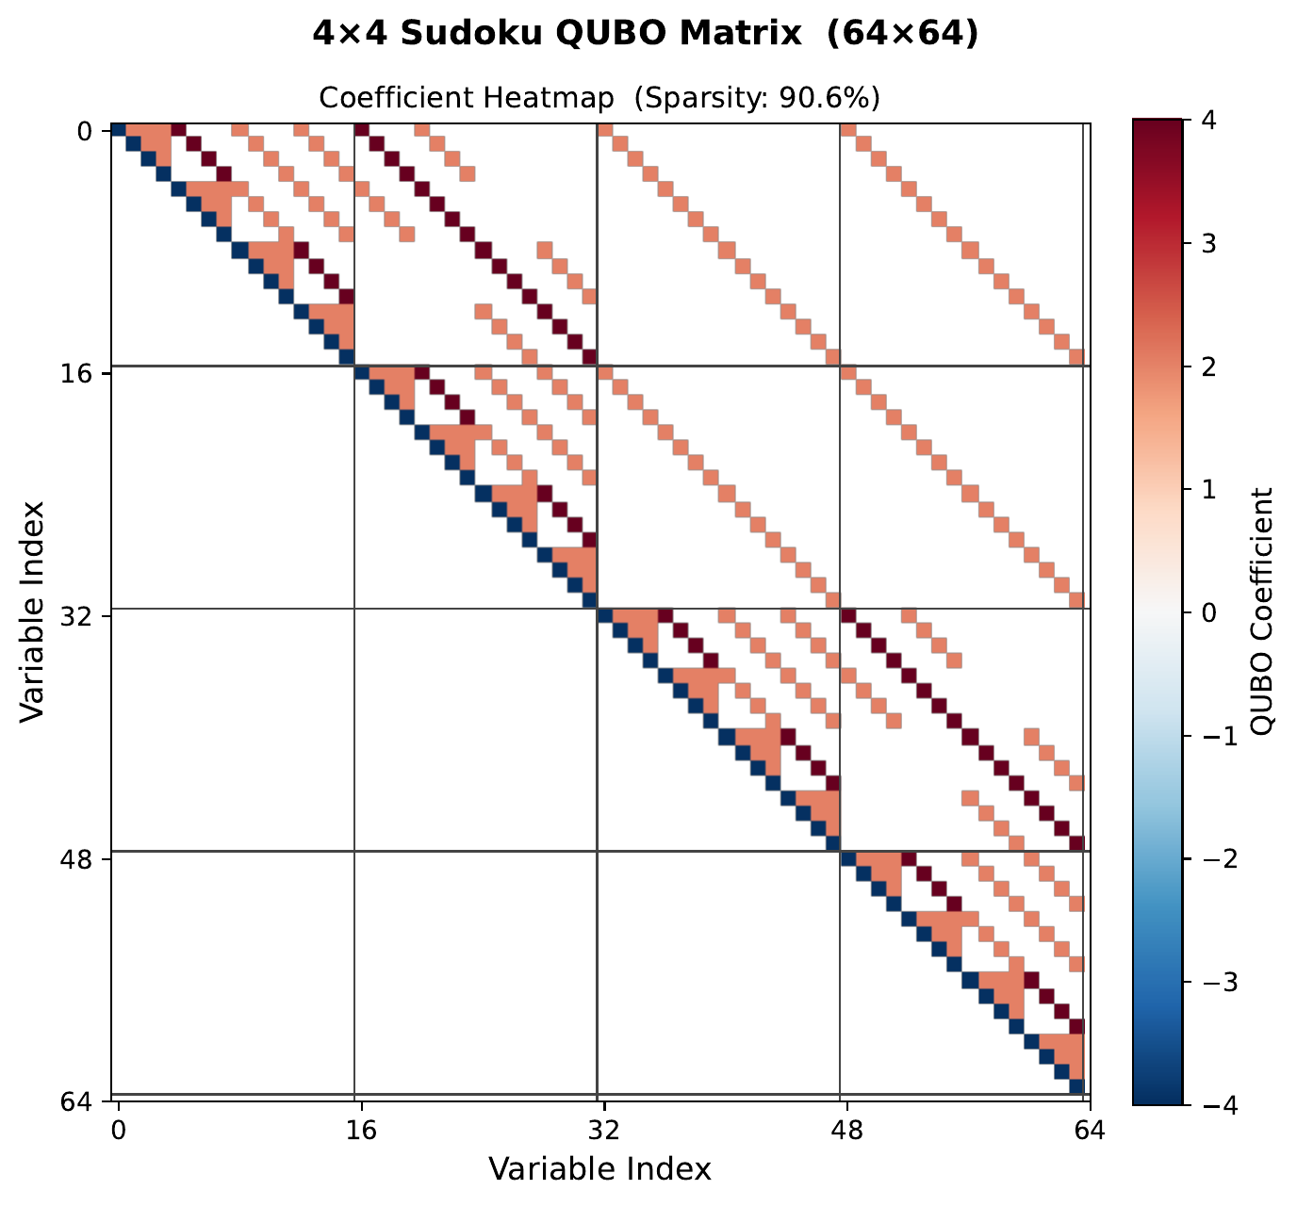
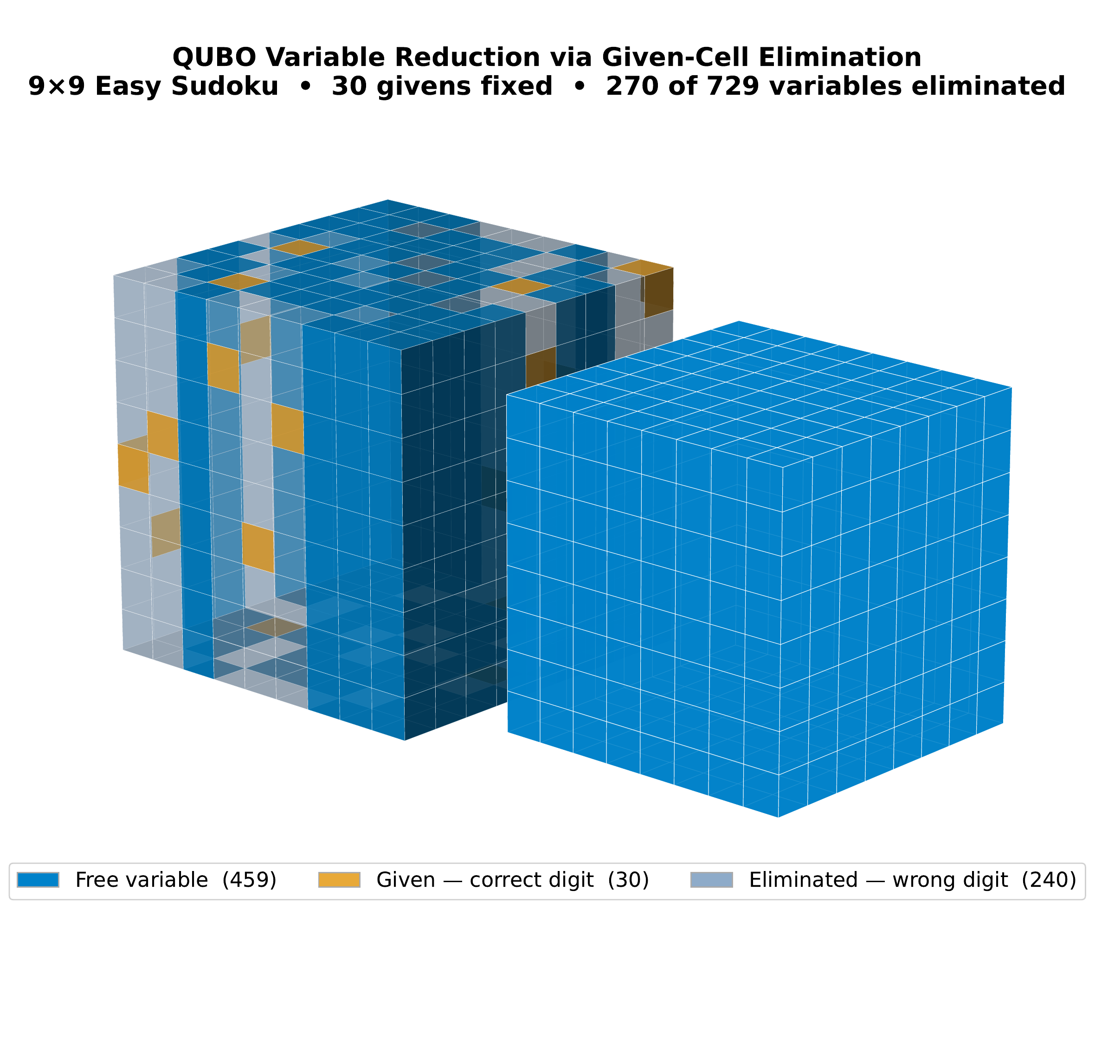

Grid-Based Quantum Annealing for Sudoku
VCU
A QUBO Formulation of Sudoku as Graph Coloring — Benchmarked Against Classical Simulated Annealing
Jonah Minkoff
COMPUTER
SCIENCE
Dept. of Computer Science · Virginia Commonwealth University · minkoffjg@vcu.edu
Background & Motivation
Methodology
Constraint Encoding
Sudoku encodes constraint satisfaction structures in scheduling, logistics, and resource allocation — an ideal quantum benchmark.
Quantum annealing uses tunneling to escape local energy minima, potentially outperforming classical heuristics.
Goal: establish baselines for when quantum methods surpass classical on structured combinatorial problems.
Solvers Evaluated
Parameters
Simulated Annealing (D-Wave neal)
QAOA (Qiskit) — 2×2 only
Simulated Bifurcation — 4×4 only
QA.jl (Julia) — infeasible >20 qubits
SA: 100 reads × 1000 sweeps
QAOA: p=2, 2048 shots, COBYLA
All λ weights = 1.0
Metrics: success rate, best energy
Sudoku Puzzles Used in Experiments
4×4 Sudoku Test Puzzles
QPU vs. SA — Results
4×4 baseline (64 vars) · 9×9 Easy (459 free vars) · 9×9 Hard (576 free vars)
2×2 Sudoku (8 qubits): energy 4.0, but post-processing recovered a valid solution.
4×4 impossible: 2⁶⁴ states ≈ 148 exabytes of RAM.
NISQ noise and exponential state space block practical scaling.
Problem Formulation
QUBO Encoding:
x(i,j,k) = 1 if cell (i,j) holds digit k+1, else 0
Sparsity pattern (left, 90.6% zeros) and coefficient values (right). Block structure encodes the four constraint types.
Why Quantum Annealing Fits
Four Constraint Penalties:
E₁ Cell · E₂ Row · E₃ Column · E₄ Box
D-Wave natively solves QUBOs — 5,000+ qubits, no circuit depth limits.
Sudoku QUBOs are 84–97% sparse — favorable for hardware embedding.
Hybrid solver pairs classical preprocessing with quantum tunneling.
E_total = E₁+E₂+E₃+E₄ = 0 ⟺ Valid Sudoku
One-Hot Encoding Over Grid-Based Representation
Conclusions
✓
QUBO correctly encodes all constraints — E=0 ↔ valid solution.
QUBO Matrix Structure
SA: 99% on 4×4, but 6% / 0% / 0% on 9×9 easy / medium / hard.
✓
9×9 Easy: 729 variables before (left) vs 459 after given-cell elimination (right). Dark = fixed, blue = free.
14× variable density increase (64→459 vars) collapses success from 99% to 0%.
✓
D-Wave hybrid solved 2/3 puzzles vs SA's 1/3 — quantum advantage on medium.
Quantum Annealing Hardware
D-Wave Hybrid Solver vs. Simulated Annealing
✗
Both solvers failed on 17-clue Sudoku — hardest instances remain open.
Puzzle | Vars | SA | SA E | Hybrid E | Time
Easy (30 clues) | 459 | 6% ✓ | 0 ✓ | 0 ✓ | 1.64s
Medium (25 clues) | 504 | 0% ✗ | 4 ✗ | 0 ✓ | 1.80s
Hard (17 clues) | 576 | 0% ✗ | 4 ✗ | 4 ✗ | 1.72s
→
Next: D-Wave Advantage QPU, penalty tuning, domain-wall encoding.
References
★ Quantum Tunneling Advantage Demonstrated
Hybrid solver succeeded on Medium where all 100 SA runs failed — tunneling past classical local minima.

