Slide 1
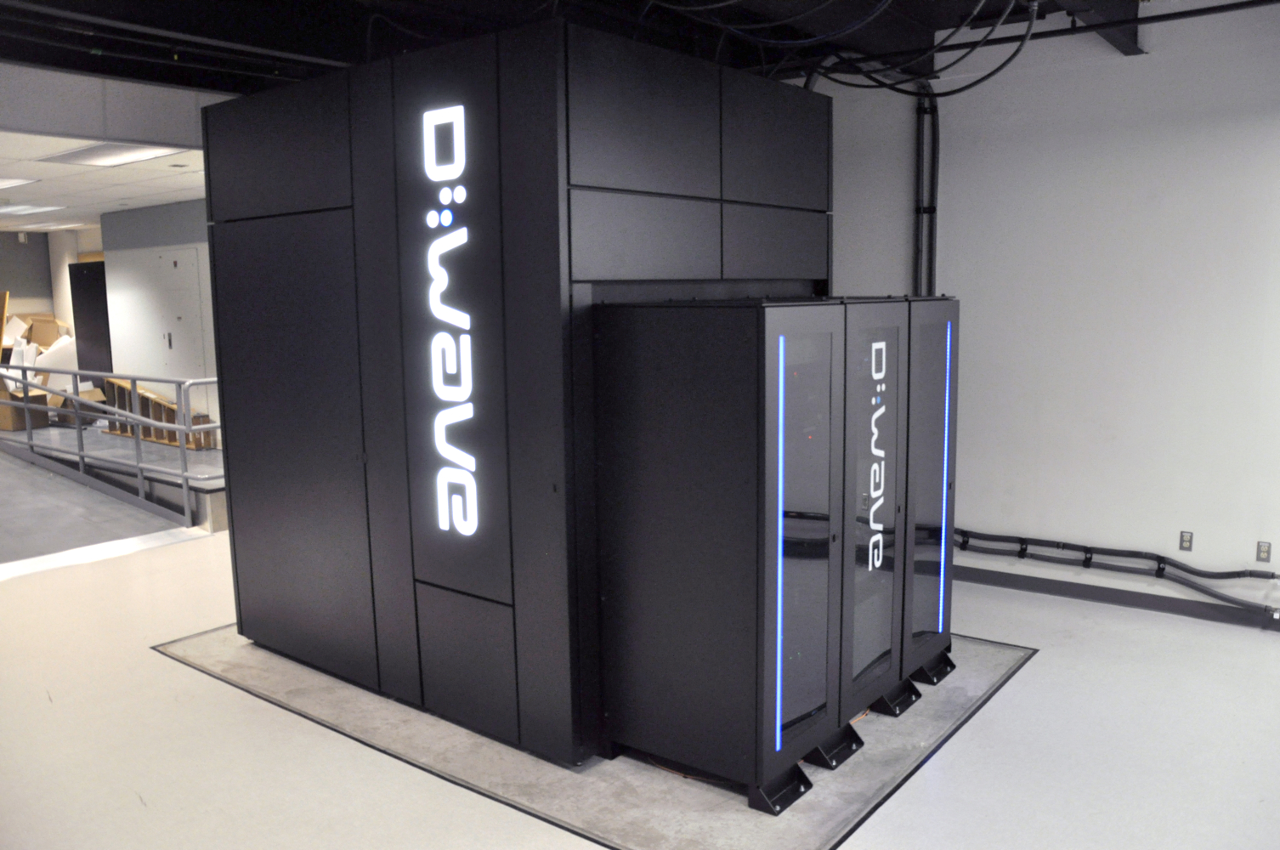
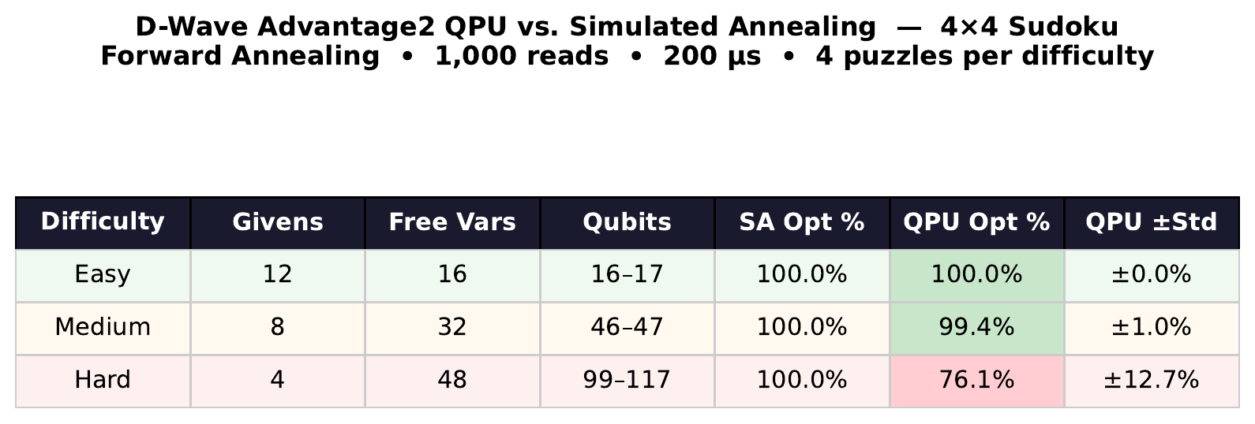
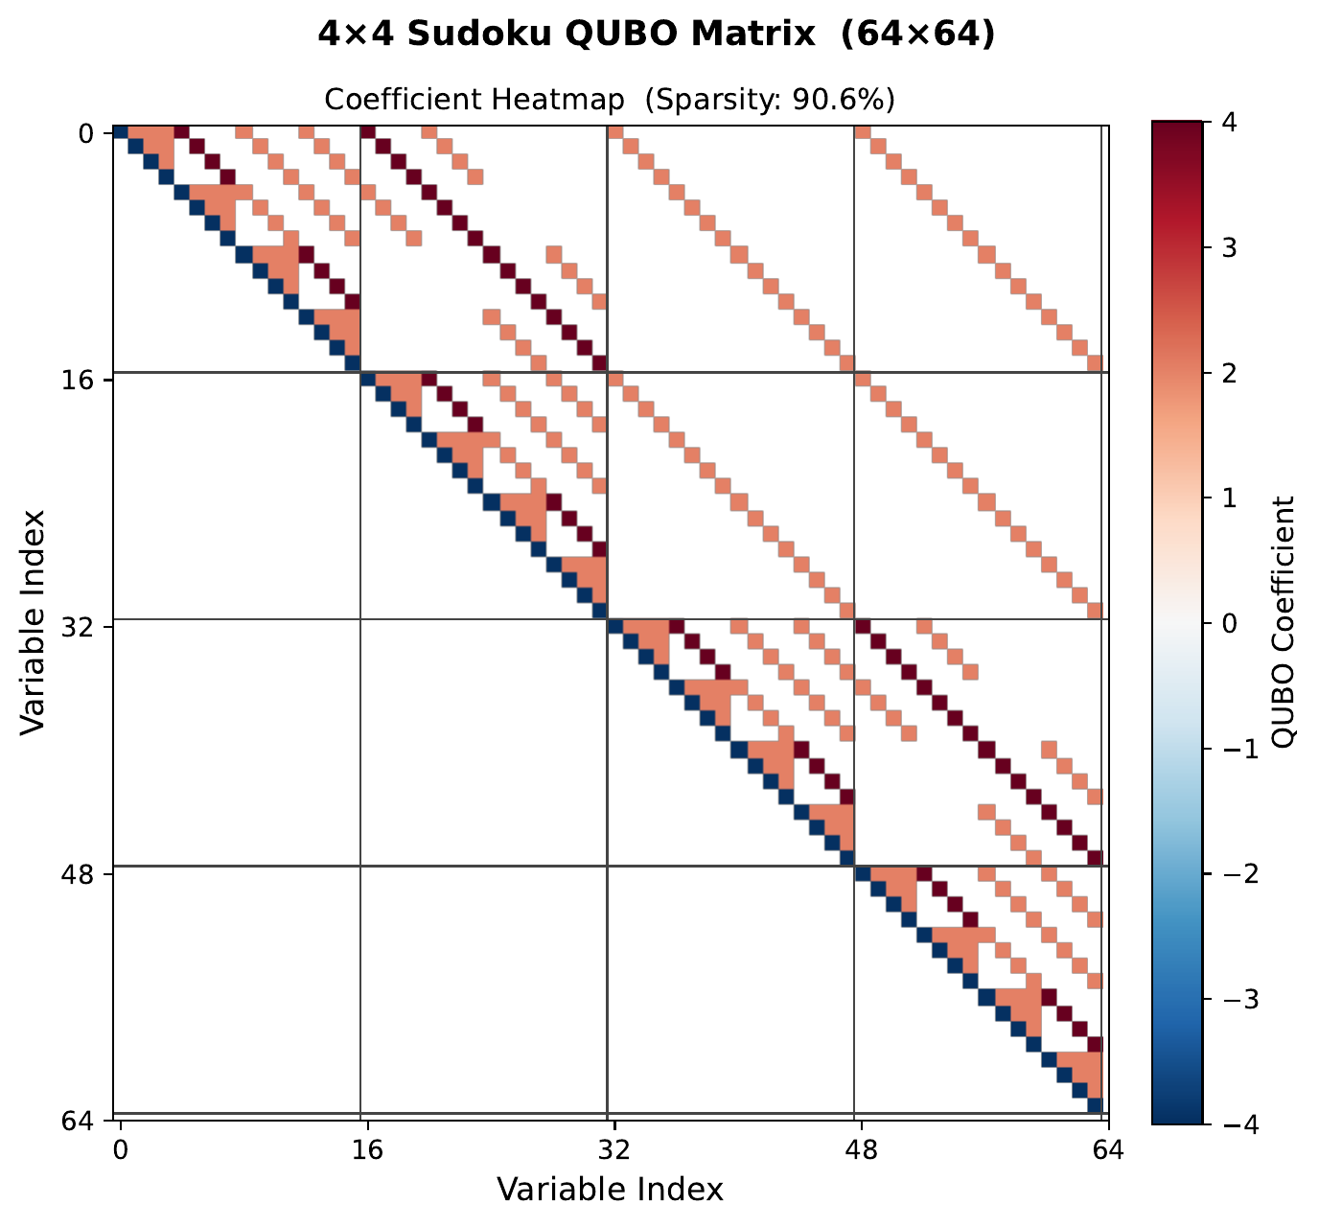
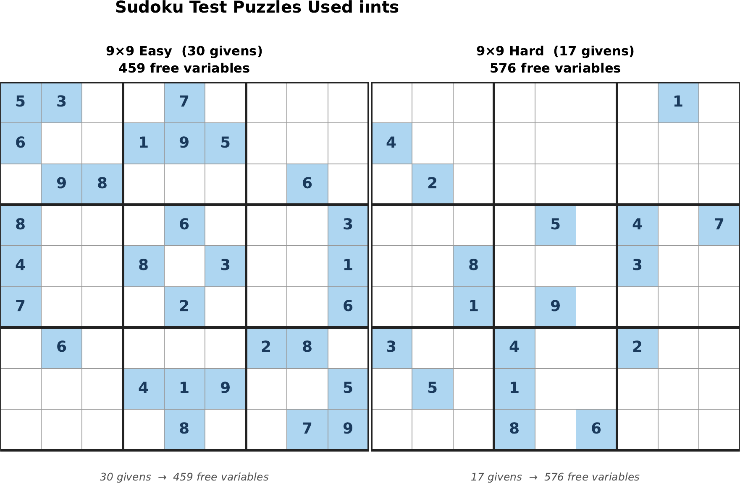
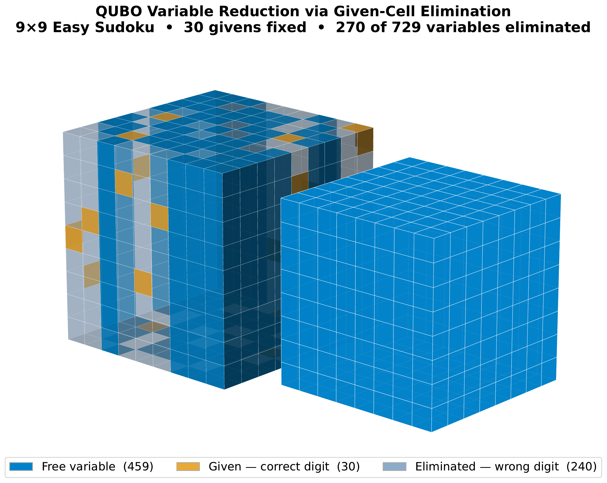
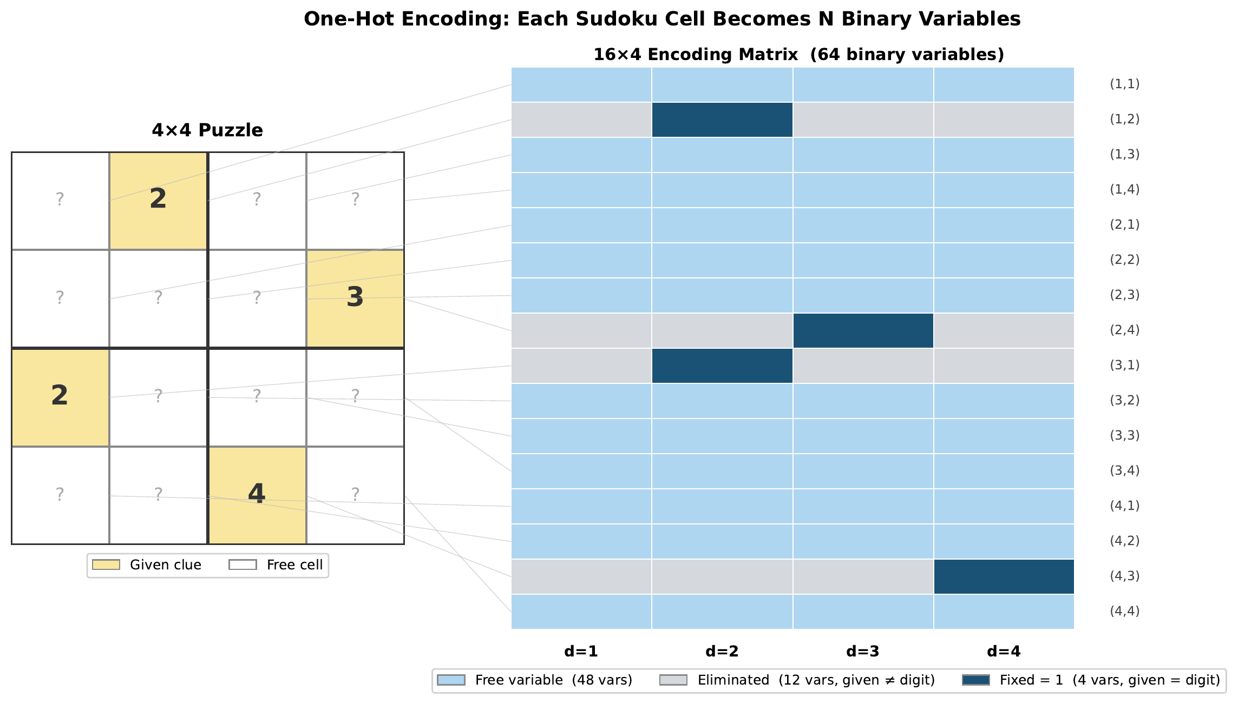

One-Hot Quantum Annealing for Sudoku
VCU
A QUBO Formulation of Sudoku as Graph Coloring • Benchmarked Against Classical Simulated Annealing • D-Wave Advantage2 QPU Validation
COMPUTER SCIENCE
Jonah Minkoff
Virginia Commonwealth University
Dept. of Computer Science · Virginia Commonwealth University · minkoffjg@vcu.edu
INTRODUCTION & MOTIVATION
METHODOLOGY
RESULTS: D-WAVE QPU VS. SIMULATED ANNEALING (4×4 Sudoku)
What is Sudoku?
Sudoku is a constraint satisfaction problem (CSP) modeled as graph coloring on an N×N grid: each cell receives exactly one digit 1–N such that no digit repeats in any row, column, or √N×√N box. It encodes the same constraint structure found in scheduling, resource allocation, and combinatorial optimization.
Why Quantum Annealing?
Classical solvers (backtracking, constraint propagation, dancing links) solve 9×9 in milliseconds but scale poorly as constraints densify. Quantum annealing leverages quantum tunneling to escape local energy minima — ideal for constraint-heavy landscapes where classical methods get trapped.
Goal
Derive a QUBO formulation for Sudoku from first principles, validate correctness via simulated annealing, then test on D-Wave’s Leap Hybrid BQM Solver and Advantage2 QPU. Benchmark scalability from 4×4 to 9×9, comparing quantum and classical methods on success rate and energy.
Hardware Platform
D-Wave Advantage2: 5,000+ superconducting qubits on Pegasus P16 topology. QUBO variables are mapped to physical qubits via minor embedding, with coupled qubit chains representing binary decisions. QPU experiments use 1,000 reads at 200 μs anneal time with forward annealing.
Solvers Evaluated
• Simulated Annealing (D-Wave neal) 100 reads, 1000 sweeps
• D-Wave Leap Hybrid BQM v2.2
• D-Wave Advantage2 QPU 1,000 reads · 200 µs · forward annealing
• QAOA (Qiskit) — 2×2 only; circuit depth prohibitive at 4×4 scale — excluded from results (p=2, 2048 shots, COBYLA)
Test Instances
• 4×4 (no givens, 64 vars) — QUBO correctness baseline
• 9×9 Easy→Hard: 30/25/17 givens → 459/504/576 free vars (17 = min unique)
D-Wave Advantage2
QUBO COEFFICIENT MATRIX (4×4 SUDOKU, 64×64)
SUDOKU TEST PUZZLES (9×9 EASY & HARD)
QUBO FORMULATION
Binary Variable: xi,j,k = 1 if cell (i,j) holds digit k+1, else 0
4×4: 64 vars | 9×9: 729 vars | 9×9 with 30 givens: 459 free vars (37% reduction via given-cell elimination)
Energy Function — minimize to solve:
Eₜₒₜₐₗ = E₁ + E₂ + E₃ + E₄ = 0 ⇒ Valid Sudoku
E₁ Cell
Σᵢⱼ (Σₖ xᵢⱼₖ − 1)² — each cell holds exactly one digit
E₂ Row
Σᵢₖ (Σⱼ xᵢⱼₖ − 1)² — each digit appears once per row
KEY OBSERVATIONS
VARIABLE REDUCTION VIA GIVEN-CELL ELIMINATION
✅
SA degrades sharply with scale: 99% on blank 4×4 (64 vars) → 7% on 9×9 Easy (459 vars, 30 givens) — 7× more variables, 14× lower success. Note: baselines differ (blank 4×4 vs. given-reduced 9×9); SA's collapse is likely understated on a fully blank 9×9.
E₃ Column
Σⱼₖ (Σᵢ xᵢⱼₖ − 1)² — each digit appears once per column
⚡
QPU on 4×4: 100% Easy · 99.4% Medium · 76.1% ± 12.7% Hard — confirms the QUBO formulation produces valid Sudoku solutions on real quantum hardware.
E₄ Box
Σʙₒˣ,ₖ (Σ₍ᵢ,ⱼ₎∈ʙₒˣ xᵢⱼₖ − 1)² — each digit appears once per √N×√N box
⚠
SA outperforms QPU on 4×4 Hard (100% vs. 76.1%) — QPU struggles on the densest constraint instances even at small scale.
✔
Chain breaks: 0% on all 12 QPU experiments — the Pegasus topology embeds 4×4 Sudoku cleanly; Hard failures are an annealing quality issue, not a connectivity issue.
Matrix entries: diagonal −1 · off-diagonal (conflicting vars) +2 · 4×4: 64×64 Q · 9×9: 459×459 Q (30 given cells eliminated = 270 vars) · ≤28 non-zero off-diagonals per variable
⏱
QPU access time: 337–352 ms per experiment — hardware overhead is modest; bottleneck is solution quality, not speed.
λ₁=λ₂=λ₃=λ₄=1.0 (Lagrange multipliers, all equal — penalty weight tuning is a future direction)
CONCLUSIONS
• QUBO encoding is provably exact: E = 0 iff all four constraint types hold — validated on both 4×4 and 9×9.
• SA drops from 99% (4×4 blank) to 7% (9×9 Easy) with a 7× variable increase — classical annealing does not scale.
• QPU finds valid Sudoku on real hardware: 100% Easy, 99.4% Medium, 76.1% Hard on 4×4 instances.
• SA beats QPU on 4×4 Hard (100% vs. 76.1%) despite 0% chain breaks — energy landscape complexity is the bottleneck, not embedding.
• Direct 9×9 QPU benchmarking remains open — 4×4 Hard results motivate annealing schedule and encoding improvements first.
ONE-HOT ENCODING
FUTURE DIRECTIONS
• Per-constraint penalty tuning (λ₁…λ₄) to improve Hard-instance success rate
• Alternative encoding (e.g. domain-wall) + embedding optimization to cut qubit count and chain breaks
• Direct Advantage2 QPU on full 9×9 without hybrid — pure annealing benchmark
• Sweep full clue-count range (17–40) to map where the QPU’s solvability boundary lies
• Scale to 16×16 Sudoku via hybrid quantum-classical decomposition
Special Thanks: Prof. Thang Dinh, Dept. of Computer Science, Virginia Commonwealth University — for guidance, resources, and D-Wave hardware access.
R
E
S
O
U
R
C
E
S

