Slide 1
Electronic Systems of Computers
Lab Assignments

Slide 2
First assignment (done)
Modify IOb-SoC’s firmware to print Fibonacci numbers
Simulate
Run on FPGA board

Slide 3
Second assignment (due 10/12/22)
Add GPIO peripheral to IOb-SoC
Modify firmware to drive GPOs
Modify firmware to read GPIs
Simulate
Run on FPGA board

Slide 4
Project proposal (due 15/12/22)
Propose a IOb-SoC system that uses the resources of the BASYS3 FPGA board
Firmware and peripherals that read buttons and switches and write to display and VGA
External hardware may be added to project (be careful with voltage compatibility, study docs and schematics)
CAUTIONS: hold USB socket with one hand while plugging with the other hand
The proposal is a 3-page presentation placed in the doc directory of your repo: short intro, description of project and expected results.

Slide 5
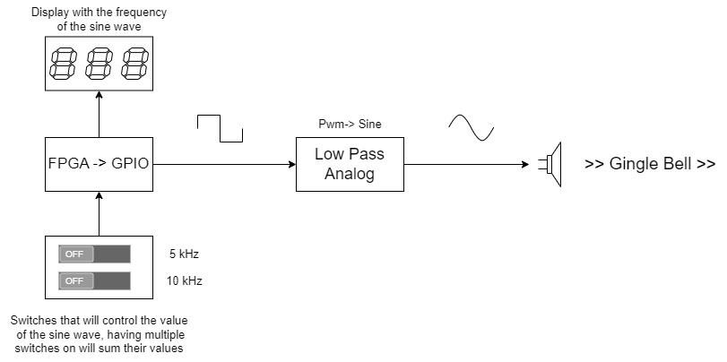

Slide 6
Project execution (due 15/01/23)
Prepare 10 minute slide presentation
  Short intro mentioning other works 1-2 slides
  Project description: 6 slides
  Conclusion: 2 slides (what you learned, what you did, directions for continuation)
Demo the project in the Lab (5 minutes)

