Slide 1
FPV Tutorübung
Woche 6
Ocaml: List-Module, Binary Search Trees
Manuel Lerchner
31.05.2023

Slide 2
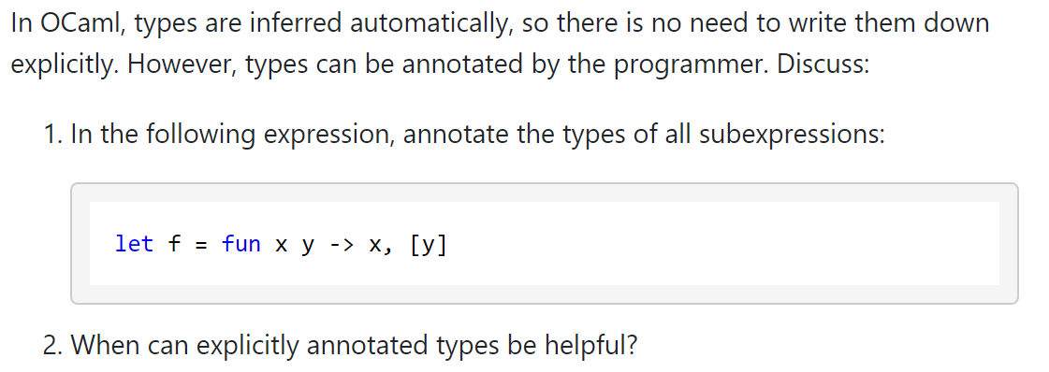
T01: Explicit Type Annotation

Slide 3
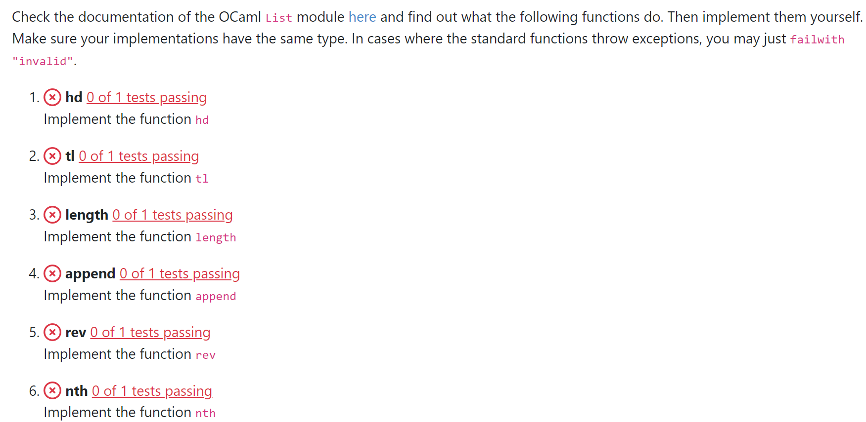
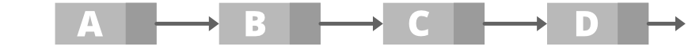
T02: The List Module

Slide 4
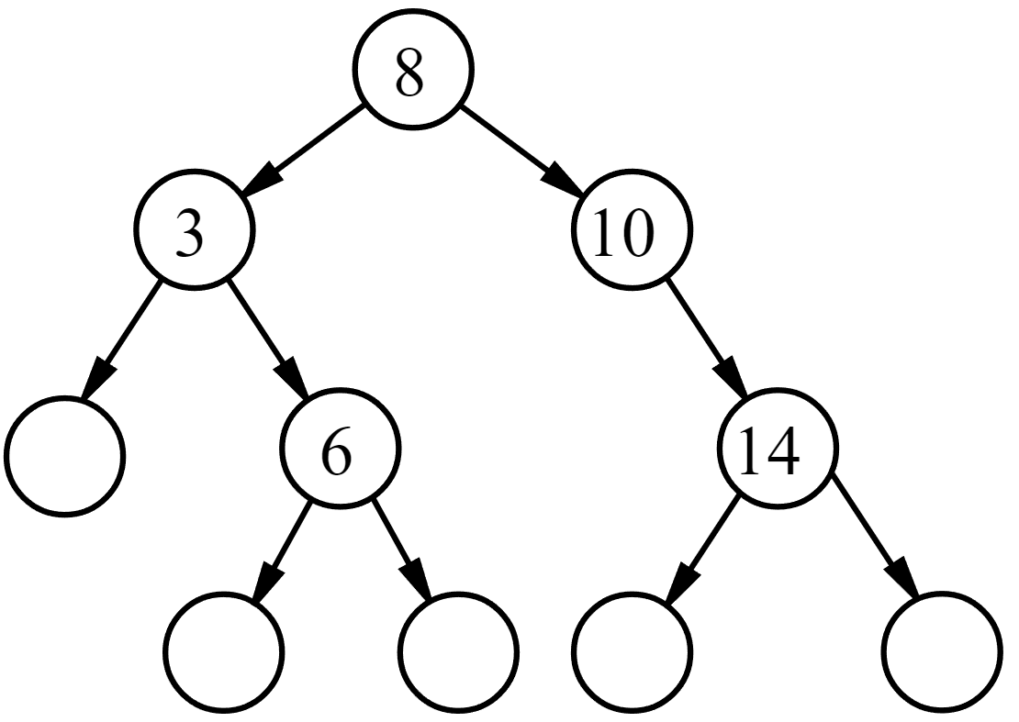
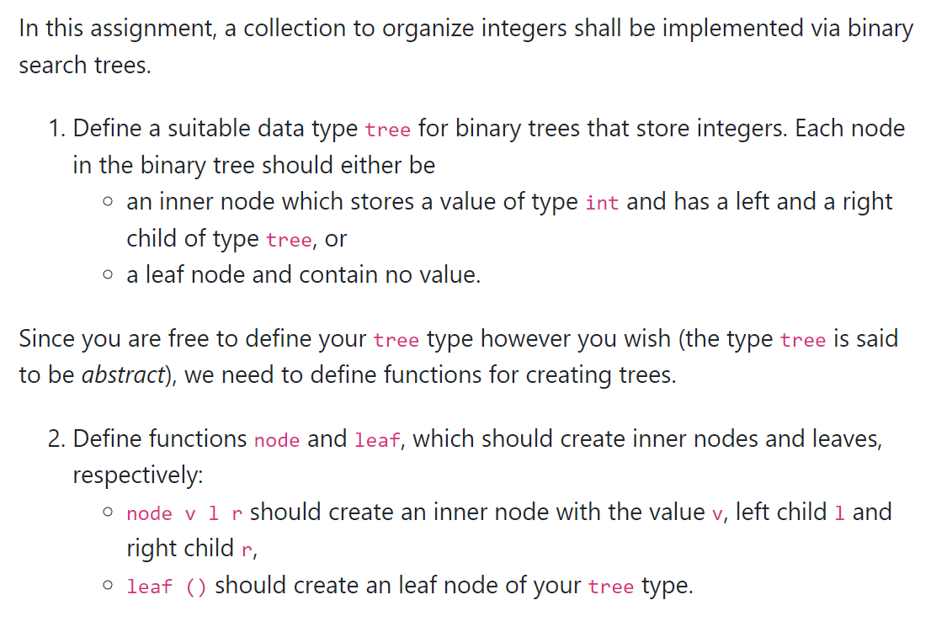
T03: Binary Search Tree 1

Slide 5
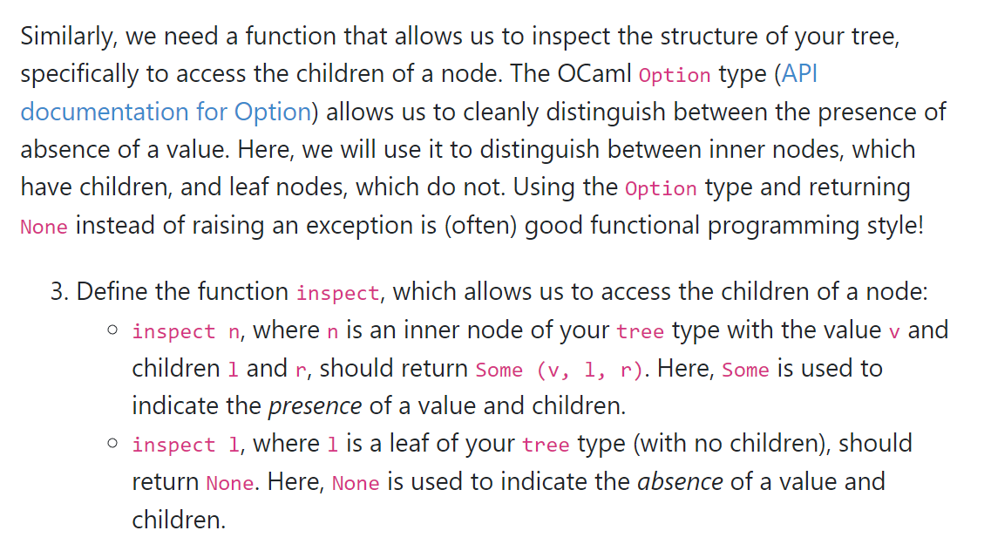
T03: Binary Search Tree 2

Slide 6
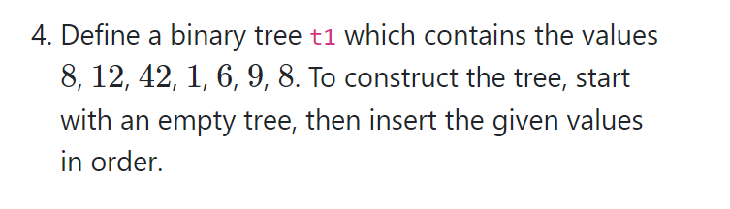
T03: Binary Search Tree 3

Slide 7
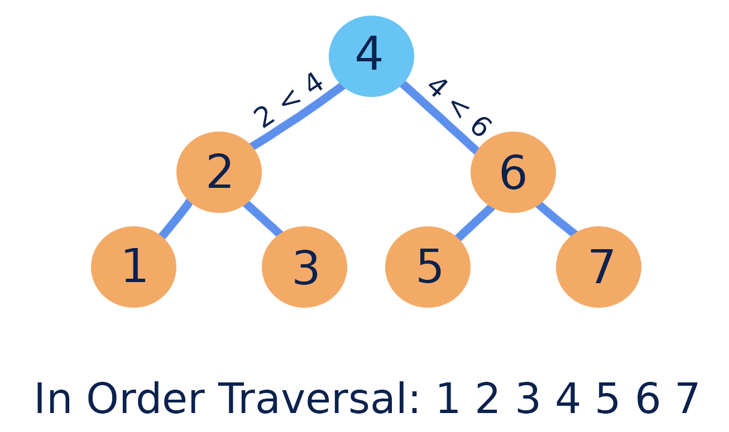
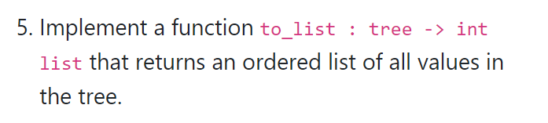
T03: Binary Search Tree 4

Slide 8
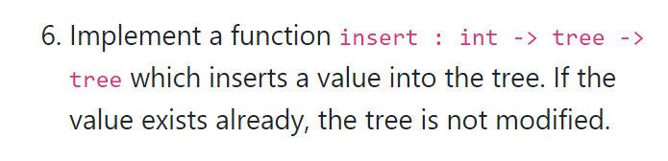
T03: Binary Search Tree 5

Slide 9
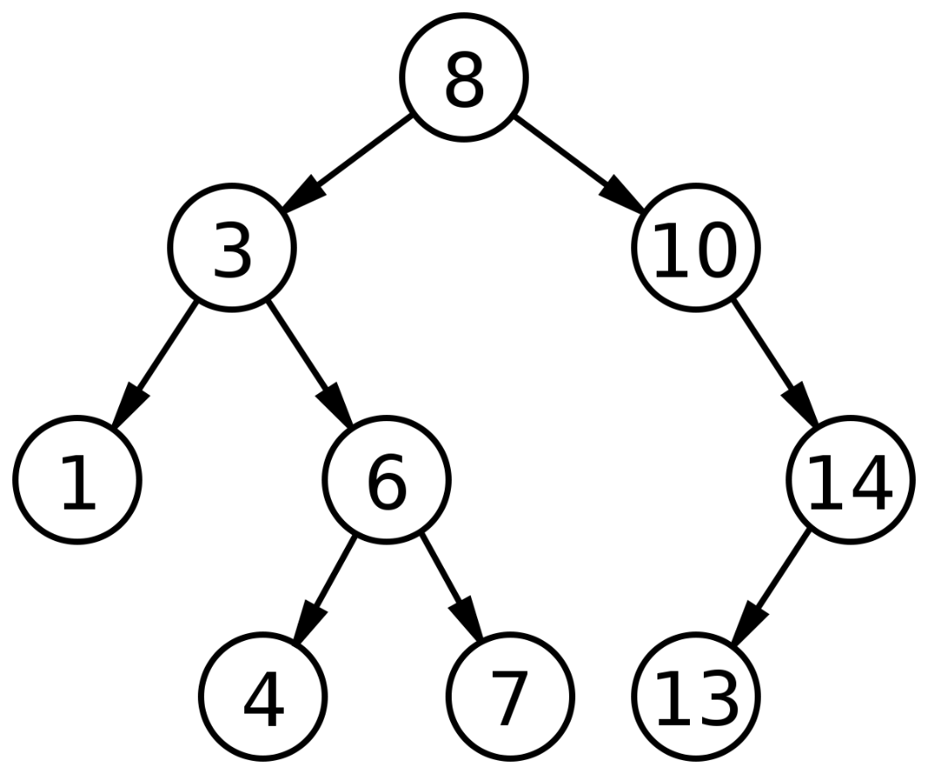
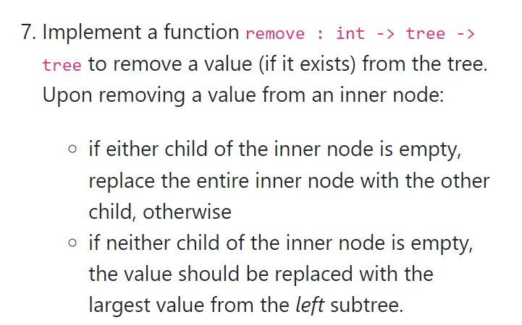
T03: Binary Search Tree 6

