Slide 1
FPV Tutorübung
Woche 12
Equational Reasoning
Manuel Lerchner
12.07.2023

Slide 2
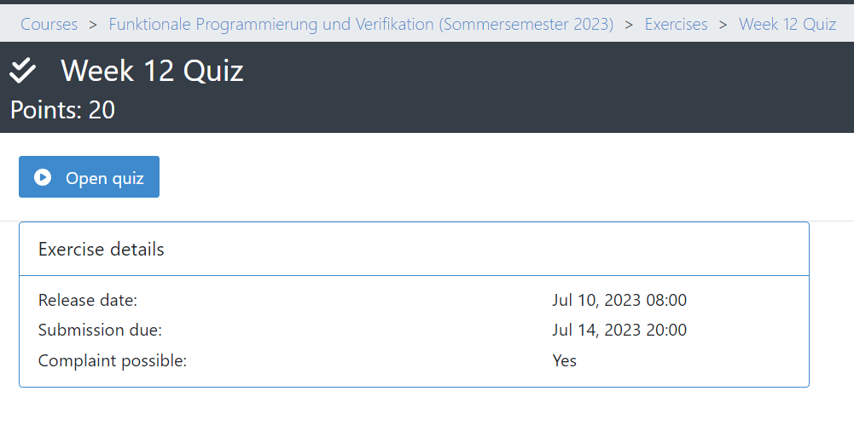
Quiz
Passwort:

Slide 3
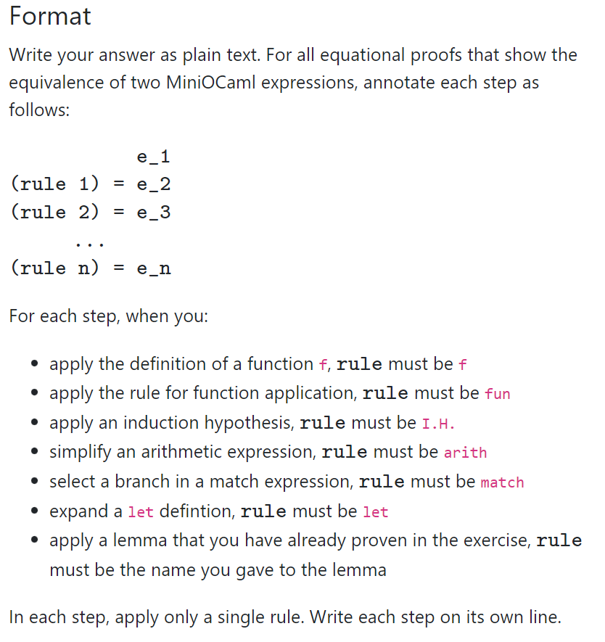
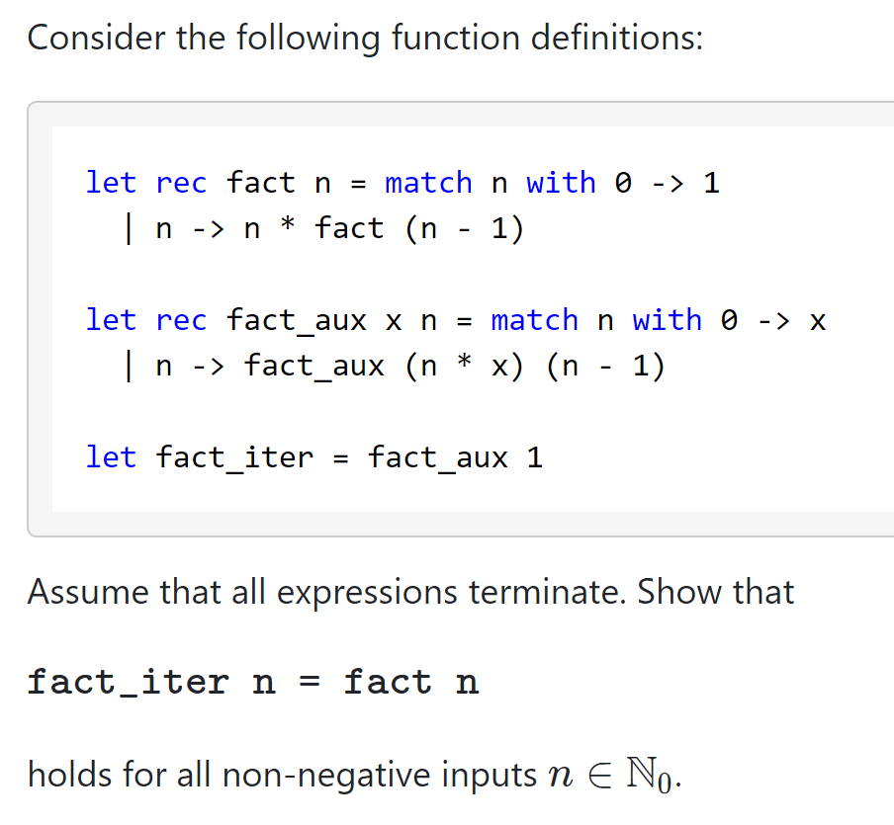
T01: What The Fact

Slide 4
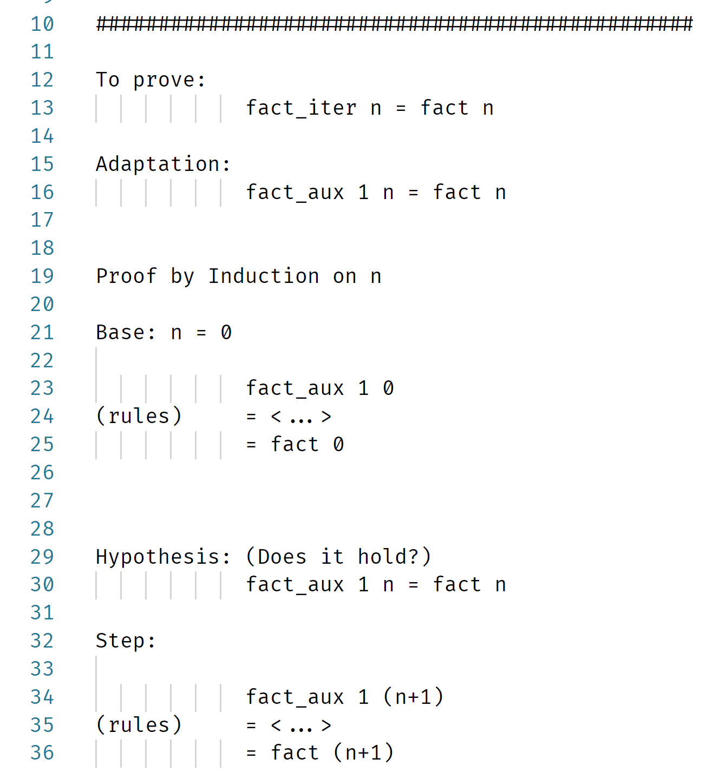
Template
Tipp: This scheme has has a flaw!
(Try to generalize!)

Slide 5
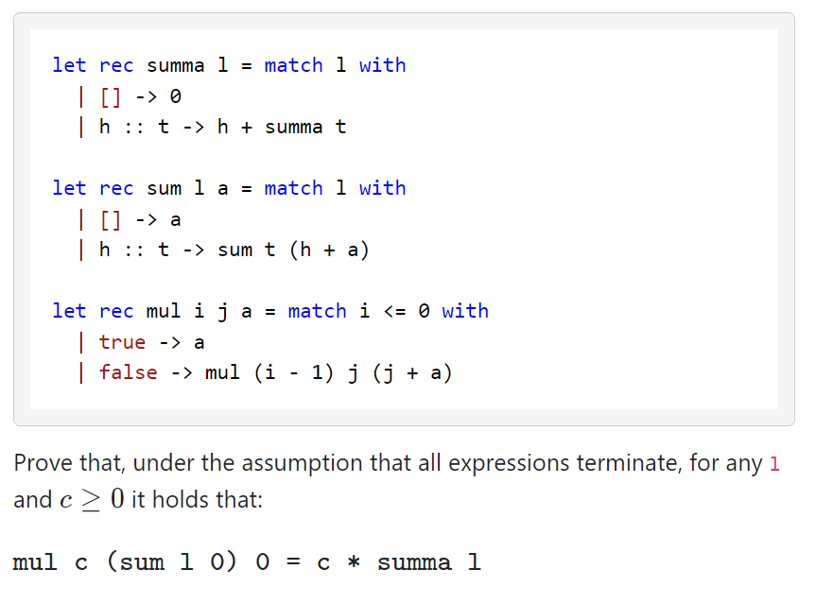
T02: Arithmetic 101

Slide 6
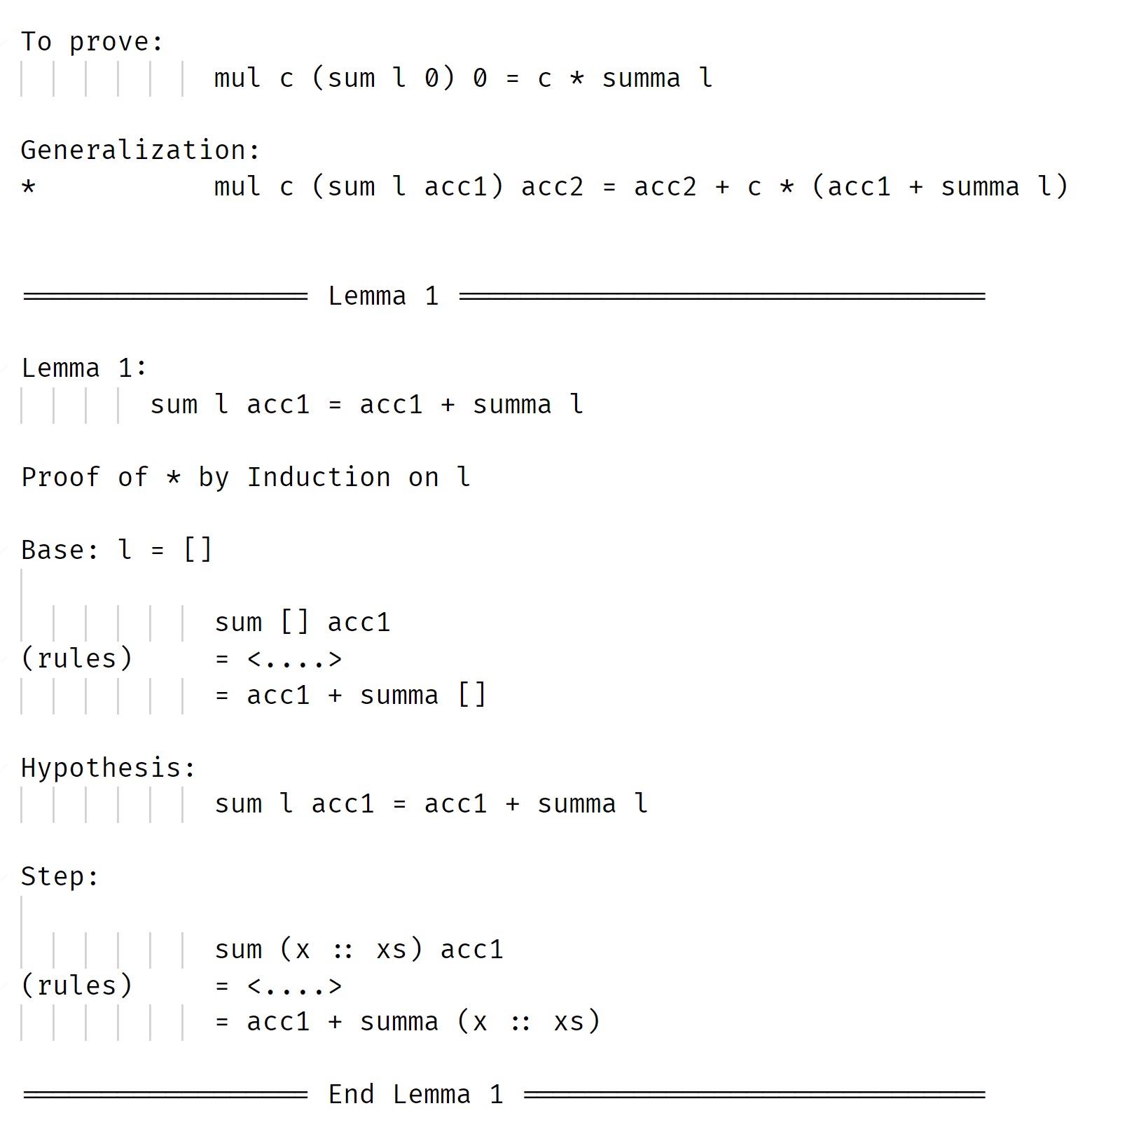
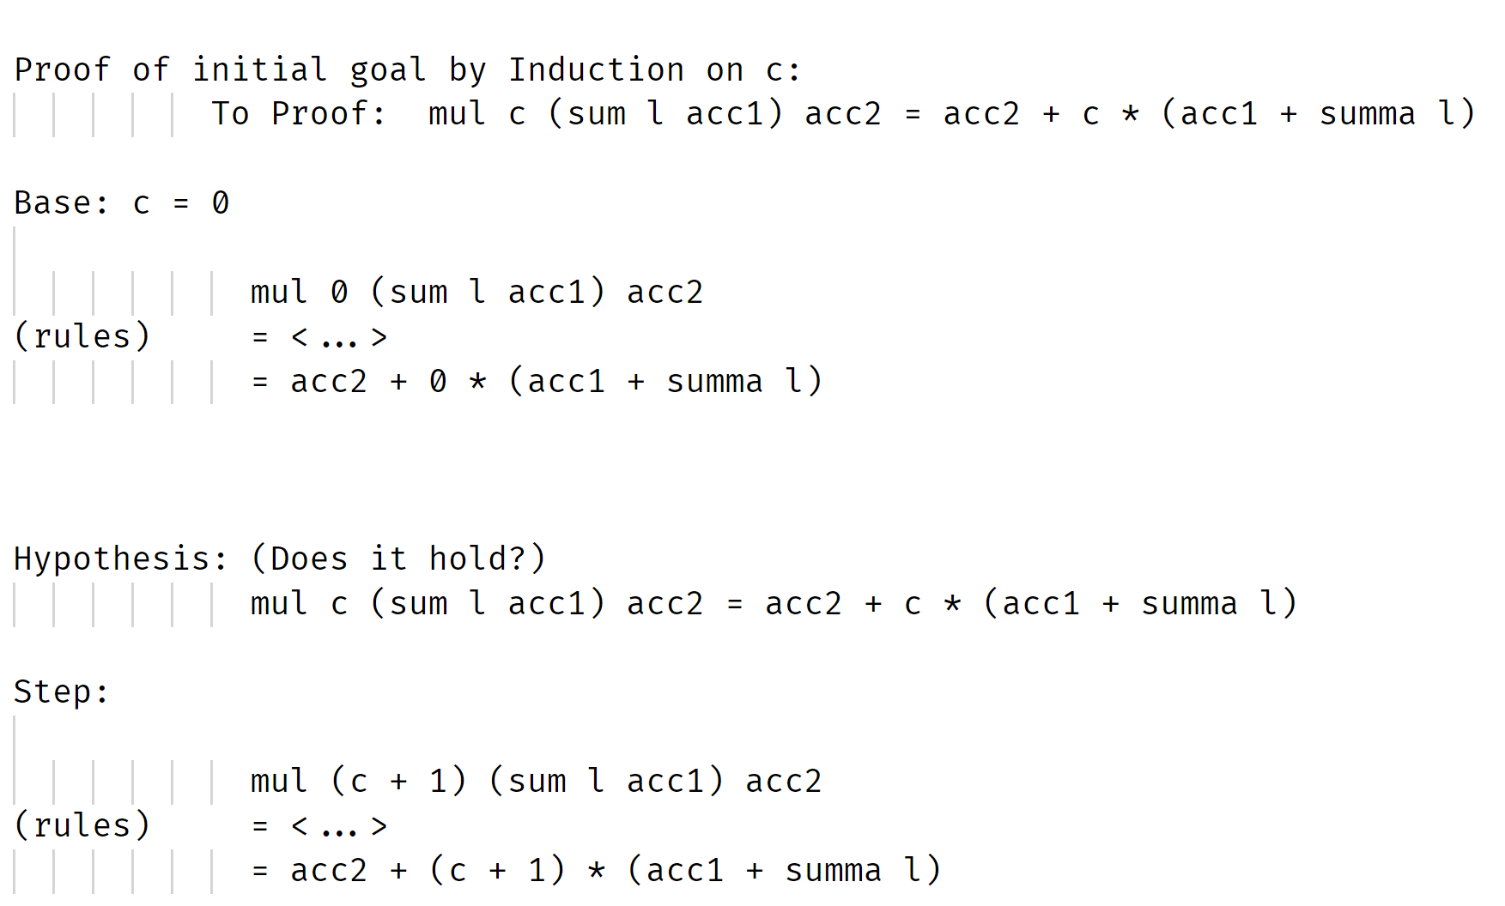
Template

Slide 7
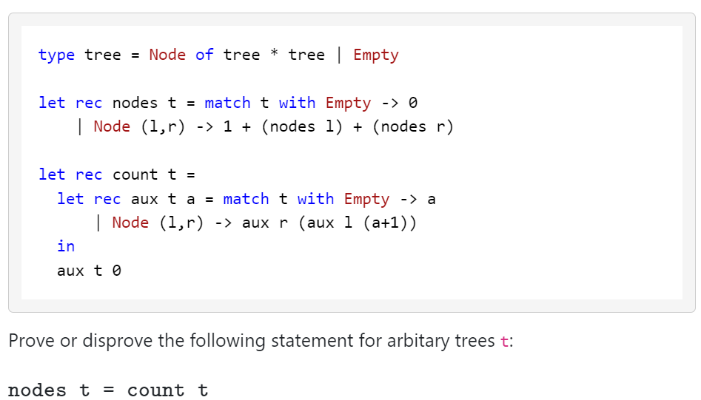
T03: Counting Nodes

Slide 8
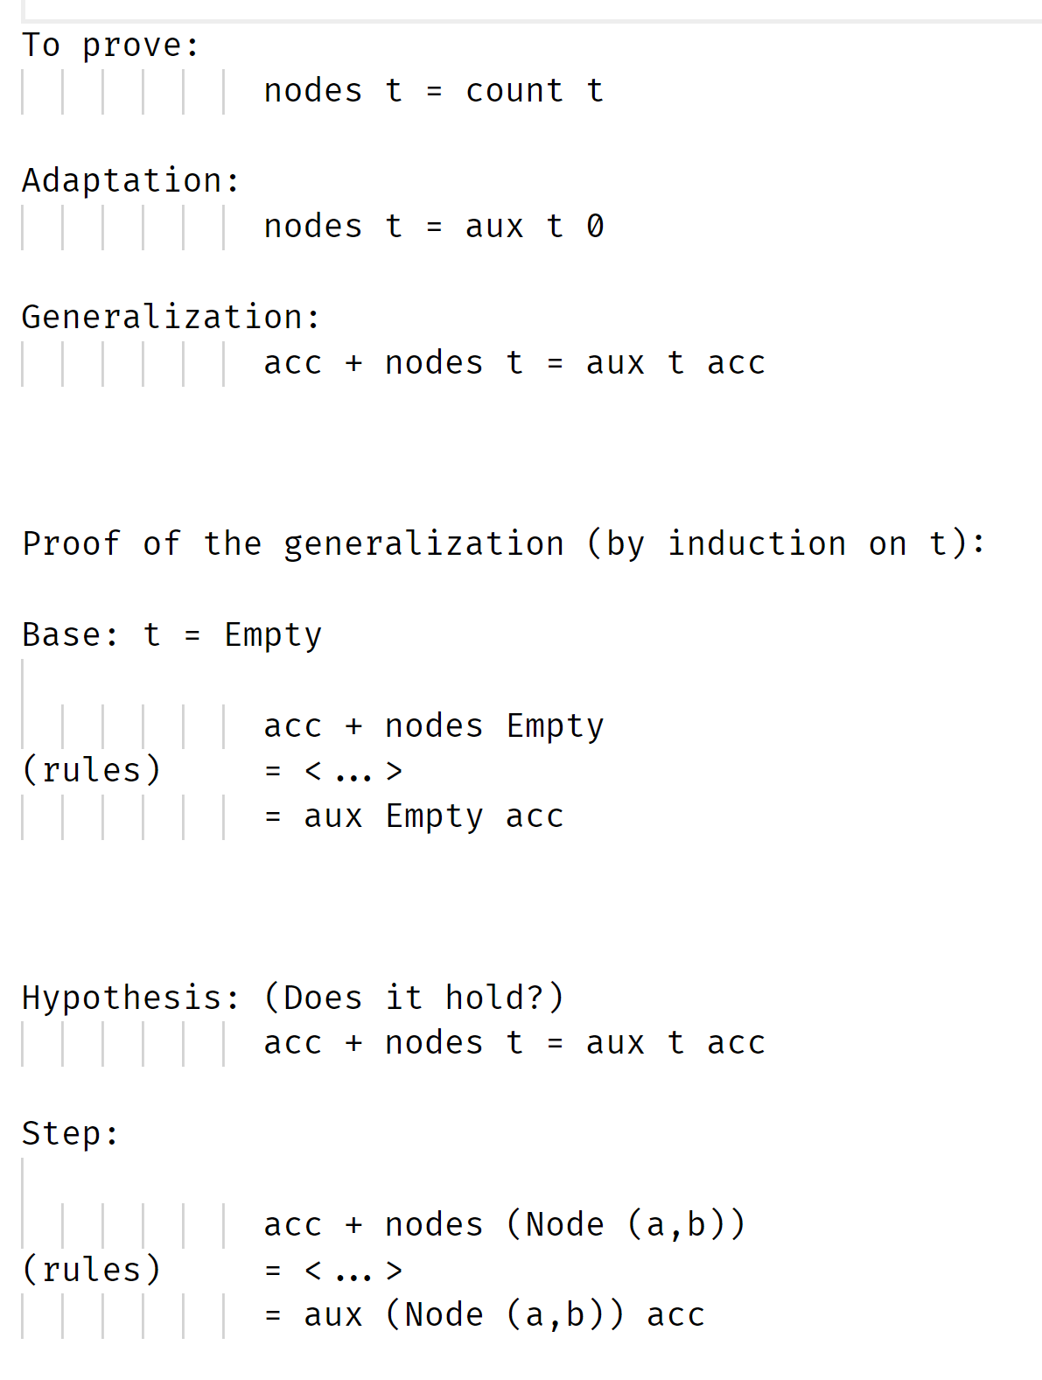
Template

