Slide 1
FPV Tutorübung
Woche 13
Threading
Manuel Lerchner
19.07.2023

Slide 2
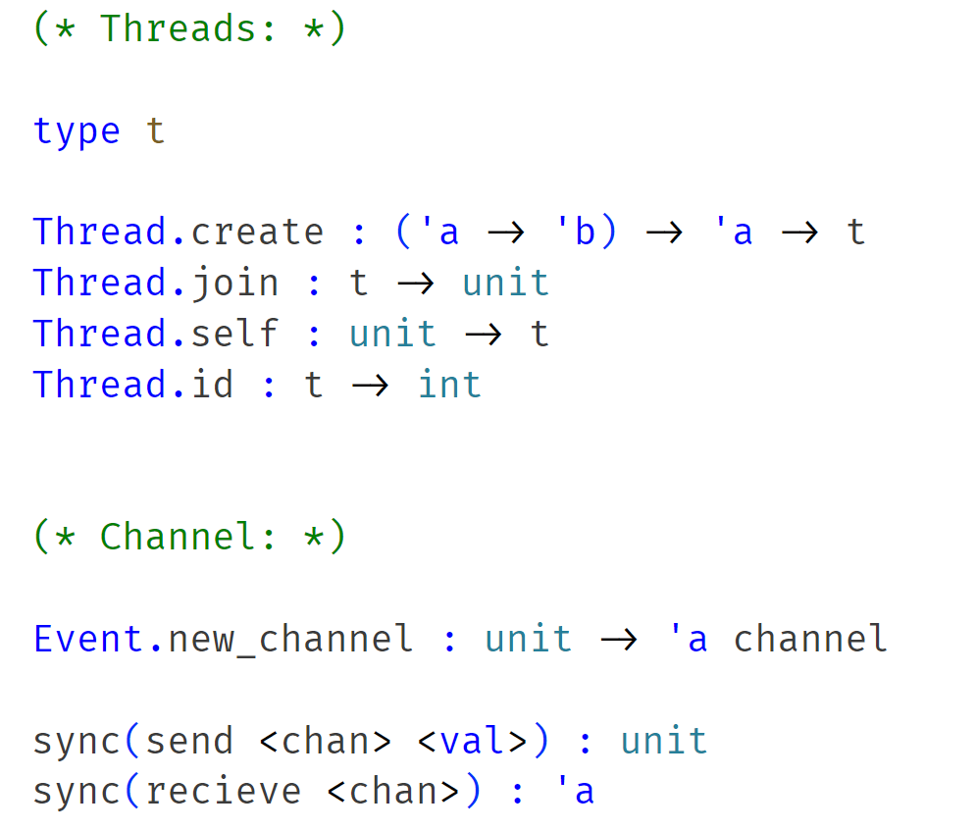
Threads
Threads in utop:
utop -I +threads
#use “src/file.ml“

Slide 3
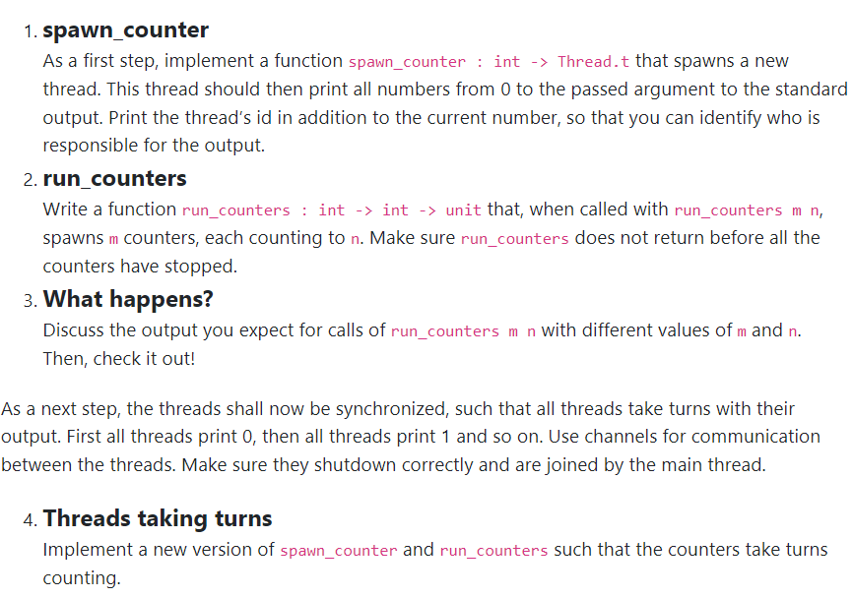
T01: Hellish Counting
spawn_counter n
Print:
id, 0
id, 1
…
id, n
Create Thread:
run_counters m n
spawn_counter n
spawn_counter n
spawn_counter n
m

Slide 4
T01: Hellish Counting
Threads write in their channel after they printed somehting and start to wait!
Main Thread repeatetly reads from all channels, to „unblock“ them
Threads proceed to print next value
Repeat until all counters are finished
run_counters m n
Spawn Threads with an individual channel.
Repeat: Read something from every
channel to „unblock“ them
Channels
Print a value, and send
something in the channel!
Wait for completion!
spawn_counter n
spawn_counter n
spawn_counter n

Slide 5
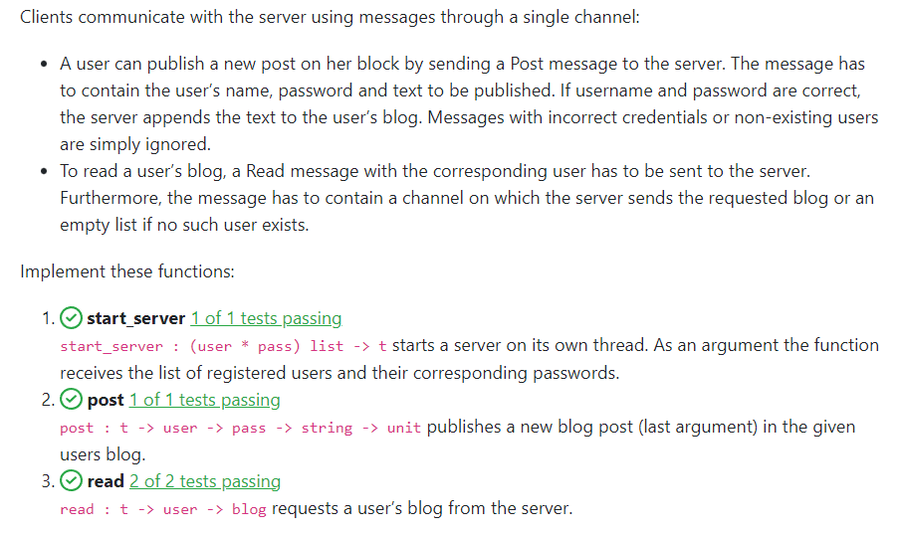
T02: Blog Server
Client
2) Send content to ch
1) read s „Manuel“ ch
Server s
db
users
Server main loop:
while true:
sync read message from channel
parse message
perfom action (update db)

Slide 6
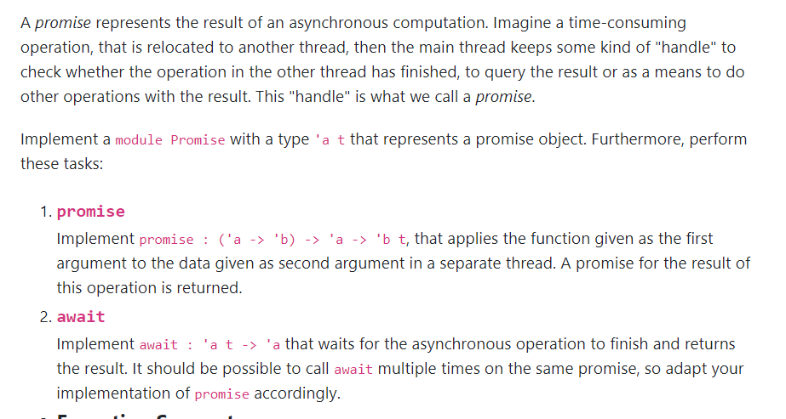
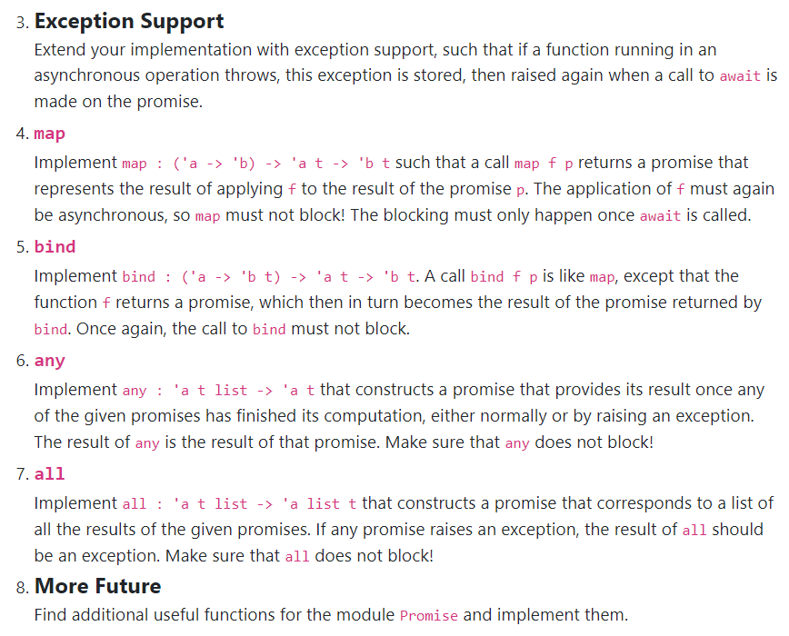

T03: How about the Future

