Slide 1
FPV Tutorübung
Woche 11
Big Step
Manuel Lerchner
05.07.2023

Slide 2
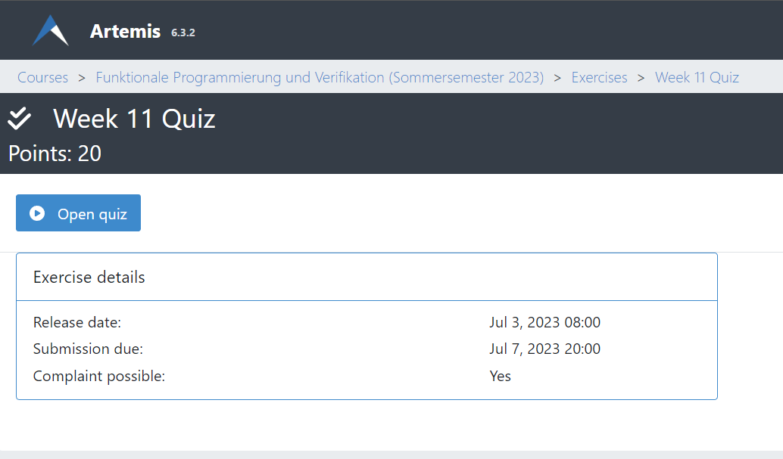
Quiz
Passwort:

Slide 3
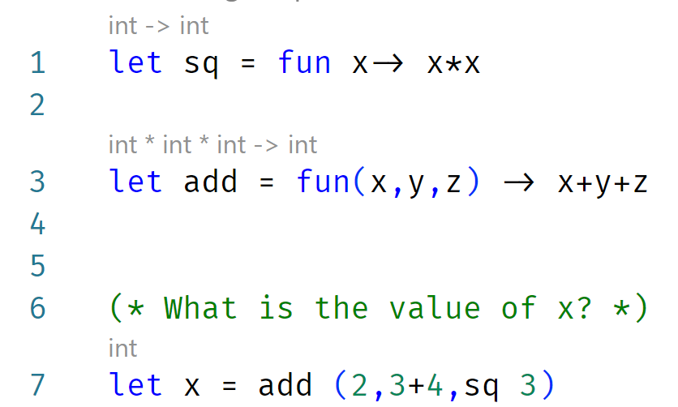
What is Big Step?
A way to formally calculate the value of expressions (Recursive style)
add (2, 3+4,sq 3) (Function call)
Find the value of the called function
add: Global Definition
Extract the value
Find the value of the argument
It‘s a tuple! Simplify all entries
2 => 2
3+4 => 7 (Arith)
sq 3 = Function call
sq: Global Definition
Extract the value
Argument 3 => 3
Substitute: x*x -> 3*3 => 9
Substitute the function variables with actual values
Substitute x+y+z with x=2, y=7, z=9
2+7+9 =>18

Slide 4
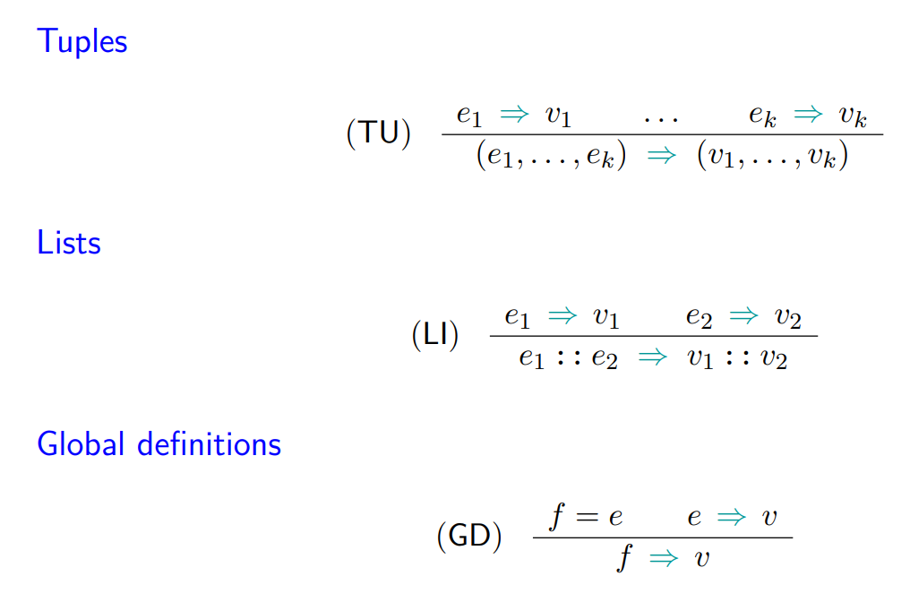
Big Step Rules 1

Slide 5
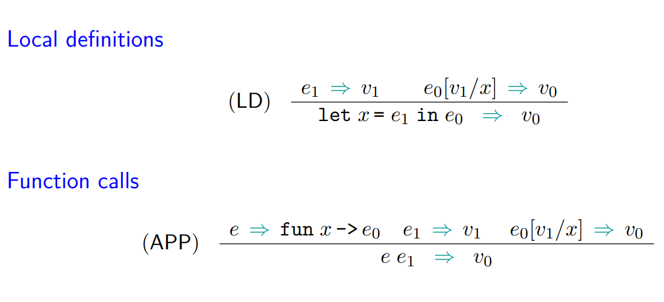
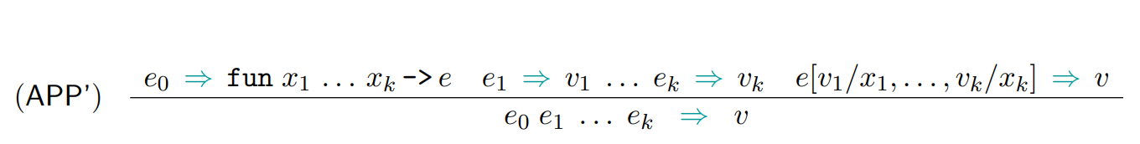
Big Step Rules 2

Slide 6
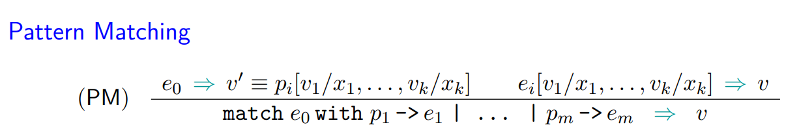
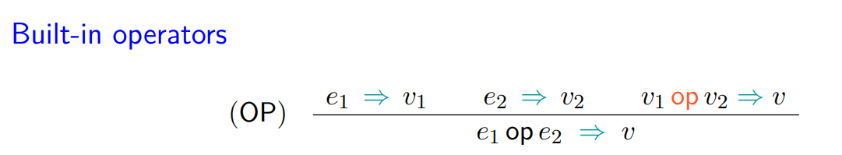
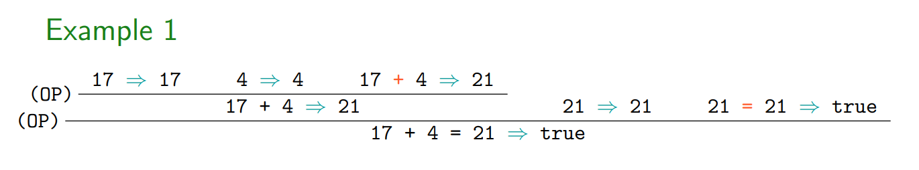
Big Step Rules 3

Slide 7
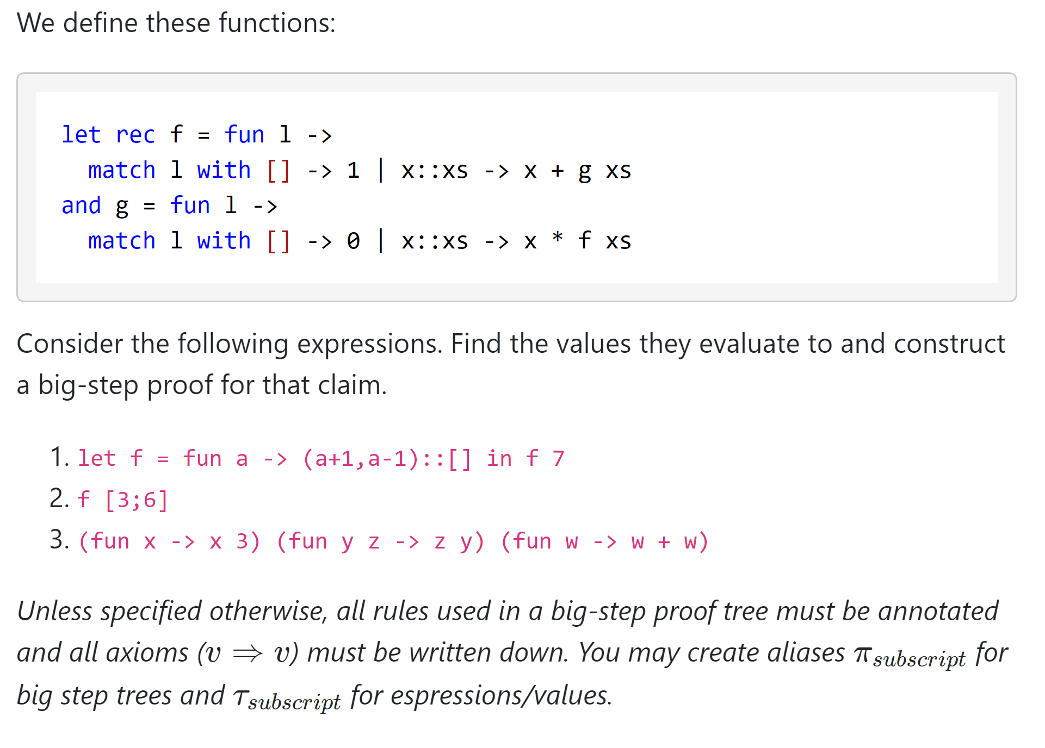
T01: Big Steps

Slide 8
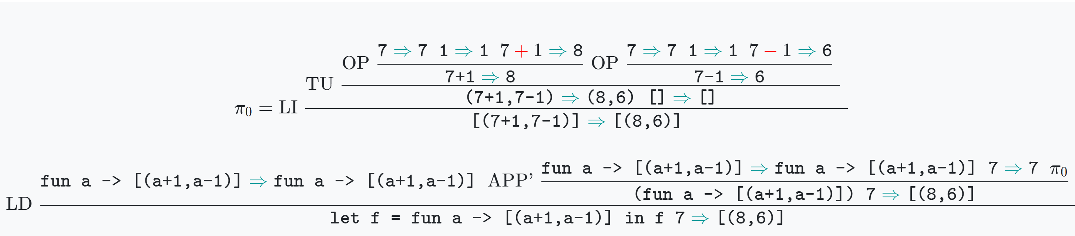
T01: Big Steps Ü1

Slide 9
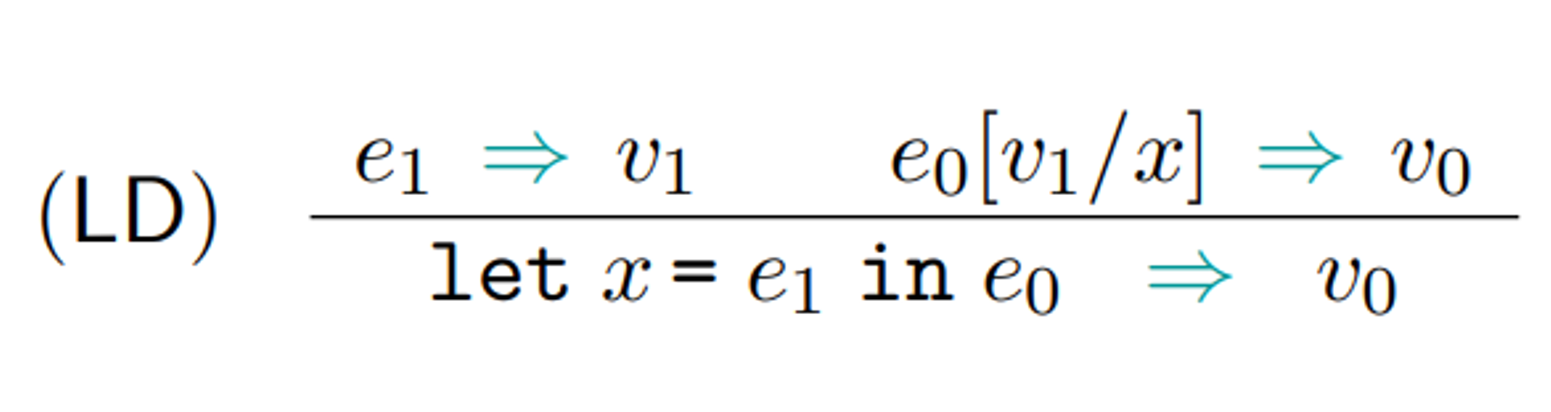
T01: Big Steps Ü1

Slide 10
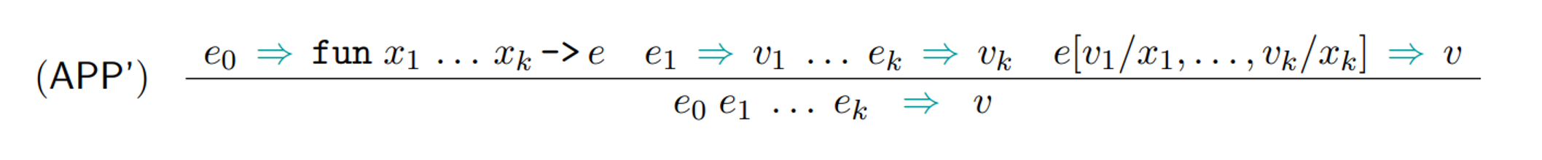
T01: Big Steps Ü1

Slide 11
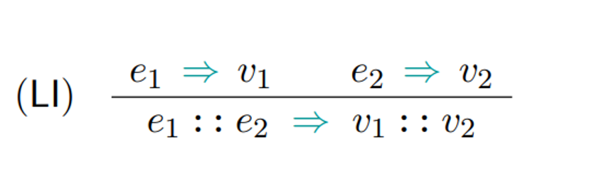
T01: Big Steps Ü1

Slide 12
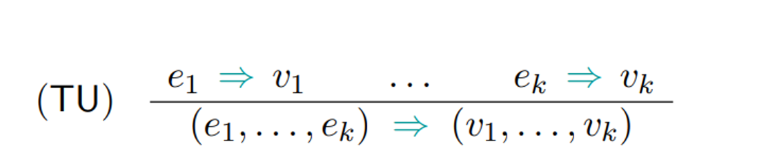
T01: Big Steps Ü1

Slide 13
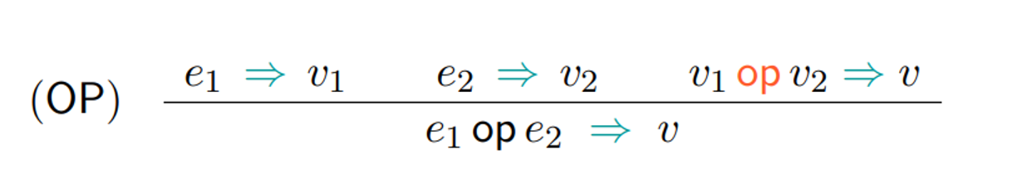
T01: Big Steps Ü1

Slide 14
T01: Big Steps Ü1

Slide 15
T01: Big Steps Ü1

Slide 16
T01: Big Steps Ü1

Slide 17
T01: Big Steps Ü1

Slide 18
T01: Big Steps Ü1

Slide 19
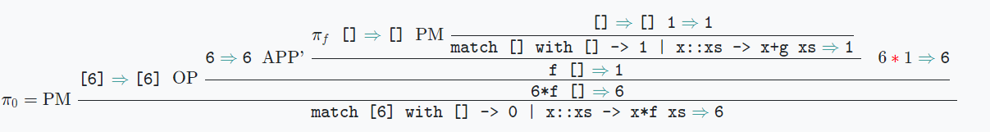
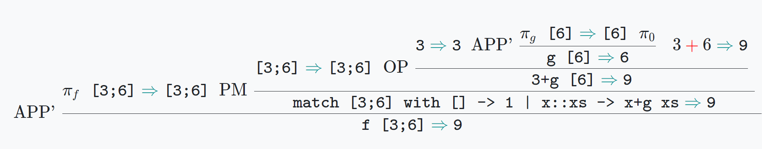
T01: Big Steps Ü2

Slide 20
T01: Big Steps Ü2

Slide 21
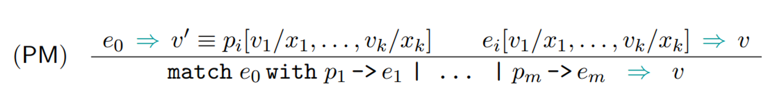
T01: Big Steps Ü2

Slide 22
T01: Big Steps Ü2

Slide 23
T01: Big Steps Ü2

Slide 24
T01: Big Steps Ü2

Slide 25
T01: Big Steps Ü2

Slide 26
T01: Big Steps Ü2

Slide 27
T01: Big Steps Ü2

Slide 28
T01: Big Steps Ü2

Slide 29
T01: Big Steps Ü2

Slide 30
T01: Big Steps Ü2

Slide 31
T01: Big Steps Ü2

Slide 32
T01: Big Steps Ü2

Slide 33
T01: Big Steps Ü2

Slide 34
T01: Big Steps Ü2

Slide 35
T01: Big Steps Ü2

Slide 36
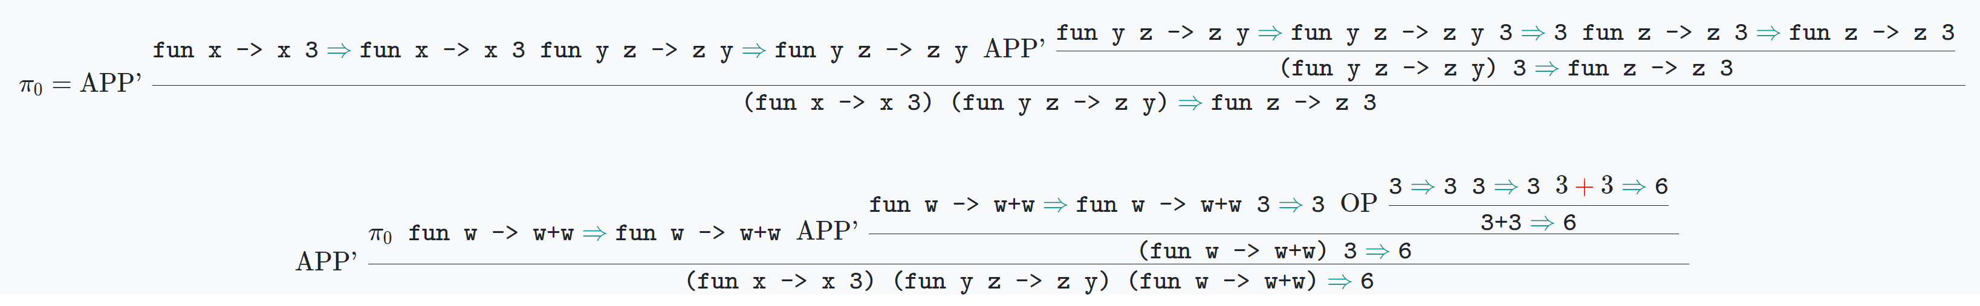
T01: Big Steps Ü3

Slide 37
T01: Big Steps Ü3

Slide 38
T01: Big Steps Ü3

Slide 39
T01: Big Steps Ü3

Slide 40
T01: Big Steps Ü3

Slide 41
T01: Big Steps Ü3

Slide 42
T01: Big Steps Ü3

Slide 43
T01: Big Steps Ü3

Slide 44
T01: Big Steps Ü3

Slide 45
T01: Big Steps Ü3

Slide 46
T01: Big Steps Ü3

Slide 47
T01: Big Steps Ü3

Slide 48
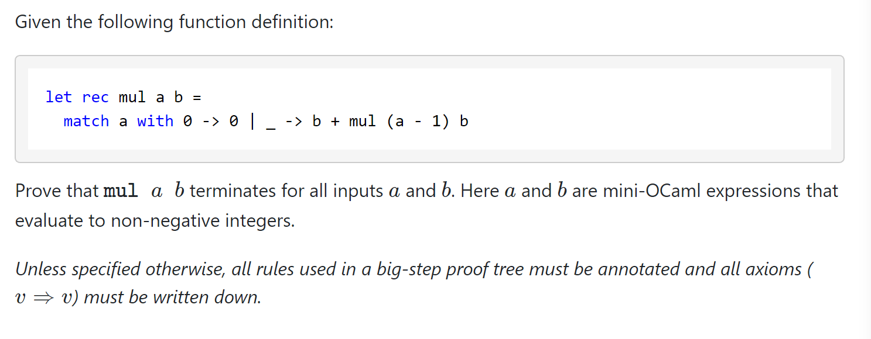
T02: Multiplication
Tipp: Induction on parameter a
Base Case: n = 0
n -> n+1

Slide 49
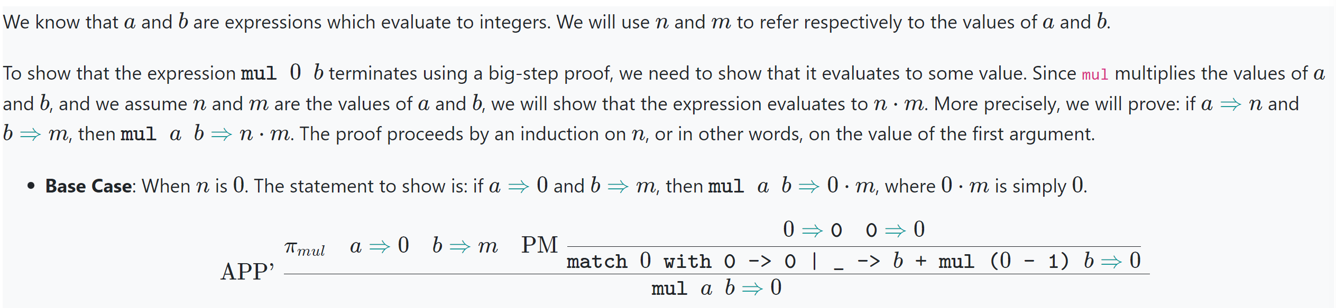
T02: Multiplication

Slide 50
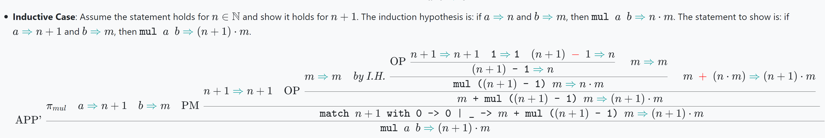
T02: Multiplication

Slide 51
T02: Multiplication

Slide 52
T02: Multiplication

Slide 53
T02: Multiplication
IH: mul a b = a*b

Slide 54
T02: Multiplication

Slide 55
T02: Multiplication

Slide 56
T02: Multiplication

Slide 57
T02: Multiplication

Slide 58
T02: Multiplication

Slide 59
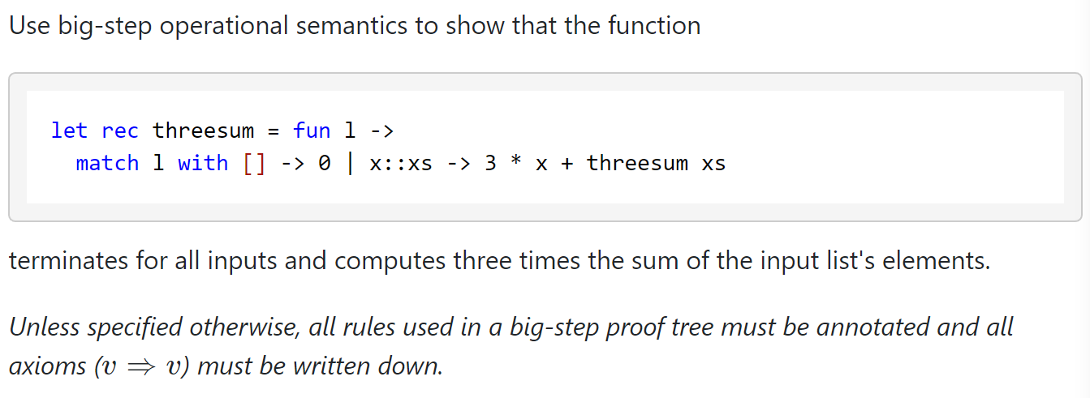
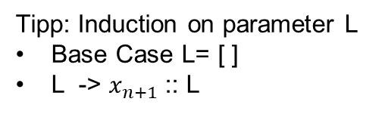
T03: Threesum
Tipp: Induction on parameter L
Base Case L= [ ]
L -> $x_{n+1}$:: L

Slide 60
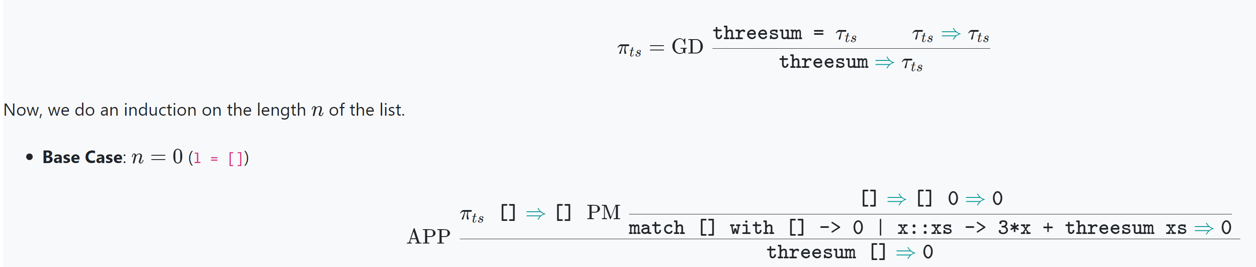
T03: Threesum

Slide 61
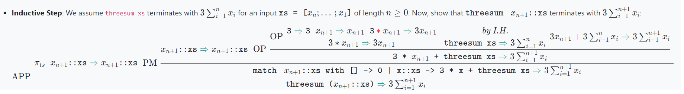
T03: Threesum

Slide 62
T03: Threesum

Slide 63
T03: Threesum

Slide 64
T03: Threesum

Slide 65
T03: Threesum

Slide 66
T03: Threesum

Slide 67
T03: Threesum

Slide 68
T03: Threesum

Slide 69
T03: Threesum

