Slide 1
FPV Tutorübung
Woche 5
Ocaml
Manuel Lerchner
22.05.2023

Slide 2
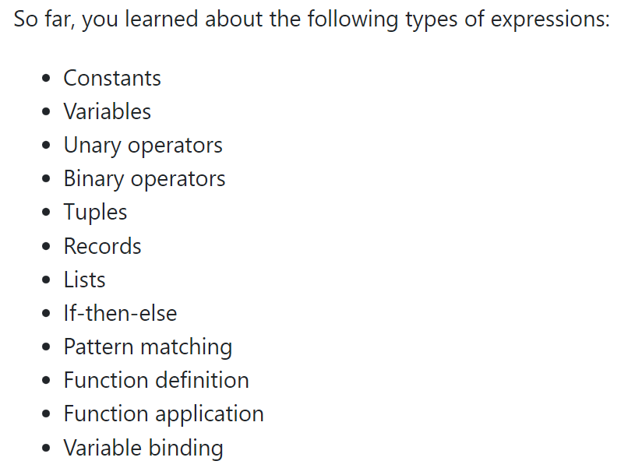
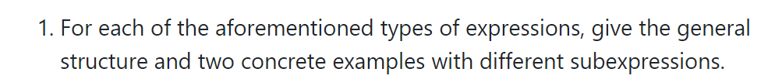
T01: Expressions

Slide 3
T01: Expressions
Constants:
Variables:
Unary Operator:
Binary Operator:
Tuples:

Slide 4
T01: Expressions
Records (definition):
Records (access):
Lists:
if-then-else:

Slide 5
T01: Expressions
Pattern Matching:
Function Definition :
Function Application :
Variable Binding:

Slide 6
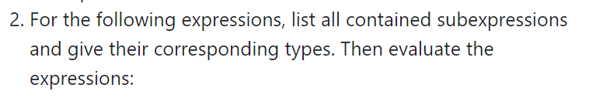
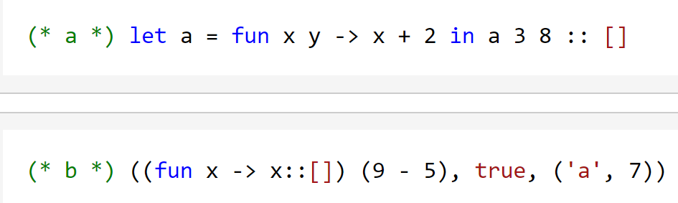
T01: Expressions

Slide 7
T01: Expressions

Slide 8
T01: Expressions

Slide 9
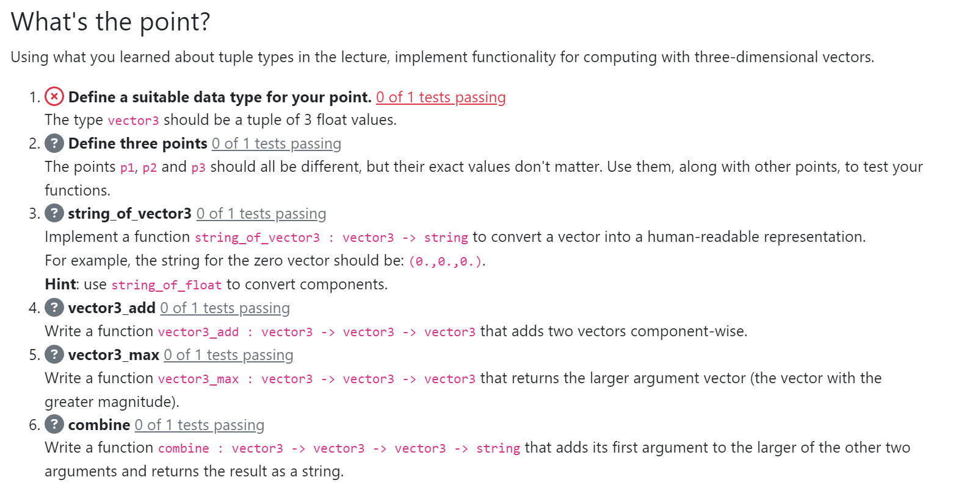
T02: What‘s the Point

Slide 10
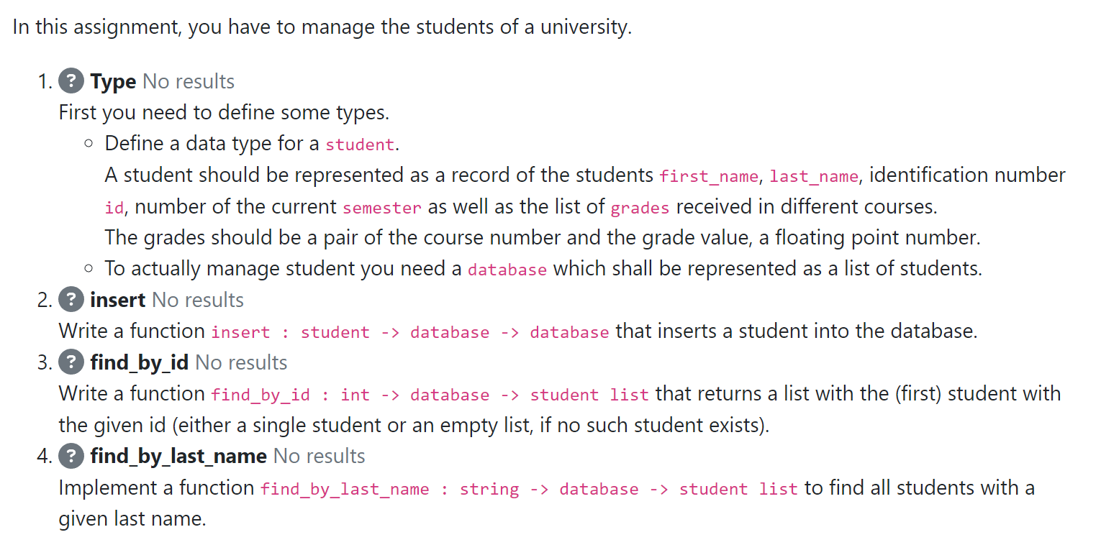
T03: Student Database

