Slide 1
FPV Tutorübung
Woche 8
OCaml: Tail Recursion, Lazy Lists, Partial Application
Manuel Lerchner
14.06.2023

Slide 2
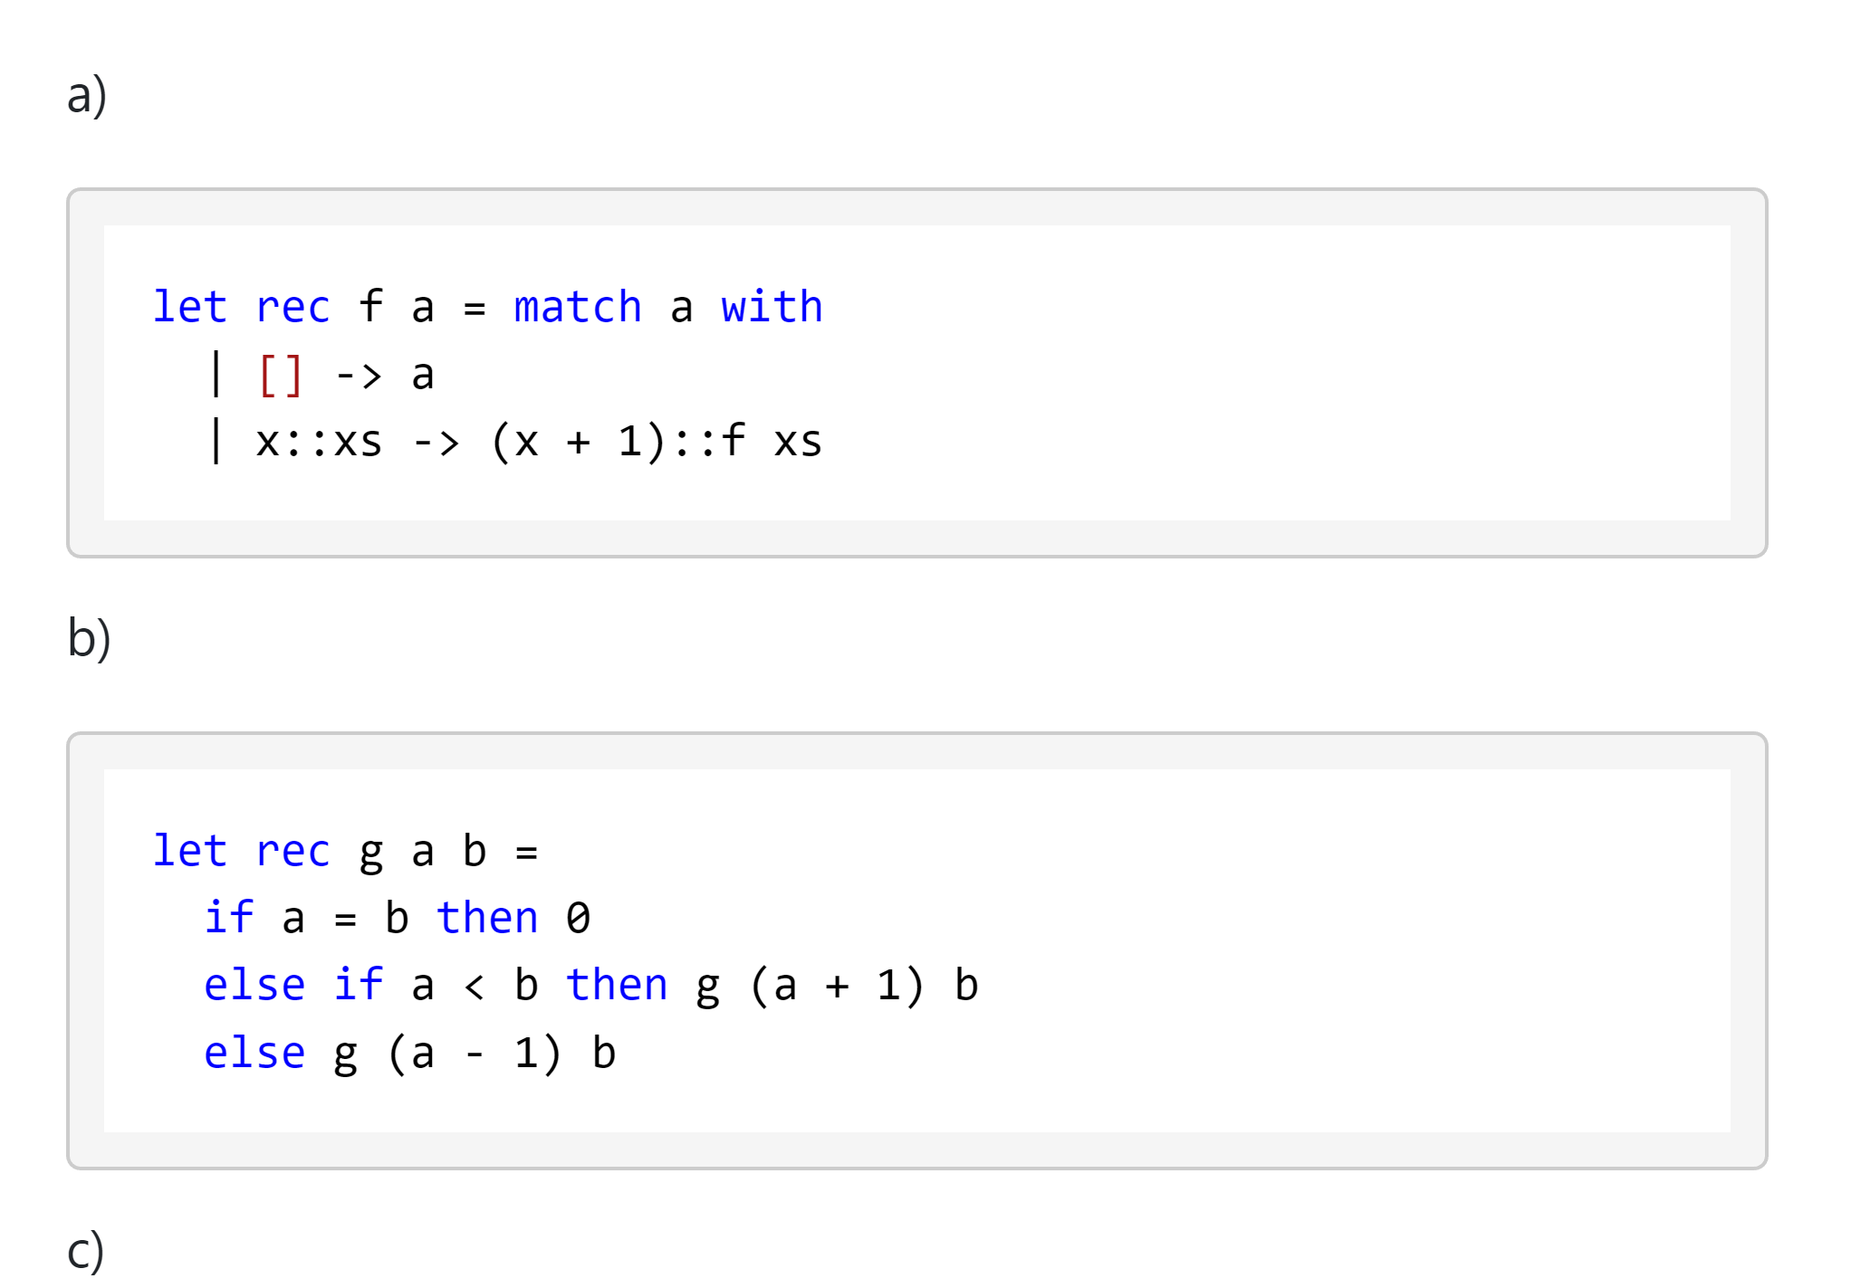
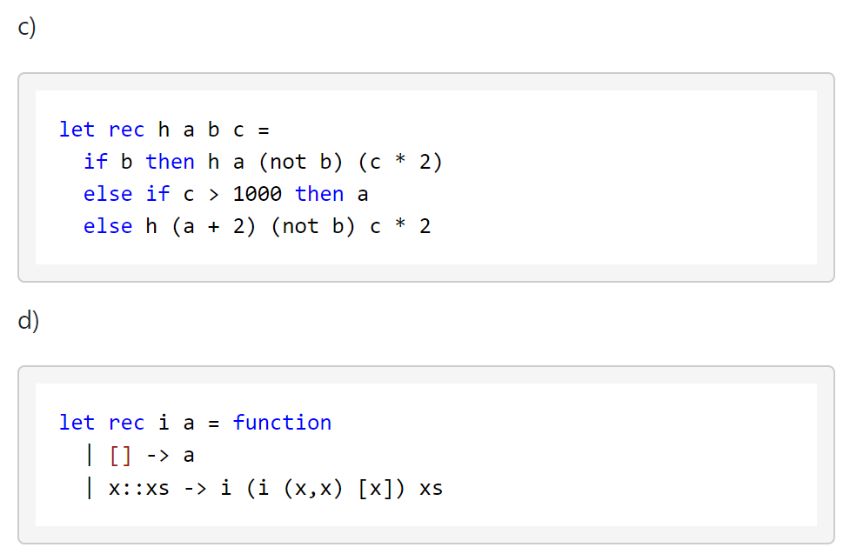
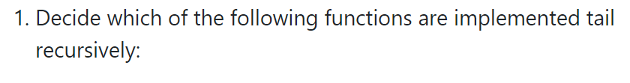
T01: Tail Recursion 1

Slide 3
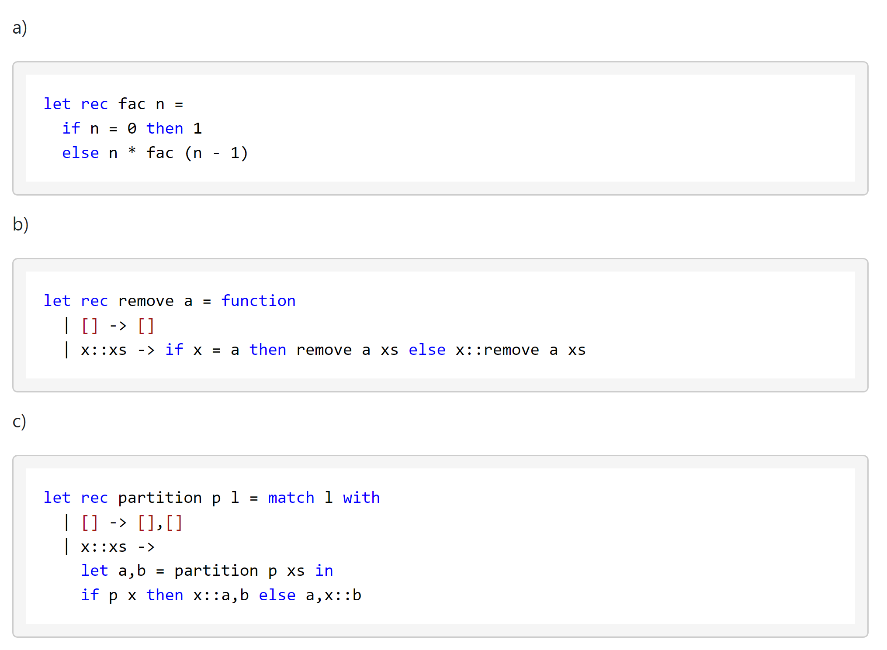
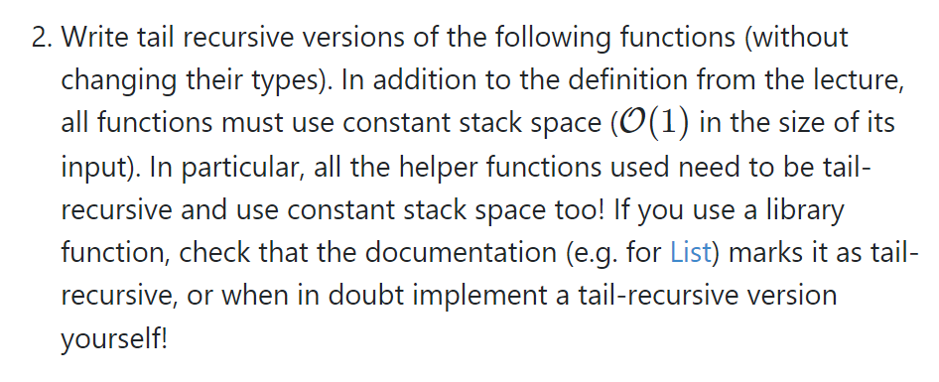
T01: Tail Recursion 2
Tipp: Use accumulator variables
and helper functions

Slide 4
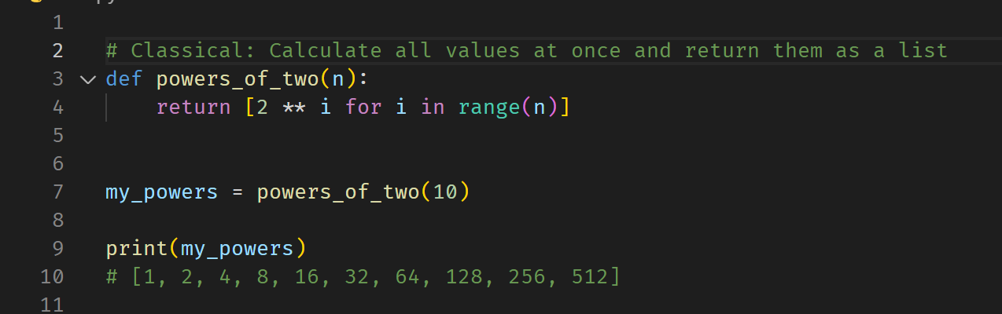
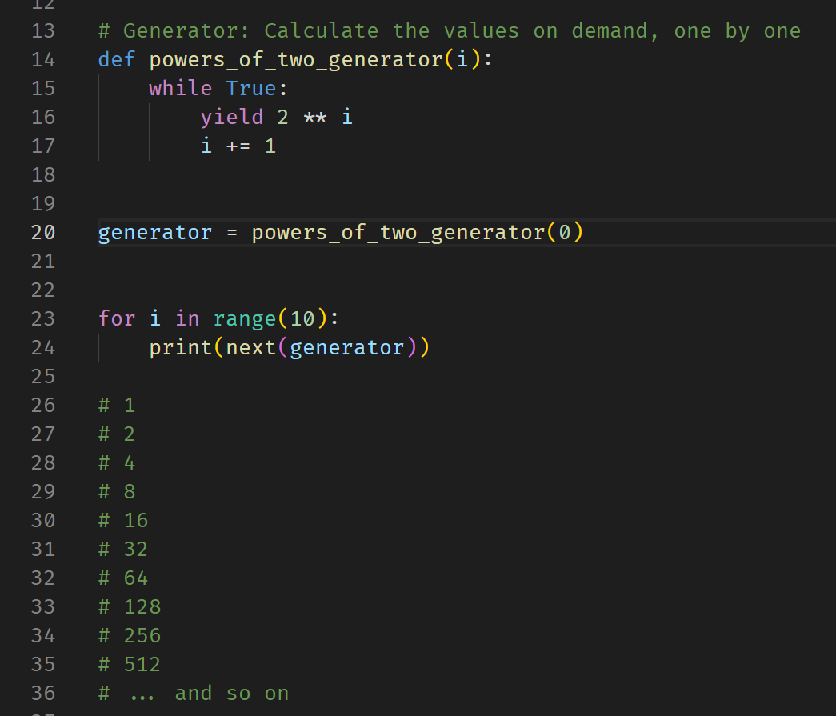
T02: Lazy List Idea

Slide 5
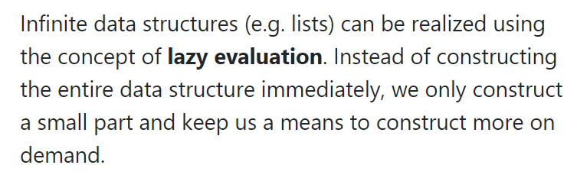
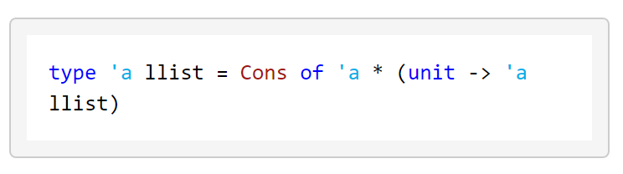
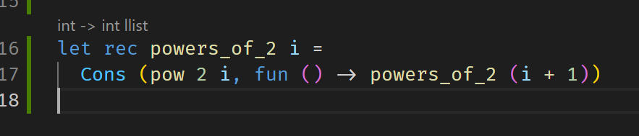
T02: Lazy List
1, fun ()->n
n
1
2
4
8
…

Slide 6
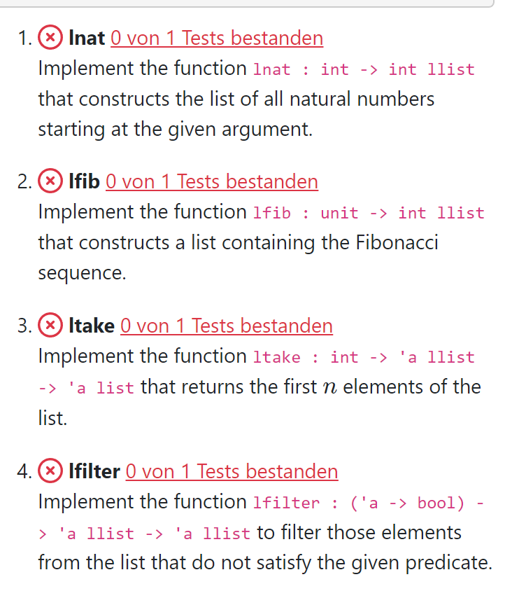
T02: Lazy List

Slide 7
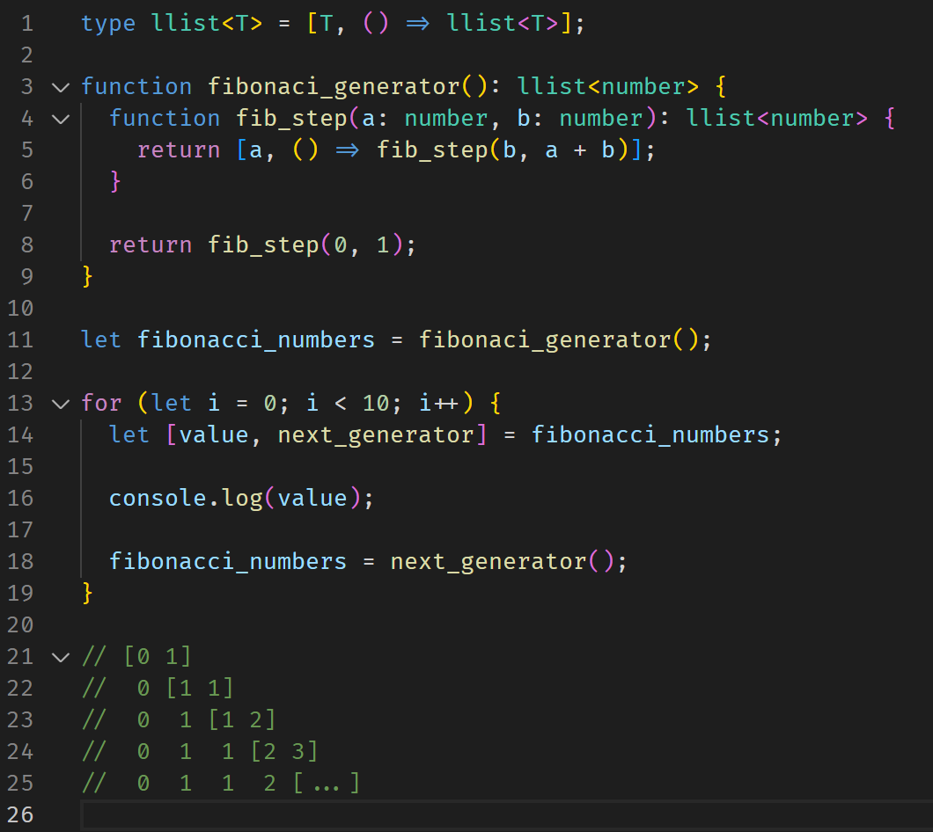
T02: Lazy List

Slide 8
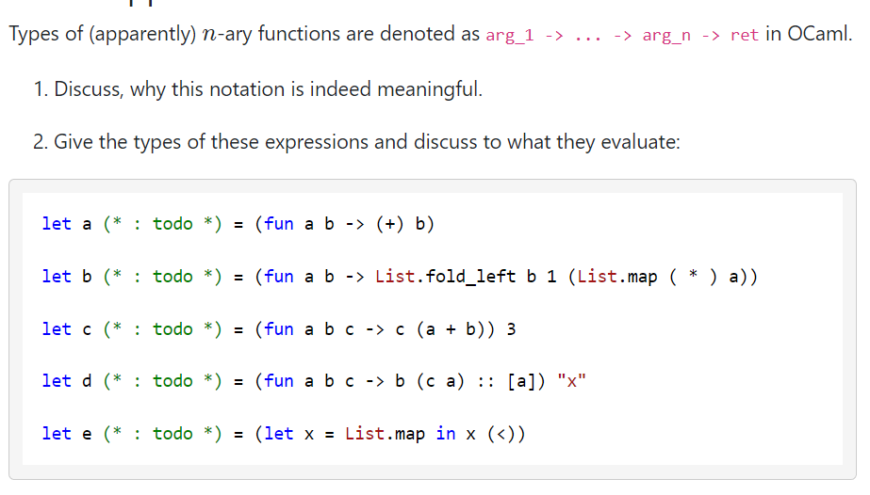
T03: Partial Application

Slide 9
T03: Partial Application

Slide 10
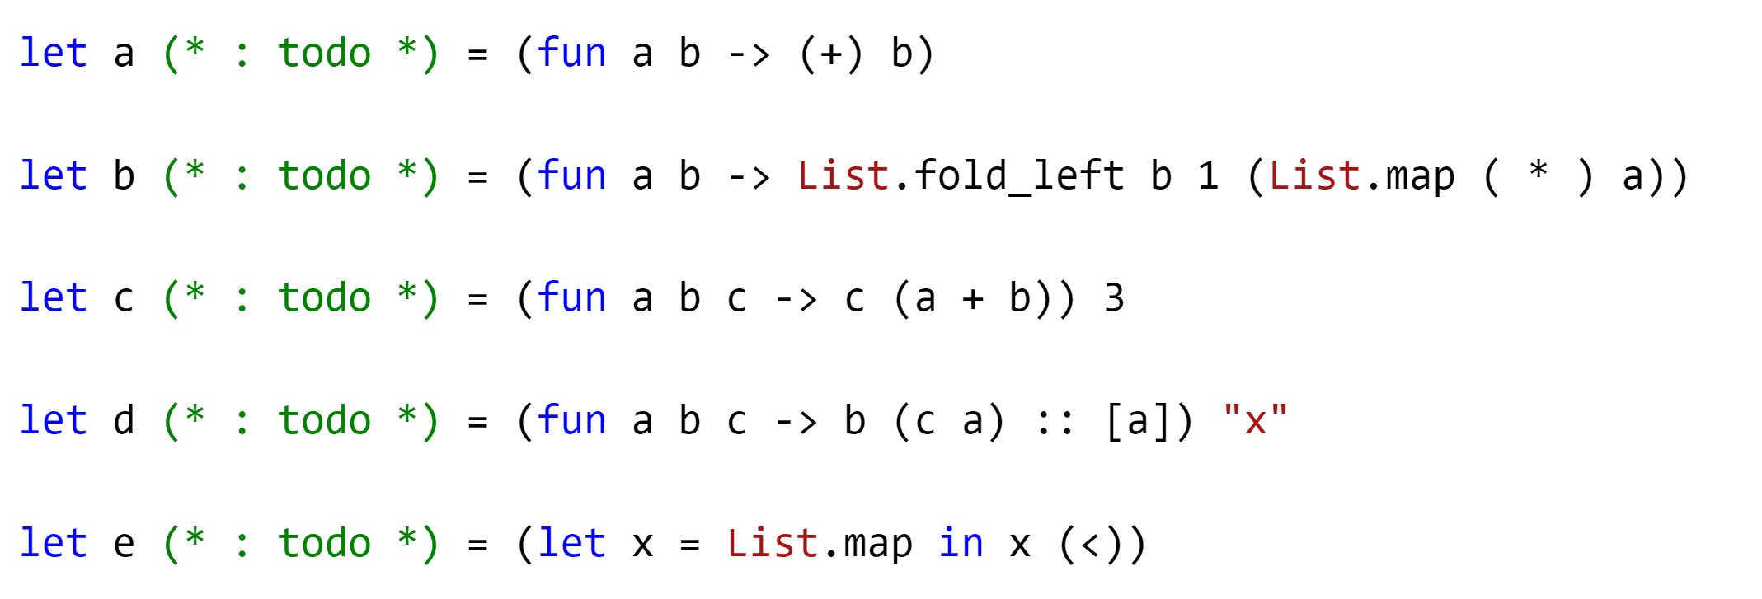
T03: Partial Application

Slide 11
T03: Partial Application

Slide 12
T03: Partial Application

