Slide 1
FPV Tutorübung
Woche 9
OCaml: Side Effects, Exceptions and Files
Manuel Lerchner
19.06.2023

Slide 2
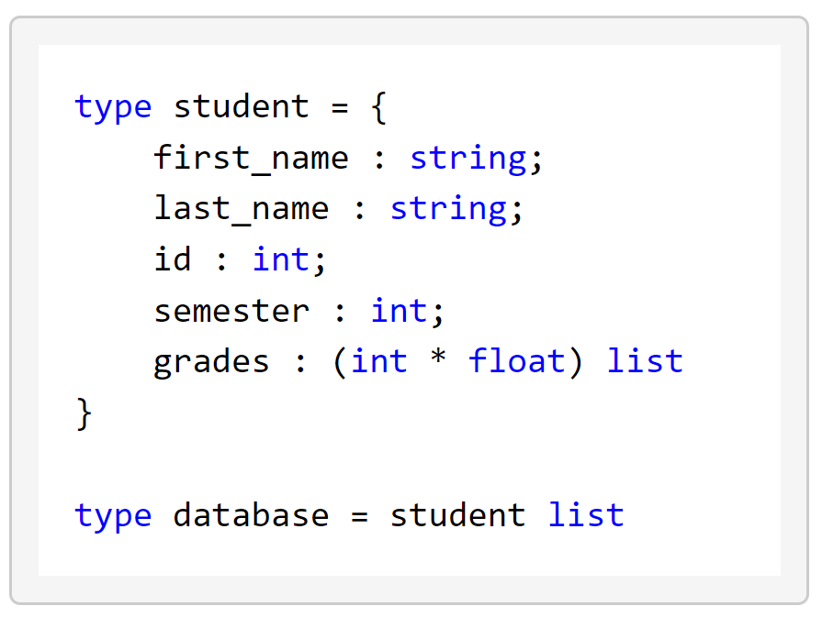
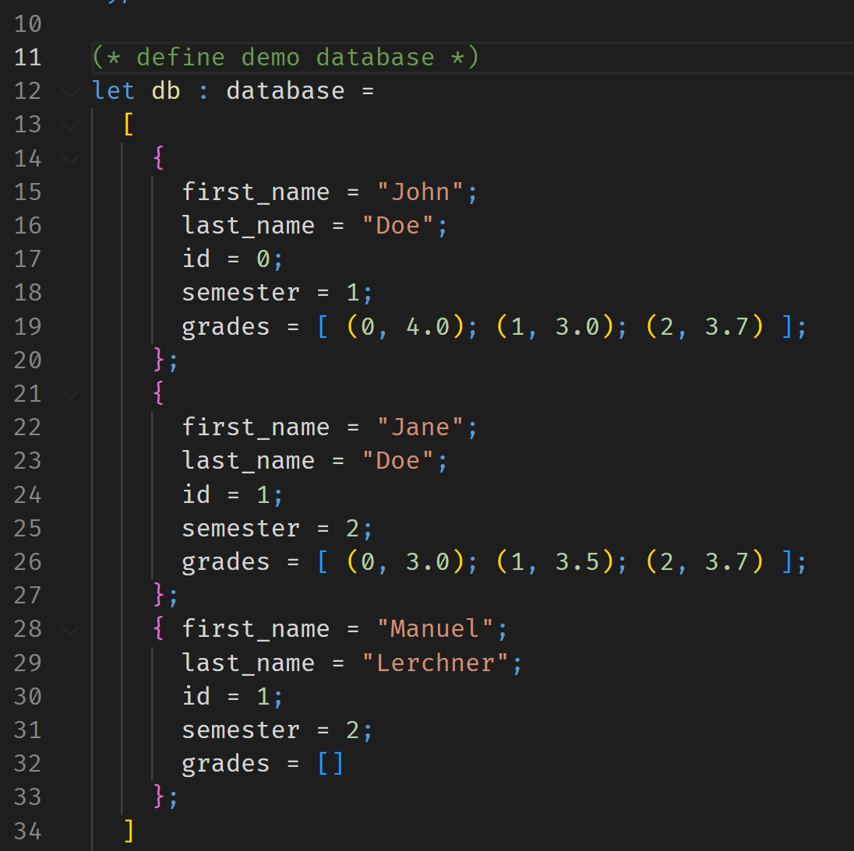
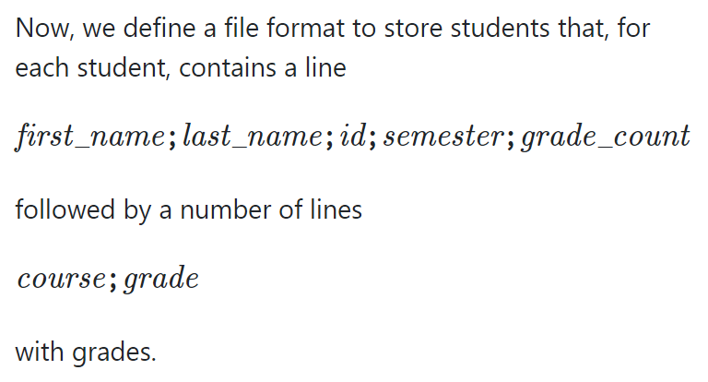
T01: Students In Students Out
John;Doe;0;1;3
0;4.
1;3.
2;3.7
Jane;Doe;1;2;3
0;3.
1;3.5
2;3.7
Manuel;Lerchner;1;2;0
store_db
student_database.txt

Slide 3
T01: Students In Students Out
John;Doe;0;1;3
0;4.
1;3.
2;3.7
Jane;Doe;1;2;3
0;3.
1;3.5
2;3.7
Manuel;Lerchner;1;2;0
load_db
student_database.txt

Slide 4
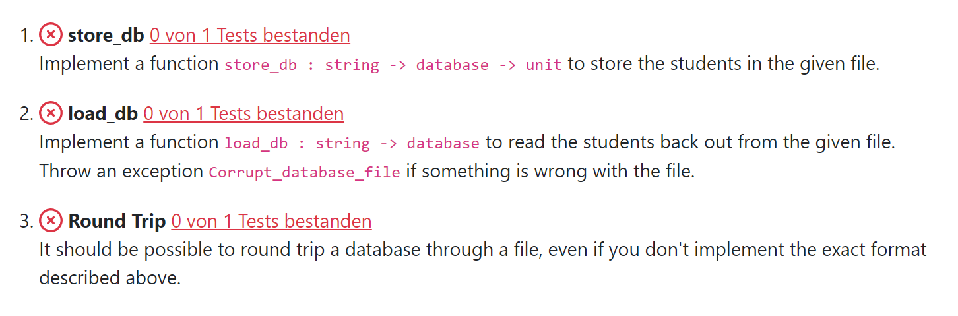
T01: Students In Students Out
File I/O
open_in
open_out
close_in
close_out
input_line
output_string
Exceptions
try expr with exn -> expr
Other helpful functions
String.split_on_char
String.concat
List.iter

Slide 5
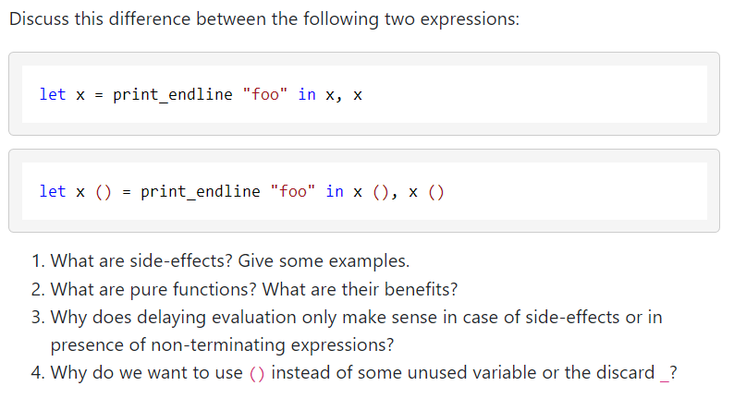
T02: (Delayed) Evaluation, Side-effects, Pure Functions

