Slide 1
FPV Tutorübung
Woche 2
Preconditions, Postconditions and Local Consistency
Manuel Lerchner
03.05.2023

Slide 2
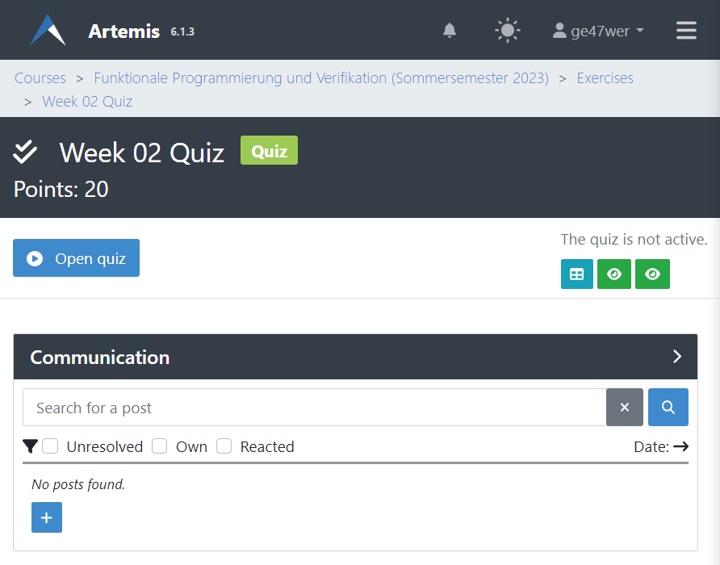
Quiz
Passwort:

Slide 3
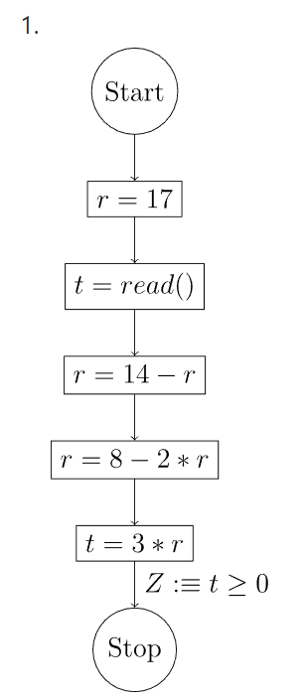
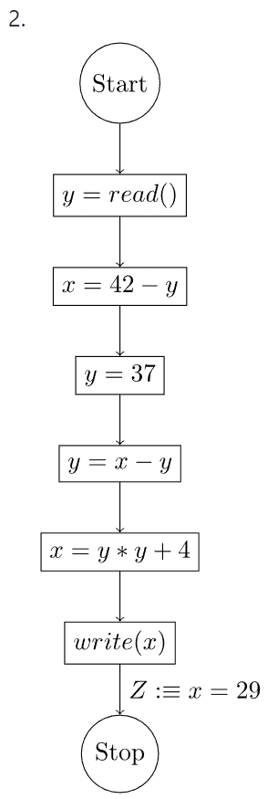
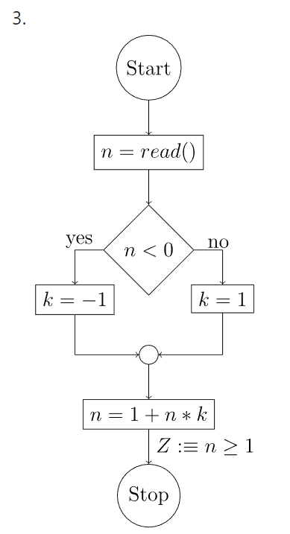
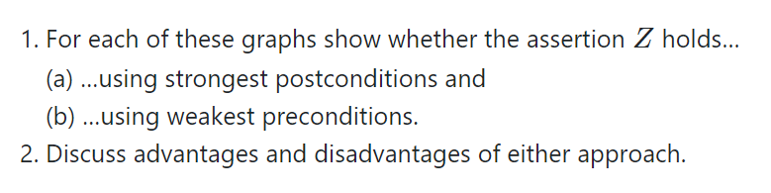
T01: From Post- to Preconditions

Slide 4
T01: From Post- to Preconditions 1
Post-Condition:
Pre-Condition:

Slide 5
T01: From Post- to Preconditions 2
Post-Condition:
Pre-Condition:

Slide 6
T01: From Post- to Preconditions 3
Post-Condition:
Pre-Condition:

Slide 7
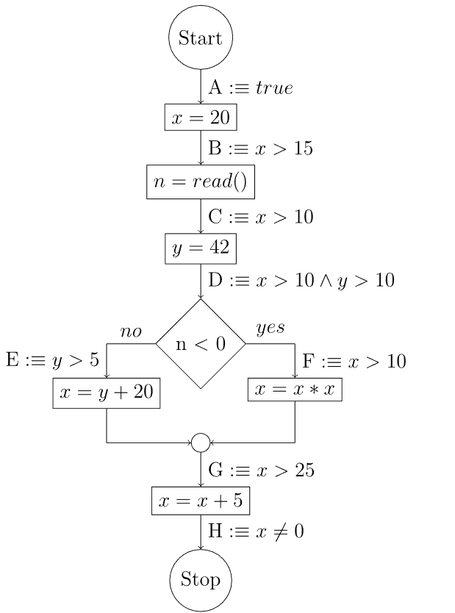

T02: Local Consistency

Slide 8
T02: Local Consistency (Extra Space)

Slide 9
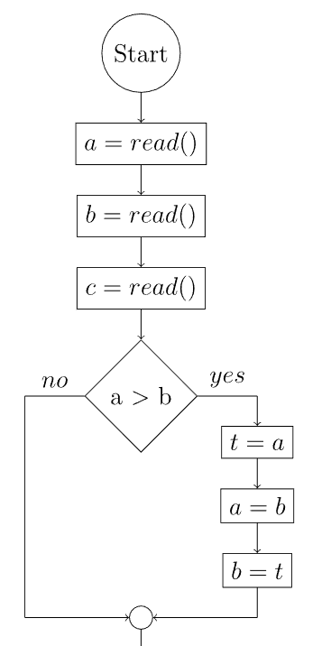
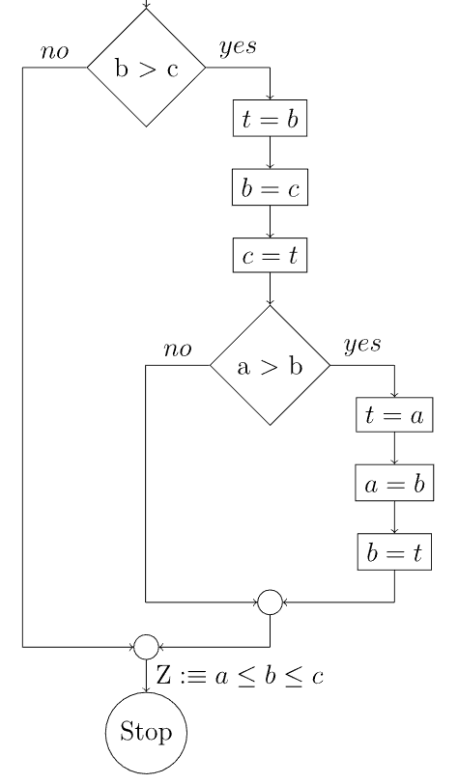
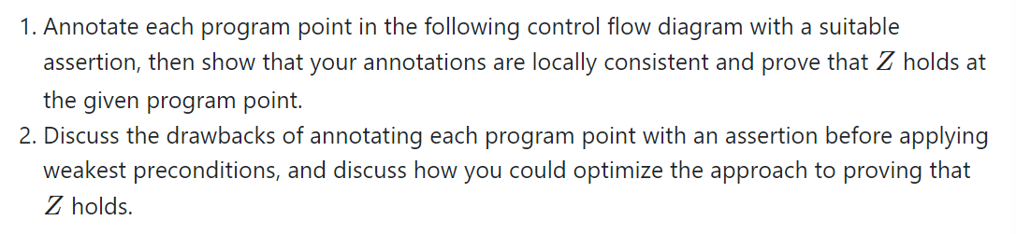
T03: Trouble Sort

Slide 10
T03: Trouble Sort (Extra Space)

