Slide 1
FPV Tutorübung
Woche 1
Implications, Assertions and Conditions
Manuel Lerchner
20.04.2023

Slide 2
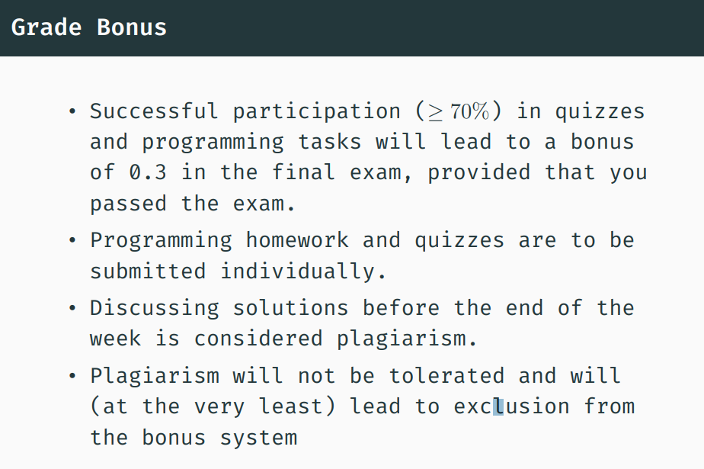
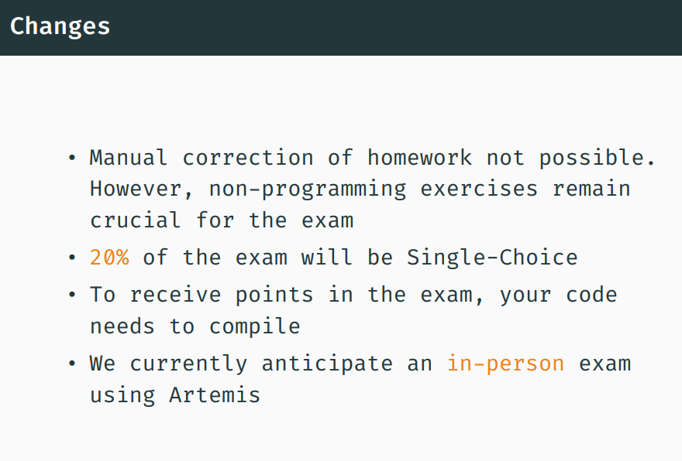
Organisatorisches

Slide 3
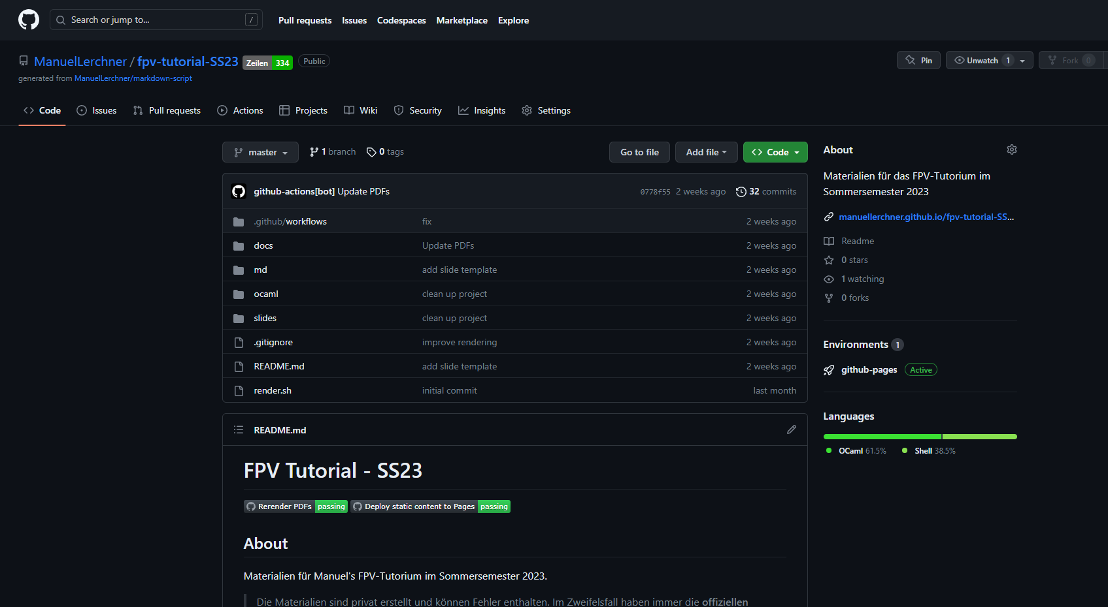
Materialien

Slide 4
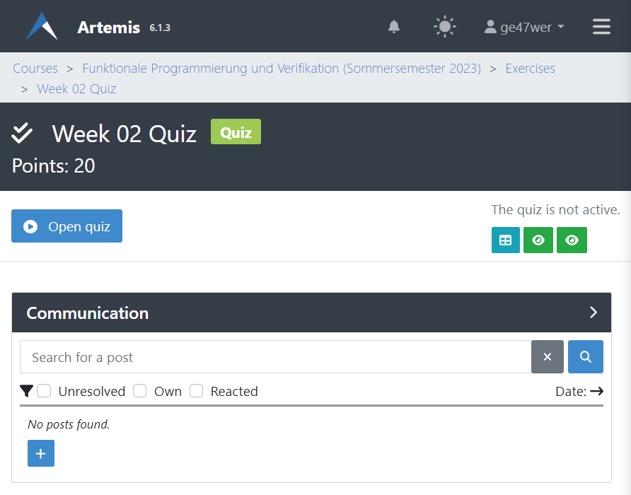
Quiz
Passwort:

Slide 5
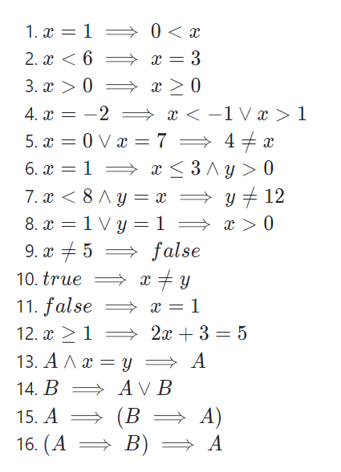
T01: Recap Implications

Slide 6
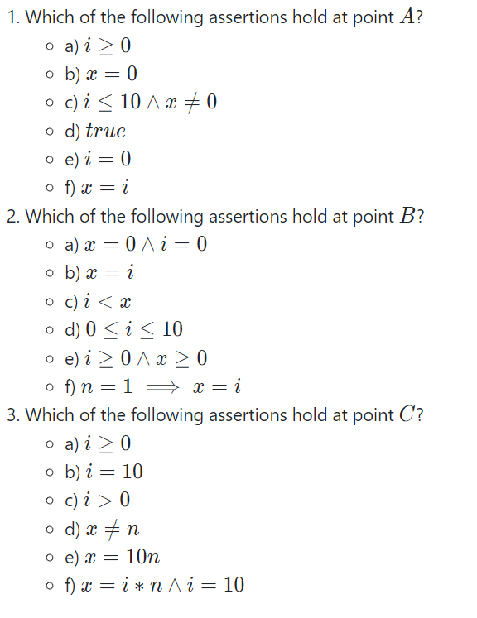
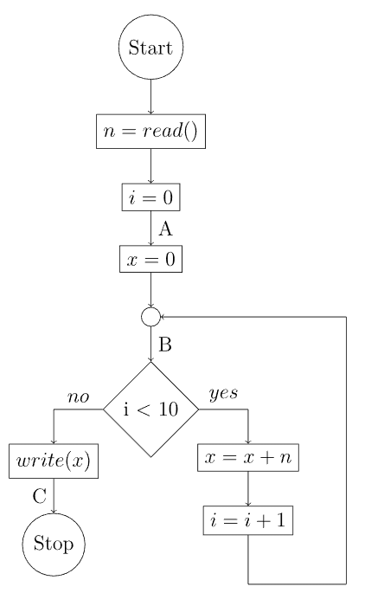
T02: Assertions

Slide 7
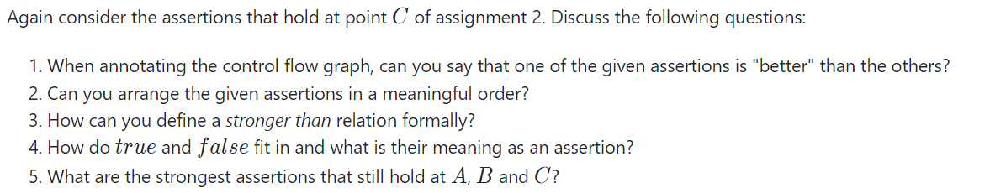





T03: The Strong and the Weak

Slide 8
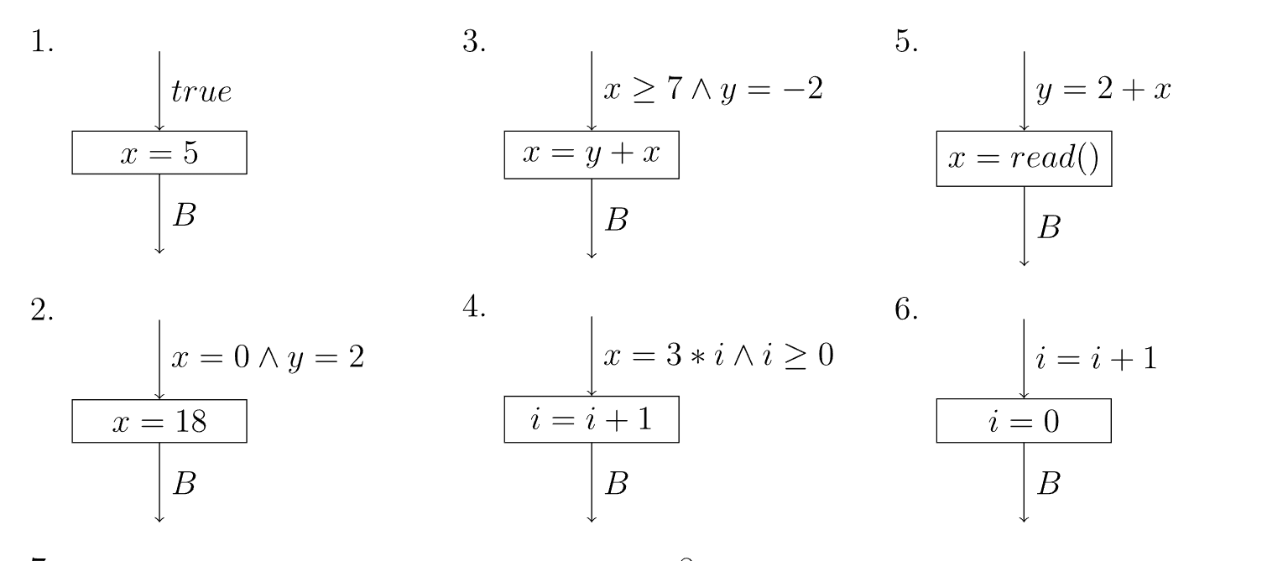
T04: Strongest Postconditions 1

Slide 9
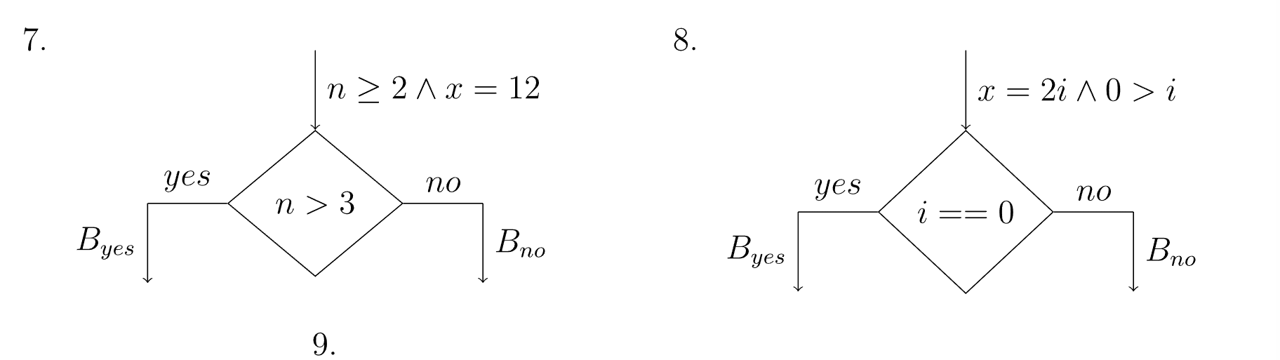
T04: Strongest Postconditions 2

Slide 10
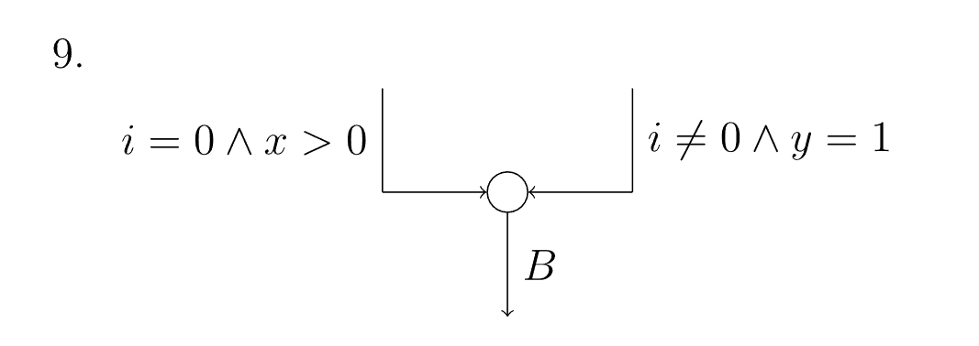
T04: Strongest Postconditions 3

