Slide 1
FPV Tutorübung
Woche 7
OCaml: List-Module 2, Mappings, Operator Functions
Manuel Lerchner
08.06.2023

Slide 2
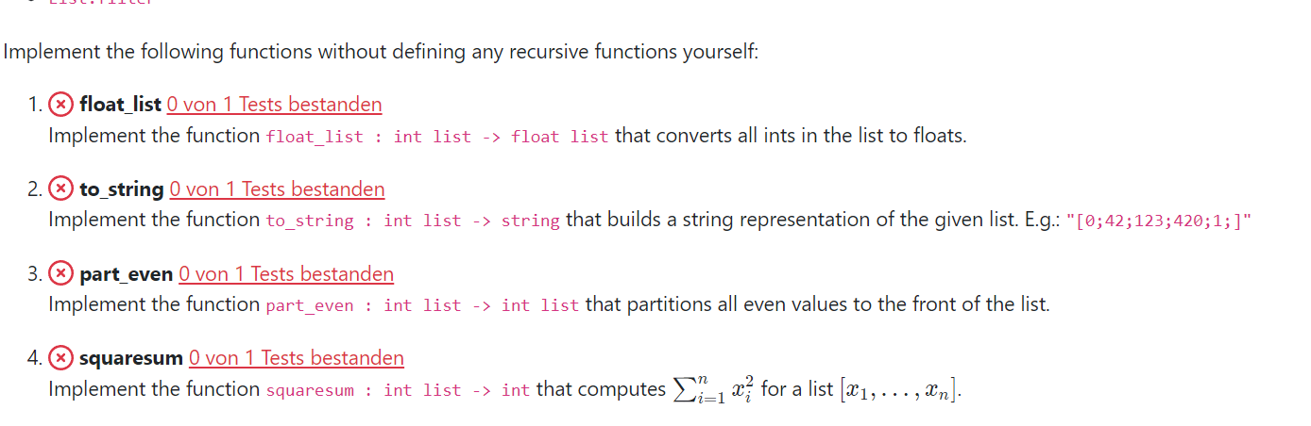

T01: List Module Part 2
Use functions from the List-Module!

Slide 3
T01: List Module Part 2
Selected Functions from the List-Module
List.map
List.fold_left
List.find_opt
List.filter
('a -> 'b) -> 'a list -> 'b list
('a -> 'b -> 'a) -> 'a -> 'b list -> 'a
('a -> bool) -> 'a list -> 'a option
('a -> bool) -> 'a list -> 'a list

Slide 4
T01: List Module Part 2
List.map
('a -> 'b) -> 'a list -> 'b list
1 | 2 | -3 | 4 | 5 | 8

Slide 5
T01: List Module Part 2
List.fold_left
('a -> 'b -> 'a) -> 'a -> 'b list -> 'a
1 | 2 | -3 | 4 | 5 | 8

Slide 6
T01: List Module Part 2
List.find_opt
('a -> bool) -> 'a list -> 'a option
1 | 2 | -3 | 4 | 5 | 8

Slide 7
T01: List Module Part 2
List.filter
('a -> bool) -> 'a list -> 'a list
1 | 2 | -3 | 4 | 5 | 8

Slide 8
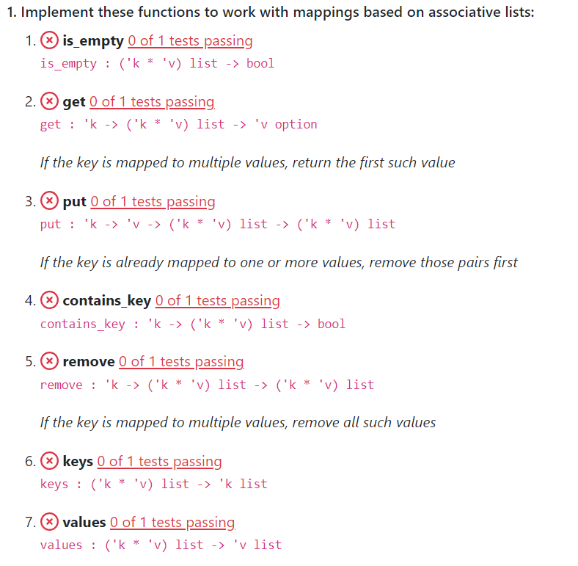
T02: Mappings
Idea: Create a Dictionary-Datastructure
age_dictionary = {
"John": 25,
"Mary": 20,
"Tom": 30
}

Slide 9
T02: Mappings
How to store dictionaries?
Association Lists
Functional mapping
25 wenn x = "John"
assoc_list = [
("John", 25),
("Mary", 20),
("Tom", 30)
]
20 wenn x = “Mary"
func_map = fun x->
30 wenn x = “Tom"
expr sonst

Slide 10
T02: Functional Mappings
Every layer saves exactly one datapoint
If the parameter matches the datapoint -> return its value
Else delegate to sub-function
25 wenn x = "John"
func_map = fun x->
20 wenn x = “Mary"
30 wenn x = “Tom"
x
sonst
expr sonst
x
sonst
*Green brackets mean function evaluation with parameter x

Slide 11
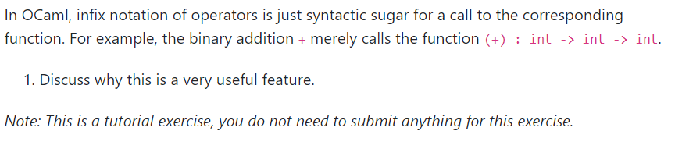
T03: Operator Functions

