Slide 1
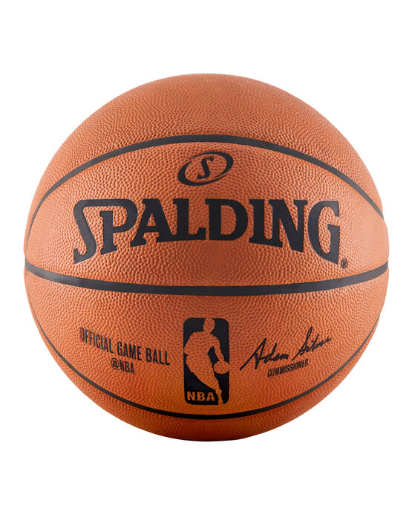

Predicting Winners and Losers for NBA games at Halftime
J. Garrecht Metzger
(Metis Winter Cohort 2021)

Slide 2
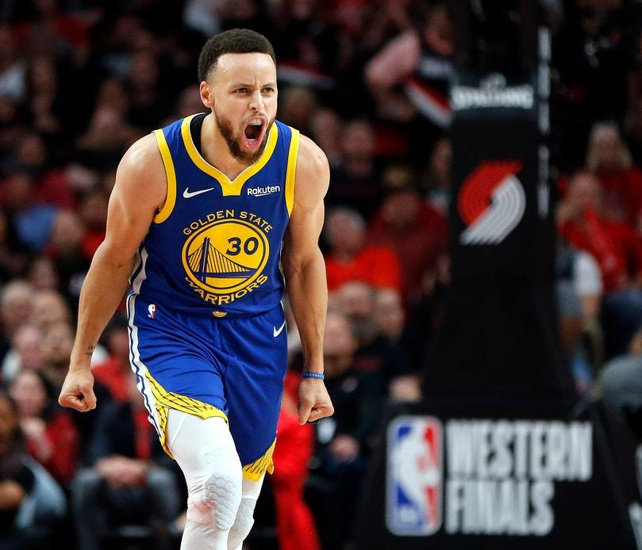
Overview

Slide 3
Overview
Background

Slide 4
Overview
Background
Dataset

Slide 5
Overview
Background
Dataset
Model

Slide 6
Overview
Background
Dataset
Model
Summary & Future Work

Slide 7
Inspiration for study?

Slide 8
Inspiration for study?
Common complaint is only the later half of the game matters

Slide 9
Inspiration for study?
Common complaint is only the later half of the game matters
Is this true?

Slide 10
Inspiration for study?
Common complaint is only the later half of the game matters
Is this true?
Use Case: Betting

Slide 11
Inspiration for study?
Common complaint is only the later half of the game matters
Is this true?
Use Case: Betting
Maybe make some avocado money off your friends?

Slide 12
Structure

Slide 13
Structure
Split into 4 quarters = 2 halves.

Slide 14
Structure
Split into 4 quarters = 2 halves.
Every game must end with a winner and a loser.

Slide 15
Structure
Split into 4 quarters = 2 halves.
Every game must end with a winner and a loser.
Balanced targets

Slide 16
Structure
Split into 4 quarters = 2 halves.
Every game must end with a winner and a loser.
Balanced targets
(i.e., count(win) = count(loss)

Slide 17
Data

Slide 18

Data

Slide 19
20 Years
Data

Slide 20
20 Years
20 Seasons
Data

Slide 21
20 Years
20 Seasons
30 Teams
Data

Slide 22
20 Years
20 Seasons
30 Teams
23,144 Games
Data

Slide 23
20 Years
20 Seasons
30 Teams
23,144 Games
46,288 Rows
Data

Slide 24
20 Years
20 Seasons
30 Teams
23,144 Games
46,288 Rows
21 Features
Data

Slide 25
Model Selection

Slide 26
Model Selection
What do we need?

Slide 27
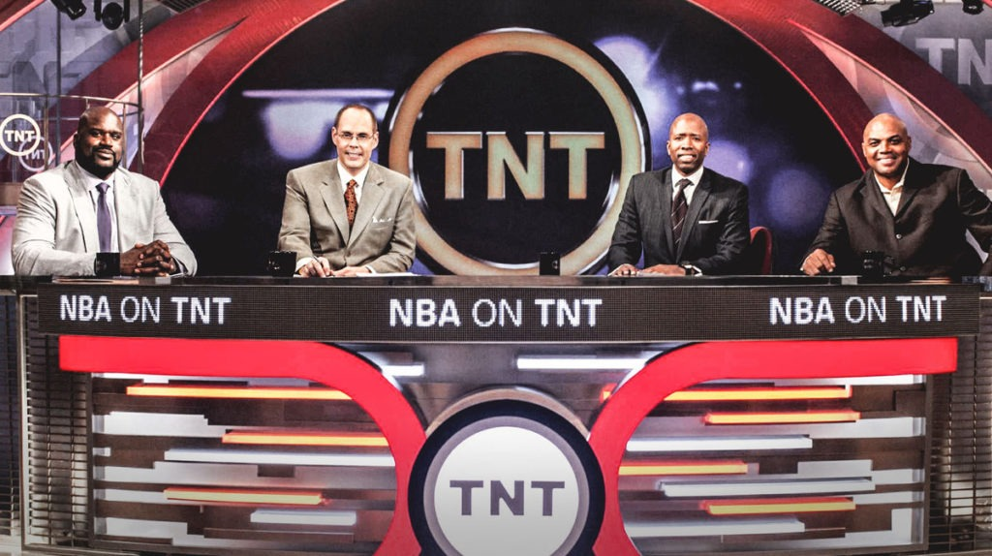
Model Selection
What do we need?
Accuracy
We need a precise model! #ShaqMath
We need an accurate model!
Oh yeah, you’re right!

Slide 28
Model Selection
What do we need?
Accuracy
Interpretable
We need a precise model!
We need an accurate model!
Oh yeah, you’re right! #ShaqMath

Slide 29
Model Selection
What do we need?
Accuracy
Interpretable
We need a precise model!
We need an accurate model!
Oh yeah, you’re right! #ShaqMath

Slide 30
Model Selection
What do we need?
Accuracy
Interpretable
Logistic Model

Slide 31
Model Selection
What do we need?
Accuracy
Interpretable
Logistic Model
21→ 2 Features

Slide 32
Model Selection
What do we need?
Accuracy
Interpretable
Logistic Model
21→ 2 Features
“PLUS-MINUS”

Slide 33
Model Selection
What do we need?
Accuracy
Interpretable
Logistic Model
21→ 2 Features
“PLUS-MINUS”
“SCORE”

Slide 34
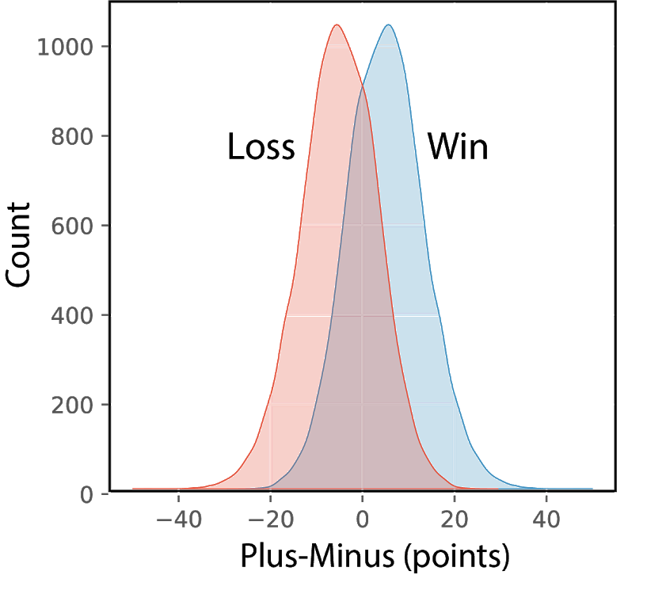
Model Selection
What do we need?
Accuracy
Interpretable
Logistic Model
21→ 2 Features
“PLUS-MINUS”
“SCORE”

Slide 35
Model Selection
What do we need?
Accuracy
Interpretable
Logistic Model
21→ 2 Features
“PLUS-MINUS”
“SCORE”
Polynomial transformation

Slide 36
Model Selection
What do we need?
Accuracy
Interpretable
Logistic Model
21→ 2 Features
“PLUS-MINUS”
“SCORE”
Polynomial transformation
Accuracy: 0.72

Slide 37
Logistic Model Evaluation

Slide 38
Logistic Model Evaluation
Accuracy Score
0.72

Slide 39
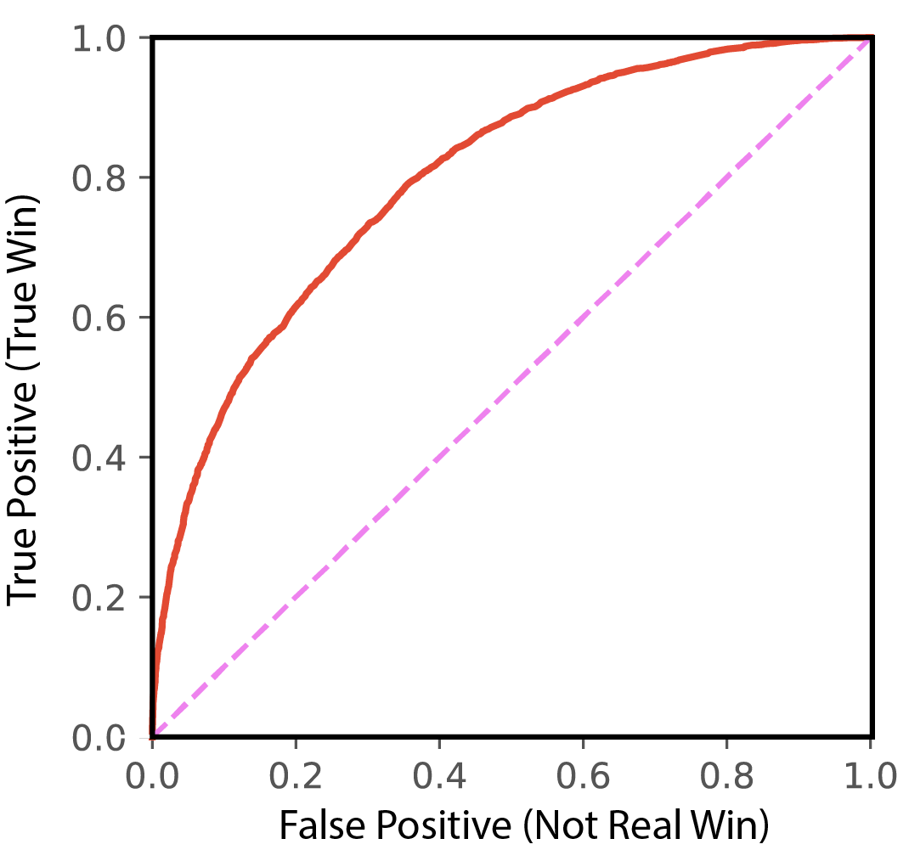
Logistic Model Evaluation
Accuracy Score
0.72

Slide 40
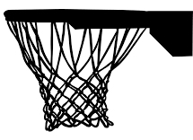
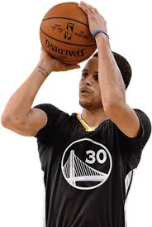
Logistic Model Evaluation
Accuracy Score
0.72

Slide 41
Logistic Model Evaluation
Accuracy Score
0.72
Shaq Shot

Slide 42
Logistic Model Evaluation
Accuracy Score
0.72
Curry Curve
Shaq Shot

Slide 43
Logistic Model Evaluation
Accuracy Score
0.72
ROAUC Score
0.8
Curry Curve
Shaq Shot

Slide 44
Point Difference is the principal feature

Slide 45
What did we learn?

Slide 46
What did we learn?
The first half matters, a lot!

Slide 47
What did we learn?
The first half matters, a lot!
Score difference matters, a lot!

Slide 48
What did we learn?
What do we want to learn next?
The first half matters, a lot!
Score difference matters, a lot!

Slide 49
What did we learn?
What do we want to learn next?
The first half matters, a lot!
Score difference matters, a lot!
Feature Engineering

Slide 50
What did we learn?
What do we want to learn next?
The first half matters, a lot!
Score difference matters, a lot!
Feature Engineering
Create new time-dependent features

Slide 51
What did we learn?
What do we want to learn next?
The first half matters, a lot!
Score difference matters, a lot!
Feature Engineering
Create new time-dependent features
More relative features (e.g., PLUS_MINUS, but rebounds).

Slide 52
What did we learn?
What do we want to learn next?
The first half matters, a lot!
Score difference matters, a lot!
Feature Engineering
Create new time-dependent features
More relative features (e.g., PLUS_MINUS, but rebounds).
More sophisticated analyses

Slide 53





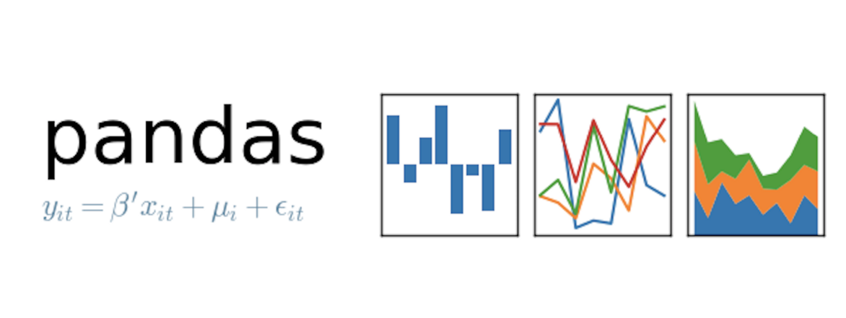
Sources
Tools Used
FIN
Jonathan Ferrey/Getty Images
https://pypi.org/project/nba-api/
https://github.com/seemethere/nba_py
https://github.com/swar/nba_api

Slide 54
Maybe data goes over too many years or seasons?
“The Game Has Changed”
-Daft Punk, Tron: Legacy
Maybe 1 season is all you should consider? Or you could have some factor for what players are still there/composition of the team?
3 pointer has doubled in popularity

