Slide 1
Cooling Rubidium atoms with quasi-static cycles on steady state manifolds
Jakub Garwola, Noah Baker

Slide 2
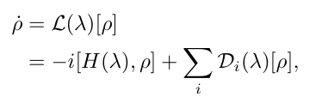


Setup: open system dynamics
Let the system evolve according to a parameter-dependent map
Where are the control parameters, and
Then the steady state

Slide 3


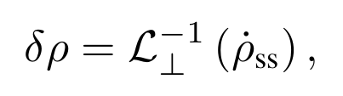


First law in the quasi-static regime
If the change parameters, such that where the rhs is the spectral gap of the dynamics generator, then at each time
And from the first law
Heat differential can be decomposed into the reversible and dissipative part
Notes:
Definition of dQ comes from taking differential of von Neumann entropy and plugging in the Gibbs state
L^-1 is defined after projecting onto Q = 1-P = 1- r_SS Tr()

Slide 4

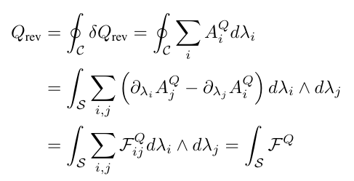
Cycle heat and curvature
Using the chain rule we write
Then from stokes theorem
So useful cycles will encircle regions of high curvature.
Notes:
The minus sign is because it was originally \partial_j d lam_j A_i d lam_i = - \partial_j A_i d lam_i d lam_j

Slide 5
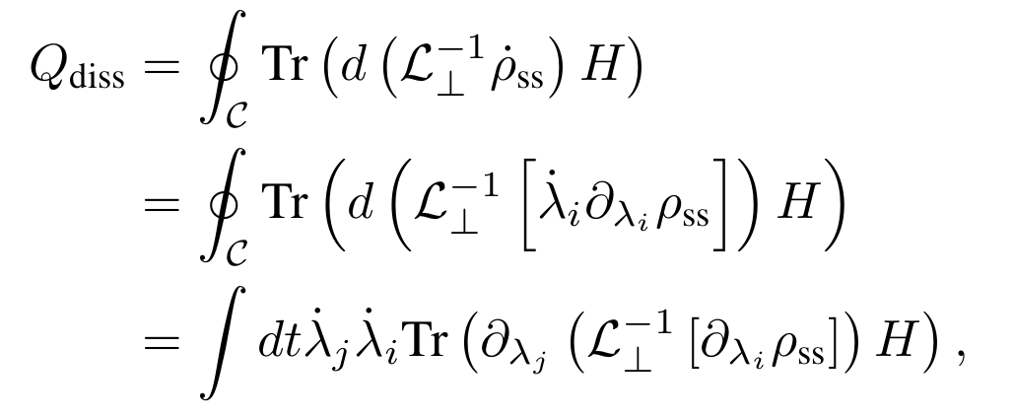
Dissipative heat
Cycle efficiency will be reduced due to hear dissipation
Dissipative heat depends on the cycle speed:

Slide 6




Example 1: 87Rb D2 line internal state cooling
Two-level system was studied by Eric Bittner [1], we study three-level system representing transitions in a 87Rb atom, let
Additionally, let there be dissipation for 1-3 and 1-2 transitions
We can add dephasing, but it does not change the results

Slide 7
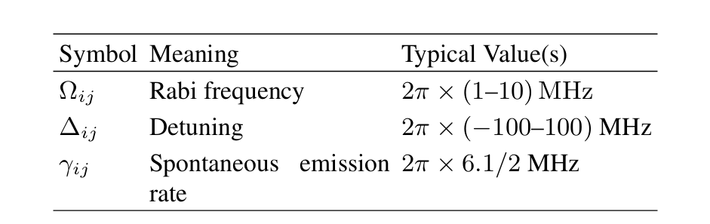
Example 1: Parameters

Slide 8
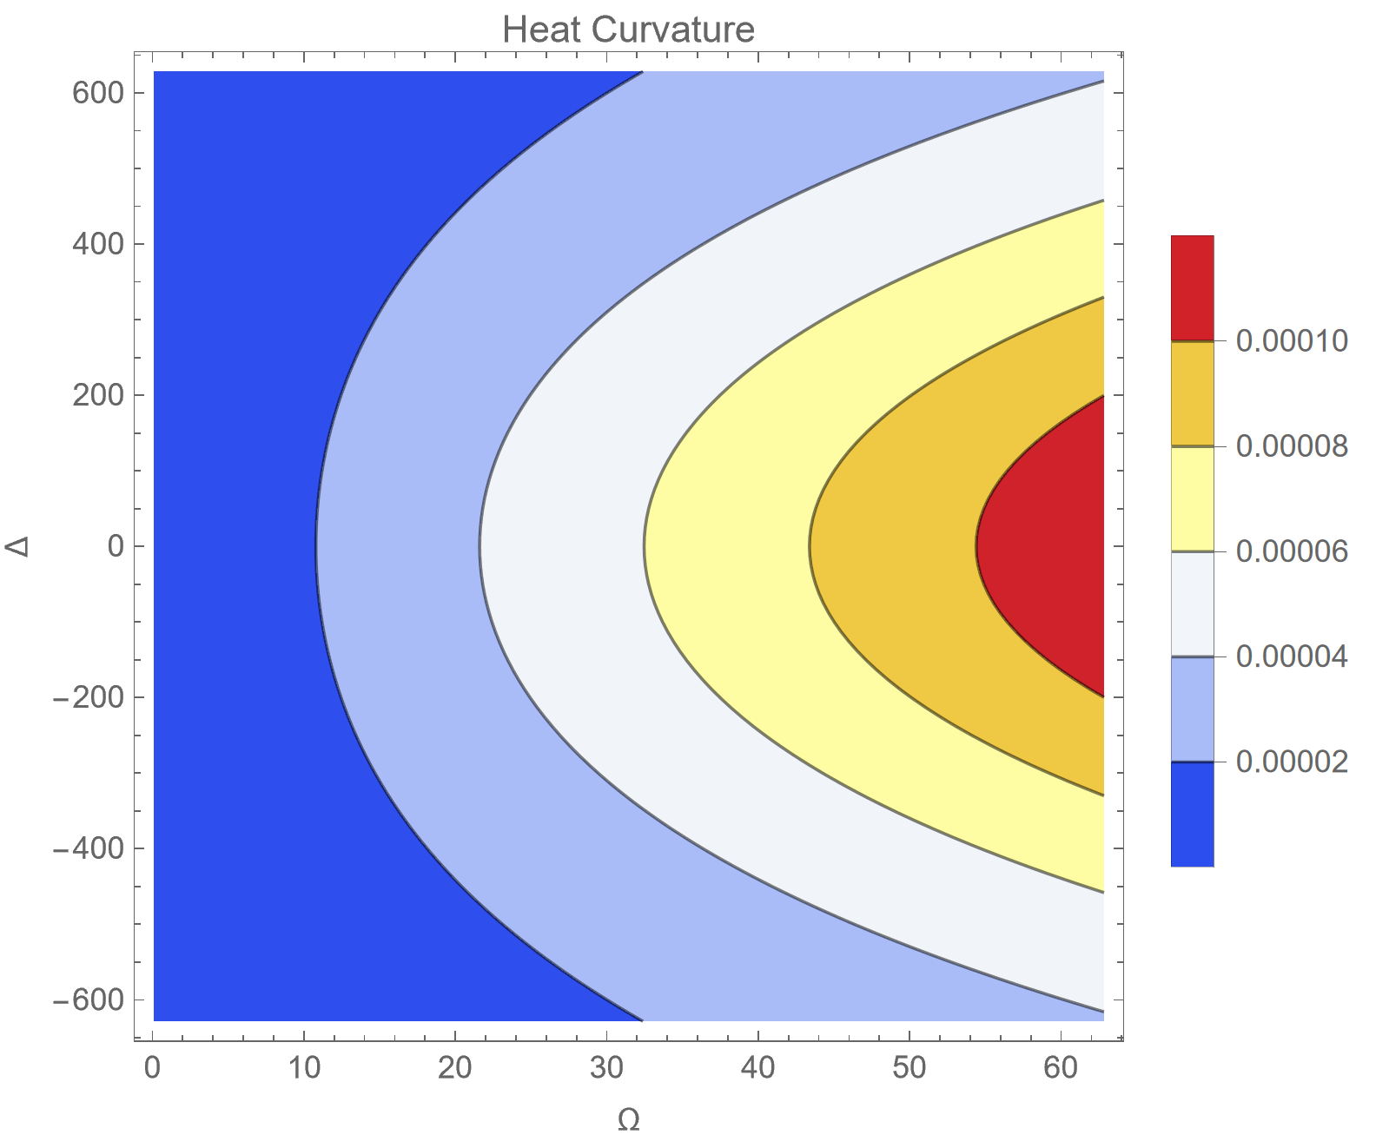
Example 1: Results
We assumed parameters values and their ranges accessible in the lab,
Louisvillian gap timescale was around 70 microseconds,
Example cycle, approximated by red circle has Q_cyc = k_B T, where T was around 3mK
Dissipative heat was negligible
Notes:
Adiabatically take omega23 to zero, instead of keeping both rabi freq. equal,
Instead of loops look at lines in control space

Slide 9
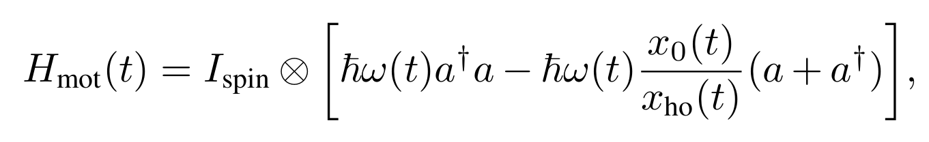
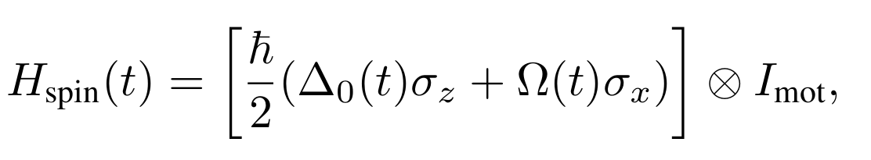
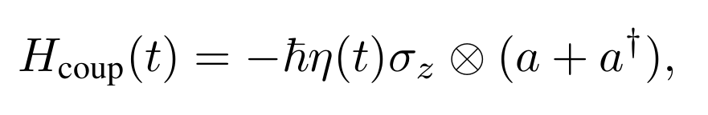
Example 2: Collective mode motion coupled to magnetic sublevels
Now we want to focus on cooling the motional DOF, modelled by
Which couple to a spin via
Control parameters are: trap frequency and position, spin detuning and Rabi frequency
Notes:
Noah draw a picture

Slide 10
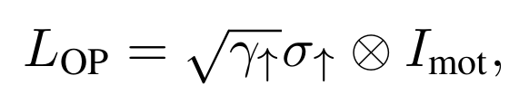
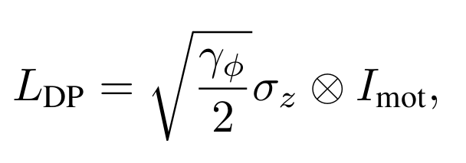
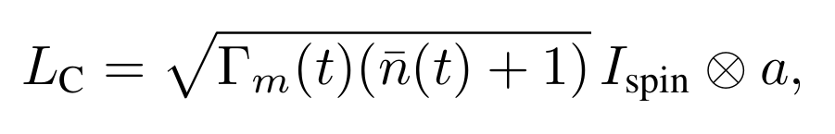
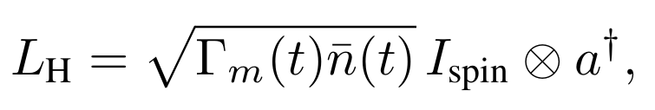
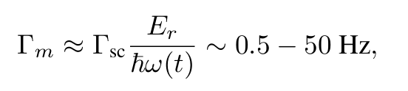
Example 2: Dissipator
We consider for terms in the dissipator:
Optical pumping
Dephasing
Thermal loss/excitations
Motional thermalization rate \Gamma_m depends on the trap frequency and the scattering rate
Notes:
Put eq for gamma_m

Slide 11
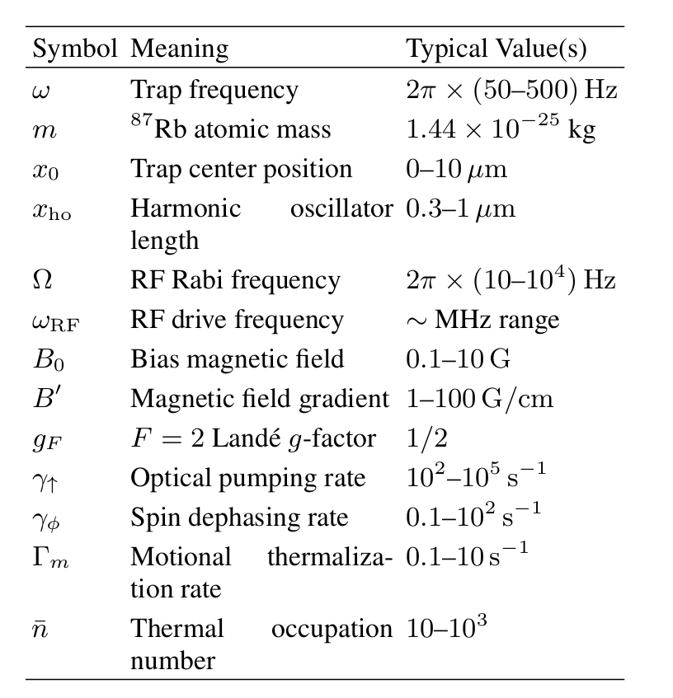
Example 2: Parameters

Slide 12
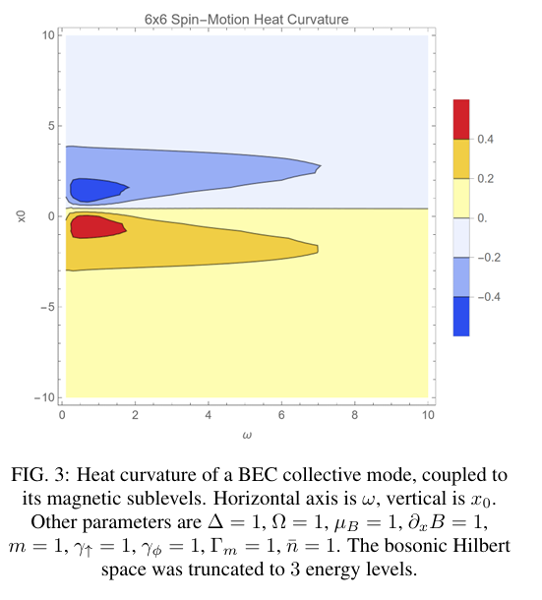
Example 2: Results
For now we assumed all parameters to be 1,
We choose the trap frequency and position as the control parameters,
Realistic parameters needed to evaluate the speed limit and the cycle heat

Slide 13
How did we get the curvature?
Symbolic and numerical scripts in Mathematica, takes the Hamiltonian and dissipators as input, computes the heat curvature
Once given a cycle path, returns Q_rev and Q_diss,
Up to dim(H) = 3, we can do symbolic computation,
Above that, we rely on numerics, same would apply for continuous-variable real-space representation (Gross–Pitaevskii equation)

Slide 14
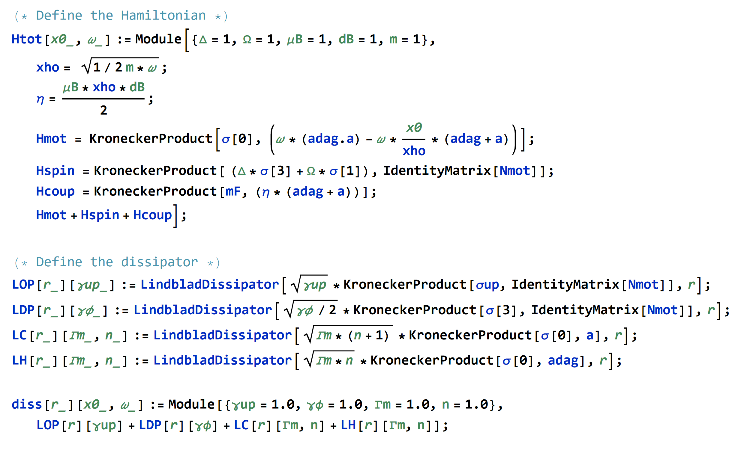
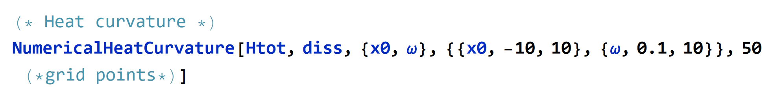
Scripts are available at JGarwola/Cooling-Rubidium-atoms

Slide 15
Questions:
Is the collective mode picture accurate in the lab?
How do we define temperature for Example 2?
Is our definition of heat the right way to quantify the cooling of the BEC?
How would this analysis look like for Potassium atoms?
What is the cooling limit with this approach? (due to thermal noise from the baths or stochastic fluctuations of the control parameters)
Notes:
Sympathetic cooling

