Slide 1
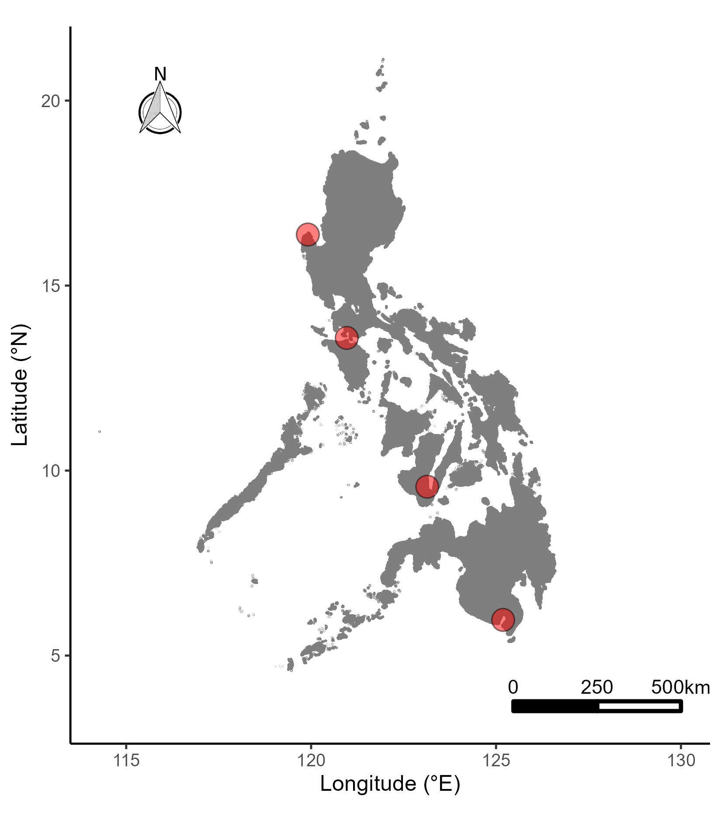
BOL
Northern Philippine Sea
West Philippine Sea
VIP
Visayas Region
NOR
Southern Philippine Sea
Sulu
Sea
Celebes
Sea
SAR

Slide 2
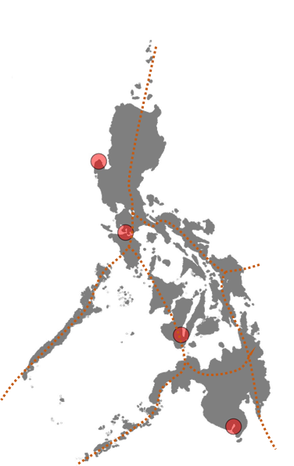
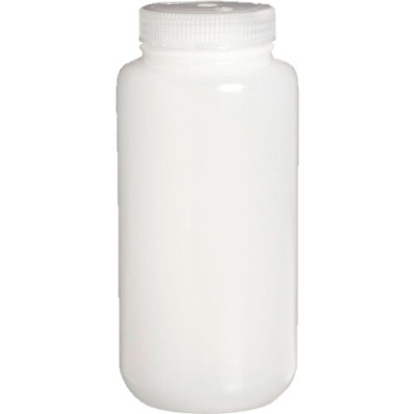
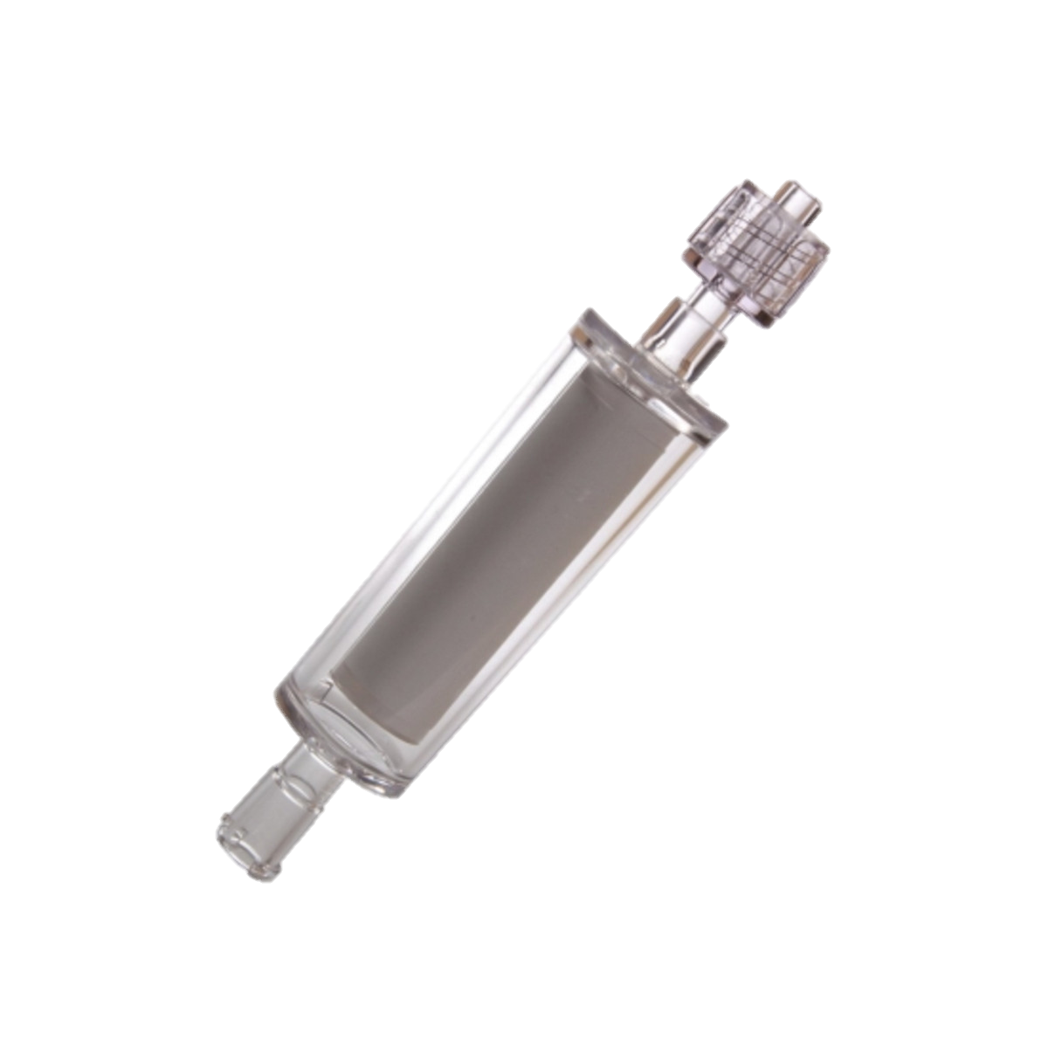
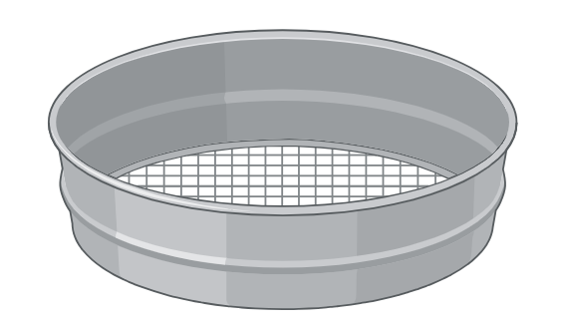

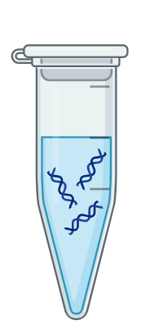
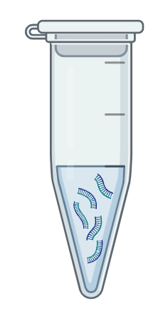
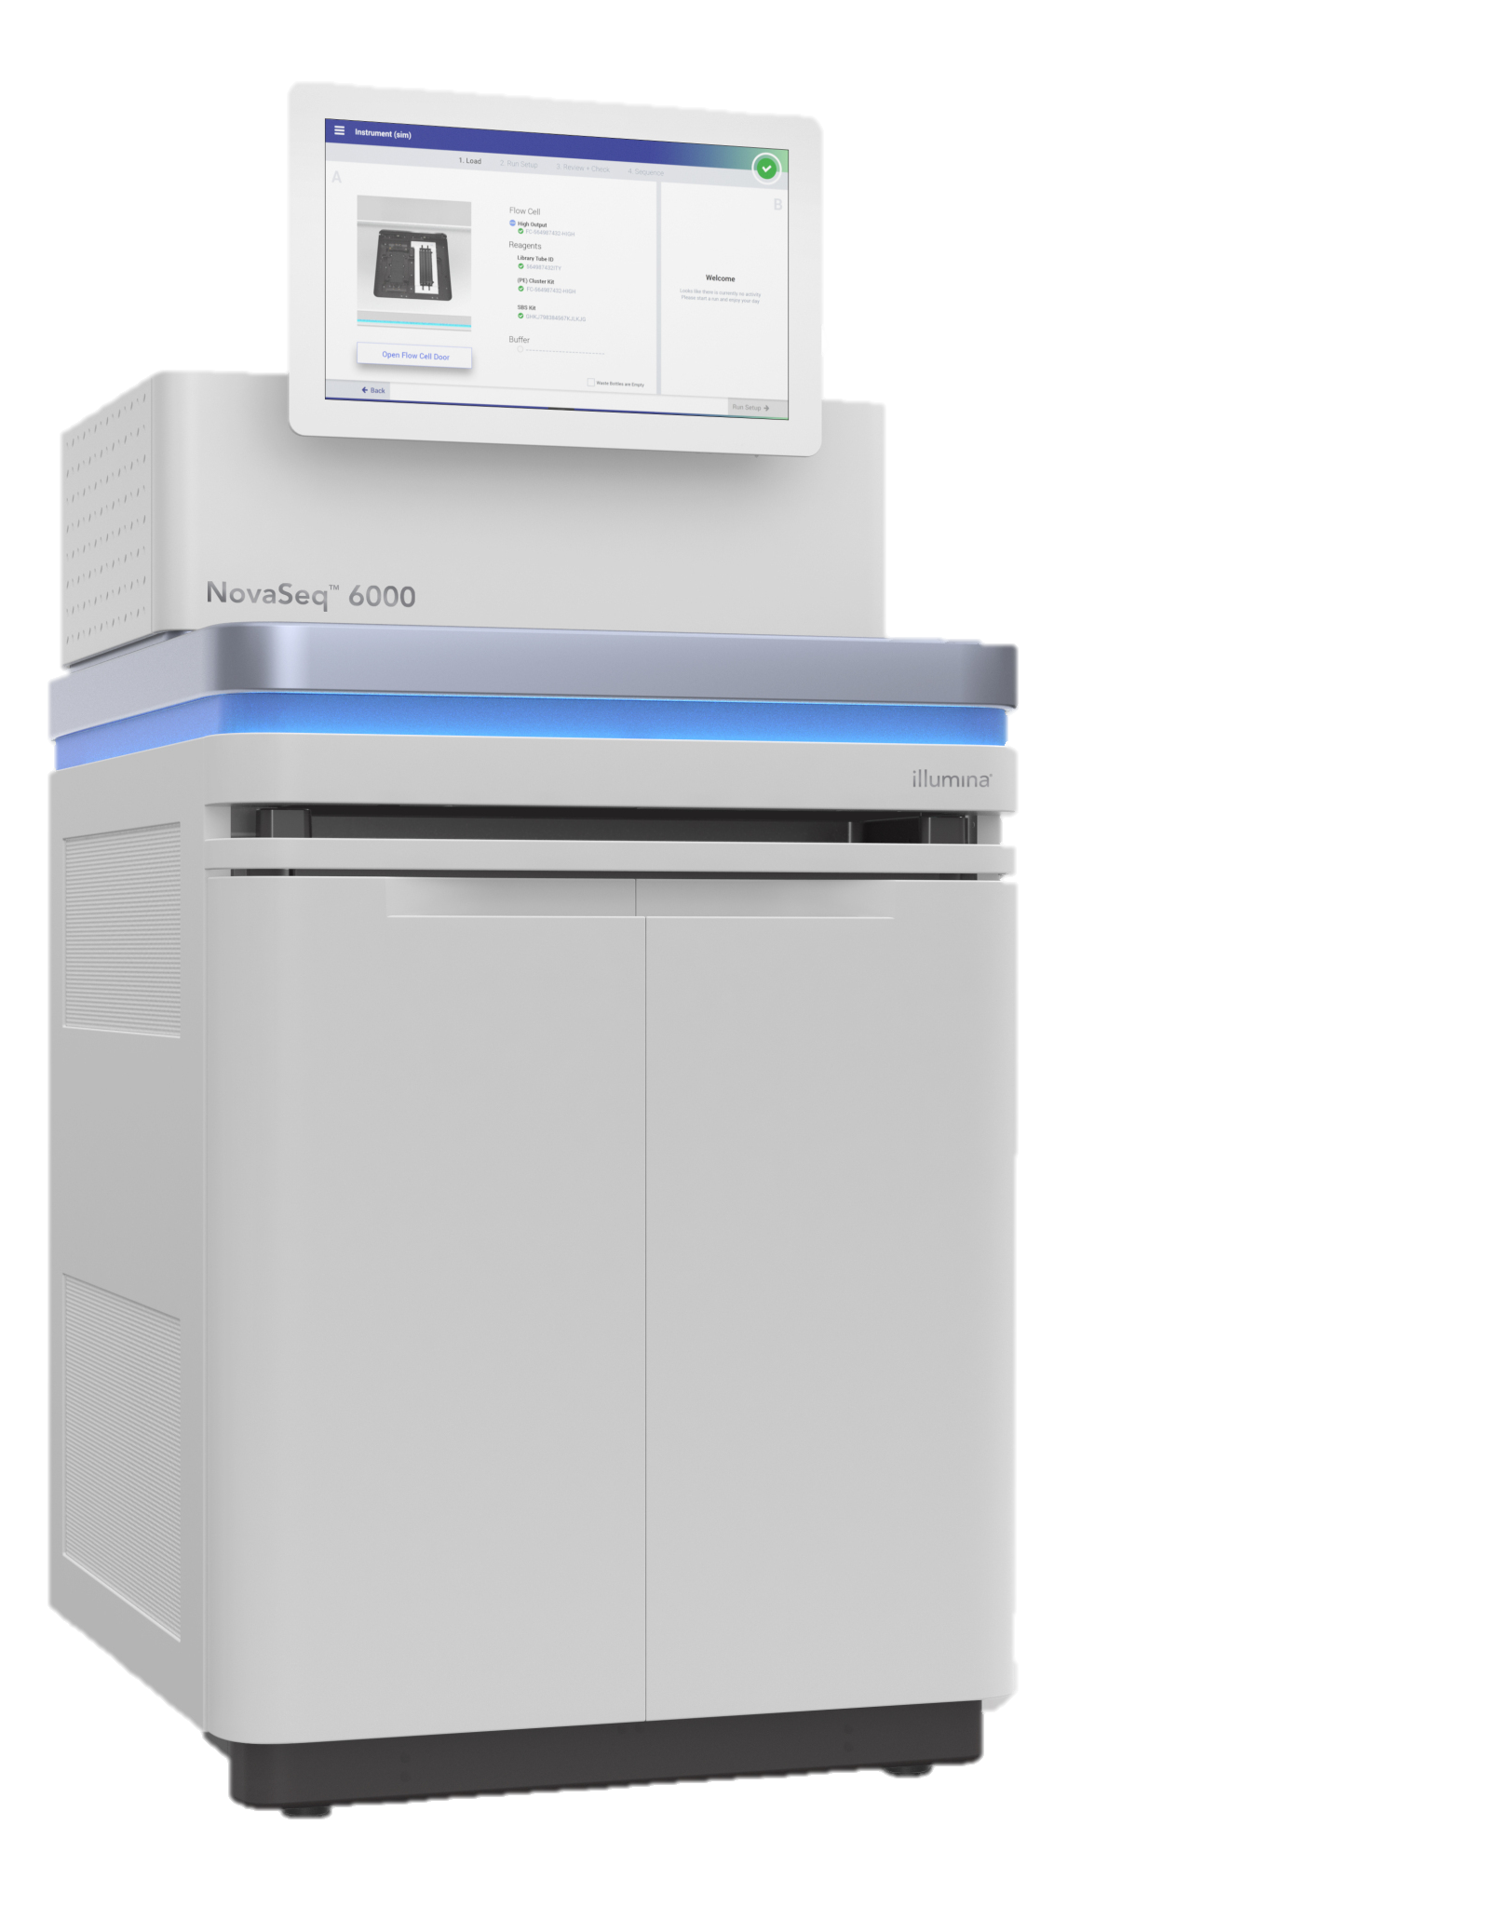

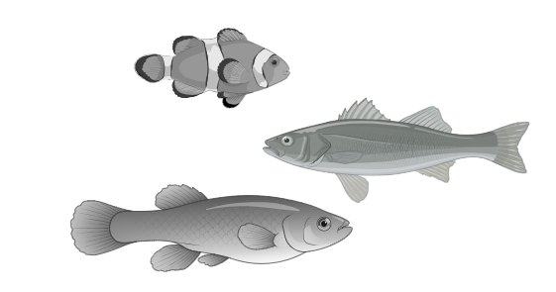
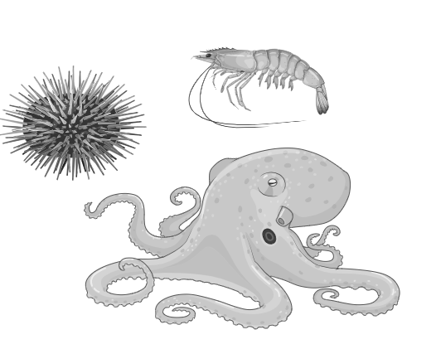
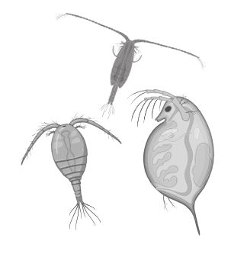
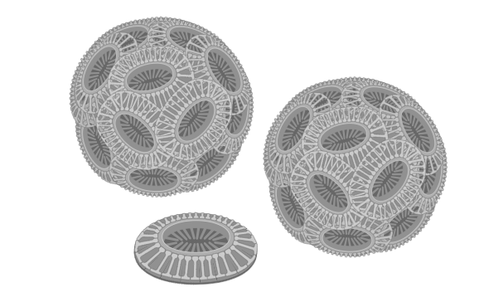
A. Sample Collection
1. Seawater sampling
2. Sequential Filtration
3. Preservation and Shipment
Seawater (≤2 L) will be collected at each site during the northeast monsoon (Nov – Jan)
Filters will be preserved and shipped to TAMU-CC
80 µm sieve
0.45 µm filter
0.22 µm filter
4 sites
12 stations/site
3 negative controls/site
2 size fractions
39 filters/site*fraction
Preservation solution:
DESS, Longmire’s Buffer, Buffer ATL
B. Metabarcoding
1. DNA extraction
2. Library preparation
3. Next-generation sequencing
DNeasy Blood and Tissue Kit
COI
n = 156
pooled
libraries
Platform:
Illumina NovaSeq 6000
130M read pairs
0.45 µm
fraction
12S
DNeasy Plant Mini Kit
16S
n = 156
pooled
libraries
0.22 µm
fraction
18S
C. Bioinformatics Processing and Data Analysis
1. Pre-processing
3. Taxonomic Assignment
4. Data Analysis
Quality filtering
Dereplication
Merging of paired-ends
mOTU_01
mOTU_02
…
mOTU_n
species_01
species_02
…
species_n
CO1
12S
Chao1 Index
16S
18S
12S
COI
Site
2. OTU Clustering
CO1
12S
mOTU_01
NMDS 2
mOTU_03
16S
16S
18S
mOTU_04
NMDS 1
mOTU_02
18S
GLM: Species richness ~ location * envi. * anthro.

