Slide 1
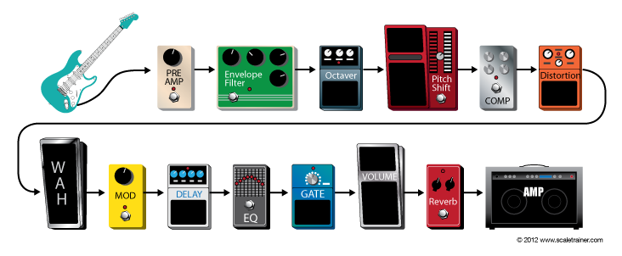
EL-6183
GUITAR EFFECT UNITS
Cheng-Hsun Lee (chl468)
Yin-Ta Lin(ytl473)

Slide 2
Effects unit
An Effects unit (effect box, stompbox, pedal) is an electronic device that alters how a musical instrument or other audio source sounds.
Some effects subtly "color" a sound, while others transform it dramatically.
In DSP views, we pass the signal to specified filter or LFO(low frequency oscillator) to implement these effects
Notes:
Subtly: fine or delicate in meaning or intent; difficult to perceive orunderstand

Slide 3
Effects units processing
Basic Filtering — Low-pass, Band-pass, High-pass filter, Equalizer, etc.
Time Varying Filters — Wah-wah, Phasor
Delays — Vibrato, Flanger, Chorus, Echo
Modulators — Ring modulation, Tremolo, Vibrato
Non-linear Processing — Compression, Limiters, Distortion, Exciters/Enhancers
Spatial Effects — Panning, Reverberation, Surround Sound

Slide 4
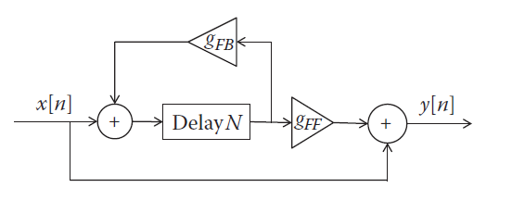
Delay effect
Time-Based effect
Illusion of an echo
Placed near the end of the signal
Notes:
Delay is a Time-Based effect that sends a duplicate version of the instrument signal to the amp with an adjustable time delay creating the illusion of an echo. Time based effects should be placed near the end of the signal path for the most natural sounding results.

Slide 5
Implementation
Using circular buffer
Delay time → index for the circular buffer
Feed delay back to direct path → Echo

Slide 6
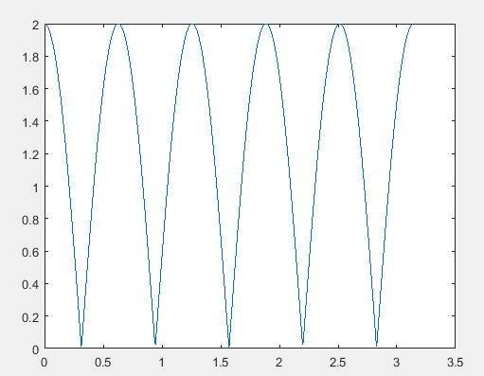
Flanger effect
Lfo f
W

Slide 7
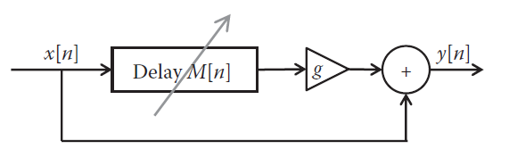
Implementation
Sweeping buffer index as a sinusoid increment
w * math.sin( 2 * math.pi * f * n / RATE + theta)

Slide 8
Fuzz
Fuzz pedals create a warm, gritty sound by clipping the guitar’s audio signal and adding overtones.
Plays an important part in electric guitar music, especially rock music and its variants.
Fuzz is a completely nonlinear effect that creates drastic changes to the input waveform, resulting in a harder or harsher sound.
Notes:
Distortion, overdrive, gain, and fuzz pedals create a warm, gritty sound by clipping the guitar’s audio signal and adding overtones. Distortion and fuzz effects produce the same amount of distortion at any volume while overdrive and gain effects are produce “clean” sounds at quieter volumes and distorted sounds at louder volumes mimicking the effect of a tube amp.

Slide 9

Implementation
A non-linear function commonly used to simulate fuzz is given by:
This a non-linear exponential function
The gain a, controls level of fuzz.
Have a mix part of the distorted signal with original signal for output.

Slide 10
Wah-wah effect
The Wah pedal is a time varying filter effect (Band-pass filter).
Produce a vowel like sound by altering the frequency spectrum of an instruments signal.
A foot pedal is tilted a volume boost sweeps through the frequency range.
Notes:
The Wah pedal is a filter effect (Band-pass filter) that produces a vowel like sound by altering the frequency spectrum of an instruments signal. As a “gas pedal” type foot pedal is tilted a volume boost sweeps through the frequency range.
In our design, we sweep central frequency of the filter automatically like we tilt the pedal back and forth

Slide 11
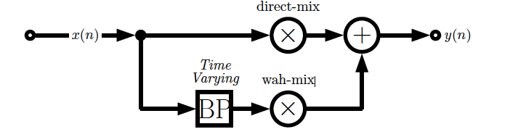
Implementation
Sweep central frequency of the bandpass filter back and forth following a low-frequency oscillator (LFO) with an adjustable frequency, called Auto-Wah

Slide 12
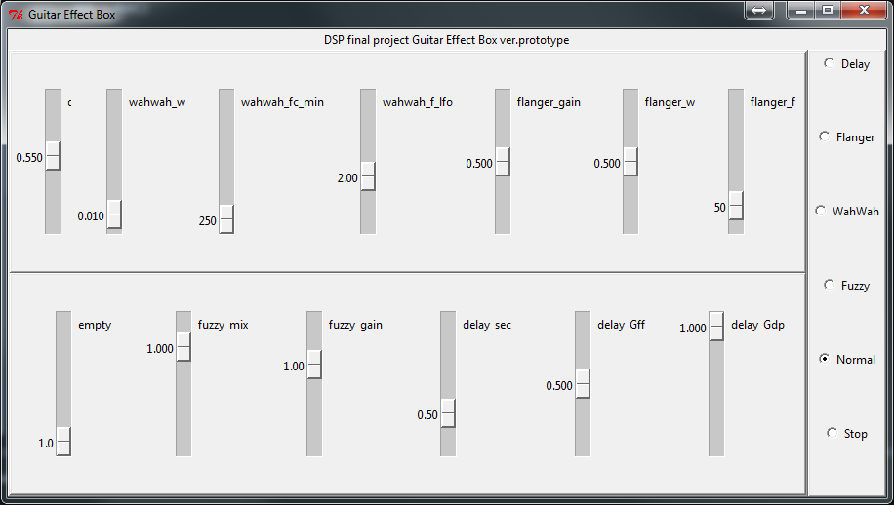
Interface design
Tkinter 8.5 on python 2.7
To work on Mac OS X, install “ActiveTcl”

Slide 13
Reference
http://www.cs.cf.ac.uk/Dave/CM0268/PDF/10_CM0268_Audio_FX.pdf
Text Book: Audio Effects Theory, Implementation and Application by Joshua D. Reiss and Andrew P. McPherson

