Slide 1
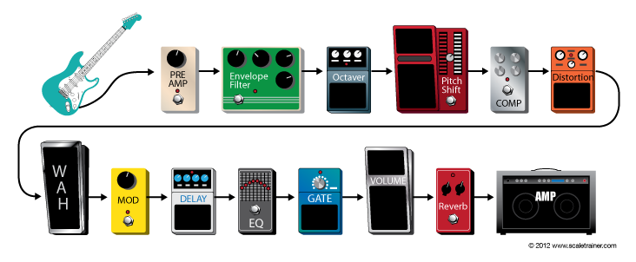
EL-6183
GUITAR EFFECT UNITS
Cheng Hsun Lee (chl468)
Yin Ta Lin(ytl473)

Slide 2
Effects unit
An Effects unit (effect box,stomp box, stompbox, pedal) is an electronic device that alters how a musical instrument or other audio source sounds.
Some effects subtly "color" a sound, while others transform it dramatically.
In DSP views, we pass the signal to specified filter or LFO(low frequency oscillator) to implement these effects

Slide 3
Effects units processing
Basic Filtering — Low-pass, Band-pass, Highp-ass filter etc., Equalizer
Time Varying Filters — Wah-wah, Phasor
Delays — Vibrato, Flanger, Chorus, Echo
Modulators — Ring modulation, Tremolo, Vibrato
Non-linear Processing — Compression, Limiters, Distortion, Exciters/Enhancers
Spatial Effects — Panning, Reverb, Surround Sound

Slide 4
Delay effect
Time-Based effect
Illusion of an echo
Placed near the end of the signal
Notes:
Delay is a Time-Based effect that sends a duplicate version of the instrument signal to the amp with an adjustable time delay creating the illusion of an echo. Time based effects should be placed near the end of the signal path for the most natural sounding results.

Slide 5
Implementation
Using circular buffer
Delay time → index for the circular buffer

Slide 6
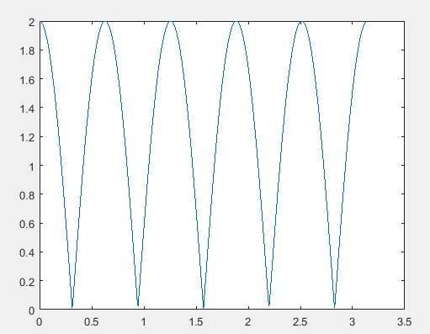
Flanger effect
Lfo f
W

Slide 7
Implementation
Sweeping buffer index as a sinusoid increment
w * math.sin( 2 * math.pi * f * n / RATE + theta)

Slide 8
Distortion (Fuzz)
Clipping the guitar’s audio signal and adding overtones.
Distortion and fuzz effects produce the same amount of distortion at any volume
Overdrive and gain effects are produce “clean” sounds at quieter volumes and distorted sounds at louder volumes mimicking the effect of a tube amp.
Notes:
Distortion, overdrive, gain, and fuzz pedals create a warm, gritty sound by clipping the guitar’s audio signal and adding overtones. Distortion and fuzz effects produce the same amount of distortion at any volume while overdrive and gain effects are produce “clean” sounds at quieter volumes and distorted sounds at louder volumes mimicking the effect of a tube amp.

Slide 9

Implementation
A non-linear function commonly used to simulate distortion/fuzz is given by:
This a non-linear exponential function
The gain a, controls level of distortion/fuzz.
Common to mix part of the distorted signal with original signal for output.

Slide 10
Wah-wah effect
Band-pass filter
Produces a vowel like sound by altering the frequency spectrum of an instruments signal.
A “gas pedal” type foot pedal is tilted a volume boost sweeps through the frequency range.
In our design, we sweep central frequency of the filter automatically like we tilt the pedal back and forth
Notes:
The Wah pedal is a filter effect (Band-pass filter) that produces a vowel like sound by altering the frequency spectrum of an instruments signal. As a “gas pedal” type foot pedal is tilted a volume boost sweeps through the frequency range.
In our design, we sweep central frequency of the filter automatically like we tilt the pedal back and forth

Slide 11
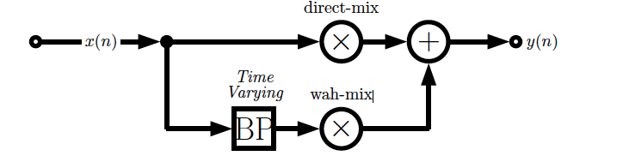
Implementation
A bandpass filter with a time varying central (resonant) frequency and a small bandwidth. Filtered signal mixed with direct signal.

Slide 12
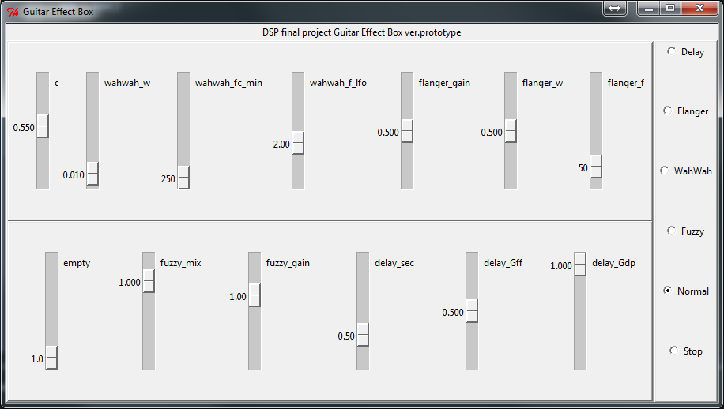
Interface design
Tkinter 8.5 on python 2.7
To work on Mac OS X, install “ActiveTcl”

Slide 13
Reference
http://www.cs.cf.ac.uk/Dave/CM0268/PDF/10_CM0268_Audio_FX.pdf
Text Book: Audio Effects Theory, Implementation and Application by Joshua D. Reiss and Andrew P. McPherson

