Slide 1

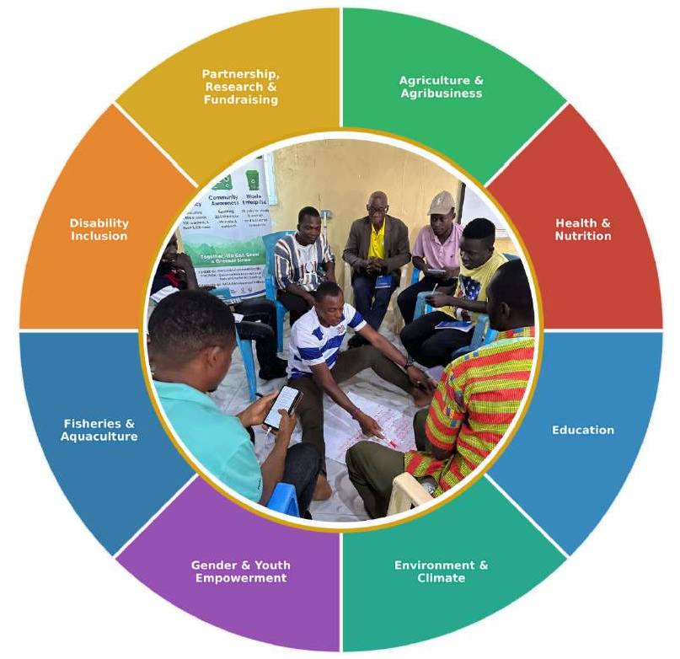
Strategic Plan 2025-2029
Empowering Youth, Women, and Communities Across
Prepared by:
BASA Development Initiatives
katherina.hopkins@basadev.org | www.basadev.org
1st Floor, Gausi Apartments, BASA Avenue, LBS-ELWA Community Paynesville City, Monrovia, Liberia
Revised Edition |January 2026

Slide 2
BASA Development Initiatives (BDI) | Strategic Plan 2025-2029
Table of Contents
Foreword from the Chief Executive Officer ......................................................................................5
About BDI - Our Essence, Vision, Mission, and Values................................................................6
Liberia Development Context .....................................................................................................6
Economic Outlook.....................................................................................................................7
Agriculture and Food Security..................................................................................................7
Health .........................................................................................................................................7
Education...................................................................................................................................7
Environment and Climate.........................................................................................................7
Fisheries.......................................................................................................................................8
Gender and Social Inclusion ....................................................................................................8
Alignment with National and Global Frameworks..................................................................8
BDI's Achievements: 2022-2026 ....................................................................................................8
Strategic Positioning and Theory of Change..............................................................................9
Where We Work and Who We Serve......................................................................................... 10
Strategic Goals Overview .......................................................................................................... 10
PROGRAM AREA 1: Agriculture and Agribusiness .................................................................... 11
Agriculture Program Summary ............................................................................................... 11
Agriculture Program Theory of Change ................................................................................ 12
Background and Rationale .................................................................................................... 13
Program Objective.................................................................................................................. 13
Key Program Objectives and Indicators................................................................................ 13 Our Approach ......................................................................................................................... 14 PROGRAM AREA 2: Health and Nutrition .................................................................................. 15
Background and Rationale .................................................................................................... 17
Program Objective.................................................................................................................. 17
Key Program Objectives and Indicators................................................................................ 17
Our Approach ......................................................................................................................... 18
PROGRAM AREA 3: Education................................................................................................... 19
Education Program Summary ................................................................................................ 19
Education Program Theory of Change ................................................................................. 20
Background and Rationale .................................................................................................... 21
Program Objective.................................................................................................................. 21
Key Program Objectives and Indicators................................................................................ 21
Our Approach ......................................................................................................................... 22
Page | 2

Slide 3
BASA Development Initiatives (BDI) | Strategic Plan 2025-2029
PROGRAM AREA 4: Environment and Climate Resilience....................................................... 23
Environmental Program Summary.......................................................................................... 23
Environmental Program Theory of Change........................................................................... 24
Background and Rationale .................................................................................................... 25
Program Objective.................................................................................................................. 25
Key Program Objectives and Indicators................................................................................ 25 Our Approach ......................................................................................................................... 26 PROGRAM AREA 5: Gender and Youth Empowerment .......................................................... 27
Gender and Youth Program Summary.................................................................................. 27
Background and Rationale .................................................................................................... 29
Program Objective.................................................................................................................. 29
Key Program Objectives and Indicators................................................................................ 29 Our Approach ......................................................................................................................... 30 PROGRAM AREA 6: Fisheries and Aquaculture ........................................................................ 31
Fisheries and Aquaculture Program Summary...................................................................... 31
Fisheries and Aquaculture Program Theory of Change....................................................... 32
Program Objective.................................................................................................................. 33
Key Program Objectives and Indicators................................................................................ 33
Our Approach ......................................................................................................................... 34
PROGRAM AREA 7: Disability Inclusion ...................................................................................... 35
Disability Inclusion Program Summary ................................................................................... 35
Disability Inclusion Program Theory of Change..................................................................... 36
Background and Rationale .................................................................................................... 37
Program Objective.................................................................................................................. 37
Key Program Objectives and Indicators................................................................................ 37
Our Approach ......................................................................................................................... 38
Cross-Program Integration...................................................................................................... 39
PROGRAM AREA 8: Partnership, Research, and Fundraising .................................................. 40
Partnership, Research & Fundraising Program Summary ..................................................... 40
Background and Rationale .................................................................................................... 42
Program Objective.................................................................................................................. 42
Key Program Objectives and Indicators................................................................................ 42
Our Approach ......................................................................................................................... 43
Cross-Cutting Themes ................................................................................................................. 43
BDI’s Programs Alignment with SDGs ..................................................................................... 44

Slide 4
BASA Development Initiatives (BDI) | Strategic Plan 2025-2029
Resource Mobilization and Financial Sustainability.................................................................. 44
Funding Diversification Strategy ............................................................................................. 44
Organizational Systems and Capacity ..................................................................................... 45
Governance and Leadership............................................................................................. 45
Human Resources................................................................................................................ 45
Systems and Technology .................................................................................................... 45
Monitoring, Evaluation, Accountability, and Learning (MEAL)........................................ 45 Plan Financing............................................................................................................................. 46 Plan Management and Accountability.................................................................................... 46
Overall Accountability ............................................................................................................ 46
Annual Planning and Review Cycle ...................................................................................... 46
Staff Responsibility ................................................................................................................... 46
Community Accountability .................................................................................................... 47

Slide 5
BASA Development Initiatives (BDI) | Strategic Plan 2025-2029
Foreword from the Chief Executive Officer
When we founded BASA Development Initiatives (BDI), we did so with a simple but unshakeable conviction: that Liberians have the capacity, the creativity, and the courage to build the country they deserve. What they often lack are the resources, the systems, and the partners who truly believe in them.
This updated strategic plan - covering 2025 to 2029 - is more than a management document. It is a statement of who we are, what we stand for, and how we intend to spend the next five years showing up for the communities that have entrusted us with their hopes.
Over the past three years, BDI has trained more than 600 farmers, conducted agriculture financing research across four counties, implemented environmental conservation programs, expanded maternal and menstrual health outreach, and forged meaningful partnerships. We are proud of this foundation. But the need - in Liberia's rural communities, its urban slums, its fishing villages, its classrooms - is far greater than anything we have addressed so far.
This plan reflects that reality. It expands our programmatic scope to include fisheries and aquaculture, strengthens our commitment to disability inclusion, deepens our work on gender and youth empowerment, and aligns all our efforts with Liberia's ARREST Agenda for Inclusive Development 2025-2029 and the United Nations Sustainable Development Goals (SDGs).
We are especially deliberate about leaving no one behind. Persons with disabilities in Liberia remain among the most excluded - from schools, from jobs, from public spaces, and from the policies designed to protect them. BDI intends to change that, one community at a time.
To our donors, partners, communities, and team: thank you. This plan is built on your trust and fueled by our shared belief that a Liberia without poverty is not a dream. It is a destination.
Katherina M. Hopkins
Founder and Chief Executive Officer BASA Development Initiatives

Slide 6
BASA Development Initiatives (BDI) | Strategic Plan 2025-2029
About BDI - Our Essence, Vision, Mission, and Values
BASA Development Initiatives (BDI) is a legally registered 501(C)3 Liberian not-for-profit and non-governmental organization. Formally registered in 2022, BDI was founded on the belief that sustainable development in Liberia must be driven by Liberians themselves. We work to improve the living conditions of the less fortunate, with a particular focus on women, youth, farmers, persons with disabilities, and marginalized communities across Liberia and the wider African continent.
Our Vision A Liberia without poverty, where development is impactful, owned, and implemented by Liberians. | Our Mission To empower the youth and women of Liberia and Africa by creating sustainable opportunities and resources that lift them out of poverty and drive impactful, community-owned development.
Our Core Values
BDI's work is anchored in seven values that guide every decision, partnership, and program we implement:
Integrity - We uphold honesty, transparency, and accountability in all our actions, ensuring trust and credibility in every relationship.
Empowerment - We foster self-reliance and capacity building within communities, enabling individuals to take charge of their own development.
Inclusiveness - We ensure that all voices, especially those of marginalized groups, are heard and respected, promoting equality and participation.
Love for People and Country - We work with genuine passion for humanity. The desire to improve living conditions for all Liberians is at the core of everything we do.
Sustainability - We promote practices that ensure long-term environmental, social, and economic viability, safeguarding the future for generations to come.
Collaboration - We build strong partnerships and work collectively toward common goals, multiplying the impact of our initiatives.
Innovation - We encourage creative thinking and the adoption of bold, evidence-based solutions to complex development challenges.
Professionalism - We maintain the highest standards in all our activities, representing our communities and our country with dignity.
Liberia Development Context
Any meaningful strategic plan must be grounded in an honest reading of the environment it seeks to change. Liberia's development landscape as of 2025 is one of paradox: rich in natural resources, resilient in people, yet burdened by structural inequalities and deeply entrenched poverty.

Slide 7
BASA Development Initiatives (BDI) | Strategic Plan 2025-2029
Economic Outlook
Liberia's economy grew by 4.0% in 2024, driven by modest improvements in mining, agriculture, and services. Extreme poverty fell to 26.4% in 2024, down from a peak of 40.9% in 2022 - a meaningful improvement, though far from sufficient. Approximately 55.6% of the population continues to live in multidimensional poverty, experiencing deprivation across health, education, and living standards simultaneously. Rural poverty stands at 81%, starkly contrasted with 30% in urban areas. Inflation averaged 8.3% in 2024, declining from 10.1% in 2023, though it resurfaced to 13.1% in early 2025, placing renewed pressure on household incomes.
Agriculture and Food Security
Agriculture accounts for nearly 30% of Liberia's GDP and provides livelihoods for approximately 70% of the workforce. Yet the sector is characterized by subsistence-level farming, limited market access, outdated practices, inadequate storage, and poor infrastructure. Cassava and rice remain primary food staples, while cash crops such as rubber, oil palm, cocoa, and timber drive export revenue. Post-harvest losses remain a critical challenge, and the 'Hunger Season' - a six-month period of food scarcity - continues to drive malnutrition in rural households. Climate change poses an existential threat: without intervention, it could shrink Liberia's economy by 15% and push 1.3 million more people into poverty by 2050.
Health
Liberia's health sector continues to face severe workforce shortages, with only 5,000 health workers and approximately 51 Liberian doctors serving a population of over 5 million. Maternal mortality remains among the highest in Africa, with adolescents bearing a disproportionate share of pregnancy-related deaths. Out-of-pocket health expenditures push vulnerable households deeper into poverty. Menstrual health, preventive care, and child nutrition remain critically underfunded areas, particularly in rural and southeastern communities.
Education
Approximately 15% to 20% of children aged 6 to 14 remain out of school. Literacy rates are low, particularly among women and girls in rural areas, and mean years of schooling remain below five nationally. Vocational and technical training opportunities are inadequate to prepare youth for a shifting labor market. Digital literacy remains largely inaccessible to the majority of students and teachers.
Environment and Climate
Liberia holds one of West Africa's largest remaining rainforest reserves, making it a globally significant biodiversity hotspot. However, deforestation, unsustainable land use, and weak environmental governance threaten this resource. Access to clean energy remains limited, with national electrification at approximately 34%. Clean cooking solutions are unavailable to the vast majority of rural households.

Slide 8
BASA Development Initiatives (BDI) | Strategic Plan 2025-2029
Fisheries
Liberia's 570-kilometer coastline and inland waterways offer significant fisheries potential. Artisanal fishing is a primary livelihood for coastal communities, particularly women who dominate fish processing and local trade. However, overfishing, poor post-harvest handling, limited access to markets, and inadequate equipment constrain the sector's contribution to food security and economic growth.
Gender and Social Inclusion
Gender inequality remains a defining feature of Liberia's development landscape. 24.9% of women marry before the age of 18, adolescent birth rates exceed 130 per 1,000, and gender-based violence reached record highs in 2023. Women and youth - who make up over 60% of the population - continue to face systematic barriers to economic participation, education, and leadership. Persons with disabilities face compounding exclusion: denied access to education, employment, public buildings, healthcare, and the legal protections they are owed.
Alignment with National and Global Frameworks
BDI's strategic plan is deliberately aligned with Liberia's ARREST Agenda for Inclusive Development (2025-2029), which focuses on Agriculture, Roads, Rule of Law, Education, Sanitation, and Tourism. Our programming also aligns with the United Nations Sustainable Development Goals (SDGs), the African Union's Agenda 2063, and the World Bank's Country Partnership Framework for Liberia. This alignment positions BDI as a credible implementing partner for both national and international funders.
BDI's Achievements: 2022-2026
Since beginning formal operations in 2022, BDI has built a track record that demonstrates both our capacity and our commitment to the communities we serve. Key achievements include:
Trained over 1600 students and teachers across 10 schools in climate literacy
Planted 5000 trees, including mangroves and coconuts, across 10 coastal communities
Established 10 climate clubs within 10 schools and built the operational capacity of 1 waste enterprise
Trained over 600 farmers and farmer cooperatives in sustainable agribusiness management and climate-smart practices across multiple counties.
Conducted robust agriculture financing research across 4 Liberian counties, producing actionable recommendations for improving smallholder access to agricultural loans.
Implemented 12 environmental conservation awareness campaigns across 4 counties, reaching thousands of community members.
Expanded healthcare access through health education programs, menstrual health initiatives, and community outreach, reaching underserved rural populations.

Slide 9
BASA Development Initiatives (BDI) | Strategic Plan 2025-2029
Supported 4 agribusinesses and facilitated the growth of 2 farmer cooperatives through targeted business support services.
Established strategic partnerships with 3 local and international organizations, including the National Civil Society Council and the Women NGO Secretariat.
Generated operating income through research, graphic design, web design, and application development services, advancing BDI's social enterprise model.
These results, achieved on an average annual budget of US$50,000 to US$60,000, reflect both the efficiency of our model and the enormous potential for greater impact with increased resources.
Strategic Positioning and Theory of Change
BDI's competitive advantage lies in our identity as a Liberian-led, community-rooted organization. Where international NGOs often struggle to navigate local context, cultural nuances, and trust deficits, BDI operates from the inside out. We understand Liberia not as outsiders describing a problem, but as Liberians living and working within it.
Our theory of change rests on three interconnected pillars:
Pillar 1: Integrated, Multi-Sector Programming
No single intervention can lift a community out of poverty. A farmer who receives agribusiness training but lacks healthcare access, clean water, or a market for her produce will not thrive. BDI's programs are intentionally interconnected - agriculture links to nutrition, education links to youth employment, environment links to food security, and disability inclusion links to everything. We address the whole person, not just the presenting problem.
Pillar 2: Community-Led Design and Implementation
Every program BDI implements begins with comprehensive scoping assessments and community consultations. We do not arrive with pre-packaged solutions. We listen, co-design, and then implement with communities as partners - not beneficiaries. This approach ensures relevance, builds local ownership, and produces results that outlast the project cycle.
Pillar 3: Evidence-Based Action and Adaptive Learning
BDI is committed to knowing what works. We invest in research, monitoring, evaluation, and learning to continuously assess and improve our programming. Our data-driven approach ensures that resources are directed where they produce the greatest impact, and that we can communicate that impact credibly to donors, partners, and policymakers.

Slide 10
BASA Development Initiatives (BDI) | Strategic Plan 2025-2029
Where We Work and Who We Serve
BDI works across Liberia, with a particular focus on the Southeast region, which remains the country's least developed and most underserved area. We maintain a Southeast office in Greenville, Sinoe County, a satellite office in Bong for central and northern coverage, and our headquarters in Monrovia to coordinate national and international partnerships.
Our primary target populations include:
Youth below the age of 35, with a focus on making agribusiness, vocational training, and entrepreneurship aspirational and accessible.
Women and girls, particularly in relation to entrepreneurship, maternal and newborn health, menstrual hygiene, and protection from gender-based violence.
Smallholder farmers, farmer cooperatives, and agribusinesses seeking to transition from subsistence to commercial production.
Artisanal fishers and fish processors in coastal and riverine communities.
Persons with disabilities, who face systemic exclusion from education, employment, healthcare, and civic life.
Marginalized and remote communities in the Southeast, urban slums, and environmentally vulnerable areas.
Strategic Goals Overview
BDI's 2025-2029 Strategic Plan is organized around four institutional goals and eight program areas. The institutional goals provide the structural foundation for everything we do, while the program areas define the thematic communities we serve.
Goal | Description
Goal One | Empower Youth, Women, and Communities to Overcome Poverty Through Integrated Programming across agriculture, health, education, environment, fisheries, gender empowerment, and disability inclusion.
Goal Two | Ensure Resource Mobilization and Financial Sustainability through diversified funding, social enterprise development, and multi-year donor partnerships.
Goal Three | Strengthen Organizational Systems and Institutional Capacity including governance, human resources, data management, and monitoring and evaluation.
Goal Four | Deepen Community Engagement and Strategic Partnerships with government, civil society, the private sector, and international organizations.

Slide 11
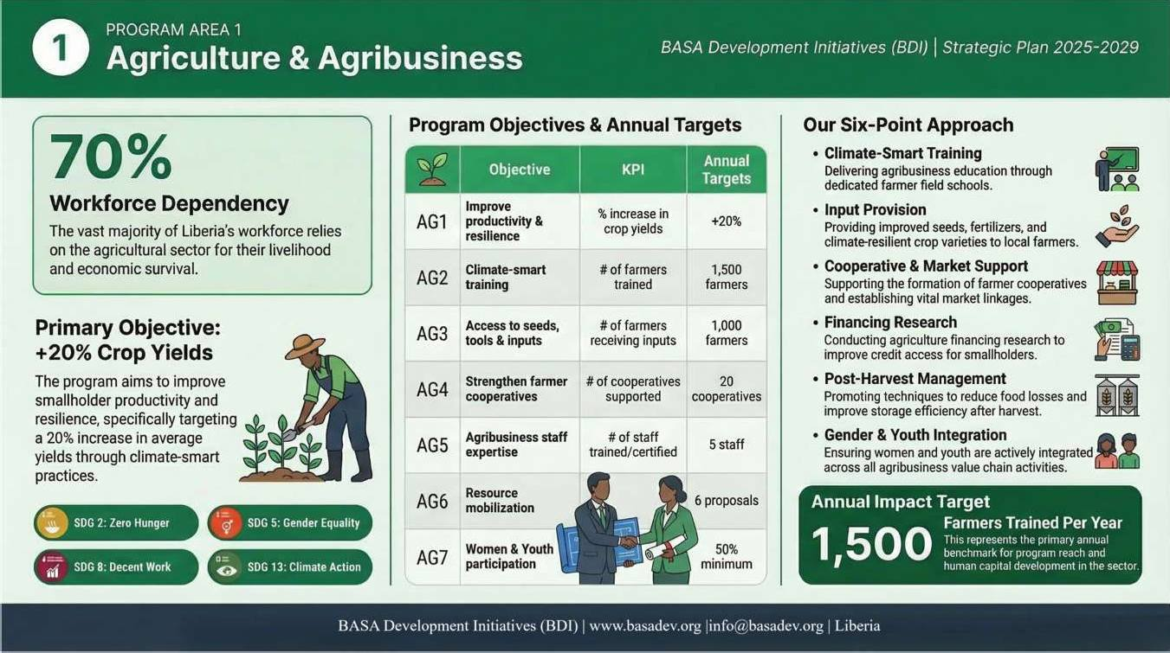
PROGRAM AREA 1: Agriculture and Agribusiness
Agriculture Program Summary
The infographic below provides a consolidated overview capturing the core rationale for the program, its overarching objective, the full set of measurable indicators and annual targets that will guide implementation, and the six strategic approaches through which BDI will engage farmers, cooperatives, and market systems across Liberia's most vulnerable rural communities.

Slide 12
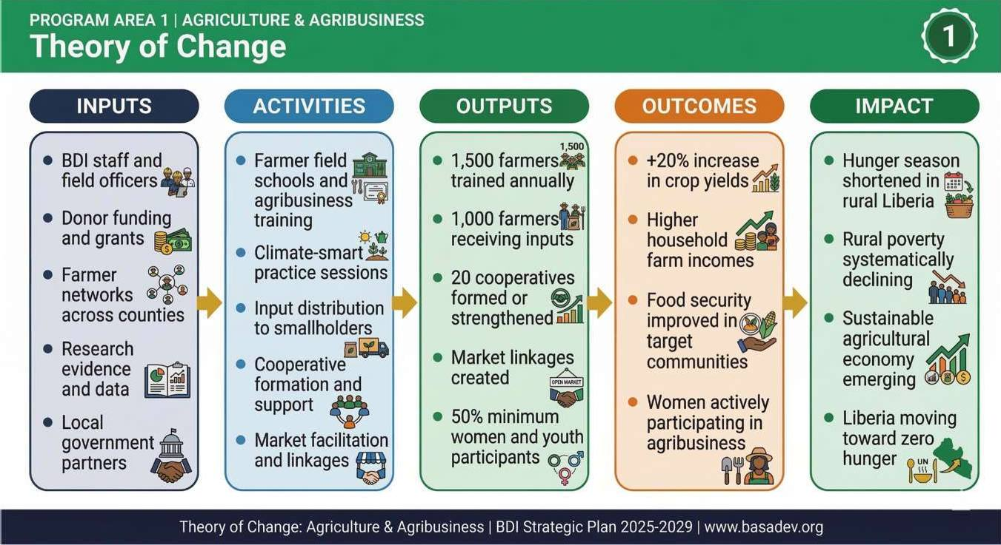
BASA Development Initiatives (BDI) | Strategic Plan 2025-2029
Agriculture Program Theory of Change
The diagram below maps the causal logic underpinning BDI's Agriculture program, illustrating the pathway from the organizational inputs and field activities BDI will deploy, through the direct outputs and measurable outcomes the program will produce, to the long-term impact of a more food-secure, economically resilient, and poverty-reduced Liberia in which smallholder farming is a viable and dignified livelihood.
Page | 12

Slide 13
Background and Rationale
Agriculture is the backbone of Liberia's economy and the primary livelihood for approximately 70% of the workforce. Yet the sector is trapped in low-productivity cycles driven by subsistence-level farming practices locally referred to as 'Hand to Mouth,' limited market access, climate vulnerability, and inadequate financing options for smallholder farmers. More than 64% of Liberian youth have historically been reluctant to enter agriculture, viewing it as low-status and uneconomical. BDI's agriculture program is designed to change that narrative - transforming farming from a survival strategy into a commercially viable, dignified, and climate-resilient enterprise.
The program focuses on the full agricultural value chain: production, processing, and commercialization. By integrating climate-smart practices, market linkages, cooperative strengthening, and access to inputs and financing, BDI seeks to build an agricultural sector that creates sustainable jobs, reduces hunger, and generates wealth for rural communities.
Program Objective
Overall Objective (AG1)
Improve smallholder farmers' productivity and resilience through climate-smart agriculture, with a target of +20% increase in average crop yields by end of plan period.
Key Program Objectives and Indicators
Code | Type | Objective | KPI | Annual Target | SDG Alignment
AG1 | Overall | Improve smallholder farmers productivity and resilience through climate-smart agriculture | % increase in crop yields | +20% by end of year | SDG 2, SDG 8, SDG 13
AG2 | Specific | Train farmers on climate-smart agriculture practices and techniques | # of farmers trained | 1,500 farmers annually | SDG 2, SDG 13
AG3 | Specific | Increase farmers access to improved seeds, tools, and inputs | # of farmers receiving inputs | 1,000 farmers annually | SDG 2
AG4 | Specific | Strengthen farmer cooperatives and market linkages | # of cooperatives supported | 20 cooperatives | SDG 8, SDG 12
AG5 | Capacity Building | Strengthen program staff expertise in agribusiness, climate resilience, and food systems | # of staff trained/certified | 5 staff annually | SDG 4
AG6 | Fundraising | Mobilize resources for agricultural programs through proposals and partnerships | # of proposals submitted | 6 proposals annually | SDG 17
AG6.1 | Fundraising | Submit innovative concept notes for climate-smart agriculture projects | # of concept notes submitted | 8 concept notes annually | SDG 17

Slide 14
BASA Development Initiatives (BDI) | Strategic Plan 2025-2029
Code | Type | Objective | KPI | Annual Target | SDG Alignment
AG7 | Cross-cutting | Promote women and youth participation in agribusiness value chains | % of participants who are women/youth | 50% minimum | SDG 5, SDG 8
Our Approach
Conduct community-based agribusiness training sessions and farmer field schools across target counties.
Provide direct input support, including improved seeds, fertilizers, and climate-resilient crop varieties.
Support the formation and strengthening of farmer cooperatives and producer associations.
Facilitate market linkages between smallholder farmers, processors, and buyers.
Conduct agriculture financing research and advocacy to improve smallholder access to credit.
Integrate gender and youth mainstreaming across all agribusiness programming.
Promote post-harvest management to reduce food losses and improve food security.
Page | 14

Slide 15
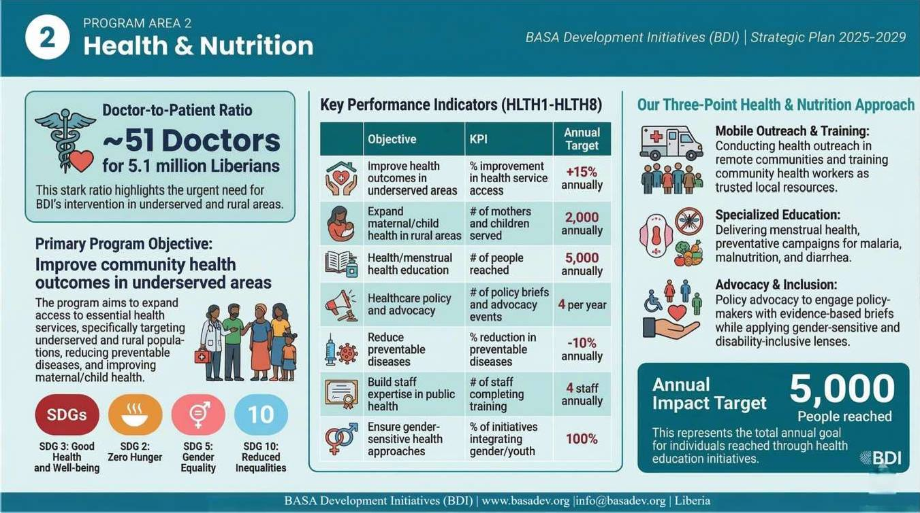
PROGRAM AREA 2: Health and Nutrition
Health & Nutrition Program Summary
The infographic below presents a structured overview of BDI's Health and Nutrition program, summarizing the critical gaps in Liberia's health landscape that make this work urgent, the program's overarching objective across its three sub-programs
- CHOICE, HEAL-P, and PREVENT - and the specific indicators, annual targets, and delivery approaches through which BDI will expand health access, strengthen policy, and reduce preventable illness in underserved and rural communities.

Slide 16
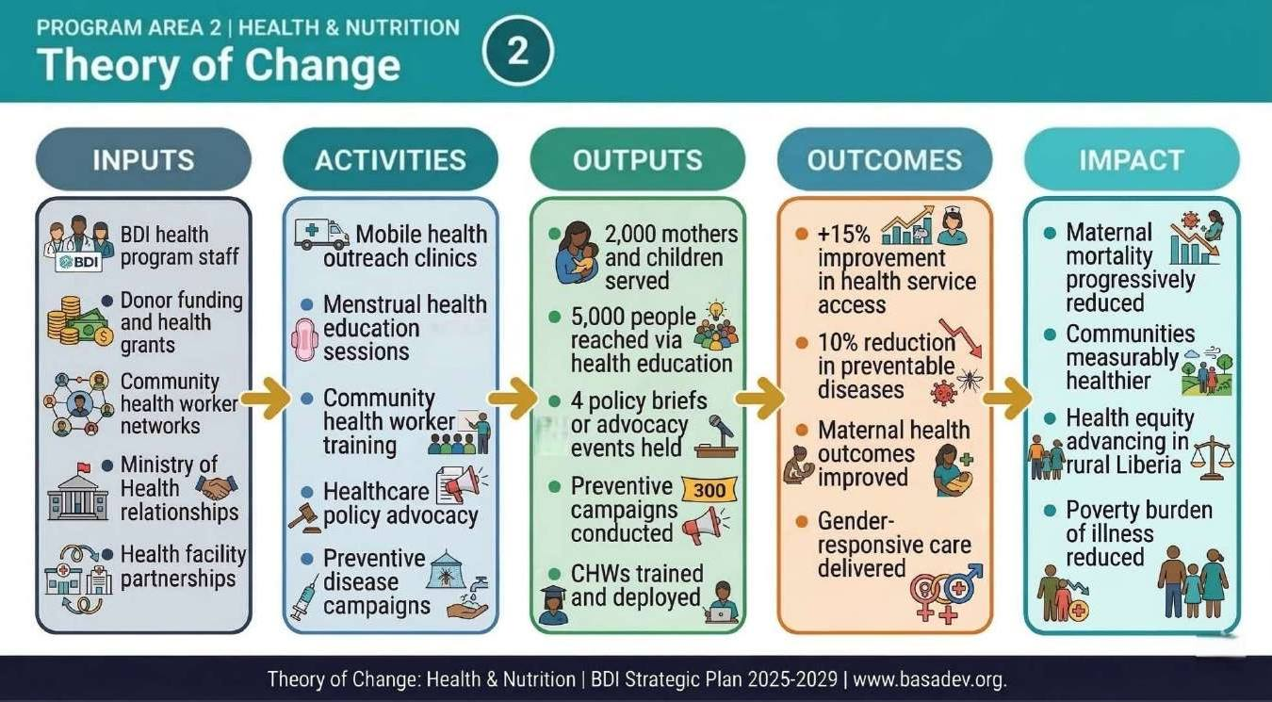
BASA Development Initiatives (BDI) | Strategic Plan 2025-2029
Health & Nutrition Program Theory of Change
The diagram below traces the logical flow of BDI's Health and Nutrition program from inputs and activities to long-term impact, showing how mobile outreach, community health worker training, menstrual health education, and policy advocacy combine to produce measurable improvements in health service access, reductions in preventable disease, and a progressively healthier population in which illness is no longer a primary driver of poverty.
Page | 16

Slide 17
Background and Rationale
Liberia's health system remains fragile. With fewer than 5,000 health workers serving a population of over 5 million, and maternal mortality among the highest in Africa, the burden of preventable illness and death falls disproportionately on the poor, rural women, and children. High out-of-pocket health costs push vulnerable families deeper into poverty. Menstrual health remains a taboo subject in many communities, leading girls to miss school and women to face avoidable health consequences. BDI's health program addresses these gaps through a combination of direct service expansion, health education, preventive campaigns, and policy advocacy. DI runs three sub-programs within its health portfolio: CHOICE (maternal and child health), HEAL-P (health policy and advocacy), and PREVENT (preventive health campaigns).
Program Objective
Overall Objective (HLTH1)
Improve community health outcomes in underserved and rural areas, targeting a 15% improvement in access to health services by end of the plan period.
Key Program Objectives and Indicators
Code | Type | Objective | KPI | Annual Target | SDG Alignment
HLTH1 | Overall | Improve community health outcomes in underserved and rural areas | % improvement in access to health services | +15% by end of year | SDG 3
HLTH2 (CHOICE) | Specific | Expand maternal and child health services in rural communities | # of mothers/children served | 2,000 annually | SDG 3, SDG 2
HLTH3 (CHOICE) | Specific | Provide health education and outreach including menstrual health education | # of people reached | 5,000 annually | SDG 3, SDG 4, SDG 5
HLTH4 (HEAL-P) | Specific | Strengthen healthcare policy and advocacy for equitable health access | # of policy briefs/advocacy events conducted | 4 per year | SDG 3, SDG 17
HLTH5 (PREVENT) | Specific | Reduce incidence of preventable diseases through awareness campaigns | % reduction in preventable diseases | -10% annually | SDG 3, SDG 6
HLTH6 | Capacity Building | Strengthen staff expertise in public health, policy advocacy, and data management | # of staff completing training | 4 staff annually | SDG 4
HLTH7 | Fundraising | Mobilize resources for health interventions through proposals and partnerships | # of proposals submitted | 5 proposals annually | SDG 17
HLTH7.1 | Fundraising | Submit concept notes for maternal, child, and preventive health projects | # of concept notes submitted | 10 annually | SDG 17

Slide 18
BASA Development Initiatives (BDI) | Strategic Plan 2025-2029
Code | Type | Objective | KPI | Annual Target | SDG Alignment
HLTH8 | Cross-cutting | Ensure gender-sensitive and youth-friendly approaches in all health programming | % of health initiatives integrating gender/youth components | 100% of initiatives | SDG 5, SDG 10, SDG 3
Our Approach
Conduct mobile health outreach clinics in remote and underserved communities.
Deliver structured menstrual health and hygiene education for adolescent girls and their communities.
Train community health workers and volunteers as trusted local health resources.
Engage policymakers with evidence-based policy briefs calling for increased investment in primary healthcare.
Run preventive health campaigns on malaria, diarrhea, malnutrition, and other preventable conditions.
Ensure all health programming applies a gender-sensitive and disability-inclusive lens.
Page | 18

Slide 19
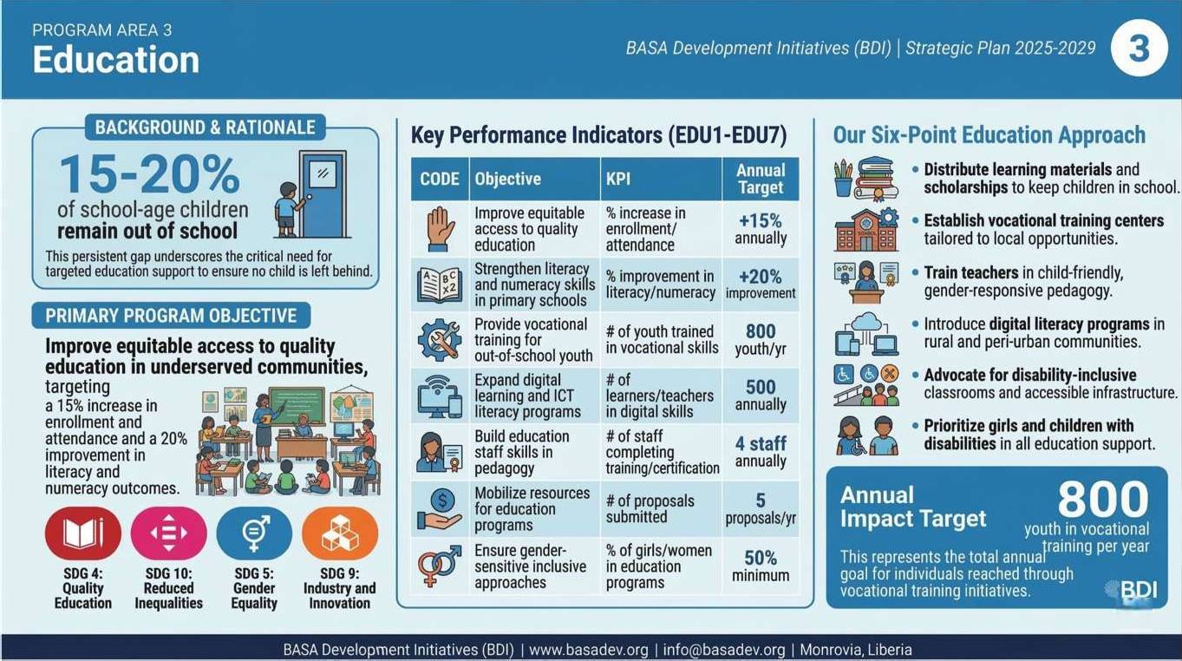
PROGRAM AREA 3: Education
Education Program Summary
This infographic summarizes our Education program, presenting the scale of Liberia's education deficit as the foundation for the program's design, the overarching objective of improving equitable access to quality learning, and the indicators, targets, and approaches through which BDI will increase enrollment, strengthen literacy and numeracy outcomes, expand vocational training for out-of-school youth, and build digital literacy in communities where it is currently almost absent.

Slide 20
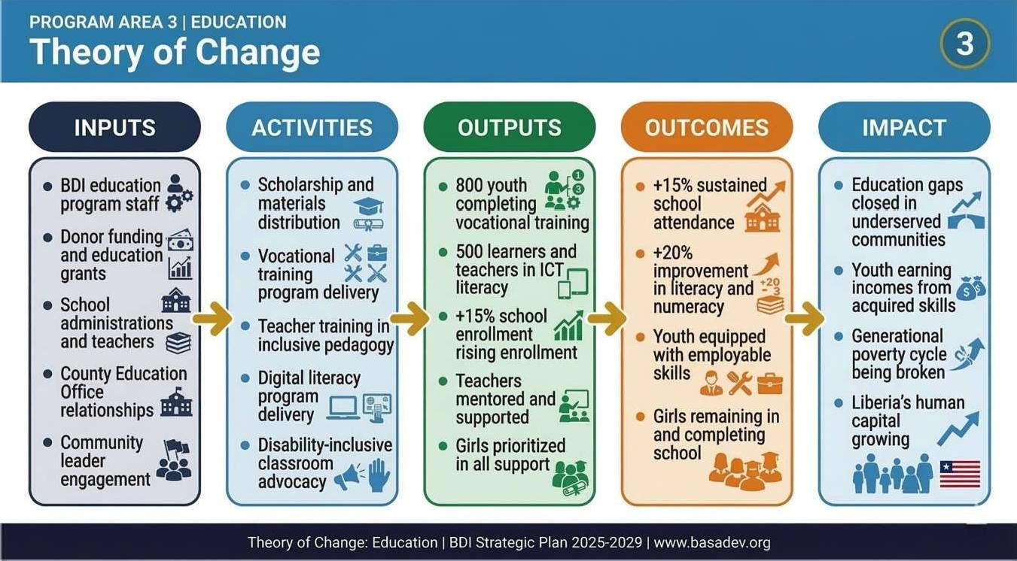
BASA Development Initiatives (BDI) | Strategic Plan 2025-2029
Education Program Theory of Change
This diagram below illustrates the Theory of Change for BDI's Education program, tracing the journey from scholarships, teacher training, vocational programs, and digital literacy initiatives through to the sustained outcomes of higher attendance, improved learning results, and youth equipped with marketable skills, ultimately contributing to the long-term impact of closing Liberia's education gap and breaking the cycle of intergenerational poverty.
Page | 20

Slide 21
Background and Rationale
Education is both a right and a catalyst. In Liberia, where 15-20% of school-age children remain out of school and mean years of schooling fall below five, the education deficit translates directly into economic exclusion, vulnerability to exploitation, and intergenerational poverty. Girls and children with disabilities face the highest barriers. Teachers are underprepared, schools are under-resourced, and vocational pathways for out-of-school youth are severely limited. Digital literacy, increasingly essential for economic participation, is virtually absent in rural communities.
BDI's education program addresses access, quality, and relevance - ensuring that more children are in school, learning effectively, and emerging with skills the labor market values.
Program Objective
Overall Objective (EDU1)
Improve equitable access to quality education in underserved communities, targeting a 15% increase in enrollment and attendance annually.
Key Program Objectives and Indicators
Code | Type | Objective | KPI | Annual Target | SDG Alignment
EDU1 | Overall | Improve equitable access to quality education in underserved communities | % increase in enrollment/attendance | +15% annually | SDG 4, SDG 10
EDU2 | Specific | Strengthen literacy and numeracy skills among primary school students | % improvement in literacy/numeracy outcomes | +20% improvement | SDG 4
EDU3 | Specific | Provide vocational and technical training for out-of-school youth | # of youth trained in vocational/technical skills | 800 youth annually | SDG 4, SDG 8
EDU4 | Specific | Expand digital learning opportunities and ICT literacy for students and teachers | # of learners/teachers trained in digital skills | 500 annually | SDG 4, SDG 9
EDU5 | Capacity Building | Strengthen education staff skills in pedagogy, curriculum design, and digital tools | # of staff completing training/certification | 4 staff annually | SDG 4
EDU6 | Fundraising | Mobilize resources for education interventions through proposals and partnerships | # of proposals submitted | 5 proposals annually | SDG 17
EDU6.1 | Fundraising | Submit concept notes for education, vocational, and digital learning projects | # of concept notes submitted | 10 annually | SDG 17
EDU7 | Cross-cutting | Ensure gender-sensitive and inclusive approaches in education programs | % of girls/women benefiting from education programs | 50% minimum | SDG 4, SDG 5, SDG 10

Slide 22
BASA Development Initiatives (BDI) | Strategic Plan 2025-2029
Our Approach
Distribute learning materials and scholarships to keep children - especially girls - in school.
Establish and support vocational training centers tailored to local economic opportunities.
Train teachers in child-friendly, gender-responsive pedagogy.
Introduce digital literacy programs in communities with or without consistent internet access.
Advocate for disability-inclusive classrooms and accessible school infrastructure.
Page | 22

Slide 23
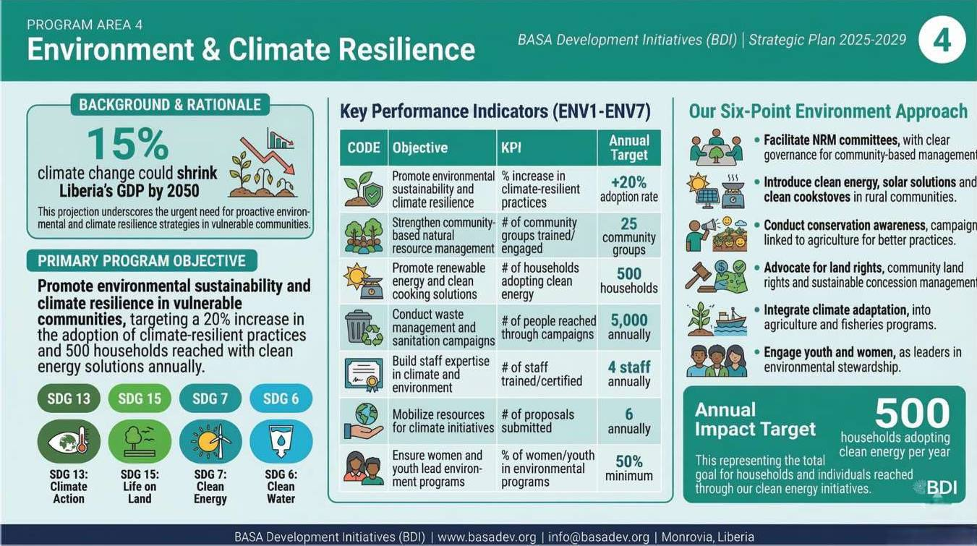
PROGRAM AREA 4: Environment and Climate Resilience
Environmental Program Summary
This image outlines BDI's Environment program, anchored in the reality that climate change could shrink Liberia's economy by 15% by 2050 if left unaddressed, and presenting the program's objective, key indicators, annual targets, and integrated approaches through which BDI will strengthen community-based natural resource management, expand access to clean energy solutions, and build the adaptive capacity of the communities most exposed to environmental shocks.

Slide 24
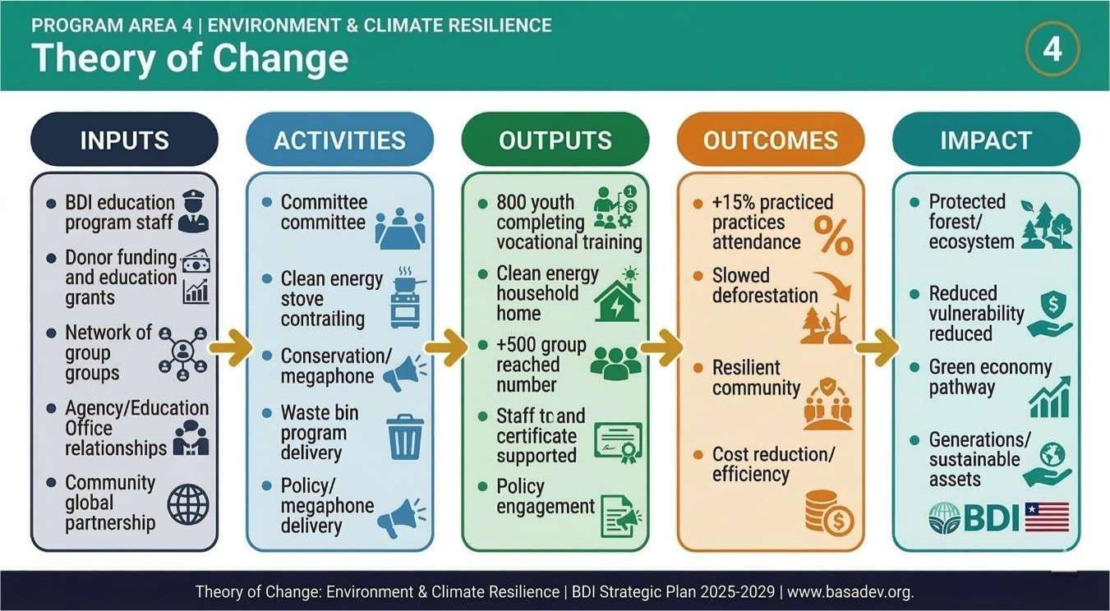
BASA Development Initiatives (BDI) | Strategic Plan 2025-2029
Environmental Program Theory of Change
The diagram below presents the Theory of Change for BDI's Environment program, demonstrating how community NRM committees, clean energy distribution, conservation campaigns, and climate policy advocacy translate into measurable increases in climate-resilient practices, slower rates of deforestation, and reduced household vulnerability, ultimately contributing to the protection of Liberia's globally significant natural assets and the long-term sustainability of the communities that depend on them.
Page | 24

Slide 25
Background and Rationale
Liberia's forests are among the most ecologically significant in West Africa, containing around 40% of the Upper Guinea Forest region's remaining tree cover. Yet deforestation, unsustainable land use, and weak environmental governance place this natural wealth - and the communities who depend on it - at severe risk. Climate change is not a distant threat for Liberians; it is a present reality. It disrupts growing seasons, intensifies flooding, and shrinks the livelihoods of farmers and fisher communities who have no safety nets.
BDI's environment program focuses on community-based conservation, climate adaptation, clean energy access, and waste management education - treating environmental sustainability not as a separate sector, but as the foundation on which all other development rests.
Program Objective
Overall Objective (ENV1)
Promote environmental sustainability and climate resilience in vulnerable communities, targeting a 20% increase in the adoption of climate-resilient practices among target groups.
Key Program Objectives and Indicators
Code | Type | Objective | KPI | Annual Target | SDG Alignment
ENV1 | Overall | Promote environmental sustainability and climate resilience in vulnerable communities | % increase in adoption of climate-resilient practices | +20% adoption rate | SDG 13, SDG 15
ENV2 | Specific | Strengthen community-based natural resource management (NRM) | # of community groups trained/engaged | 25 community groups | SDG 15
ENV3 | Specific | Promote renewable energy and clean cooking solutions in rural households | # of households adopting renewable energy/clean cooking | 500 households | SDG 7, SDG 13
ENV4 | Specific | Conduct public education campaigns on waste management and sanitation | # of people reached through campaigns | 5,000 annually | SDG 6, SDG 12
ENV5 | Capacity Building | Strengthen staff expertise in climate policy, environmental management, and renewable energy | # of staff trained/certified | 4 staff annually | SDG 4
ENV6 | Fundraising | Mobilize resources for environment and climate initiatives | # of proposals submitted | 6 annually | SDG 17
ENV6.1 | Fundraising | Submit concept notes for climate resilience and renewable energy projects | # of concept notes submitted | 8 annually | SDG 17

Slide 26
BASA Development Initiatives (BDI) | Strategic Plan 2025-2029
Code | Type | Objective | KPI | Annual Target | SDG Alignment
ENV7 | Cross-cutting | Ensure women and youth play leading roles in environmental and climate resilience initiatives | % of women/youth participants in environmental programs | 50% minimum | SDG 5, SDG 13, SDG 15
Our Approach
Facilitate community-based natural resource management committees with clear governance structures.
Introduce solar-powered solutions and clean cookstoves in rural and peri-urban communities.
Conduct environmental conservation awareness campaigns linked to agricultural practices.
Advocate for community land rights and sustainable concession management.
Integrate climate adaptation strategies into all BDI agricultural and fisheries programming.
Page | 26

Slide 27
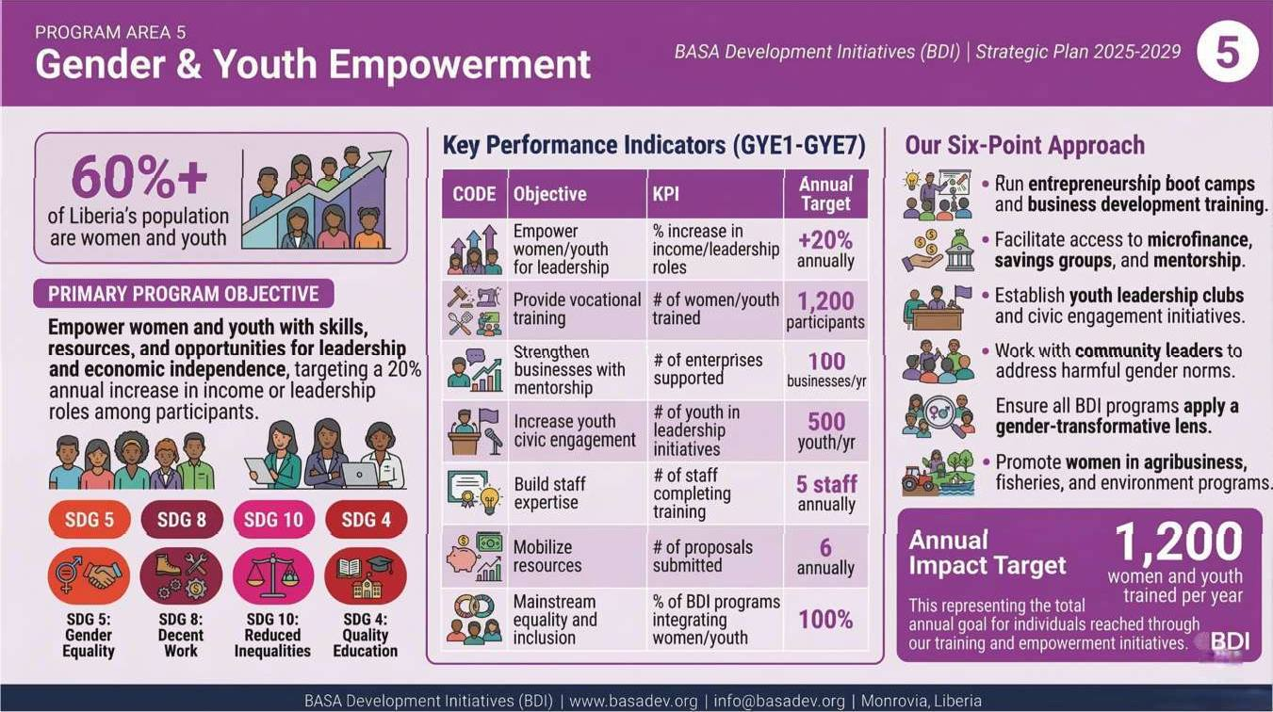
PROGRAM AREA 5: Gender and Youth Empowerment
Gender and Youth Program Summary
The infographic below presents BDI's Gender and Youth program, which recognizes that women and youth represent over 60% of Liberia's population yet continue to face structural barriers to economic participation, leadership, and dignified livelihoods, and sets out the program's objective, indicators, annual targets, and six delivery approaches through which BDI will expand entrepreneurship, strengthen women- and youth-led enterprises, and deepen civic engagement.

Slide 28
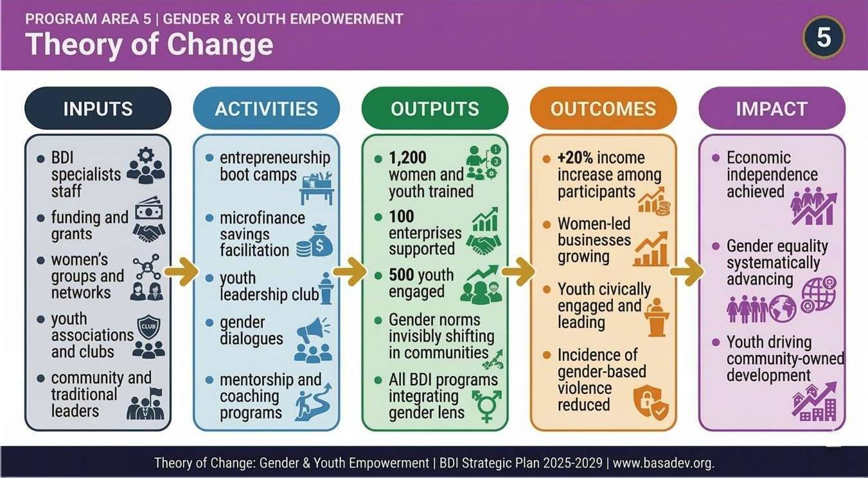
BASA Development Initiatives (BDI) | Strategic Plan 2025-2029
Gender and Youth Program Theory of Change
The diagram below maps the Theory of Change for BDI's Gender and Youth Empowerment program, showing how entrepreneurship training, microfinance facilitation, leadership clubs, and community dialogues on gender norms produce measurable increases in income and leadership participation, which in turn contribute to the long-term impact of economic independence for women and youth, advancing gender equality, and a Liberia in which poverty is reduced structurally rather than symptomatically
Page | 28

Slide 29
Background and Rationale
Women and youth are not simply beneficiaries in BDI's work - they are the primary drivers of the development we seek to achieve. Yet structural inequalities continue to lock them out of economic opportunity, political participation, and dignified livelihoods. Youth unemployment is high, exacerbated by insufficient vocational pathways and a challenging investment climate. Women face gender-based violence at alarming rates, bear the brunt of unpaid care work, and encounter systematic bias in accessing finance, land, and leadership roles.
BDI's gender and youth empowerment program is a dedicated, cross-cutting initiative that supports women-led enterprises, youth civic engagement, financial literacy, and vocational skills development - while simultaneously working to shift the social norms that perpetuate exclusion.
Program Objective
Overall Objective (GYE1)
Empower women and youth with skills, resources, and opportunities for leadership and economic independence, targeting a 20% annual increase in income or leadership roles among participants.
Key Program Objectives and Indicators
Code | Type | Objective | KPI | Annual Target | SDG Alignment
GYE1 | Overall | Empower women and youth with skills, resources, and opportunities for leadership and economic independence | % increase in income/leadership roles among participants | +20% annually | SDG 5, SDG 8
GYE2 | Specific | Provide vocational, entrepreneurship, and financial literacy training for women and youth | # of women and youth trained | 1,200 participants | SDG 4, SDG 8
GYE3 | Specific | Strengthen women- and youth-led businesses through access to finance and mentorship | # of enterprises supported | 100 businesses annually | SDG 8, SDG 9
GYE4 | Specific | Increase youth civic engagement and leadership opportunities in communities | # of youth engaged in leadership initiatives | 500 youth annually | SDG 10, SDG 16
GYE5 | Capacity Building | Strengthen staff expertise in gender-sensitive programming, youth development, and advocacy | # of staff completing training | 5 staff annually | SDG 4
GYE6 | Fundraising | Mobilize resources for women and youth initiatives through proposals and partnerships | # of proposals submitted | 6 annually | SDG 17
GYE6.1 | Fundraising | Submit concept notes for gender and youth projects | # of concept notes submitted | 10 annually | SDG 17

Slide 30
BASA Development Initiatives (BDI) | Strategic Plan 2025-2029
Code | Type | Objective | KPI | Annual Target | SDG Alignment
GYE7 | Cross-cutting | Mainstream gender equality and youth inclusion across all BDI program areas | % of BDI programs integrating women and youth empowerment | 100% | SDG 5, SDG 10
Our Approach
Run structured entrepreneurship boot camps and business development training for women and youth.
Facilitate access to microfinance, savings groups, and mentorship networks.
Establish youth leadership clubs and civic engagement initiatives in target communities.
Work with traditional and community leaders to address harmful gender norms.
Ensure all BDI programs apply a gender-transformative and youth-inclusive lens.
Page | 30

Slide 31
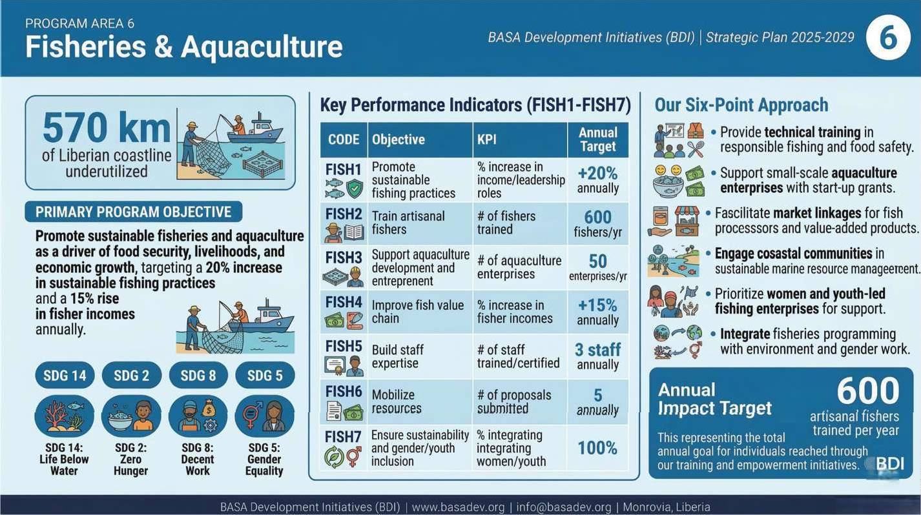
PROGRAM AREA 6: Fisheries and Aquaculture
Fisheries and Aquaculture Program Summary
The image below summarizes BDI's Fisheries program, presenting the untapped potential of Liberia's 570-kilometer coastline alongside the constraints holding back artisanal fishing communities, and outlining the program's overarching objective, measurable indicators and targets, and the practical approaches through which BDI will train fishers, support aquaculture enterprises, improve market access, and ensure women and youth are central actors in the growth of Liberia's blue economy.

Slide 32
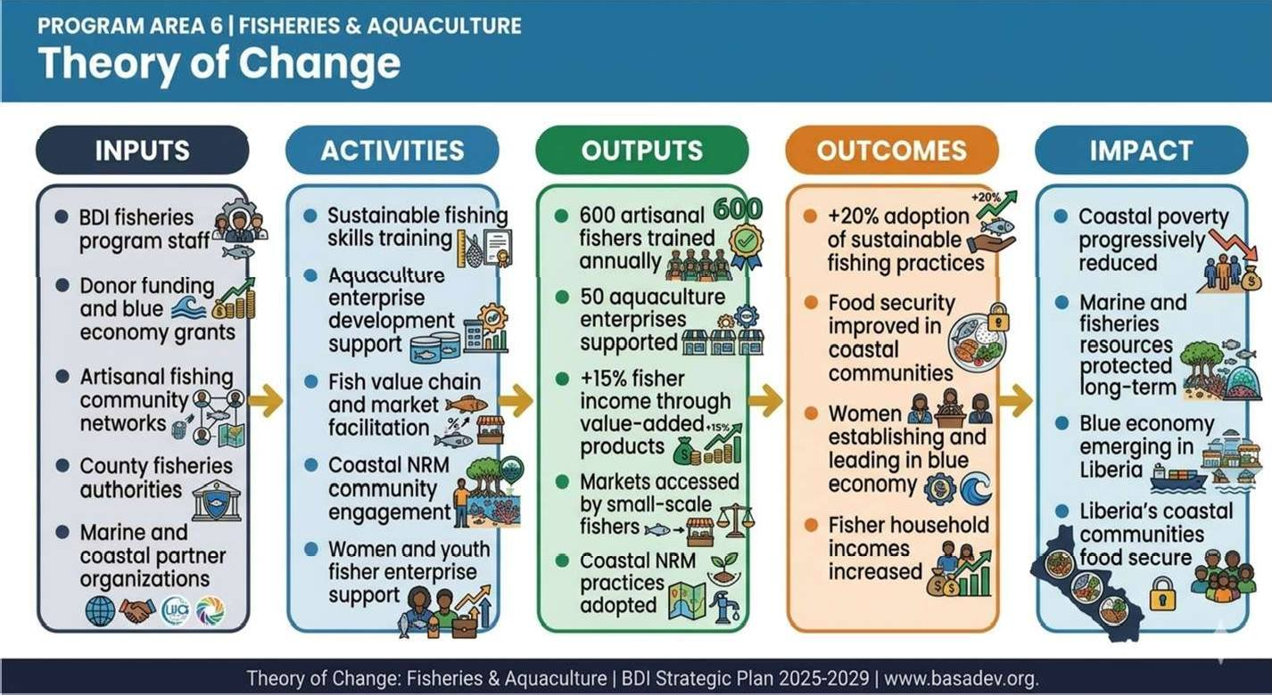
BASA Development Initiatives (BDI) | Strategic Plan 2025-2029
Fisheries and Aquaculture Program Theory of Change
The diagram below illustrates the Theory of Change for BDI's Fisheries and Aquaculture program, tracing the path from staff expertise, donor resources, and coastal community networks through fishing skills training, enterprise support, and value chain facilitation to the outcomes of higher fisher incomes and improved food security, and ultimately to the long-term impact of a sustainably managed, economically productive coastal sector in which Liberia's marine resources are protected for generations to come.
Page | 32

Slide 33
Background and Rationale
Liberia's coastline and inland waterways represent an underutilized economic and food security asset. Artisanal fishing is a primary livelihood for coastal communities, and fish is the country's most widely consumed source of animal protein. Yet the sector is constrained by overfishing, inadequate post-harvest infrastructure, poor market access, and limited technical capacity. Women play a central role in fish processing and trade but are often excluded from formal support systems and market opportunities.
BDI's fisheries and aquaculture program aims to sustainably expand the sector's contribution to food security, income generation, and economic diversification - with a particular focus on women and youth as entrepreneurs and innovators within the blue economy.
Program Objective
Overall Objective (FISH1)
Promote sustainable fisheries and aquaculture as a driver of food security, livelihoods, and economic growth, targeting a 20% increase in sustainable fishing practices among target communities annually.
Key Program Objectives and Indicators
Code | Type | Objective | KPI | Annual Target | SDG Alignment
FISH1 | Overall | Promote sustainable fisheries and aquaculture as a driver of food security, livelihoods, and economic growth | % increase in sustainable fishing practices | +20% annually | SDG 2, SDG 14, SDG 8
FISH2 | Specific | Strengthen capacity of artisanal fishers through training on sustainable fishing methods and safety | # of fishers trained | 600 fishers annually | SDG 14, SDG 8
FISH3 | Specific | Support aquaculture development for women and youth entrepreneurs | # of aquaculture enterprises established/supported | 50 enterprises annually | SDG 5, SDG 8, SDG 14
FISH4 | Specific | Improve fish value chain and market access for small-scale fishers | % increase in fisher incomes through value-added products and markets | +15% annually | SDG 8, SDG 9
FISH5 | Capacity Building | Strengthen staff expertise in fisheries management, aquaculture, and value chain development | # of staff trained/certified | 3 staff annually | SDG 4
FISH6 | Fundraising | Mobilize resources for fisheries and aquaculture programs through proposals and partnerships | # of proposals submitted | 5 annually | SDG 17
FISH6.1 | Fundraising | Submit concept notes for innovative fisheries and aquaculture projects | # of concept notes submitted | 8 annually | SDG 17
FISH7 | Cross-cutting | Ensure environmental sustainability and | % of fisheries projects integrating | 100% | SDG 5, SDG 13, SDG 14

Slide 34
BASA Development Initiatives (BDI) | Strategic Plan 2025-2029
Code | Type | Objective | KPI | Annual Target | SDG Alignment
 |  | gender/youth inclusion in fisheries programs | sustainability and gender/youth
Our Approach
Provide technical training in responsible fishing methods, fish processing, and food safety.
Support the development of small-scale aquaculture enterprises with start-up grants and mentorship.
Facilitate market linkages for fish processors, focusing on value-added products.
Engage coastal communities in sustainable marine resource management practices.
Ensure women and youth-led fishing enterprises receive priority access to training and resources.
Page | 34

Slide 35
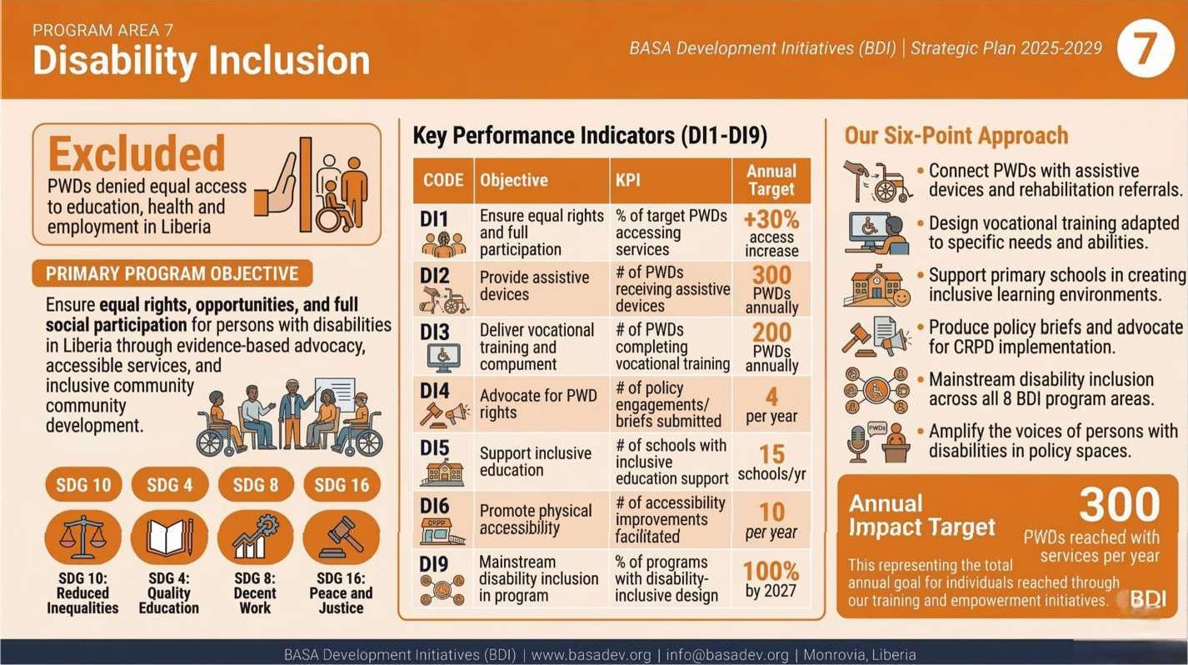
PROGRAM AREA 7: Disability Inclusion
Disability Inclusion Program Summary
This image summarizes BDI's Disability Inclusion program, which responds to the reality that persons with disabilities in Liberia are systematically denied equal access to education, employment, healthcare, and public spaces, and details the program's rights-based objective, the indicators and targets that will measure progress toward full inclusion, and the four delivery pillars - direct services, inclusive education, vocational training, and policy advocacy - through which BDI will work to dismantle these barriers.

Slide 36
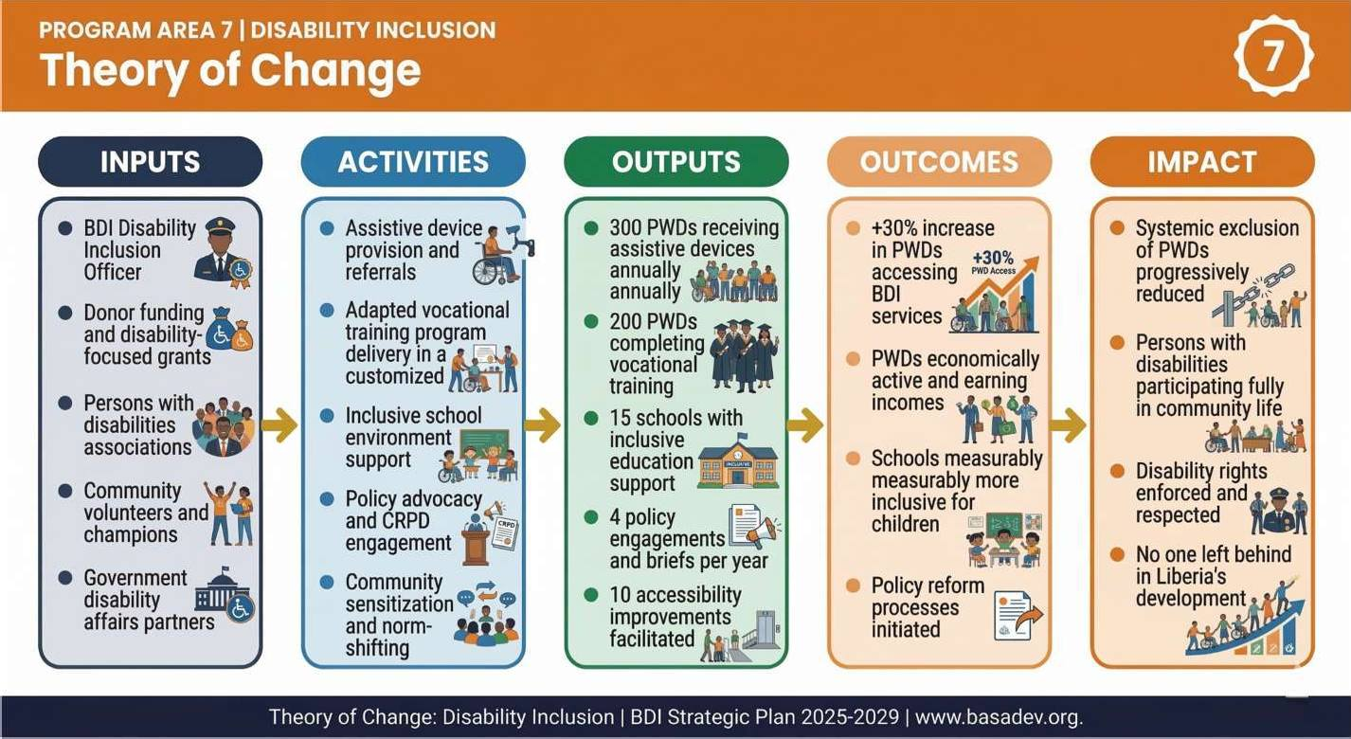
BASA Development Initiatives (BDI) | Strategic Plan 2025-2029
Disability Inclusion Program Theory of Change
The diagram below maps the Theory of Change for BDI's Disability Inclusion program, illustrating how assistive device provision, adapted vocational training, inclusive school support, CRPD advocacy, and community sensitization combine to produce measurable gains in service access and economic participation for persons with disabilities, contributing to the long-term impact of a Liberia where systemic exclusion is replaced by full and dignified participation in community and civic life, and where no one is left behind.
Page | 36

Slide 37
Background and Rationale
Persons with disabilities (PWDs) in Liberia face one of the most pervasive and yet least addressed forms of exclusion in the country's development landscape. According to the
U.S. Department of State, persons with disabilities cannot access education, health services, public buildings, or transportation on an equal basis with others, and routinely face
discrimination in employment, housing, and healthcare. The exact number of PWDs in Liberia is uncertain due to underreporting, but estimates consistently point to a significant and underserved population.
Years of civil war have left many Liberians with physical and psychological disabilities. Poverty deepens the exclusion of PWDs, who often cannot afford assistive devices, cannot access schools that lack inclusive infrastructure, and cannot find employers willing to hire them. Social stigma compounds the structural barriers, isolating persons with disabilities from community life, religious spaces, and civic participation.
Liberia has signed the United Nations Convention on the Rights of Persons with Disabilities (CRPD) and enacted domestic legislation to protect the rights of PWDs. However, implementation remains slow, underfunded, and largely unmonitored. Civil society organizations have a critical role to play in bridging this gap - documenting violations, advocating for enforcement, providing direct services, and changing the social norms that treat disability as a source of shame rather than a call to action.
BDI's commitment to 'leaving no one behind' demands that we explicitly and systematically include persons with disabilities in our programming. This is not a peripheral concern. It is a core expression of our values, our theory of change, and our vision of a Liberia without poverty.
Program Objective
Overall Objective (DI1)
Ensure equal rights, opportunities, and full social participation for persons with disabilities in Liberia through evidence-based advocacy, accessible services, and inclusive community development.
Key Program Objectives and Indicators
Code | Type | Objective | KPI | Annual Target | SDG Alignment
DI1 | Overall | Ensure equal rights, opportunities, and full participation for persons with disabilities | % of target PWDs accessing at least one BDI service or referral | +30% access increase annually | SDG 10, SDG 4, SDG 8
DI2 | Specific | Provide assistive devices and rehabilitation support to PWDs in target communities | # of PWDs receiving assistive devices/rehabilitation support | 300 PWDs annually | SDG 3, SDG 10
DI3 | Specific | Deliver vocational training and employment support tailored to the needs of PWDs | # of PWDs completing vocational training | 200 PWDs annually | SDG 8, SDG 10

Slide 38
BASA Development Initiatives (BDI) | Strategic Plan 2025-2029
Code | Type | Objective | KPI | Annual Target | SDG Alignment
DI4 | Specific | Advocate for the rights of PWDs in national policy, budgeting, and law enforcement | # of policy engagements/briefs submitted on disability rights | 4 per year | SDG 10, SDG 16
DI5 | Specific | Support inclusive education in primary schools serving children with disabilities | # of schools supported with inclusive education infrastructure or training | 15 schools annually | SDG 4, SDG 10
DI6 | Specific | Promote physical accessibility in public spaces, markets, and community facilities | # of accessibility improvements facilitated through advocacy or direct support | 10 per year | SDG 11, SDG 10
DI7 | Capacity Building | Build staff and community volunteer capacity in disability-inclusive programming and rights-based approaches | # of staff/volunteers trained | 5 staff and 30 volunteers annually | SDG 4
DI8 | Fundraising | Mobilize dedicated resources for disability inclusion through proposals, campaigns, and partnerships | # of proposals submitted for disability inclusion programs | 4 annually | SDG 17
DI8.1 | Fundraising | Submit concept notes for disability inclusion and rights advocacy projects | # of concept notes submitted | 6 annually | SDG 17
DI9 | Cross-cutting | Mainstream disability inclusion across all BDI program areas | % of BDI programs incorporating disability-inclusive design and indicators | 100% by 2027 | SDG 10, SDG 5
Our Approach
BDI's disability inclusion program is built on four mutually reinforcing pillars:
Pillar A: Direct Services and Assistive Support
BDI will work with disability-focused partners to connect PWDs with assistive devices such as wheelchairs, crutches, hearing aids, and white canes. We will facilitate rehabilitation referrals and provide community-based support to enable PWDs to participate in economic and social life.
Pillar B: Inclusive Education
BDI will support primary schools in creating inclusive learning environments for children with disabilities. This includes teacher training in inclusive pedagogy, infrastructure

Slide 39
BASA Development Initiatives (BDI) | Strategic Plan 2025-2029
advocacy, and provision of adapted learning materials. We will work to ensure children with disabilities are not only enrolled but genuinely included in school life.
Pillar C: Vocational Training and Economic Inclusion
Many PWDs possess untapped skills and entrepreneurial potential. BDI will design and deliver vocational training programs adapted to the specific needs and abilities of participants, offering pathways into agriculture, small business, digital work, and craft-based enterprise. Where possible, BDI will facilitate linkages with employers committed to inclusive hiring.
Pillar D: Advocacy and Policy Engagement
BDI will engage with national government, the legislature, and disability rights organizations to advocate for full implementation of the CRPD and domestic disability laws. This includes producing policy briefs, participating in national consultations, and amplifying the voices of persons with disabilities themselves in policy spaces.
Cross-Program Integration
Disability inclusion will be mainstreamed across all BDI program areas. This means:
Agriculture programs will include adapted techniques and tools for farmers with physical disabilities.
Health programs will ensure PWDs can access maternal, preventive, and menstrual health services.
Education programs will prioritize children with disabilities in scholarship and materials distribution.
Fisheries programs will identify opportunities for PWDs in fish processing and market trade.
Gender and youth programs will specifically engage young women and girls with disabilities.
By 2027, 100% of BDI programs will incorporate disability-inclusive design principles and dedicated indicators.

Slide 40
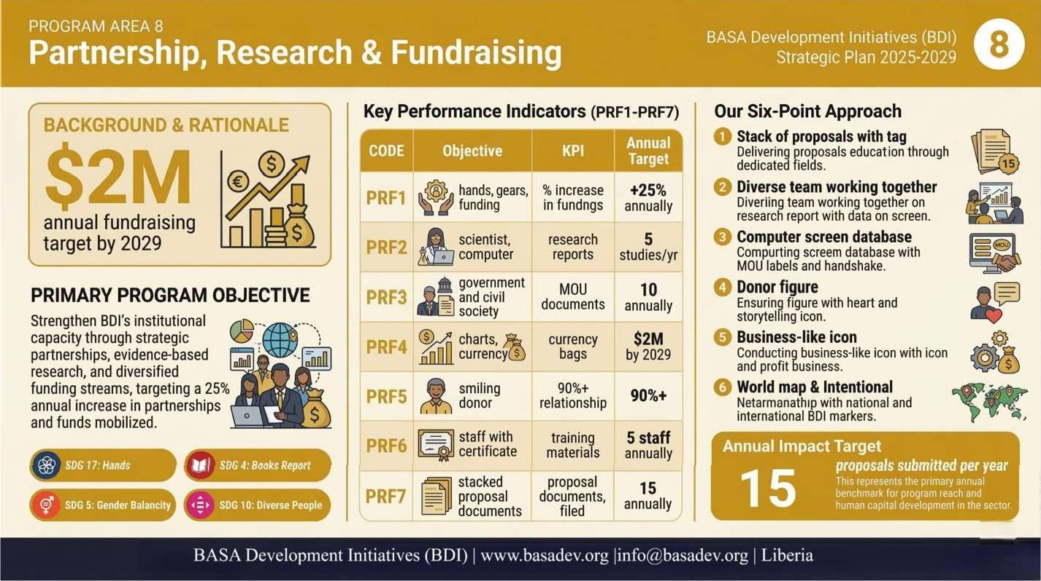
PROGRAM AREA 8: Partnership, Research, and Fundraising
Partnership, Research & Fundraising Program Summary
The image below presents BDI's Partnership, Research and Fundraising program, which functions as the institutional engine that makes all other program areas possible, and summarizes the program's overarching objective of achieving a 25% annual increase in partnerships and funds mobilized, the key indicators tracking BDI's growth toward a $2 million annual fundraising target by 2029, and the six strategic approaches by which BDI will build a diverse, resilient, and evidence-driven funding and partnership base.

Slide 41
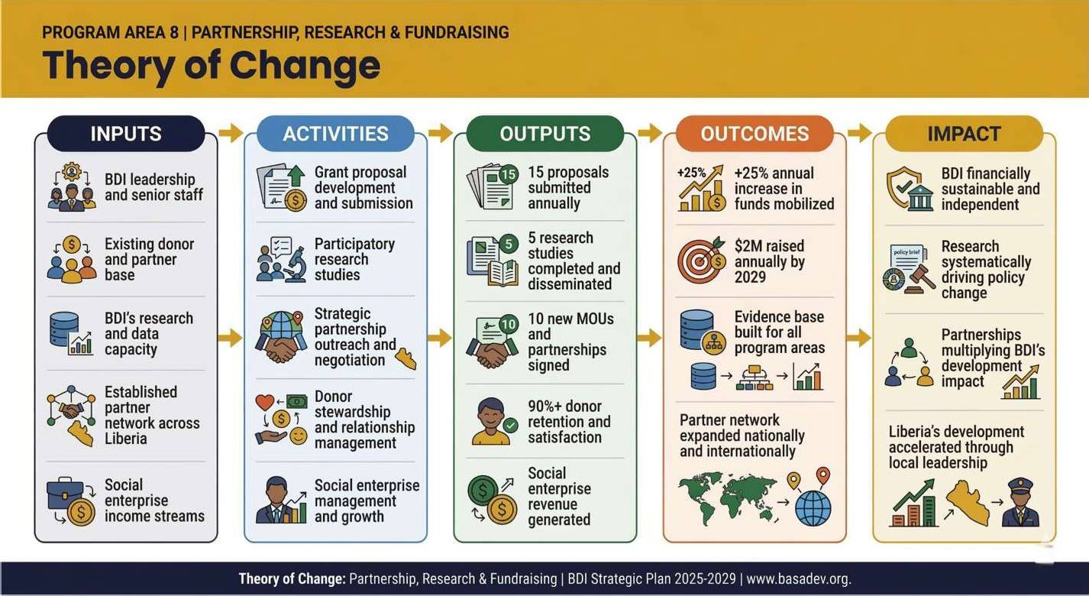
BASA Development Initiatives (BDI) | Strategic Plan 2025-2029
Partnership, Research & Fundraising Program Theory of Change
The diagram below presents the Theory of Change for BDI's Partnership, Research and Fundraising program, showing how proposal development, participatory research, strategic partnership outreach, and donor stewardship produce a growing volume of secured funding, formalized partnerships, and disseminated evidence, ultimately contributing to the long-term impact of a financially sustainable, research-driven BDI whose partnerships multiply its development reach far beyond what any single organization could achieve alone.
Page | 41

Slide 42
Background and Rationale
No organization achieves lasting development impact in isolation. BDI's ability to serve communities at scale depends on the strength of our partnerships, the quality of our evidence, and the diversity of our funding. This program area provides the institutional infrastructure that makes all other programs possible.
BDI occupies a unique position in Liberia's civil society landscape: we are local, credible, corruption-resistant, and mission-driven. These qualities make us a natural partner for international NGOs, foundations, donors, and government agencies seeking to maximize the impact of their investment in Liberia.
Program Objective
Overall Objective (PRF1)
Strengthen BDI's institutional capacity through strategic partnerships, evidence-based research, and diversified funding streams, targeting a 25% annual increase in partnerships and funds mobilized.
Key Program Objectives and Indicators
Code | Type | Objective | KPI | Annual Target | SDG Alignment
PRF1 | Overall | Strengthen institutional capacity through strategic partnerships, research, and diversified funding | % increase in partnerships and funds mobilized | +25% annually | SDG 17
PRF2 | Specific | Conduct high-quality research to inform program design, advocacy, and policy engagement | # of research studies completed and disseminated | 5 studies annually | SDG 4, SDG 17
PRF3 | Specific | Build strategic partnerships with government, private sector, and civil society | # of new partnerships formalized (MOUs, agreements) | 10 annually | SDG 17
PRF4 | Specific | Develop and implement a robust fundraising strategy to support all BDI program areas | $ value of funds raised annually | $2M annually by 2029 | SDG 17
PRF5 | Specific | Strengthen donor engagement and relationship management | % of donor retention/satisfaction | 90%+ | SDG 17
PRF6 | Capacity Building | Enhance staff capacity in proposal writing, research methods, and partnership management | # of staff trained | 5 staff annually | SDG 4
PRF7 | Fundraising | Submit proposals and concept notes across all BDI program areas | # of proposals submitted | 15 annually | SDG 17
PRF7.1 | Fundraising | Submit concept notes for innovative multi-sector projects | # of concept notes submitted | 20 annually | SDG 17

Slide 43
BASA Development Initiatives (BDI) | Strategic Plan 2025-2029
Code | Type | Objective | KPI | Annual Target | SDG Alignment
PRF8 | Cross-cutting | Ensure gender and youth priorities are embedded in all partnerships, research, and fundraising efforts | % of proposals and partnerships integrating gender and youth | 100% | SDG 5, SDG 10, SDG 17
Our Approach
Maintain an active proposal pipeline with a minimum of 15 funding proposals submitted annually across all program areas.
Conduct participatory research studies that generate actionable evidence for program improvement and policy advocacy.
Build and maintain a partnership database, tracking MOUs, collaborative initiatives, and joint reporting.
Develop and implement a donor stewardship framework that includes regular reporting, site visits, and impact storytelling.
Explore and establish social enterprise ventures that generate income to complement grant funding.
Expand BDI's presence on national and international platforms to raise profile and attract new partners.
Cross-Cutting Themes
Across all eight program areas, BDI applies four cross-cutting themes that shape program design, implementation, and measurement:
Theme | Application Across Programs
Gender Equality and Social Inclusion | All BDI programs target a minimum of 50% women and youth participation. Disability inclusion is explicitly mainstreamed across all program areas by 2027. Gender-based violence prevention is integrated into health, education, and community engagement work.
Climate Resilience | Agriculture, fisheries, and environment programs explicitly adopt climate-smart approaches. Community vulnerability assessments inform program design. BDI advocates for climate adaptation in national policy.
Localization and Community Ownership | All programs begin with scoping assessments and community consultations. Community members are involved in program design, monitoring, and feedback. BDI invests in local leadership development as a long-term sustainability strategy.
Data, Evidence, and Learning | BDI maintains robust monitoring and evaluation systems across all programs. Research findings are used to adapt programming and inform policy advocacy. Annual reviews ensure strategic relevance and accountability.

Slide 44
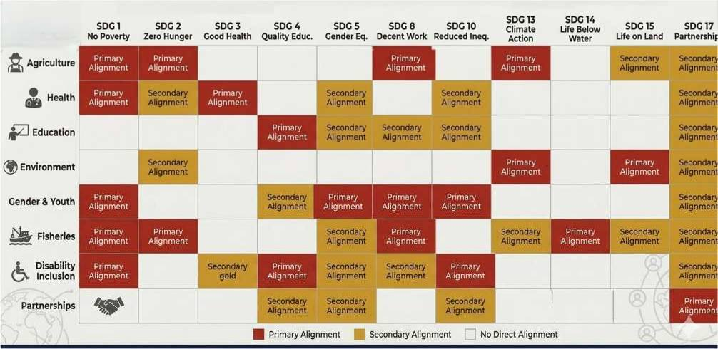
BASA Development Initiatives (BDI) | Strategic Plan 2025-2029
BDI’s Programs Alignment with SDGs
Resource Mobilization and Financial Sustainability
BDI has historically operated on an average annual budget of US$50,000 to US$60,000 - a figure that, while modest, has enabled significant results. Looking ahead, BDI's ambition is to scale its impact commensurately with Liberia's needs. Our five-year financial trajectory is structured as follows:
Period | Annual Budget Target | Key Milestones
2022-2024 (Baseline) | US$50,000 - $60,000 | Established operations, trained 600+ farmers, formed core partnerships
2025-2026 (Growth Phase) | US$500,000 | Expand to all 8 program areas; secure first multi-year grant; launch social enterprise
2027-2029 (Scale Phase) | US$1.5M - $2.0M | Expand across West Africa; strengthen institutional reserves; achieve donor diversity
Funding Diversification Strategy
To achieve financial sustainability, BDI will pursue the following funding streams:
Institutional grants from international foundations, bilateral donors, and multilateral agencies.
Multi-year program grants from INGOs and consortium partners operating in Liberia.
Individual and corporate philanthropy, including diaspora giving from the Liberian community abroad.

Slide 45
BASA Development Initiatives (BDI) | Strategic Plan 2025-2029
Crowdfunding campaigns for specific programs, particularly disability inclusion and education.
Social enterprise income from research, data analysis, web design, graphic design, and application development services.
A dedicated reserve fund to ensure operational continuity during funding gaps.
Organizational Systems and Capacity
BDI's long-term impact depends not just on the quality of our programs, but on the strength of the organization delivering them. This strategic plan commits BDI to significant investment in its institutional infrastructure across four dimensions:
Governance and Leadership
Strengthen Board effectiveness through regular governance training, performance reviews, and clear fiduciary responsibilities.
Enhance transparency and accountability through regular financial audits, public annual reports, and adherence to donor compliance requirements.
Develop succession and leadership continuity plans to protect institutional knowledge.
Human Resources
Recruit and retain skilled program staff across all thematic areas, including a dedicated Disability Inclusion Officer.
Implement structured onboarding, continuous professional development, and performance management systems.
Build a positive organizational culture grounded in BDI's values, staff wellbeing, and psychological safety.
Systems and Technology
Implement a digital data management system to improve program tracking, reporting, and decision-making.
Develop standardized templates for program design, monitoring, reporting, and communication.
Strengthen BDI's digital presence including website, social media, and donor communications.
Monitoring, Evaluation, Accountability, and Learning (MEAL)
Establish a formal MEAL framework aligned with all program objectives and indicators defined in this plan.
Conduct annual program reviews and mid-term evaluations to assess progress, document lessons, and adjust strategies.
Invest in staff capacity for data collection, analysis, and use - ensuring that evidence drives program improvement.

Slide 46
BASA Development Initiatives (BDI) | Strategic Plan 2025-2029
Publish and disseminate research findings, case studies, and impact reports to contribute to sector knowledge.
Plan Financing
The financing of this strategic plan is the responsibility of BDI's management team and board, led by the CEO. Key financing principles include:
Proactive pursuit of multi-year funding commitments to ensure program continuity and planning stability.
Reduction of over-reliance on any single donor or funding source, with a target of no single source exceeding 35% of annual income by 2027.
Investment in business development capacity - including dedicated proposal writing and fundraising personnel.
Building BDI's reputation as a corruption-free, impact-driven, and professionally managed organization as a core fundraising asset.
Regular financial reporting to the Board and, where required, to donors, with full transparency on fund utilization.
Plan Management and Accountability
The successful implementation of this strategic plan requires clear ownership, regular review, and shared accountability across the organization.
Overall Accountability
The CEO-led BDI Management Team holds ultimate responsibility for plan implementation. The Board of Directors provides governance oversight and holds the Management Team accountable for progress against key goals and indicators.
Annual Planning and Review Cycle
Annual operational plans will be developed at the beginning of each year, translating strategic objectives into quarterly milestones, staff work plans, and budget allocations.
Quarterly management reviews will assess progress against targets, flag emerging challenges, and enable adaptive course-correction.
Annual progress reports will be produced for the Board, donors, and communities, documenting results, lessons learned, and the plan for the year ahead.
A mid-term review will be conducted in 2027 to assess overall strategic direction and make substantive adjustments where needed.
Staff Responsibility
Every BDI staff member will have a clear understanding of this plan and their role within it. Individual performance objectives will be aligned with program-level indicators, and staff will develop personal action plans and timelines for their assigned responsibilities. A

Slide 47
BASA Development Initiatives (BDI) | Strategic Plan 2025-2029
simplified version of this strategic plan will be developed in local language and accessible formats to ensure staff at all levels, including field staff and community volunteers, understand BDI's direction and their place in it.
Community Accountability
BDI is accountable not only to our donors and board, but to the communities we serve. We will maintain regular community feedback mechanisms - including suggestion systems, community review meetings, and grievance procedures - ensuring that our programming remains responsive, respectful, and relevant to the people at its center.
BASA Development Initiatives (BDI) - Strategic Plan 2025-2029
www.basadev.org | info@basadev.org | Monrovia, Liberia

