Slide 1
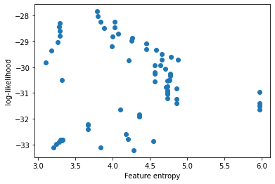
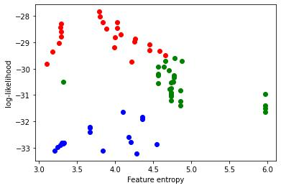
Frey & Osborne (2017) methodology
Non-convex domain
Standardised training
data, X
Train optimal Gaussian Process
Grid search on hyperparameters
Quantify accuracies and interpretabilities
Identify clusters, select local interpretations
PIGEBaQ
Weight by model accuracies
Model interpretation
Bayesian interpretation

