Slide 1
Predicting austen
Using Markov chains to generate content in the style of Jane Austen
Jennifer Green

Slide 2

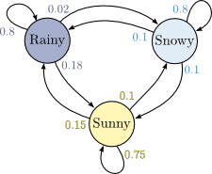
What is a Markov chain?
Markov chains satisfy the Markov property – we can predict the next word in a sequence based only on what the current word is.
Used to predict the weather, guess what word a user is typing, and forms the basis for Google’s PageRank system
Only cares about the current state, not what has come before
If today is sunny, what is the chance that tomorrow is also sunny?

Slide 3
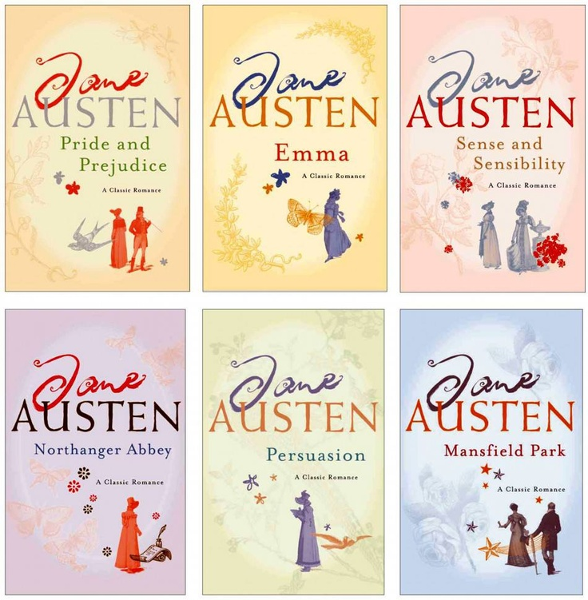
Why Jane Austen?
Austen’s work is popular – many people have read at least some of her works
Her combined novels have a token count of 852,342, large enough to be able to generate good predictions
Her novels are available for free on Project Gutenberg

Slide 4
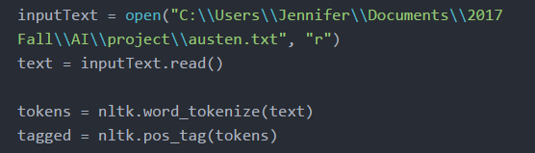
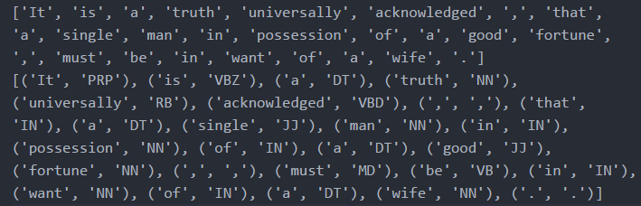
Processing our corpus
First, we manipulate our corpus into a useable form.
We use two files as input: pride.txt, which contains the text of Pride and Prejudice, is used for testing purposes, while austen.txt, which contains the text of all six of Jane Austen’s novels, is used for the final result
Then, we use the Natural Language Toolkit to process our text and tag each word with its part of speech. This helps to reduce ambiguity

Slide 5
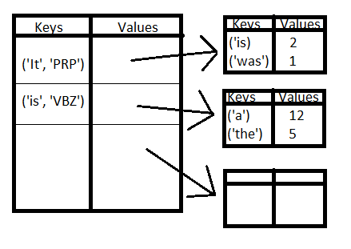
Creating our dictionary system
We use a nested series of dictionaries as our chain. The outer dictionary has each word in our corpus as its key, while the value is a second dictionary which contains each word that follows it as its key, and the number of times that combination has been seen as its value.

Slide 6
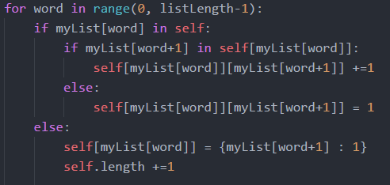
Populating our dictionaries
Populating our dictionaries is simple. For each word in tagged, we check to see if it already exists in our dictionary. If it is, then we check to see if the next word in tagged is already listed in its value dictionary. If it is, we increment the second word’s value, to show that we have seen it again. If it isn’t, we add it and set its value to 1.
If the first word isn’t in our main dictionary, then we add it, and initialize its value as a new dictionary with the next word as its key and one as its value. Our main dictionary will be very large, so we keep track of its length as well.

Slide 7
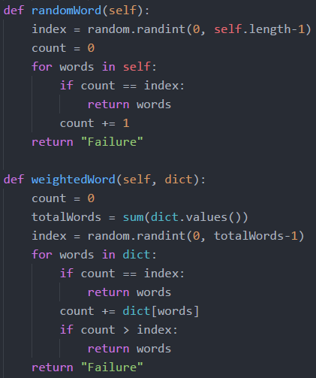

Predicting what comes next
We use two functions to generate our predictions. randomWord returns a random word from the main dictionary. This can be used as a starting point for our chain, or we could use a seed word instead. weightedRandomWord returns a random word from the inner dictionary, weighted by the number of times that word was seen.
How do we know our weighted word function is accurate? We test it with a sample dictionary.

Slide 8
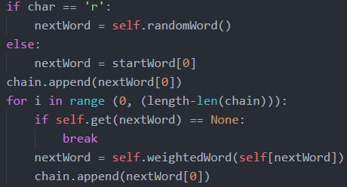
Forming our chain
Now we can form our chain. We can either use a random word to start our chain, or we can seed it ourselves.
Using that initial word, we then select our next word from the ones in our inner dictionary, and append it on to our list. We keep going until we either reach the specified length, or chance upon the end of our input text (which would not be included in our main dictionary.
Once our chain is complete, we clean up the text and print it.

Slide 9
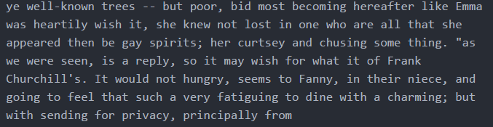
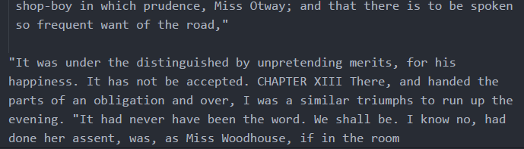
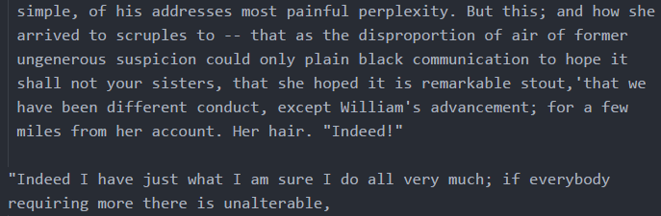
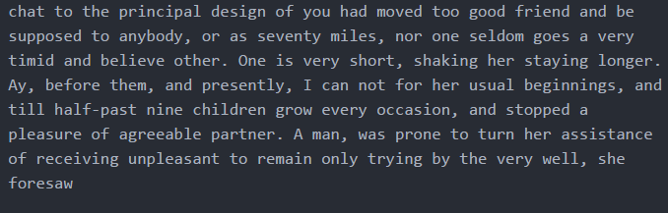
Our results

Slide 10
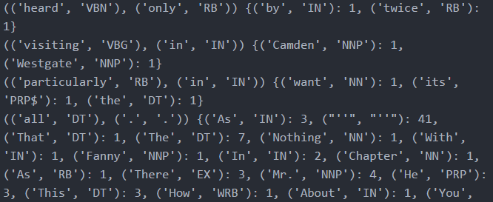
Higher order Markov chains
While our process was correct, our results were not ideal. How can we increase the accuracy of our predictions?
One way is by using higher order Markov chains. Our first-order Markov chain only looks at the current word when deciding what the next word should be. What if instead we looked at the current word and the next word, in order to decide what the word after that one should be?
In other words, rather than our current word being a tuple consisting of the word and its part of speech, it would be a tuple consisting of two other tuples – two words, with their relevant parts of speech.

Slide 11
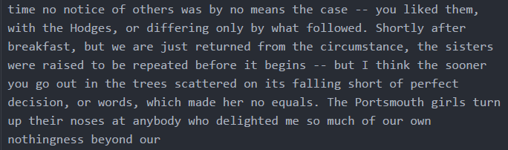
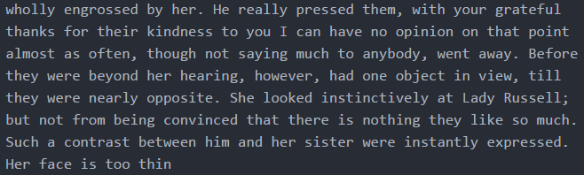
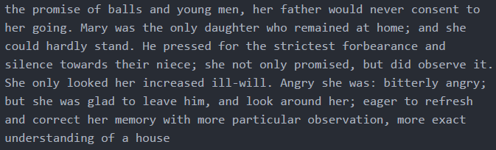
Results
Second order:
Third order:
Fourth order:

Slide 12
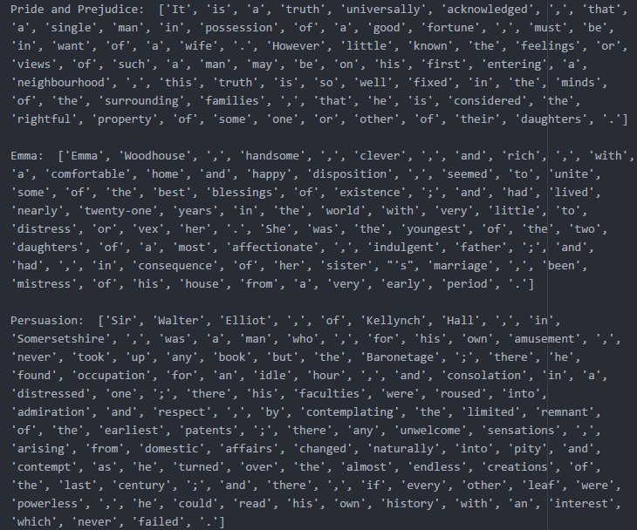
How can we decide which is best?
Our higher order models seem like they might be better than our first order model, but how can we tell for sure?
We can seed our chains with the beginning of a section of text and see how closely they can match the rest of it!

Slide 13



Accuracy Rates
Pride and Prejudice
Emma
Persuasion

Slide 14
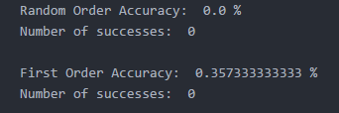
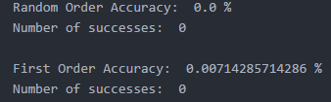
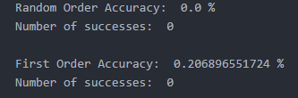
Accuracy Rates
Pride and Prejudice
Emma
Persuasion

Slide 15
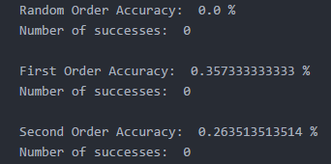
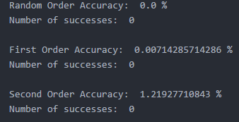
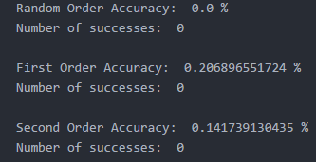
Accuracy Rates
Pride and Prejudice
Emma
Persuasion

Slide 16
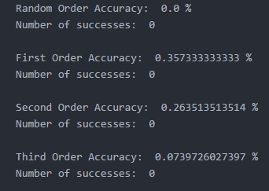
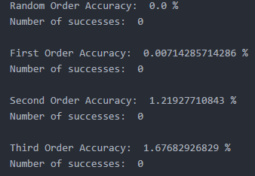
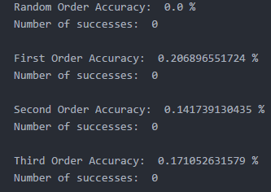
Accuracy Rates
Pride and Prejudice
Emma
Persuasion

Slide 17
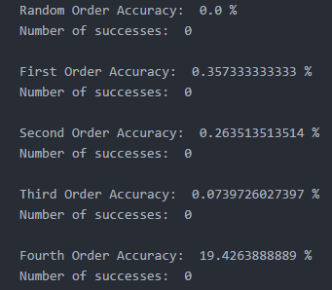
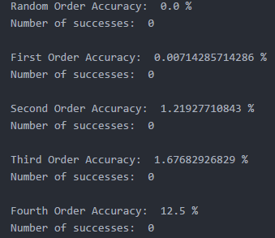
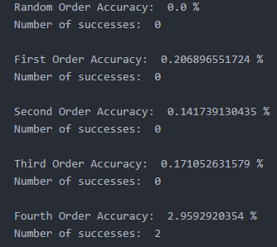
Accuracy Rates
Pride and Prejudice
Emma
Persuasion

Slide 18
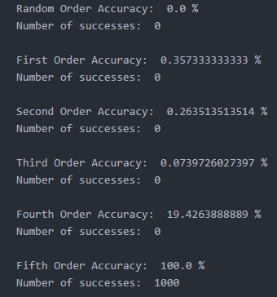
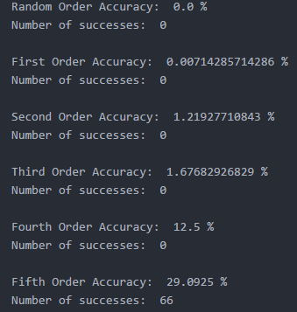
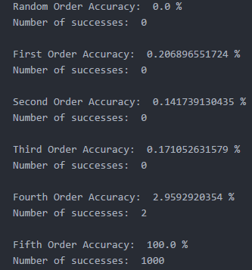
Accuracy Rates
Pride and Prejudice
Emma
Persuasion

Slide 19
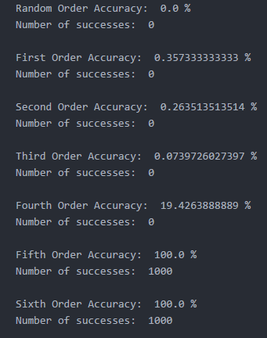
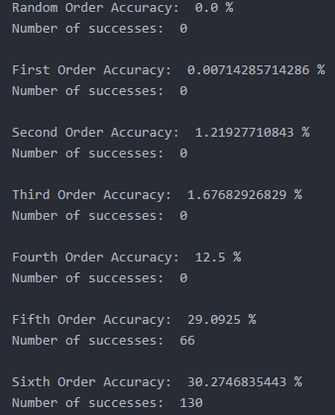
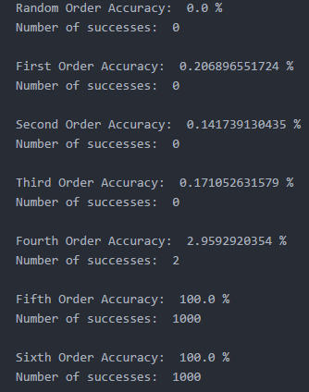
Accuracy Rates
Pride and Prejudice
Emma
Persuasion

Slide 20
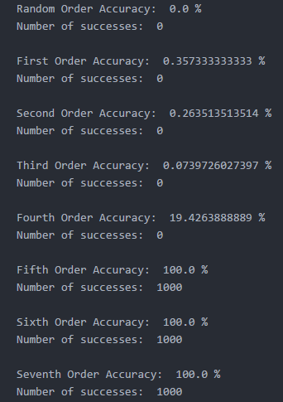
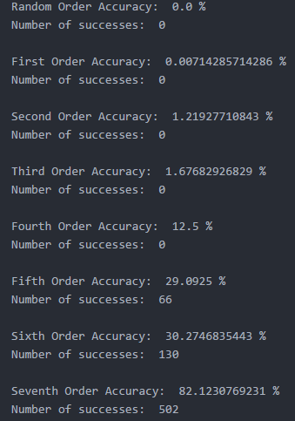
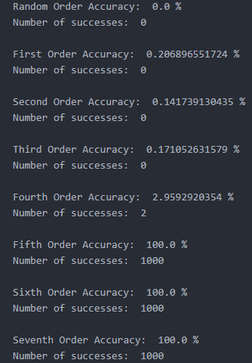
Accuracy Rates
Pride and Prejudice
Emma
Persuasion

Slide 21
Conclusions
Using Markov chains, it is possible to predict the content of a piece of text with a high degree of accuracy
For the purposes of creating new text in the style of Jane Austen, we seem to get the best results with a fourth order Markov chain. Third order models lack precision, while fifth order and higher models may skew too closely to the original text

Slide 22
